Slide 1


Participatory system dynamics: Empowering teams to increase access to timely, high-quality mental health care
@LZPhD
September 21, 2017
Lindsey Zimmerman, PhD
Clinical & Community Psychologist, Implementation Science
National Center for PTSD, Dissemination & Training Division
Affiliate Instructor, University of Washington School of Medicine
Lindsey.zimmerman@va.gov
David Lounsbury, PhD, Craig Rosen, PhD
Rachel Kimerling, PhD, Jodie Trafton, PhD,
Steve Lindley MD, PhD and Tom Rust, PhD

Slide 2

Three Goals for Today our PSD introduction today:
Why problems persist
Partnerships/Next Steps
PSD effectiveness
PSD MODELING TO LEARN

Slide 3

Context 1: PSD for quality improvement
Care System
Regulatory environment
Organizations facilitate teams
Patient-centered teams
Population Outcomes
Institute of Medicine, 2001

Slide 4
PSD for balancing priorities.
Safe
Effective
Efficient
Personalized
Timely
Equitable
Institute of Medicine, 2001

Slide 5
Evidence-based – healthcare practices with proven efficacy & effectiveness.
Context 2: PSD as implementation science.
Rabin & Brownson, 2012

Slide 6
There is strong evidence for
the best practices to meet patient needs in VA.
Evidence-based Psychotherapy (EBPsy)
Evidence-based Pharmacotherapy (EBPharm)
reduce PTSD and depression symptoms, reduce alcohol or opiate use
reduce risk of chronic impairment, relapse, suicide and overdose.
Model(s) Problem: “Limited EBP reach”
~5-30% of eligible patient populations

Slide 7

Veterans Health Administration
Model of a US National Health Care System
American J. Public Health 97, 2007
VA innovates with national dissemination efforts to train providers in evidence-based mental health practices
Enterprise-wide quality measures
Clinical practice guidelines and mandates for evidence-based care
National electronic health information system
Mental health care coordinated in multidisciplinary teams

Slide 8



PSD in the era of the learning health system
(Atkins, Kilbourne, Shulkin, 2017)

Slide 9
Healthcare Learning Organization (Akhnif, et al., 2017)
Senge, 1990
Personal mastery
Mental models
Shared vision
Team learning
Systems thinking
Garvin, 2008
Leadership that reinforces learning
Learning processes and practices
Supportive learning environment

Slide 10
PSD theory: Understanding how common dynamics emerge from team capacities/constraints
KEY IDEA: Systems Theory + Simulation Learning increases team psychological safety and thereby MH quality (EBP reach)
Teams
Patients
Providers
General
MH
Prescribe
Specialty
Addiction
Therapy

Slide 11
Pilot
Preliminary pilot
NIH R21
Increase reach of EBP initiation
Increase reach of full EBP dose
Increase EBP timeliness
Modeling to Learn
QI training continuing education credit
Accessible simulation user-interface
Data/training tailored to local care teams
IIR
PSD vs QI as usual for increasing EBP reach
Determine Budget impact of PSD
Calculate PSD Incremental Cost-effectiveness Ratio
R01
PSD vs Audit-&-Feedback for increasing EBP reach
Measure hypothesized mechanisms of change
Exploratory mediational analyses
Suicide
Prevention
Address new priority in team “Modeling to Learn” training
Guide facility Suicide Prevention Coordinators
Train OMSHP Tech. Assistants; Network Performance Plan

Slide 12
The aim of our research:
…is to develop a systems understanding of mental health service delays and how they contribute to limited reach of evidence-based mental health care.
…and empower mental health stakeholders to make optimized quality improvement decisions with ex ante assessments of their proposed redesign solutions.

Slide 13
We define EBP reach as the proportion of patients with a PTSD, depression or SUD diagnosis who a) initiate b) timely EBP session c) complete an adequate, therapeutic EBP dose

Slide 14
EBP Reach: Starts and Completes
Population Coverage - Denominator (diagnostic cohorts) | Continuity of Care - Denominator (diagnosis + active treatment)
PTSD | EBPsy
Depression | EBPsy and EBPharm
OUD | EBPharm
AUD | EBPharm
SAIL MH Domains
Complex interventions delivered by multidisciplinary teams

Slide 15
Reach as a system behavior: the whole set of mechanisms by which the needs of the patient population are or are not addressed by their health care system.

Slide 16
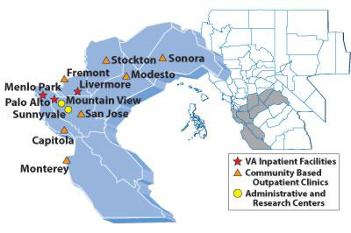
Palo Alto VA Health Care System
Main facility and nine outpatient clinics
+85K patients served
>17,000 patients receive MH care each year

Slide 17
Existing State: Inadequate proportion of patients getting timely, high-quality care

Slide 18
Target State: Lean SMART Goal
By April 2015, 40% of patients newly seen in outpatient mental health at Menlo Park for depression, PTSD, or anxiety disorders will have two psychotherapy visits completed within 28 days from time of intake assessment.

Slide 19
Local improvement, but wide variability & goal not achieved.

Slide 20
Gap between scheduling and completing psychotherapy remained.

Slide 21
Target State: Lean SMART Goal
By April 2015, 40% of patients newly seen in outpatient mental health at Menlo Park for depression, PTSD, or anxiety disorders will have two psychotherapy visits completed within 28 days from time of intake assessment.

Slide 22
Systems have properties of self-organization, emergence & adaptation.
Plan
Do
Study
Act
Plan
Do
Act
Study
Damschroder et al., 2009 – Process domain: Engage, Plan, Execute, Evaluate
Consolidated Framework for Implementation Research

Slide 23
Why do problems persist?
Scientific Model | Problem | Description of why quality problems persist.
General QI Teams | Learning | Stakeholders cannot or do not learn and adapt to their situation.
 | Coordination | Conflict or lack of stakeholder consensus.
EBP Specific Systems Theory | Analysis | Policies are inconsistent with the real system constraints.
 | Restructuring | The underlying structure of the system prevents workable solutions.
Hovmand, 2013; Scaccia et al., 2015

Slide 24

Community-based Participatory Research: A partnership approach to research that equitably involves stakeholders in all aspects of the research process and in which all partners contribute expertise and share decision-making and ownership.
Hovmand, 2014; Israel, Eng, Schulz & Parker, 2013

Slide 25
Team PSD Stakeholders
We partner with national stakeholder.
National Center for PTSD
National Program Evaluation Resource Center (OMHO/PERC)
Core Modeling Group of Frontline Staff
Director of Outpatient Mental Health, MD
Veteran Patients (VAPOR)
Modeler, Consultant
Full Staff
Veterans Engineering Resource Center (VERC)
Meets monthly all together; some workgroups meet more frequently

Slide 26
Core Modeling Group
We put a local stakeholder engagement process in place.
BHIP, psychologist
BHIP, RN
SMI, psychologist
BHIP & Telehealth, MD
PCT, psychologist
WCC, psychologist
Clinic Coordinator, LCSW
Director of Outpatient Mental Health, MD
Facilitator, Implementation Scientist
Modeler, Consultant
Meets every two weeks for one-hour.

Slide 27
Why do problems persist?
Scientific Model | Problem | Description of why quality problems persist.
General QI Teams | Learning | Stakeholders cannot or do not learn and adapt to their situation.
 | Coordination | Conflict or lack of stakeholder consensus.
EBP Specific Systems Theory | Analysis | Policies are inconsistent with the real system constraints.
 | Restructuring | The underlying structure of the system prevents workable solutions.
Hovmand, 2013; Scaccia et al., 2015

Slide 28
System – A set of elements interconnected in such a way that they produce their own internal dynamics. The system, to a large extent, causes its own behavior.
Meadows, 2008

Slide 29
Reach as a system behavior: the purposes of subunits in a system may add up to an overall behavior no one wants; changing elements usually has the least effect on the system.
Meadows, 2008

Slide 30
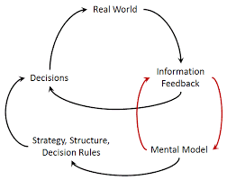

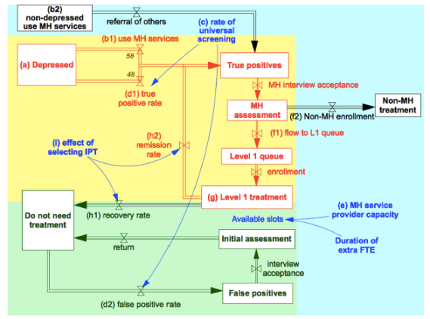
Participatory System Dynamics
1. Stakeholder engagement & input
Mental models
made explicit
4 & 5. Re-design selected, implemented & tracked
2. System ‘behavior’
observed holistically
3. Implementation impacts
tested via simulation
1. Participate
2. Calibrate
3. Simulate
4. Translate
5. Evaluate
6. Iterate
Administrative data,
stakeholder estimates &
research evidence

Slide 31
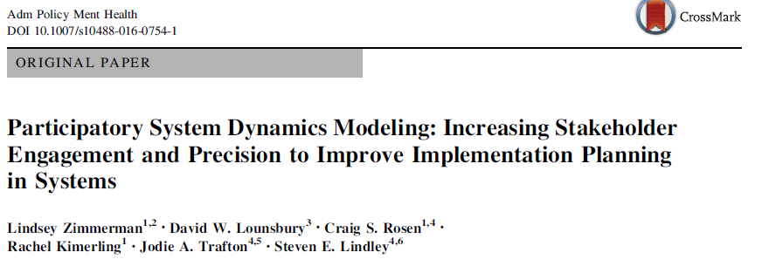

Participatory system dynamics for implementation planning.
Please email me for even more “tech specs”

Slide 32
PCT Streamline Scenario

Slide 33
Pilot
Preliminary pilot
NIH R21
Increase reach of EBP initiation
Increase reach of full EBP dose
Increase EBP timeliness
Modeling to Learn
QI training continuing education credit
Accessible simulation user-interface
Data/training tailored to local care teams
IIR
PSD vs QI as usual for increasing EBP reach
Determine Budget impact of PSD
Calculate PSD Incremental Cost-effectiveness Ratio
R01
PSD vs Audit-&-Feedback for increasing EBP reach
Measure hypothesized mechanisms of change
Exploratory mediational analyses
Suicide
Prevention
Address new priority in team “Modeling to Learn” training
Guide facility Suicide Prevention Coordinators
Train OMSHP Tech. Assistants; Network Performance Plan

Slide 34
The research question in our current effort:
Using simulation tests of stakeholder hypotheses about what procedural and policies changes would increase timely access to EBPs:
Which proposals are most likely to align existing mental health resources to maximally increase reach of EBPs?

Slide 35
Each team has capacities for particular services.
Intake
Therapy
Phone work
EBPsy
Meds
Adjunctive Services
EBPharm
Consult

Slide 36
Teams Coordinate Care
Menlo Park Teams | Stockton Team
3548 unique patients/year | 2043 unique patients/year
Lower caseload per provider | Higher caseload per provider
Rare wait for initial appointment | Occasional waitlist to get into clinic
5.2 psychiatrists per 9 EBPsy providers | 3.0 psychiatrists per 4 EBPsy providers
Higher EBPsy providers/MD ratio | Lower EBPsy provider/MD ratio
Higher EBPsy base rate | Higher EBPharm base rate
Providers often self refer for EBPs | Referrals to other providers by necessity
Multiple on-site specialty programs | Only telehealth specialty care
Training program site multiple disciplines | No trainees providing care
Most groups "open" (ongoing enrollment) | Most groups "closed" (infrequent opening)
Shorter time to next available appointment | Longer time to next available appointment

Slide 37
The team as the fundamental molecule of the model.
BHIP
PCT
SMI
WCC
Trainees
PCT Tele-health
Tele-health
Consult
Choice/Fee-basis
Addiction

Slide 38
Teams in the VA learning health system
PACTs (2009) created in primary care due to
lagging patient access
increasing rates of clinician burnout and turnover
inefficient use of staff
PACTs effectiveness variable, depends on implementation
use of clinical information
care coordination
provider turnover and burnout, still an issue
(Atkins, Kilbourne, Shulkin, 2017; Nelson et al., 2014)

Slide 39
PSD Uses Existing VA Data
VA Corporate Data Warehouse (CDW) Data Source
Patient cohorts
ICD diagnostic information from visits and clinic usage (below)
Clinic capacity
Clinic/Scheduling hours VISTA/BISL clinic availability
Provider capabilities
Provider disciplines with user input to map to encounter types
Clinic utilization
Visit (workload) schema. CPT encounters.
Appointment data = ‘no shows’
EBP reach
Template usage from health factor schema

Slide 40
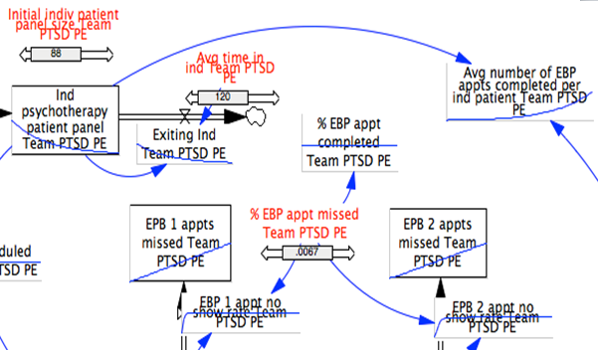
Stakeholder Hypotheses: Testing policy/procedure changes.
BHIP to PCT: What if intake was in BHIP and PCT started treatment without another intake?

Slide 41
Modeling to Learn: Example
Flow of Psychotherapy Patients in Multi-Disciplinary Teams Over Time
Data Review Tools for Simulation Modeling in Teams

Slide 42
We know identification of psychotherapy
need far exceeds graduate rate.
The quit rate brings the level of patients engaged
in psychotherapy down. Without the
quit rate and graduation rate
Patients in psychotherapy would rise until
limited by the supply of psychotherapists.
Psychotherapy
Quit Rate
Patients in Psychotherapy
Psychotherapy
Start Rate
Psychotherapy
Graduation Rate
B
This is a simplified “stock-and-flow” diagram showing that the number of patients in psychotherapy (the rectangle “stock”) is determined by three rates (the start, quite and graduate “flows”) and it also determines the start rate through a feedback loop: perception of psychotherapy availability.
As level of Patients in
Therapy Increase
Start Rate Decreases
Perception of Current
Engagement (Availability)

Slide 43
We identified 6 patterns of psychotherapy engagement in teams.
One and done
Initiators
Completers
One visit and return later
Initiators who return later
Completers who don’t graduate
To get a sense of patients’ typical psychotherapy flow in the teams, we examined the total psychotherapy engagement for any patient seen in CY2016.
If a patient had any psychotherapy visit in CY2017 we looked backward in time to find their first visit, and then looked forward to August of 2017.

Slide 44
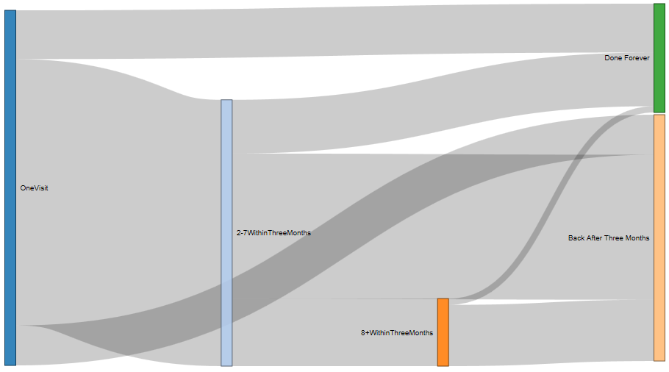
284 psychotherapy patients in CY 2016 in PCT

Slide 45
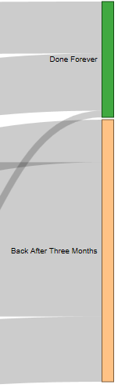
This dimension shows median visits used by these different types of patients, so the total area (visits times patients) is the total slot usage.
116 patients
13 visits x 116 patients = 1508 slots
13 visits

Slide 47
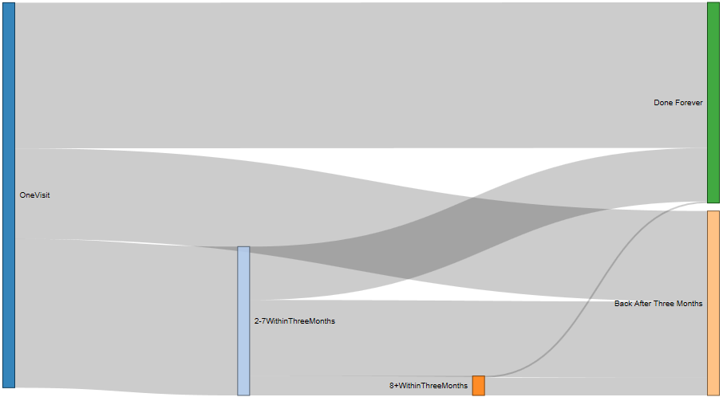
238 psychotherapy patients in BHIP Team Blue in CY 2016

Slide 48
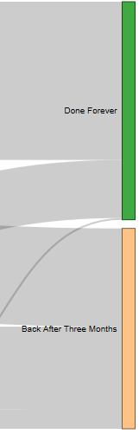
This dimension shows average visits by these different types of patients over their entire span of time engaged with the clinic, so the total area (visits times patients) is the total psychotherapy slot usage.
9 visits x 47 patients = 423 slots
9 visits
47 patients

Slide 50
Dynamic Hypotheses about Psychotherapy Continuity of Care
(Existing Patients only!)
Slots used by current pts
Graduation Rate
% of pts receiving
an adequate dose
Ease of responding to
bureaucratic nonsense that
prevents you from seeing pts
when you want to
# of Slots Allocated to
Psychotherapy
Increase in slots allocated to Psychotherapy
time
Delay until EBPs affect grad rate

Slide 51
Balancing Access to Care Priority for New Patients, with Completion of EBPs by Existing Patients
Dynamic Hypothesis: Worse before better!
Wait Time for
Starting Psychotherapy
Graduation Rate
Slots used by current pts
# Starting Psychotherapy
% of Pts receiving EBP
time
Team decides to do more EBP, at expense of starting new pts
Delay until EBPs affect grad rate

Slide 52
With information delays among providers, it’s actually way worse before better!!!!!
Wait time rises until slots used by current patients falls below equilibrium value
Wait time falls only after new patient starts rises above equilibrium value
Wait Time for
Starting Psychotherapy
Graduation Rate
Slots used by current pts
# Starting Psychotherapy
% of Pts receiving EBP
Delay until clinics notice availability, and open more new pt. slots
time
Team decides to do more EBP, at expense of starting new pts
Delay until EBPs affect grad rate

Slide 53
Yes, way worse before better, but with increasing long term improvement!!!!!!!
Wait time rises until slots used by current patients falls below equilibrium value
Wait time falls only after new patient starts rises above equilibrium value
Wait Time for
Starting Psychotherapy
Graduation Rate
After delay, grad rate increases, opening even more slots, and clinic enters virtuous cycle!
Slots used by current pts
# Starting Psychotherapy
% of Pts receiving EBP
When more slots open, it’s easier to keep patients in an EBP
Delay until clinics notice availability, and open more new patient slots
time
Team decides to do more EBP, at expense of starting new pts
Delay until EBPs affect grad rate

Slide 54
Pilot
Preliminary pilot
NIH R21
Increase reach of EBP initiation
Increase reach of full EBP dose
Increase EBP timeliness
Modeling to Learn
QI training continuing education credit
Accessible simulation user-interface
Data/training tailored to local care teams
IIR
PSD vs QI as usual for increasing EBP reach
Determine Budget impact of PSD
Calculate PSD Incremental Cost-effectiveness Ratio
R01
PSD vs Audit-&-Feedback for increasing EBP reach
Measure hypothesized mechanisms of change
Exploratory mediational analyses
Suicide
Prevention
Address new priority in team “Modeling to Learn” training
Guide facility Suicide Prevention Coordinators
Train OMSHP Tech. Assistants; Network Performance Plan

Slide 55
VA learning health system
VA learning to achieve
timely access
coordination of care
consistent high quality
Using systems theory PSD examines trade-offs among competing priorities to optimize existing resources
(Atkins, Kilbourne, Shulkin, 2017)

Slide 56



Modeling to Learn Workshop Series
Modeling to Learn
Virtual Workshop
Simulation User-Interface
Data Interface & Scripts
Usual QI A&F
Enhanced learning
Team-based quality improvement training.
VA Employee Education Services (EES) working with us for accreditation.

Slide 57
Session prototypes in Rmarkdown https://github/lzim/teampsd
Four simulation models have been developed
Lessons that can be learned in 1 team meeting:
Care Coordination
Medication Management & EBPharm
Psychotherapy & EBPharm
Aggregate Model “Putting it all Together”

Slide 58
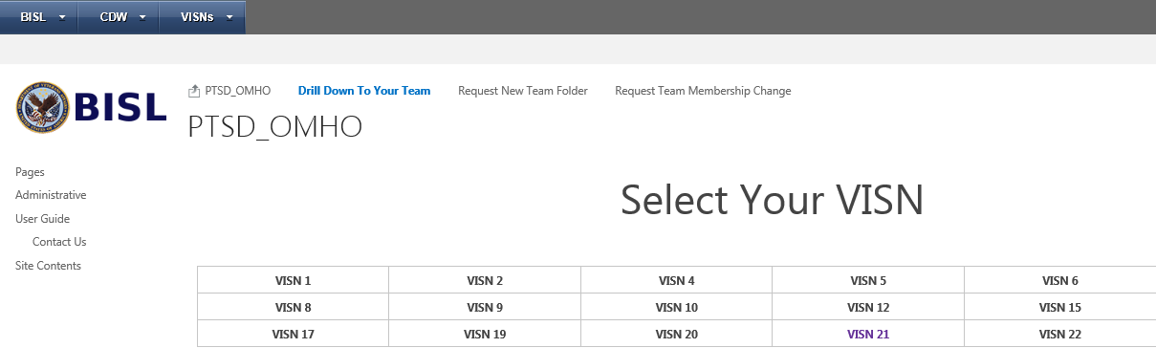
OSI/VERC and NCPTSD/ OMHSP developed a site for reviewing data used in team simulations.
VA Office of Strategic Integration (OSI) and Veterans Engineering Resource Center (VERC)
National Center for PTSD (NCPTSD) and Office of Mental Health and Suicide Prevention (OMHSP)
The data and code have been developed for consistency with other OMHSP dashboards and quality metrics, such as SAIL.

Slide 59
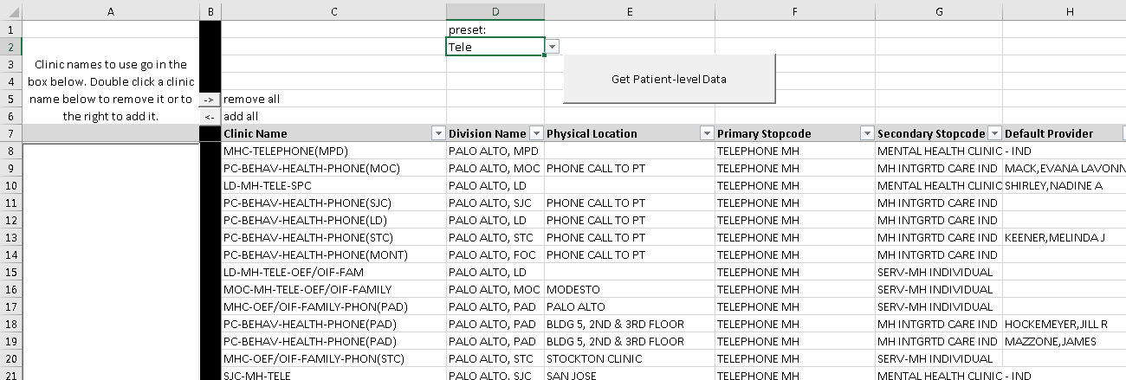
Dynamic Data Tool for Reviewing Data Used in Simulation Model
Providers can select the clinic “grids” that make up the dataset they want to explore.
There may be a preset set up already, such as the telephone encounters presented here.

Slide 60
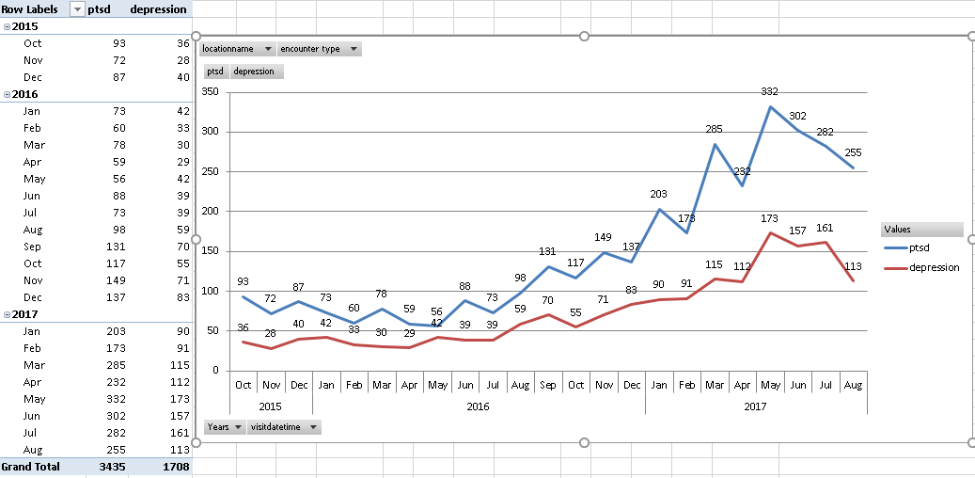
Data Used in Simulation Model is Graphically Displayed as Trends over Time for the Team.
This shows that the Telehealth team has been serving an increasing number of patients in which the visits (all encounter types shown) listed PTSD or depression as a primary or secondary diagnosis. Providers can filter to different views.

Slide 61
Trends Graphs also produce searchable reports.
Teams can discuss graphs and reports during team huddles for care coordination decisions and for quality improvement.
Providers review data, and have the ability to drill-down to individual patient data
This afford strengths for
Improving the quality of coding encounter, diagnosis and other EHR data through nearly real-time review
Improving provider confidence in the data that feeds the simulation models
Model simulations can more precisely guide decisions when parameters are a from a particular team

Slide 62
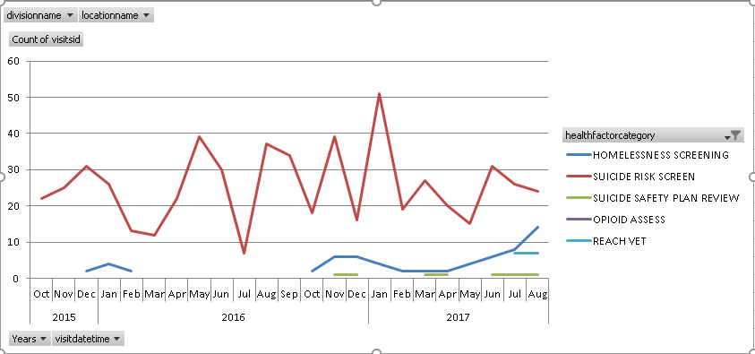
Teams report that they value graphically displayed trends (peaks) of time spent with high-risk patients.
The team can review their typical screening practices to note where gaps in quality exist.
They can also review the underlying report to follow-up with specific patients who require care coordination and follow-up.

Slide 63
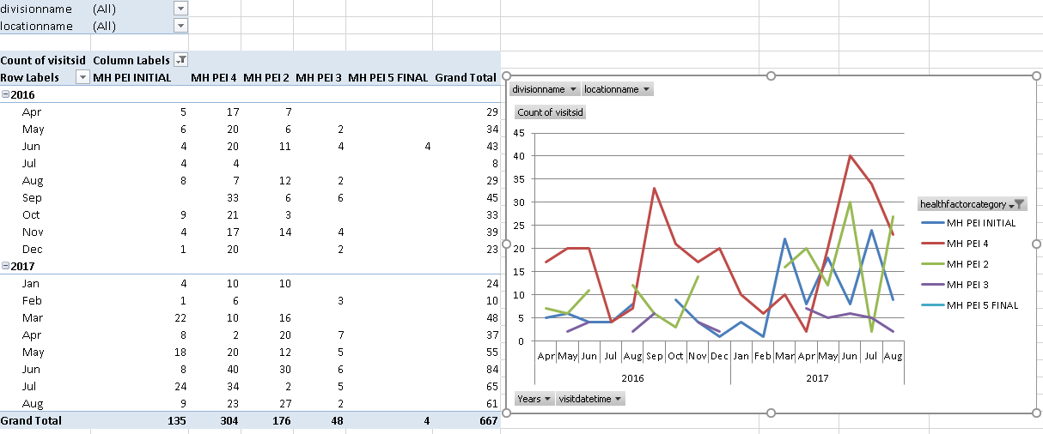
Teams value graphical review of EBP template data, such as this Team Prolonged Exposure graph.
The team can review EBP delivery to determine where gaps in continuity exist. They can also filter and review the underlying report to review specific patients and where they are in their treatment.

Slide 64
PSD Modeling Approaches for Building Consensus and Commitment for System Changes
Provide information about the local need for change | Show the system behavior reference mode (quality gap)
Identify demands/resources/constraints driving quality gaps | Explore tradeoffs and mechanisms of system behaviors
Explore how changes will impact frontline staff and patients | Simulate QI changes proposed by staff using local data
Use accessible tools for selecting and sharing the best changes | Interactive, Online Data Visualization, Simulation Tools
Adapted from Morecroft & Sterman, Modeling for Learning Organizations, 1994; Vennix, Group Model Building, 1996; Langley G.J. et al., The Improvement Guide: A Practical Approach to Enhancing Organizational Performance. San Francisco: Jossey-Bass

Slide 65
What staff think is useful
If staff feel heard, that will improve morale. Some basic changes will be very helpful.
Better scheduling and sensible workflow.
Getting everyone on the same page.
Show accurate numbers/stats to help give the overall staff understanding of process, uniformity and reflect workload adequately.
Being able to implement change in a far more targeted way.
Having a physical representation for fine tuning a process.
That is looking at systems and allowing needed dialogue.
Taking into consideration more real world complexity.
Integration.
Having an outside consultant with the potential to engage without vested interest to manipulate.

Slide 66
Pilot
Preliminary pilot
NIH R21
Increase reach of EBP initiation
Increase reach of full EBP dose
Increase EBP timeliness
Modeling to Learn
QI training continuing education credit
Accessible simulation user-interface
Data/training tailored to local care teams
IIR
PSD vs QI as usual for increasing EBP reach
Determine Budget impact of PSD
Calculate PSD Incremental Cost-effectiveness Ratio
R01
PSD vs Audit-&-Feedback for increasing EBP reach
Measure hypothesized mechanisms of change
Exploratory mediational analyses
Suicide
Prevention
Address new priority in team “Modeling to Learn” training
Guide facility Suicide Prevention Coordinators
Train OMSHP Tech. Assistants; Network Performance Plan

Slide 67
Modeling saves time and effort.
We use simulation to see impacts of proposed changes on the whole system in real time before we actually try to implement anything.
We also determine when we should achieve our goal.

Slide 68
Value of PSD Review
Front-end Value Proposition
Improved consensus 49% (53 of 107 projects)
More efficient than other modalities for problem-solving 33% (34 of 107)
Back-end Value Proposition
Systems change 42% (46 of 107)
Most (89%; 41 of 46) use the model to guide and evaluate
Commitment to change increased 33% (35 of 107)
(Rouwette et al. 2002)

Slide 69
Frameworks for the IIR
Theory | Systems Theory
Policy | OMHO SAIL (pink QI) VA EBP Dissemination (blue)
Strategy | Participatory System Dynamics (PSD)
Target | Quality Improvement Defined by EBP Reach
PSD Value
Value = Quality/Cost
SAIL/Health Services
EBP Capacity/ Reach
PSD/QI Costs
General QI Functioning
$/% increase in reach

Slide 70
Pilot
Preliminary pilot
NIH R21
Increase reach of EBP initiation
Increase reach of full EBP dose
Increase EBP timeliness
Modeling to Learn
QI training continuing education credit
Accessible simulation user-interface
Data/training tailored to local care teams
IIR
PSD vs QI as usual for increasing EBP reach
Determine Budget impact of PSD
Calculate PSD Incremental Cost-effectiveness Ratio
R01
PSD vs Audit-&-Feedback for increasing EBP reach
Measure hypothesized mechanisms of change
Exploratory mediational analyses
Suicide
Prevention
Address new priority in team “Modeling to Learn” training
Guide facility Suicide Prevention Coordinators
Train OMSHP Tech. Assistants; Network Performance Plan

Slide 71
Mechanism of Change in Learning Organizations
Systems, Simulations and Psychological Safety
Learning key to effectiveness (Senge, 1990; Argyris,1993)
Interpersonal interactions inhibit/facilitate learning
Shared belief that a team is safe for interpersonal risk taking

Slide 72
Bendoly, 2014
Systems Thinking
Psychological Safety
Information Sharing
Organizational Performance
Team Psychological Safety
Team Learning Behavior
Team Performance
Team coaching/context support
Edmonson, 1999

Slide 73
Measures - Learning Organization Survey (LOS-27)
Singer et al., 2012
Supportive learning environment
Leadership reinforces learning
Experimentation
Time for reflection
Training
Knowledge acquisition
Performance monitoring

Slide 74
Measures – Systems Thinking Scale (STS)
Moore et al., 2010/VA Quality Scholars
The 20-item Systems Thinking Scale has good reliability and construct and discriminate validity.
Systems thinking: The ability to recognize, understand, and synthesize interactions and interdependencies.
an understanding of how actions and components can reinforce or counteract each other.

Slide 75
Pilot
Preliminary pilot
NIH R21
Increase reach of EBP initiation
Increase reach of full EBP dose
Increase EBP timeliness
Modeling to Learn
QI training continuing education credit
Accessible simulation user-interface
Data/training tailored to local care teams
IIR
PSD vs QI as usual for increasing EBP reach
Determine Budget impact of PSD
Calculate PSD Incremental Cost-effectiveness Ratio
R01
PSD vs Audit-&-Feedback for increasing EBP reach
Measure hypothesized mechanisms of change
Exploratory mediational analyses
Suicide
Prevention
Address new priority in team “Modeling to Learn” training
Guide facility Suicide Prevention Coordinators
Train OMSHP Tech. Assistants; Network Performance Plan

Slide 76
High value deliverables for the suicide prevention priority.
An EES supported, accredited (CMEs/CEUs for mental health) “Modeling to Learn” national training program to improve care delivered by multidisciplinary mental health teams (BHIPs and special program teams)
A facility simulation model of the suicide prevention coordinator workflow and staffing to prevent suicide
Aim is for these resources to become standard practice for guiding mental health improvements.
Training of OMSHP Technical Assistants in this approach
Participating in the Suicide Prevention Council
Provide resources to support the suicide prevention priority in the network directors performance plan

Slide 77
Questions?
lindsey.zimmerman@va.gov
@LZPhD
Co-Investigators David Lounsbury, PhD, Craig Rosen, PhD, Craig Rosen, PhD, Jodie Trafton, PhD, Seven Lindley, MD, PhD, Project Support Stacey Park, McKenzie Javorka, Dan Wang, PhD, Savet Hong, PhD, Kathryn Azevedo, PhD Team PSD Mentees Cora Bernard MS, Swap Mushiana MS, Alexandra Ballinger, Joyce Yang, PhD, Melissa London, PhD, Dominique Malebranche, PhD, Myra Altman, PhD | VA Partners VA Palo Alto Mental Health Staff Ann LeFevre, LCSW Maya Kopell, MD Trisha Vinatieri, PsyD, Bruce Linenberg, PhD, Pompa Malakar, RN Rosemarie Geiser, RN, Sarah Walls, LCSW, Gigi Fernandez, LCSW Emily Hugo, PhD, Martha Losch, MD Jessica Cuellar, PhD, Erin Sakai, PhD, Kesha Diodato, LCSW, Nathaniel Mendelssohn, MD, Nina Yi, MD, Lisa Giovanetti, LMFT, Joan Smith, LCSW, Darryl Silva, LCSW and Smita Das, LCSW Office of Mental Health and Suicide Prevention/Program Evaluation Resource Center (OMHSP/PERC) Matthew Neuman, PhD, Matthew Boden, PhD, Hugo Solares, PhD, Shalini Gupta, PhD, David Wright, PhD, Susanna Martins, PhD, Eric Schmidt, PhD, Ilse Wiechers, PhD Office of Strategic Integration/Veterans Engineering Resource Center (OSI/VERC) Tom Rust, PhD, Andrew Holbrook, Liz May

