Slide 1
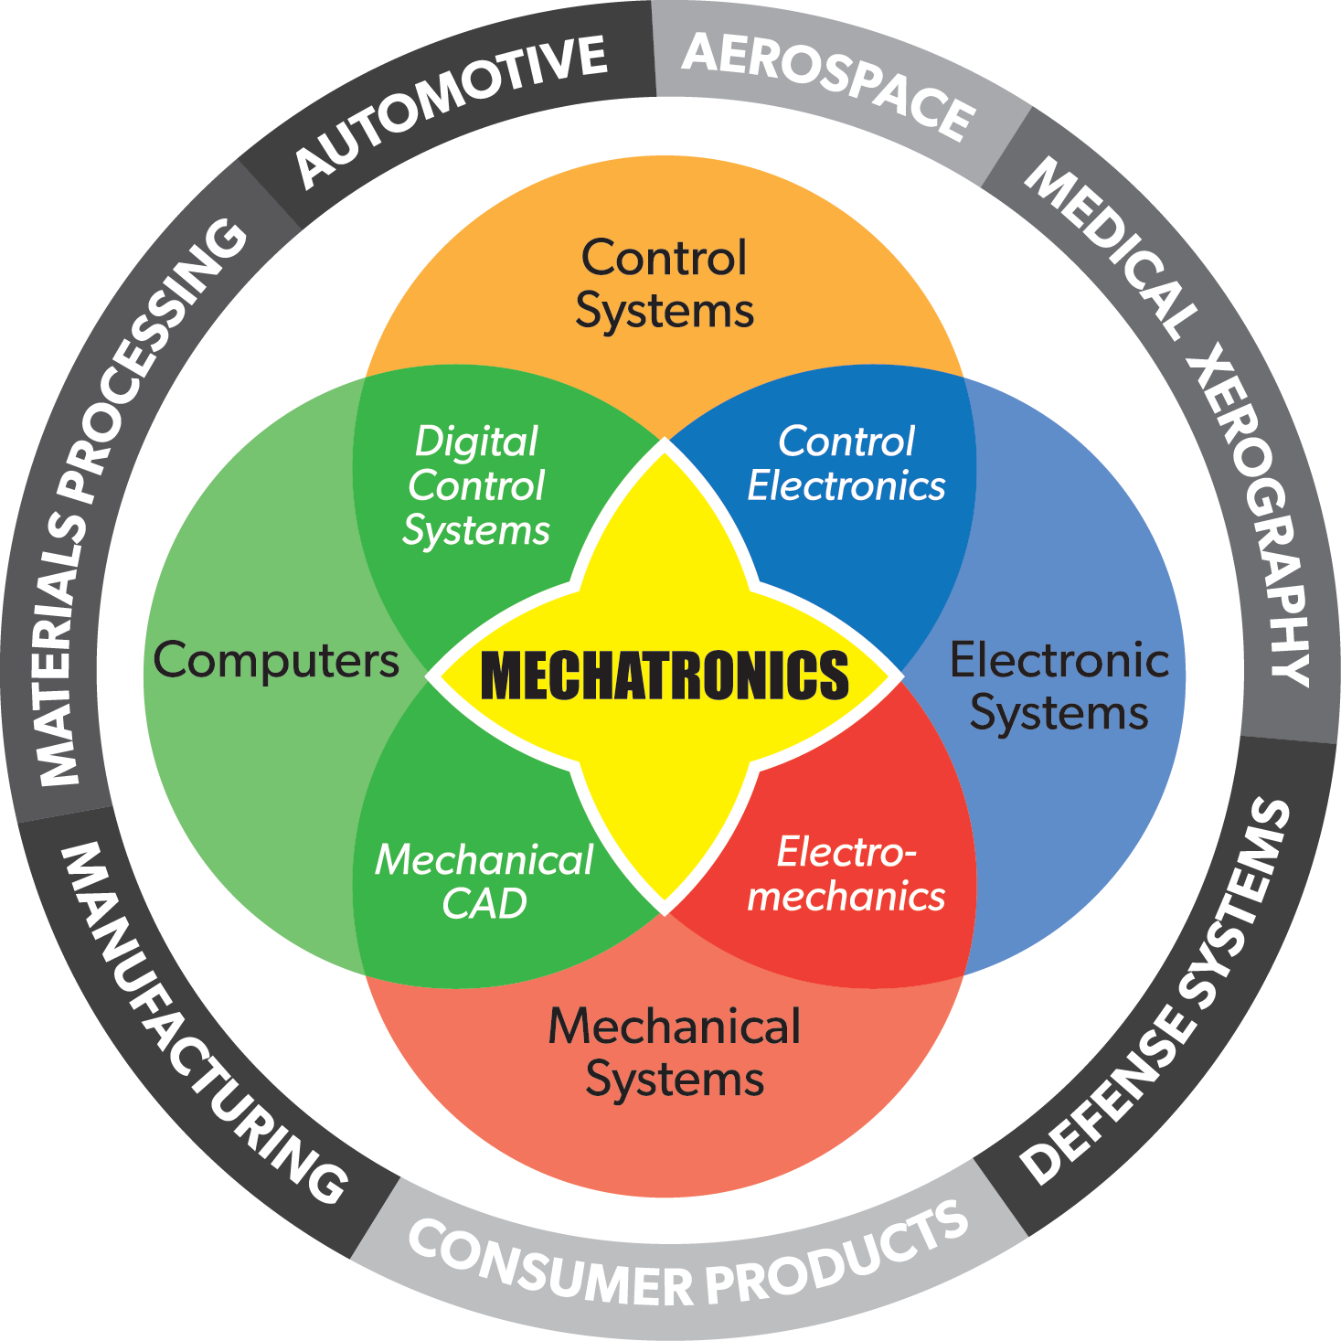
Introduction to Mechatronics
ENGR 4020 Lecture 1
Adapted from work by Matthew Stein

Slide 2
Mecha-what?
The word itself is a portmanteau of 'Mechanics' and 'Electronics'.
Main Entry:
¹port·man·teau
Pronunciation:
\pȯrt-ˈman-(ˌ)tō\
Function:
noun
Etymology:
Middle French portemanteau, from porter to carry + manteau mantle, from Latin mantellum
Date:
1579
1 : a large suitcase 2 : a word or morpheme whose form and meaning are derived from a blending of two or more distinct forms (as smog from smoke and fog)

Slide 3
Basics of Mechatronics
Always described as a combination of mechanical and electronic devices

Slide 4
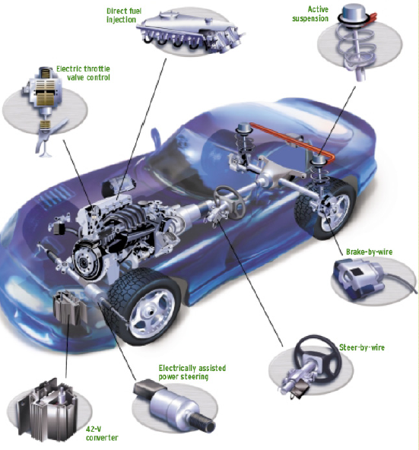
Like what?
Formerly mechanical control system replaced by mechatronic systems
Performance improved by digital control
Figure courtesy of Kevin Craig
Marquette University

Slide 5
How is it done?
Mechanism
Sensor
Electronic Device
Actuator

Slide 6
A little more detail
Power
Mechanism
Sensor
Electronic Device
Actuator
Physical Signal
Physical Signal
Power
Mechanical
Electronic
Electronic signal
Electronic signal

Slide 7
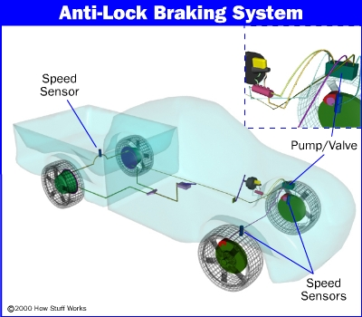
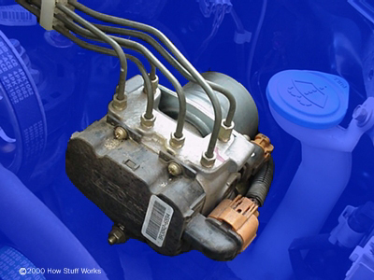
For Example:
From:
Howstuffworks.com

Slide 8
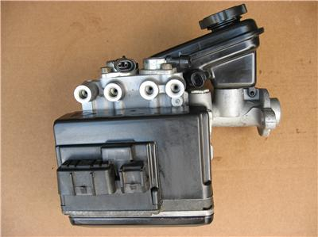

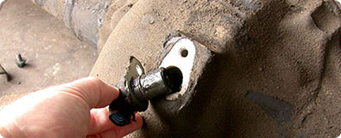
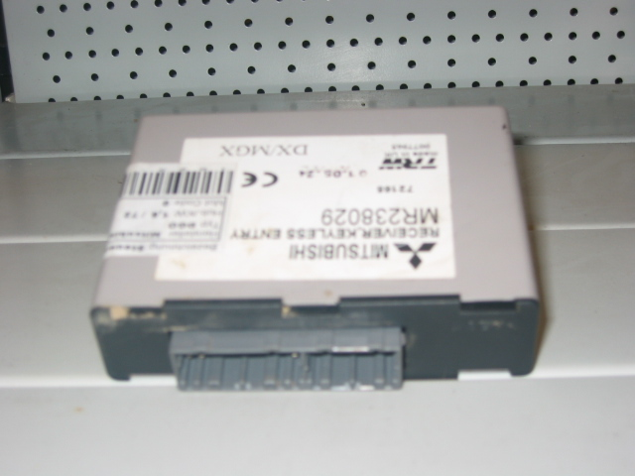
Anti-lock brakes
Hydraulics
Hydraulic cylinder on brakes
Wheel speed sensor
ABS Control Unit
Solenoid pulse on hydraulic line
Physical Signal
Mechanical
Physics of car
Electronic
Wires
Wires

Slide 9
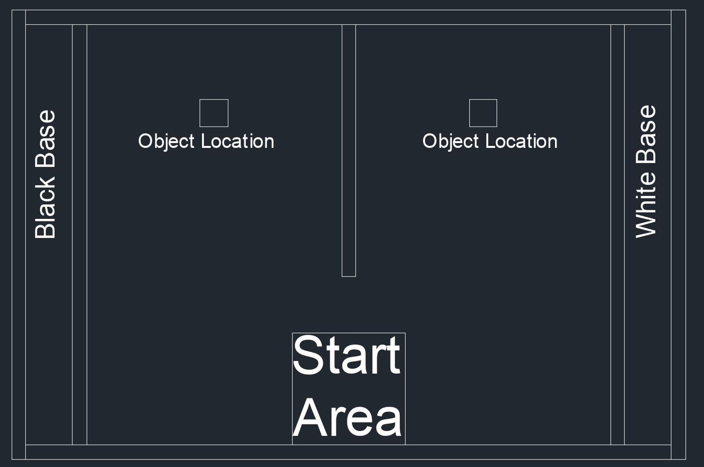
Course Project

Slide 10
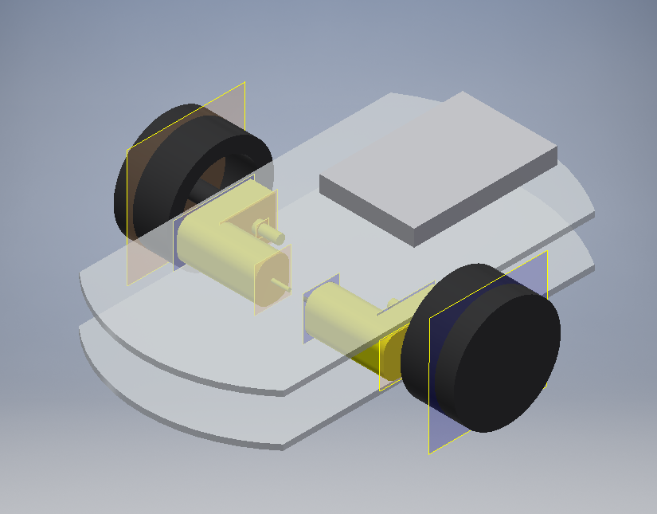
Course Project

Slide 11
Robotics Design Axioms
Software cannot overcome weak mechanical design
A machine cannot control what it cannot sense

Slide 12
Robotics Design Axioms: Result
This course will deal with aspects of both mechanical and software design, as well as covering use and integration of sensors

Slide 13
Anti-lock brakes
Hydraulics
Hydraulic cylinder on brakes
Wheel speed sensor
ABS Control Unit
Solenoid pulse on hydraulic line
Physical Signal
Mechanical
Physics of car
Electronic
Wires
Wires

Slide 14
Signals
Arrows in diagram are signals
Signals are either mechanical
Pneumatic/Hydraulic pressure or flow
Position/velocity/acceleration/rotation
Deformation/deflection/pressure
Or electrical
Voltage/current/charge
Analog or digital
Mechatronics always has both

Slide 15
What’s the difference
A digital signal is a voltage
Either 3.3V (5V) or 0V (logical 1 or logical 0)
In between is undefined
Chosen for convenience
Konrad Zuse, Eckerd & Mauchley (1940’s)
Represented in binary

Slide 16
Analog signals
An analog signal is also voltage
Range chosen for convenience
Any value in a given range
0V-5V
-5V – 5V
0 V– 10V
All physical signals are inherently analog

Slide 17
What’s the difference?
Is the wheel Spinning?
Yes/No; On/Off; Digital
How fast?
Slow < --- > Fast; Analog

Slide 18
How to handle
Digital computer cannot handle directly
2.54V not immediately usable by a computer
Convert between Analog and Digital
Analog to digital conversion (A/D)
Digital to Analog conversion (D/A)
In LAB tomorrow, we will look at these (some) + learn to use our microcontroller (mbed)

