Slide 1

Gears
ENGR 4020: Lecture 31
Notes:
Images and Information for this Presentation from source: http://www.revrobotics.com/content/docs/Gear-Guide.pdf

Slide 2
Gears are rotating parts that have teeth and meshed with other gears to transmit torque
Used to change speed, torque, or direction of motor’s original output
Meshing teeth must have same size and pitch
Most common type is a spur gear
Notes:
Spur gears are parallel axes, to change direction you need intersecting axes (bevel)

Slide 3
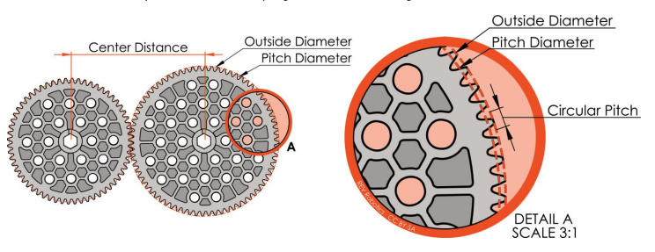

Slide 4
Gear Parameters
N: Number of teeth
M: Module (pitch diameter per tooth) [mm]
Higher module=bigger teeth
PD: Pitch diameter (circle that mates with other gear’s pitch diameter)
OD: Outside diameter (true outside diameter)

Slide 5
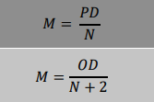
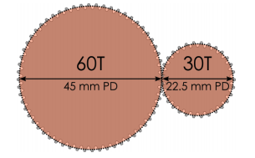
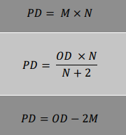


Slide 6
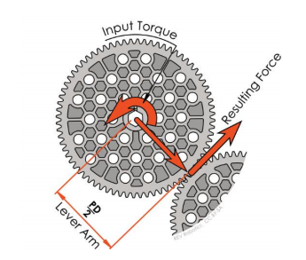
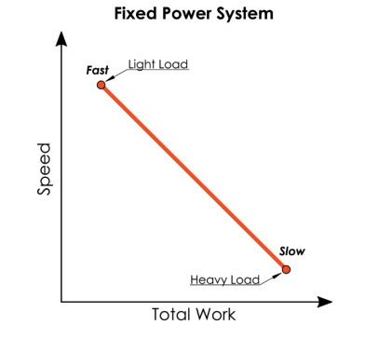
Notes:
Total amount of power available is determined by motors and batteries. We can change the amount of power delivered by using gears.

Slide 7
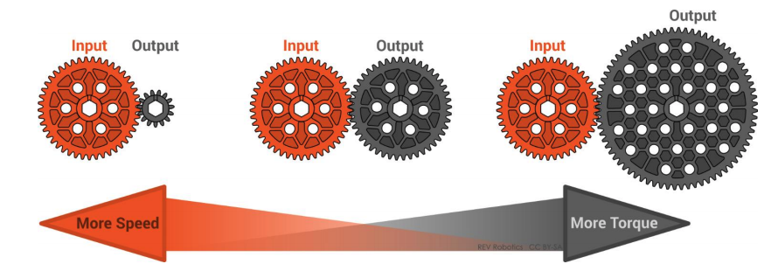
Notes:
Bigger input gear, faster speed, smaller input gear, more torque, slower speed

Slide 8
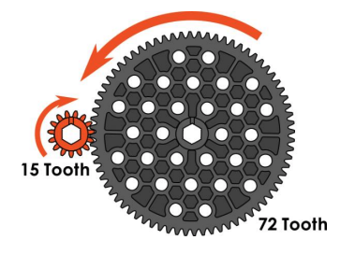
Tout=72/15 x Tin
⍵out = 15/72 ⍵in

Slide 9
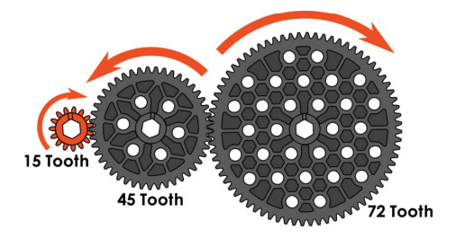
Idler gears transmit torque over long distance
Don’t do work
Can change direction
Tout=77/45 x 45/15 x Tin
Notes:
Only first and last gear determine the gear ratio

Slide 10
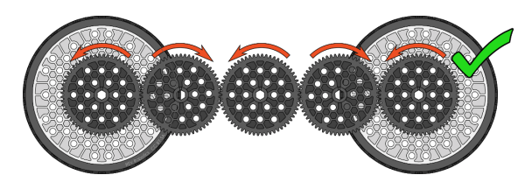
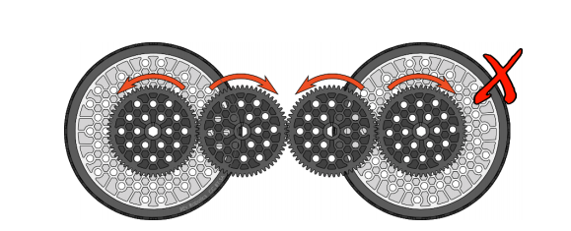
Notes:
For a drivetrain, we usually want output to go same direction as input

Slide 11
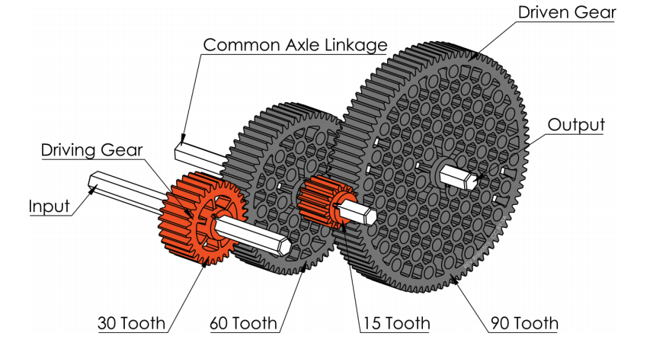
Compound gearing can be used to do multiple reductions
Move gears out of line with each other
Tout=60/30 x 90/15 x Tin
Notes:
https://www.mcmaster.com/gears

Slide 12
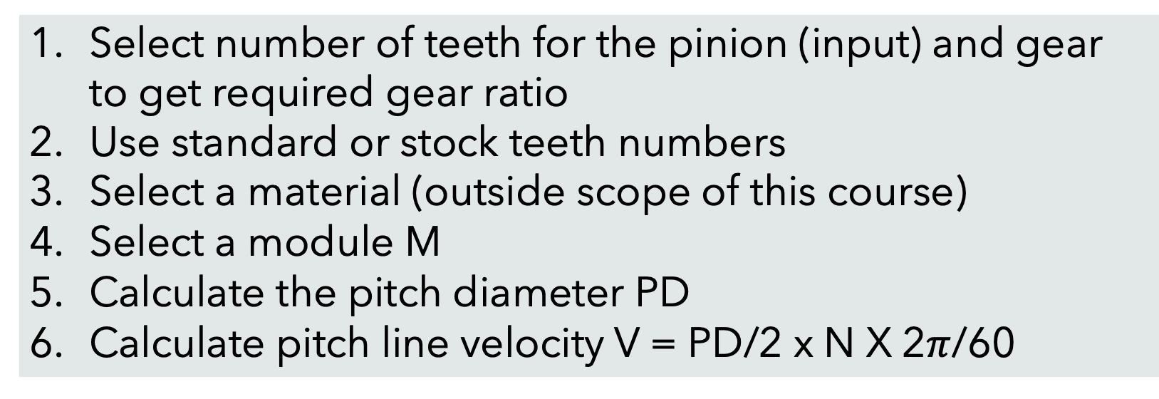
Gear Selection
Select number of teeth for the pinion (input) and gear to get required gear ratio
Use standard or stock teeth numbers
Select a material (outside scope of this course)
Select a module M
Calculate the pitch diameter PD
Calculate pitch line velocity V = PD/2 x N X 2$π$/60
Notes:
https://eng-resources.uncc.edu/unccengkit/mechanical/gears/simple-gear-selection-procedure/

Slide 13
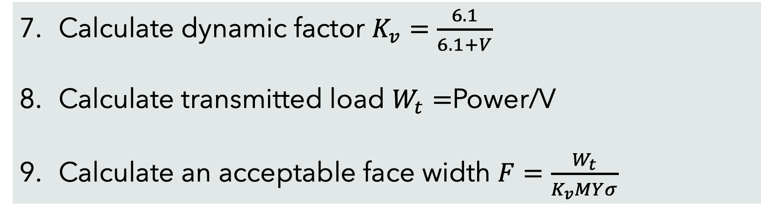
Gear Selection
Calculate dynamic factor $K_{v}=\frac{6.1}{6.1+V}$
Calculate transmitted load $W_{t}=$Power/V
Calculate an acceptable face width $F=\frac{W_{t}}{K_{v}MYσ}$
Notes:
https://eng-resources.uncc.edu/unccengkit/mechanical/gears/simple-gear-selection-procedure/

Slide 14
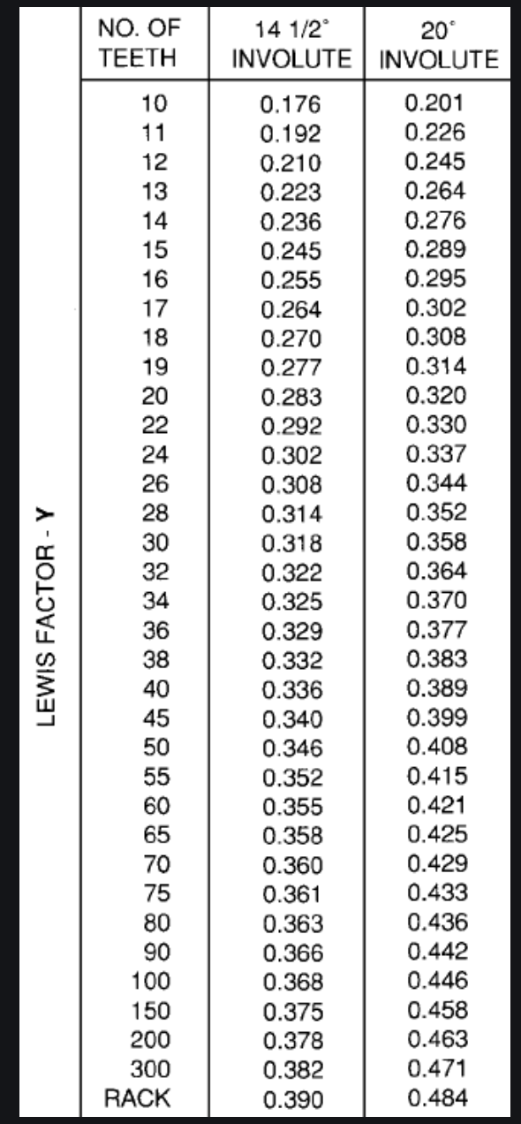
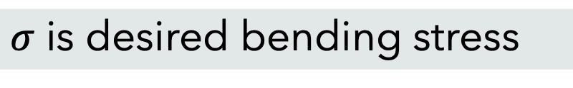
Gear Selection
$σ$ is desired bending stress
Notes:
https://www.engineersedge.com/gears/lewis-factor.htm

Slide 15
Planetary Gears
https://www.youtube.com/watch?v=ARd-Om2VyiE
Notes:
https://www.mcmaster.com/gears

