Slide 1
Line Detection with the Hough Transform
ENGR 4020: Lecture 37
Adapted from INF 4300, Anne Solberg

Slide 2
The hough transform
The Hough transform (HT) can be used to detect lines, circles, or parametric curves
Introduced by Hough in 1962, used to find lines by Duda in 1972
Find locations of lines in images
Gives robust detection under noise and partial occlusion

Slide 3
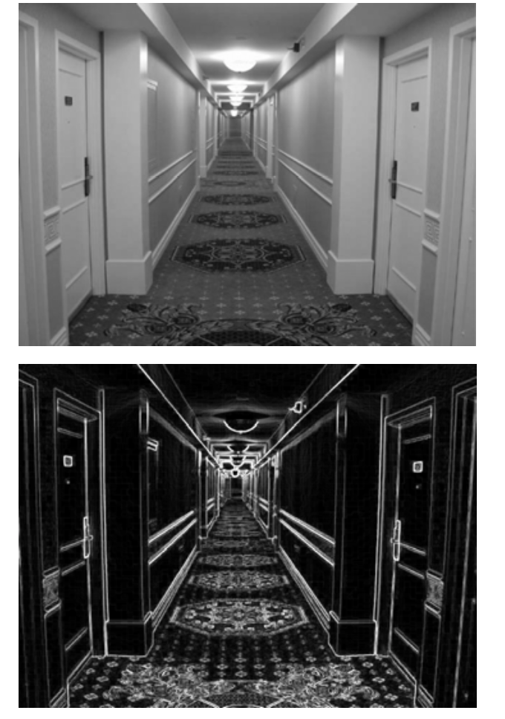
Linear structures in an Image
Borders between regions are straight lines
These lines separate regions with different gray levels
Edge detection is preprocessing step prior to Hough transform
Input must be a logical edge image <0,1>

Slide 4
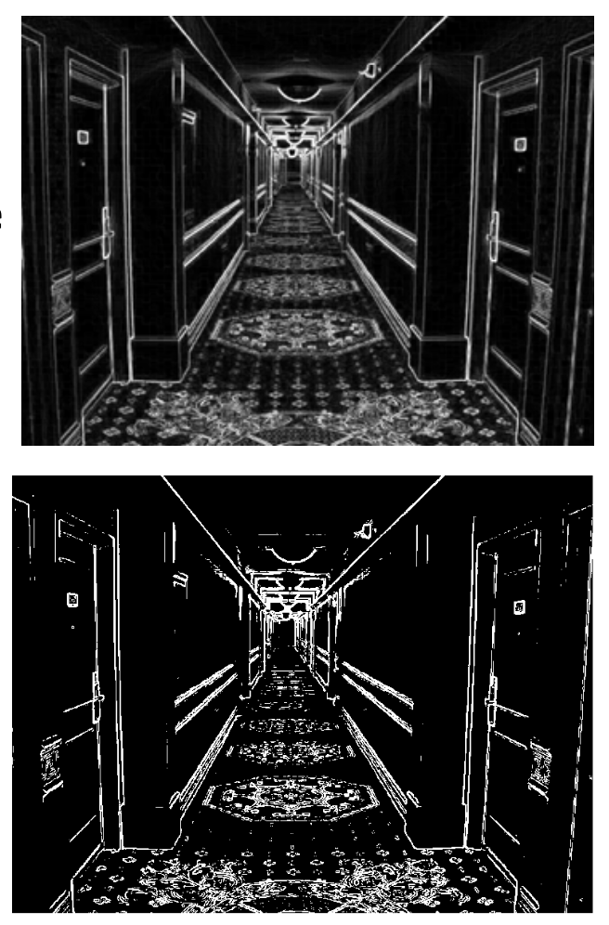
Linear structures in an Image
Notes:
Can

Slide 5
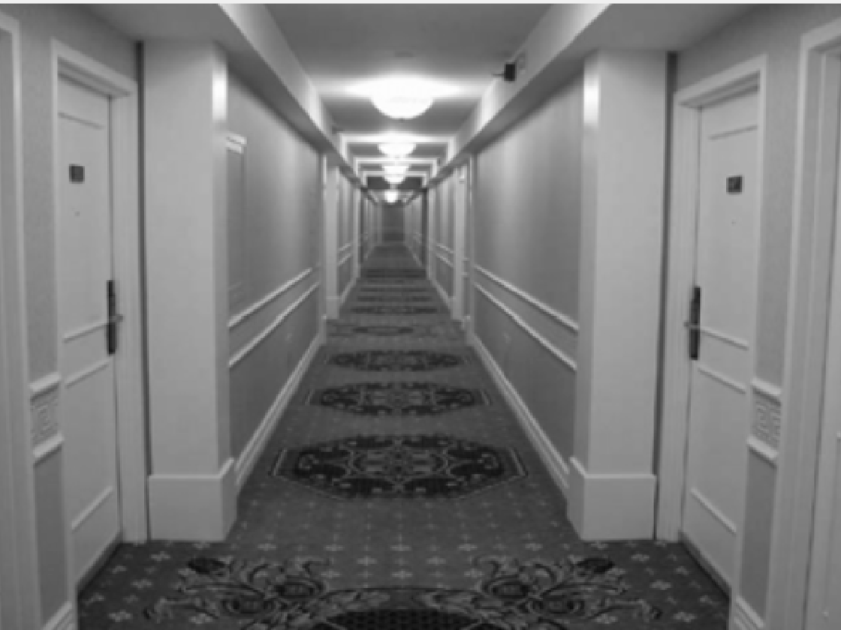
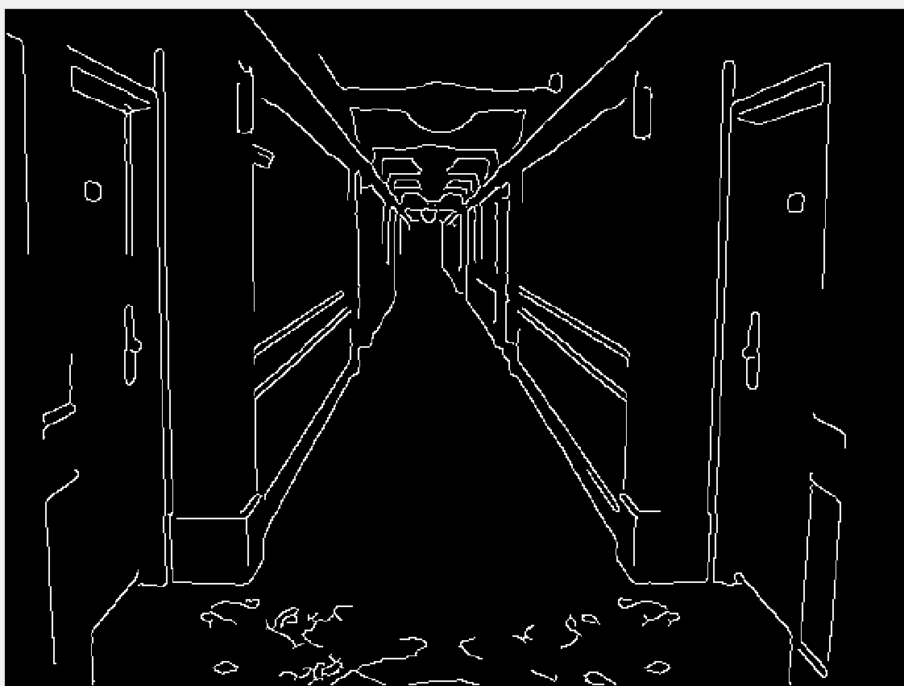
hough transform Example: MATLAB

Slide 6
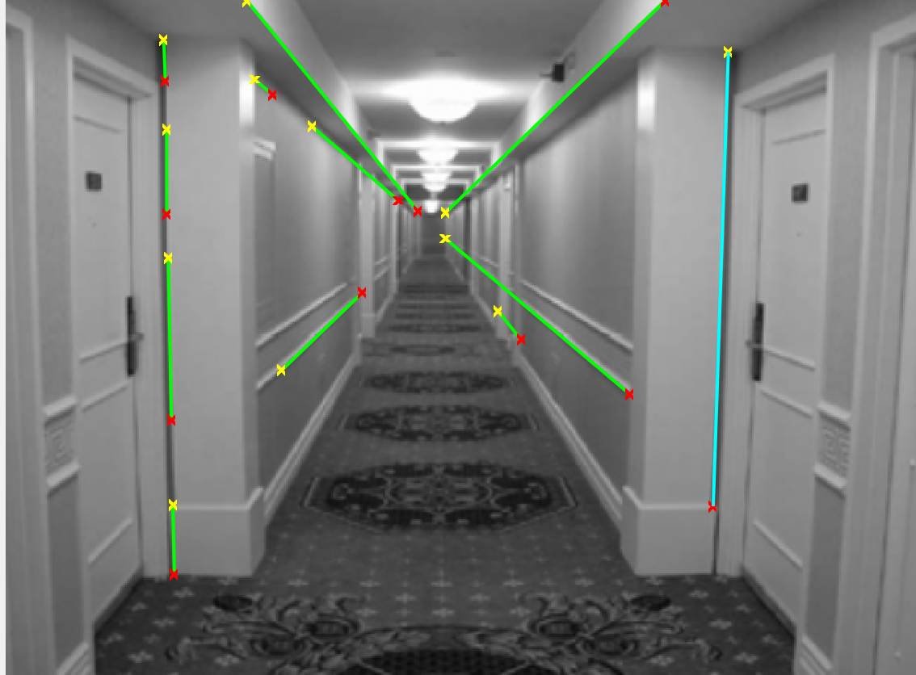
hough transform Example: MATLAB

Slide 7
hough transform Advantages
Easy implantation
Handles missing and occluded data
Can be adapted to things other than lines

Slide 8
hough transform Disadvantages
Can be computationally complex
Looks for only one type of object
Can be fooled by apparent line
Length and position of a line segment cannot be determined
Colinear line segments cannot be separated

Slide 9
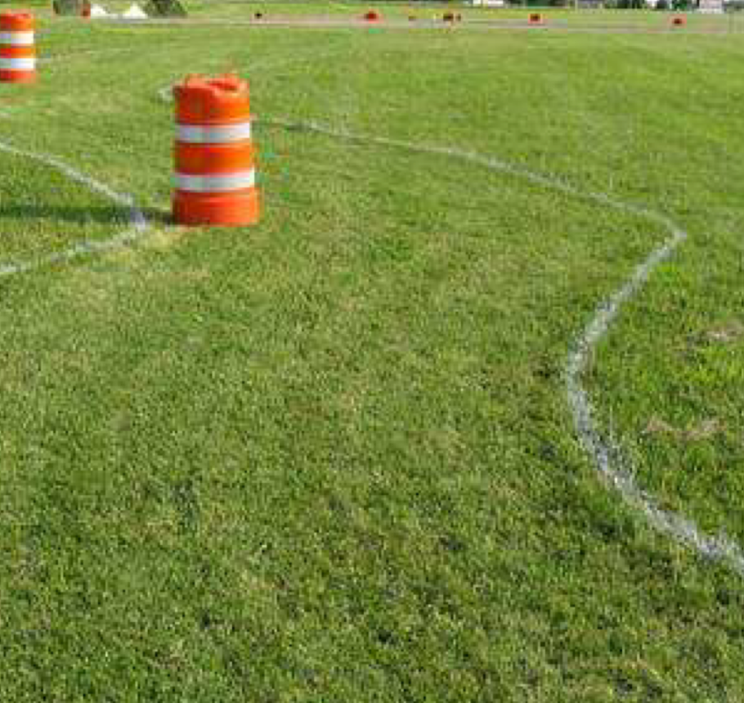
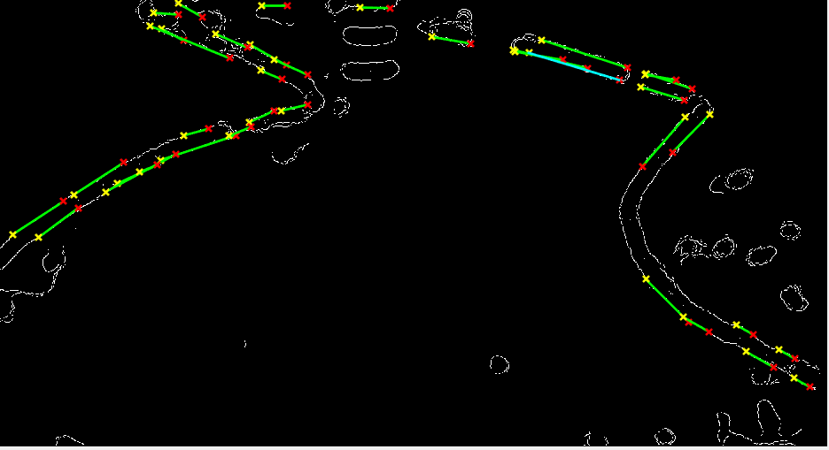
hough transform For Lane Following

