Slide 1
Potential functions based sampling heuristic for optimal path planning
Sameer
Pavan

Slide 2
RRT and RRT*
Randomized sampling techniques which generates space filling trees.
Computationally faster than action based method for exploration.
Sampling is done uniformly over the C space
How do we sample better?

Slide 3
Artificial Potential Fields
A function that returns potential field value for every point in the configuration space of the robot.
It is computed with respect to goal and obstacle locations.
The potential would be the least at the goal location, attracting the robot towards

Slide 4
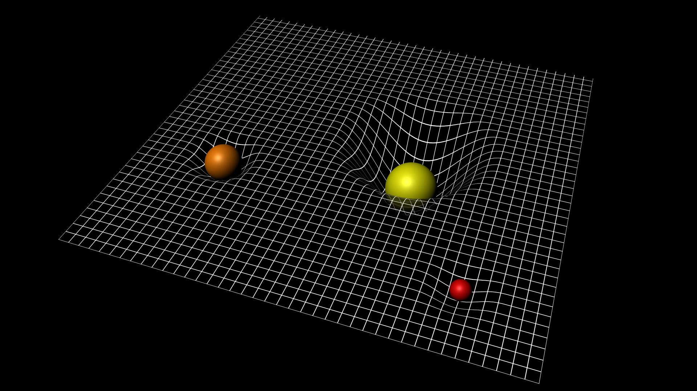
Attractive Potential
Notes:
We are going to treat the robot as a body lying in a potential field of heavy mass located the goal
Plan the path by integrating the differential equations of this potential field over time

Slide 5
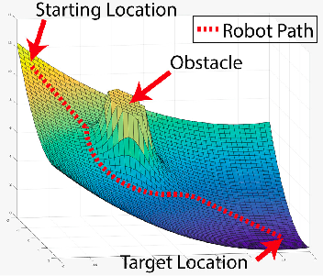
Repulsive Potential
Obstacles are modelled as repulsive potential fields
When, the equations are integrated over time it will avoid paths colliding with the obstacle.

Slide 6
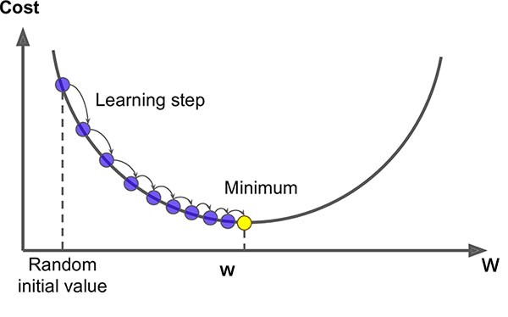
How do we integrate?
Gradient Descent
Notes:
We update the robot position according to the decreasing gradient of the potential field.

Slide 7
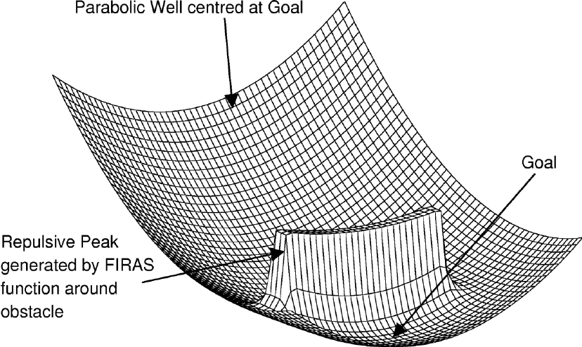
Problem of Local Minima
Planning using APFs doesn’t guarantee a solution!
It’s hard to reach a global minima with non-convex obstacles

Slide 8
APF + RRT* = PRRT*
We guide the sampling using the artificial potential field
We have added a new function in RRT* called Randomised Gradient Descent (RGD)
This function takes the randomly sampled point and outputs a new sample point
This new sample point is always directed towards goal position

Slide 9
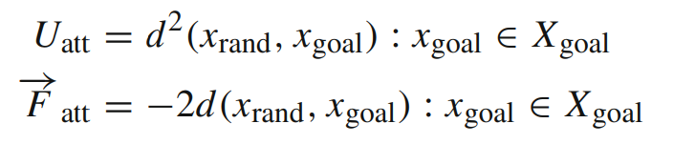
Attractive Potential Gradient

Slide 10

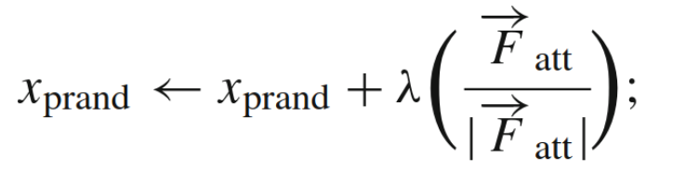
Randomised Gradient Descent
Notes:
Using the above gradient, we can compute our next point.

Slide 11

Visualisation of Resampling in PRRT*
Notes:
Video Available on: https://drive.google.com/file/d/1EFCrNY0XIKL_PJZ4W3cqWaLQhPgS_tWq/view?usp=sharing
We implemented this using the same map as project 3 phase 3.
Start node and goal nodes

Slide 12
RRT* vs PRRT*: Advantages of PRRT*
RRT STAR: 100 Iterations
PRRT Star: 100 Iterations
Notes:
Video2 : https://drive.google.com/file/d/14N5BOsjgW1QI-YOViDrjjA6W-iiiTHYf/view?usp=sharing
Video1: https://drive.google.com/file/d/1yGFt1Kq2miCQhtboubnvnyC3hNj85K9W/view?usp=sharing
Video on the left. Video on the right Rewire well in PRRTStar

Slide 13
RRT* vs PRRT*: Advantages of PRRT*
RRT Star: 500 iterations
PRRT Star: 500 iterations
Notes:
Video2 https://drive.google.com/file/d/1TDlPqWY9uB30ULRXDYjE1RnSTmkF9BZL/view?usp=sharing
Video1: https://drive.google.com/file/d/14N5BOsjgW1QI-YOViDrjjA6W-iiiTHYf/view?usp=sharing

Slide 14
Results: RRT* vs PRRT*
Number of nodes generated for the same iteration
Iterations | Cost of path RRT Star | Cost of path PRRT Star
100 | No path found | 13.8336
200 | No path found | 14.6192
500 | No path found | 13.3935
2000 | 14.61 | 13.4835

Slide 15
Results: RRT* vs PRRT*
Number of nodes generated for an optimal path
Cost | Nodes for RRT Star | Nodes for PRRT Star
~13.39 | 553 | 160
~12.9 | 673 | 153
~13.34 | 723 | 139

Slide 16
Improvements
Running a gradient descent with high learning rate can sometimes aggressively sample near the goal position.
This leads to lesser no. of way points in the path.
If can incorporate a way to gradually shift the sampling mean from start node to goal node can improve the performance

Slide 17
References
[1] A. Yershova, L. Jaillet, T. Simeon and S. M. LaValle, "Dynamic-Domain RRTs: Efficient Exploration by Controlling the Sampling Domain," Proceedings of the 2005 IEEE International Conference on Robotics and Automation, Barcelona, Spain, 2005, pp. 3856-3861, doi: 10.1109/ROBOT.2005.1570709.
[2] J. Amiryan and M. Jamzad, "Adaptive motion planning with artificial potential fields using a prior path," 2015 3rd RSI International Conference on Robotics and Mechatronics (ICROM), Tehran, Iran, 2015, pp. 731-736, doi: 10.1109/ICRoM.2015.7367873. (https://ieeexplore.ieee.org/document/7367873)
[3] Qureshi, A.H., Ayaz, Y. Potential functions based sampling heuristic for optimal path planning. Auton Robot 40, 1079–1093 (2016). (https://doi.org/10.1007/s10514-015-9518-0)

Slide 18
References
[4] https://sci.esa.int/web/lisa-pathfinder/-/56434-spacetime-curvature
[5]https://www.researchgate.net/figure/An-example-of-a-traditional-potential-field-which-can-be-used-for-navigating-toward-a_fig2_294645105
[6] https://www.researchgate.net/figure/Example-of-a-Potential-Field_fig2_49402674
[7] https://morioh.com/p/15c995420be6

