Slide 1

Federated Meta Learning
Under Supervision
Asst. Prof. Rami Zewail
Presented By
Mahmoud Mohammed Taha
Assistant Lecturer, Shoubra faculty of Engineering, Benha University, MOHE PhD student at E-JUST University, Egypt. mahmoud.aboayaad@ejust.edu.eg

Slide 2
Outline
Significance
Objective
Current Status and Trends
Types
Federated Learning
Meta Learning
Implementation, Dataset and result
Conclusion

Slide 3
Terminology: Federated-learning
A distributed machine learning framework where multiple clients (devices or servers) collaboratively train a shared model Clients keep their data local, enhancing privacy.
Federated Learning is a specific type of collaborative learning that focuses on decentralized model training while preserving data privacy.

Slide 4
Terminology: Meta-learning
In this approach, the model is trained on a variety of tasks so that it can learn how to learn quickly when given a few examples of a new task.
The goal is for the model to generalize across tasks and adapt quickly to new, unseen tasks with limited data.

Slide 5
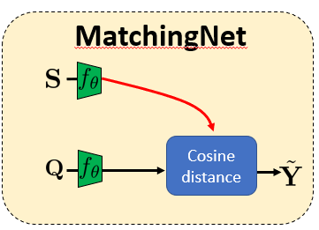
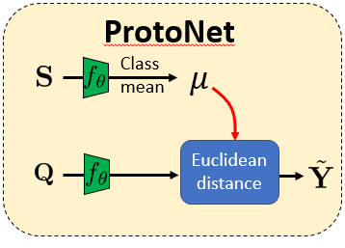
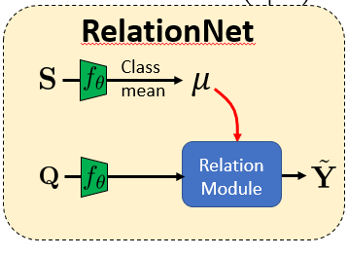
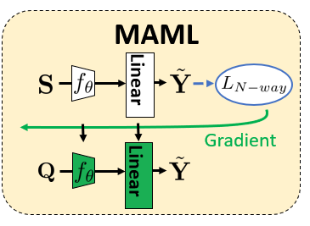
Different Meta-Learning Types

Slide 6
MAML
MAML is a meta-learning method that enables strong generalization with few samples per class.
It uses small gradient steps to facilitate quick adaptation to new tasks, focusing on the challenges of gradient-based learning.

Slide 7
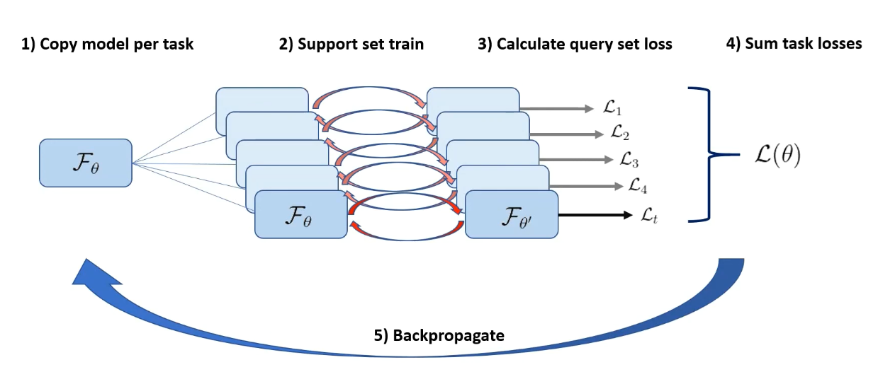
MAML: The Algorithm

Slide 8
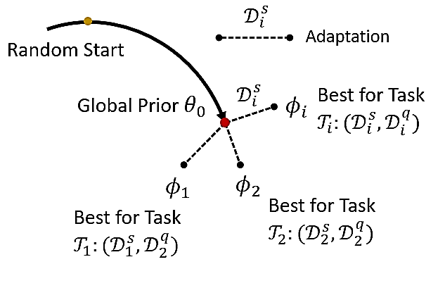
MAML
MAML does not learn an update function or learning rule, it learns the model parameters in a fully differentiable way.
It has a probabilistic interpretation in terms of hierarchical models.

Slide 9

MAML
Agnostic, in the sense that the method can be used in different contexts, few-shot learning is a particular case.

Slide 10

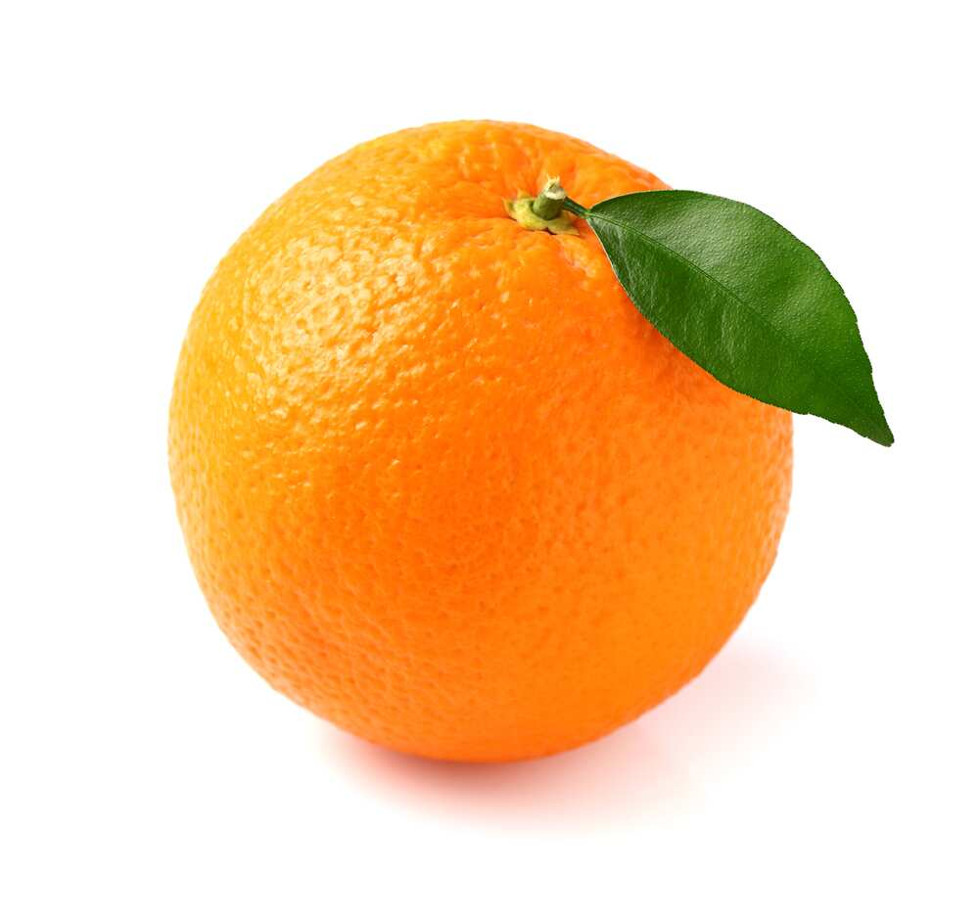

Dataset: Fruits Dataset¹
The database contains 75 images (224 x 224) of three fruits (Apple, Banana, Orange).
¹ https://www.kaggle.com/datasets/shreyapmaher/fruits-dataset-images?resource=download

Slide 11
Federated Meta Learning Implementation
The implementation in the Federated MAML Learning lab involves several key with python such as (preprocessing dataset to resize images).
Necessary libraries such as matplotlib, numpy, torch, and torchvision are loaded.

Slide 12
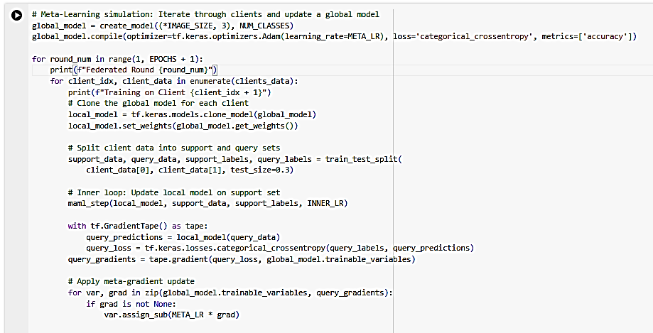
Federated Meta Learning Implementation

Slide 13
Final results
Federated Meta Learning have achieved accuracy of 53 % due to challenges of limited data samples and distributed agents.
Federated Meta learning demonstrates the potential to classify new categories with minimal labeled data, addressing real-world problems where large datasets are unavailable.

Slide 14
References
Vinyal et al., Matching networks for oneshot learning, NeurIPS 2016
Snell et al., Prototypical networks for few-shot learning, NeurIPS 2017
Finn et al., Model-agnostic meta-learning for fast adaptation of deep network, ICML 2017
Sung et al., Learning to compare: Relation network for few-shot learning, CVPR 2018

Slide 15
Thank you
Mahmoud Mohammed Taha
Assistant Lecturer, Shoubra faculty of Engineering, Benha University, Scholarship student at E-JUST University, Egypt. mahmoud.aboayaad@ejust.edu.eg

