Slide 1
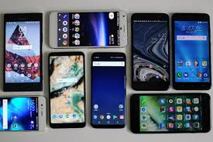

Slide 2

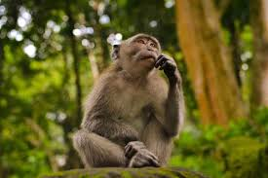
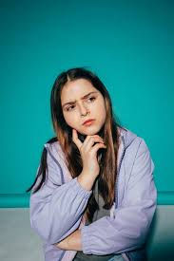
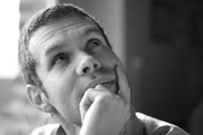
Remember the words used ????????

Slide 3
ADJECTIVE
the describing words
give more information and observation about a noun or a pronoun
color, material, shape, size, amount, price, quality, origin, personality, weight, temperature, age, direction, etc.

Slide 4
Types
Numeric: six, one, hundred, first, second, third, several
Quantitative: more, all, some, half, much, less, little, some, enough, great
Qualitative: white red, short, long, smell, weary, worn etc
Distributive: each, every, either, neither
Interrogative: which, whose, what
Demonstrative: this, that, those, these, yonder

Slide 5
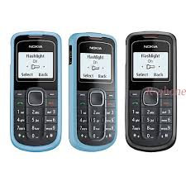
Difference

Slide 6
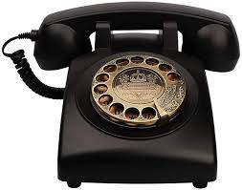
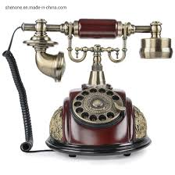
Difference

Slide 7
Degrees of Comparison
three degrees of comparison: positive, comparative and superlative.
All monosyllabic and some disyllabic words ---add ‘–er’ or ‘–est’
For example:
Adjectives Comparative Superlative
Tall taller tallest
Short shorter shortest
Fast faster fastest
Slow slower slowest

Slide 8
Remember:
the adjective --only one syllable long and ends in a single consonant------double the final consonant, then add -er or -est. For example:
Positive Comparative Superlative
Big bigger biggest
Fat fatter fattest
Hot hotter hottest
Thin thinner thinnest

Slide 9
Adjectives
ending in ‘y’ proceeded by a consonant must be changed into comparatives and superlatives by adding ‘– ier’ or ‘–iest’ removing ‘y’ respectively.
For example:
Adjectives Comparative Superlative
Happy happier happiest
Lucky luckier luckiest
Friendly friendlier friendliest
Pretty prettier prettier

