Slide 1
Problem
Trigger: How can maintain Maximize Thailand fishing cat population in the overview
Scope: Wetland-Agriculture of Gulf of Thailand

Slide 2
Object
Maintain
Maximize Fishing cat population
Strategies
Disease
Translocation and reintroduce
Abundant and density
Habitat potential
Community participation
fundamental
Captive breeding
Reduce land change
Reduce conflict
Eco-tourism / Volunteer research-conserve.
Food abundant
Means
One health
Tech. reproduction
Genetic diversity
Fishing cat land use
Public known leg of ecology, Fishing cat ecology service

Slide 3
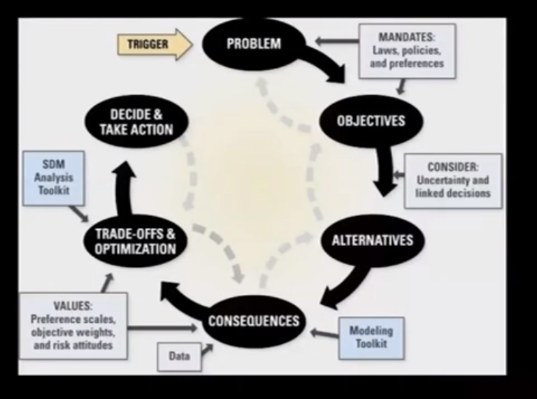
Alternative
Strategies
How- where fishing cat landscape use and distribution
Reduce land use change
How food abundant for fishing cat
How DNA diversity of fishing cat
Take Note: Alternatives. What are the different management actions to choose from? This element requires explicit articulation of the alternatives available to the decision maker. The range of permissible options is often constrained by legal or political considerations, but structured assessment may lead to creative new alternatives

Slide 4
Management -Action
Fishing cat abundant
Food abundant and suitability
Landscape suitability for support
Habitat type
Maximize population
Habitat potential
Reduce conflict and Protect method for Poultry
Translocation and reintroduce
Support habitat conservation and management
Eco-tourism / Volunteer research-conserve.
Captive breeding
DNA Diversity
Distribution
Law enforcement
Reduce land use change
Community participation for conservation
Green = Objective
Blue = Alternative Action
Public known leg of ecology, Fishing cat ecology service

Slide 5
Consequences
Objective Alternative | Habitat potential (Index 0 = Lower 1 =Low 2=midrate 3 =High 4= Very high ) | Fishing cat abundant ( individual per area sqkm2) | Community participation for conservation (Index 0 – 100 percent)
landscape use and distribution | 3-4 | 0.5 | 80
Reduce land use change | 3-4 | > 0.5 | 90
food abundant | 3-4 | > 0.5 | 70
DNA diversity | 2 | - | -
Law enforcement | 2-3 | > 0.5 | 60
*** Because no data information and have never conducted any research, so can’t to score, if use knowledge from work , learning and experience can got score that show in Table

Slide 6
Trade off
Objective Alternative | Habitat potential (Index 0 = Lower 1 =Low 2=midrate 3 =High 4= Very high ) | Fishing cat abundant ( individual per area sqkm2) | Community participation for conservation (Index 0 – 100 percent) | Select
landscape use and distribution | 3-4 | 0.5 | 80 | 2
Reduce landuse change | 3-4 | > 0.5 | 90 | 1
food abundant | 3-4 | > 0.5 | 70 | 3
DNA diversity | 2 | - | - | -
Law enforcement | 2-3 | > 0.5 | 60 | 4
I decide to select 4 Alternative, off 1 Alternative (DNA diversity)

Slide 7
Decide & Take Action
1. Survey fishing cat landuse and distribution
2. Survey food abundant of fishing cat
3. Use the law enforcement and Community participation for reduce landuse change

