Slide 1
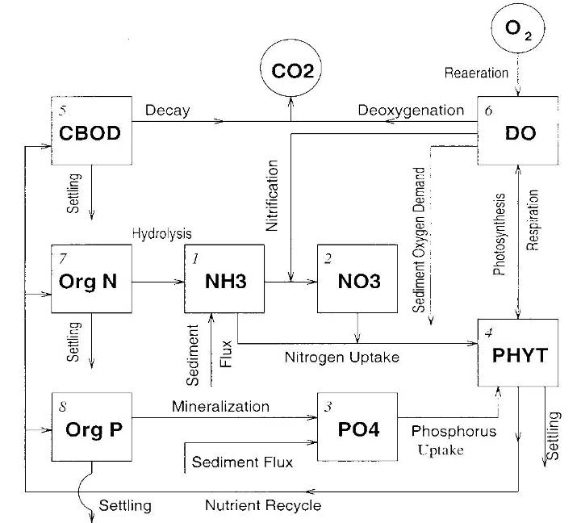
LECTURE 7 – Nutrient and Eutrophication
Wu-Seng Lung
Professor of Civil Engineering
University of Virginia

Slide 2
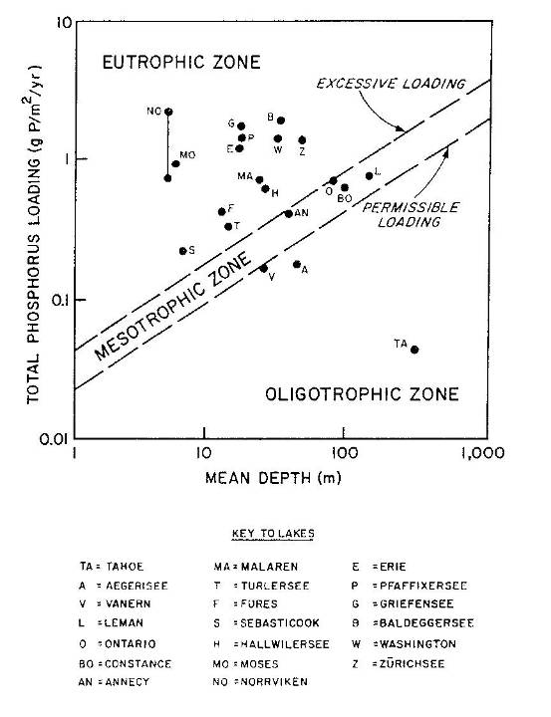
Vollenweider Phosphorus Loading Plot
In the Treaty Between US and Canada to Clean Up the Great Lakes

Slide 3
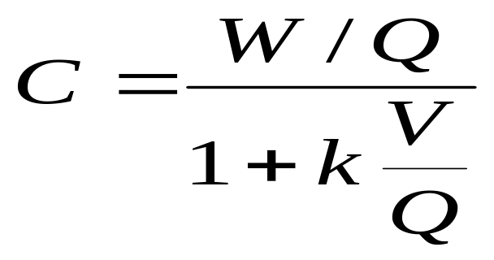
Theoretical Basis of Vollenweider Model
A Steady-State Model
Completely Mixed Lake
Input = Output + Retention

Slide 4
Key Issues Using Vollenweider Model
Time to Reach Equilibrium
Equilibrium Between Water Column and Sediment (Is the Sediment System Saturated with Nutrients?)
Historical Data to Support the Analysis
Quantifying Phosphorus Loads

Slide 5
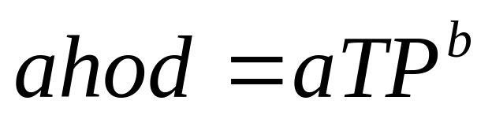
The PHOSMOD Model
from Chapra and Canale (1991)
One-Box Water Column and a Sediment Layer Total Phosphorus Model
Rate of Summer Dissolved Oxygen Consumption is Related to the Total Phosphorus Concentration in the Water Column
ahod = areal hypolimnetic oxygen demand (mg O₂/L/m²)
TP = Total Phosphorus Concentration (μg/L) in the Water Column
a and b = Empirical Constants
Chapra, S.C. and R.P. Canale, 1991. Long-Term Phenomenological Model of Phosphorus and Oxygen in Stratified Lakes. Water Research, 25(6):707-715.

Slide 6
Enhanced PHOSMOD Model
Two-Layer Water Column
Modeling Dissolved Oxygen and Total Phosphorus in Both Layers
ahod is related to the Total Phosphorus Concentration in the Bottom Layer

Slide 7
Configuring Enhanced PHOSMOD to Platte Lake, Michigan
Key Parameter: The Settling Rate of Phosphorus in the Water Column (a Highly Parameterized Rate Coefficient) Could it Vary with Season (i.e., Time-Variable Settling Rate Justified)?
Composition of Phosphorus Between Particulate and Dissolved Phosphorus Varies with Season
Deriving Time-Variable Settling Rate from Independent Quantification of the Amount of Phosphorus Accumulated in the Lake Bottom, i.e., Back Calculate the Settling Rate.

Slide 8
Processes Configured for Platte Lake
Tracking Total Phosphorus:
Inflow from Watershed, Including Hatchery Discharge and Nonpoint Sources
Outflow from the Lake
Settling of Phosphorus from Top Layer to Bottom Layer
Vertical Exchange of Phosphorus Between Two Layers
Deposition of Phosphorus from Bottom Layer to Sediment
Sediment Release of Phosphorus to Bottom Layer of Water Column
Tracking Dissolved Oxygen:
Inflow from Watershed, Including Hatchery Discharge and Nonpoint Sources
Reaeration at Lake Surface
Dissolved Oxygen Exchange Between Two Layers
Oxygen Consumption in Bottom Layer (i.e., ahod) During Summer Months

Slide 9
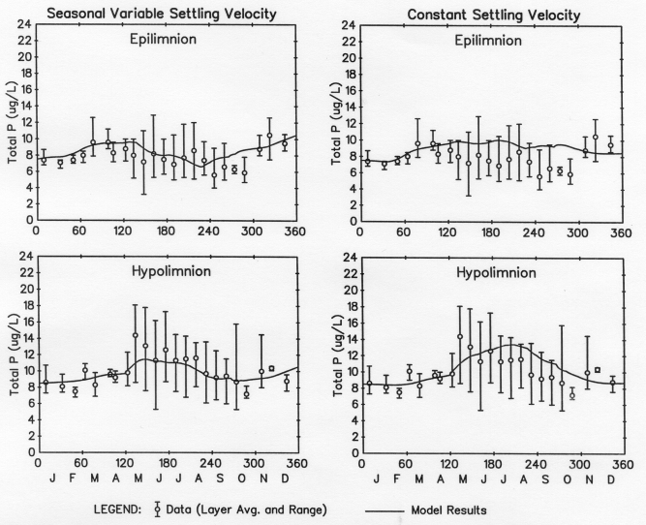
Two-Layer TP Model of Platte Lake

Slide 10
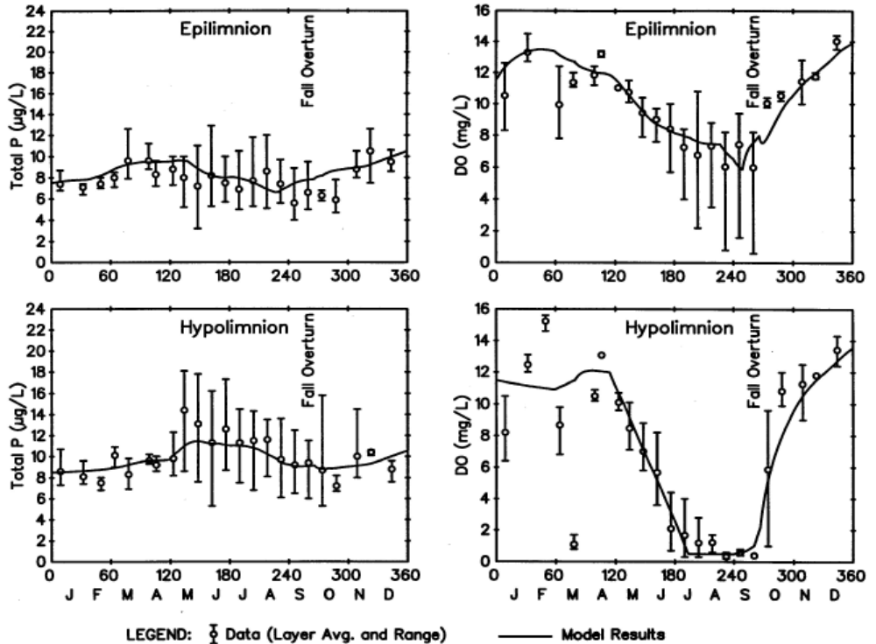
Model Results vs. Data – Platte Lake

Slide 11
Eutrophication Kinetic Processes
Phytoplankton Growth
  Temperature Effect on Phytoplankton Growth
  Light Effect on Phytoplankton Growth Rate
  Nutrient Effect on Phytoplankton Growth Rate
Phytoplankton Death
Phytoplankton Settling

Slide 12
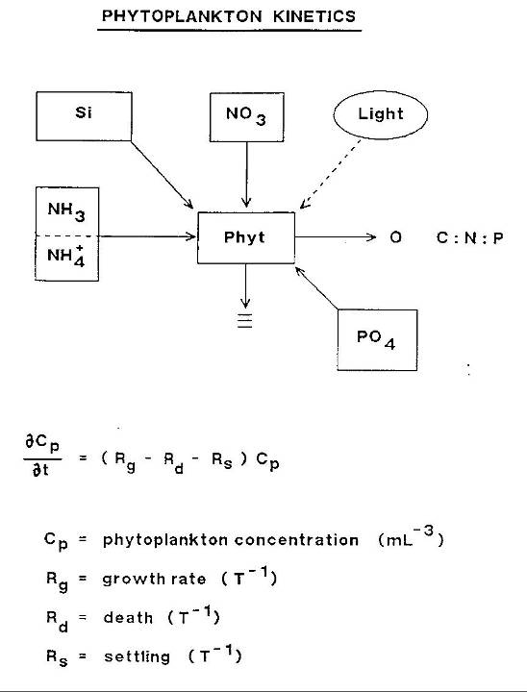

Slide 13
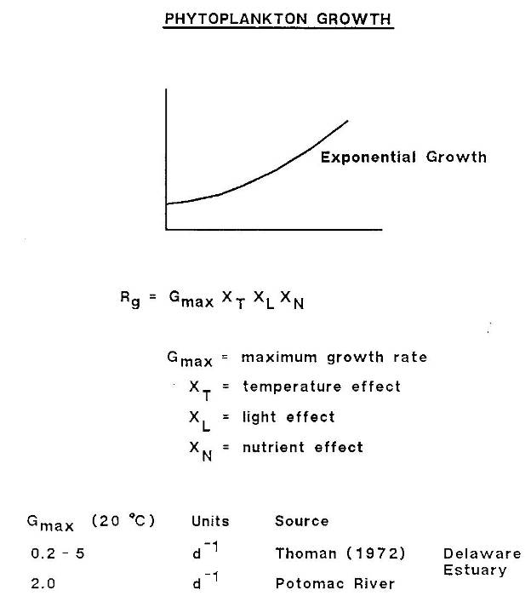

Slide 14
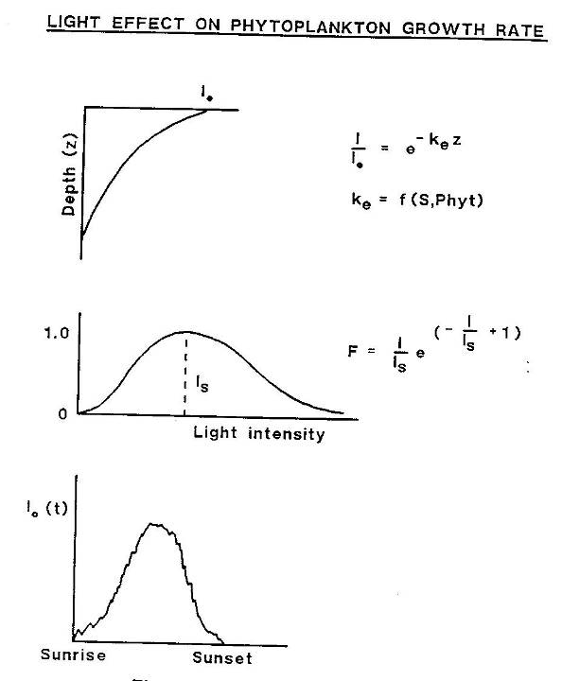

Slide 15
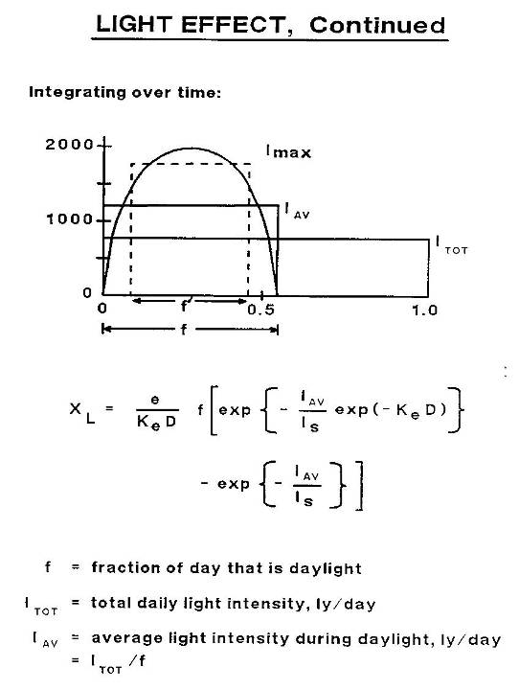

Slide 16
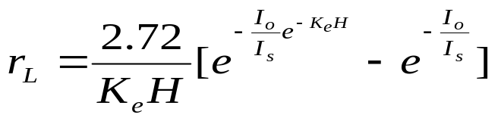
Depth and Daily Averaged Algal Growth
H = Average Water Column Depth
K_{e} = Total Light Extinction Coefficient
I_{o} = Incident Light Intensity at Water Surface
I_{s} = Saturating Light Intensity of Phytoplankton

Slide 17
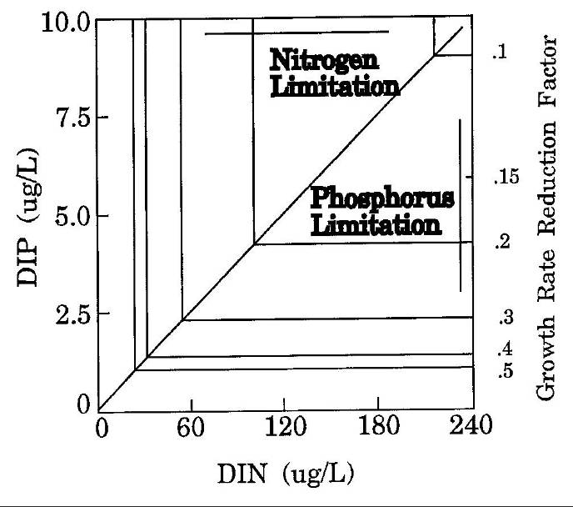
Nutrient Limitation

Slide 18
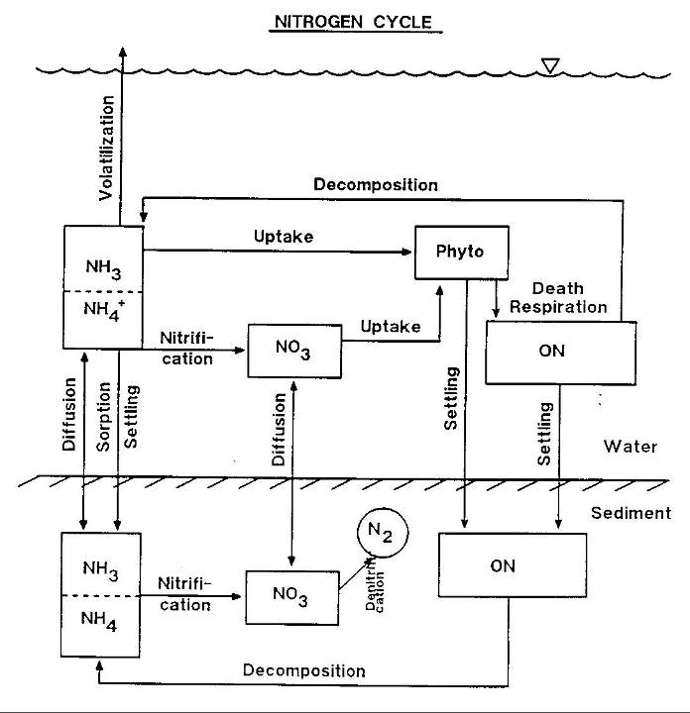

Slide 19
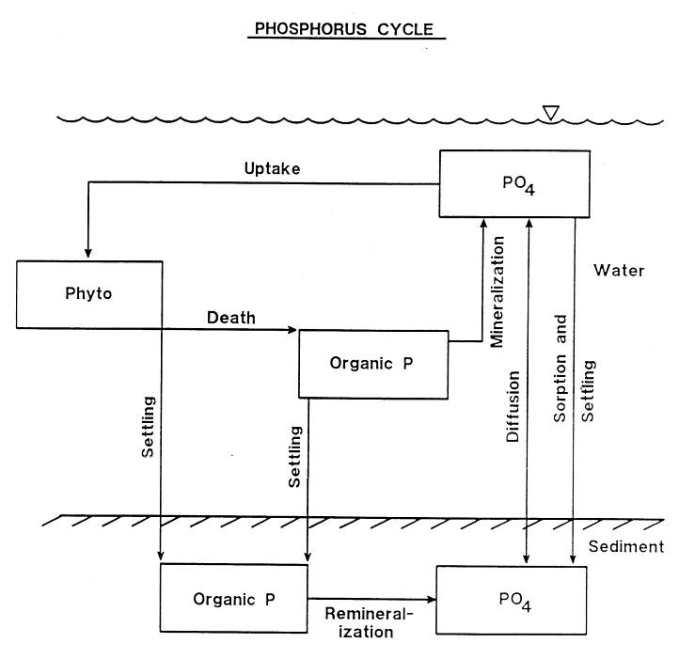

Slide 20
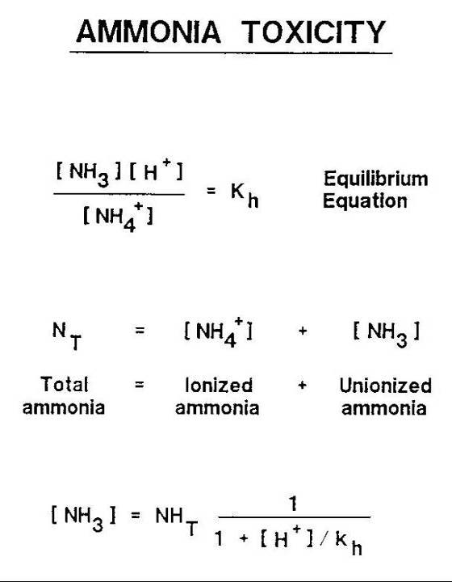

Slide 21
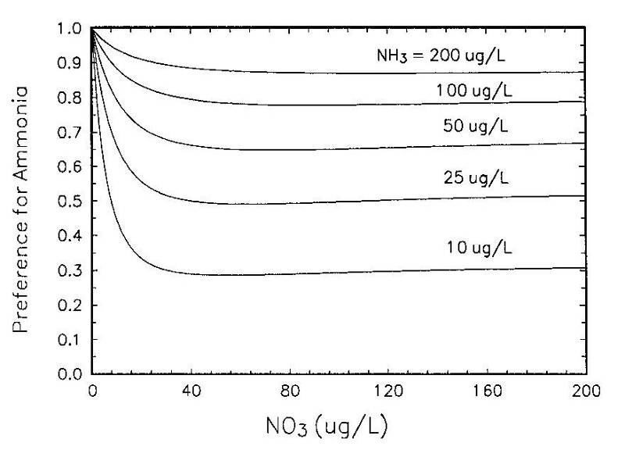
Ammonia Preference by Algae

Slide 22
Phytoplankton “Death”
R_{d} = R_{e} + R_{g}
R_{e} = endogenous respiration rate (day⁻¹)
R_{g} = death rate due to grazing (day⁻¹)
Phytoplankton Settling
R_{s}= (A/V) Vs
A = area through which settling is occuring
V = volume
V_{s}= settling velocity of phytoplankton

Slide 23
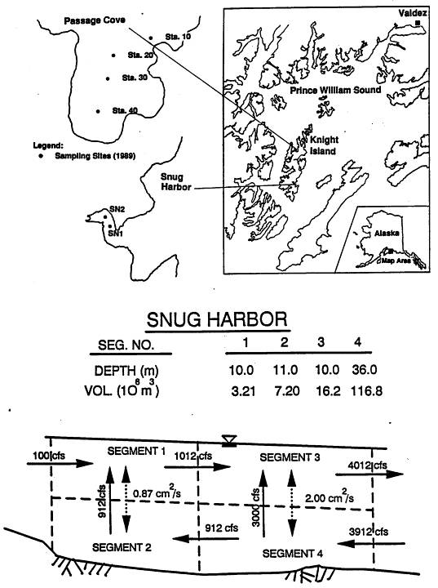
WASP/EUTRO Modeling of Snug Harbor following the EXXON Veldez Oil Spill in 1988

Slide 24
Water Column Kinetic Processes in EUTRO

Slide 25
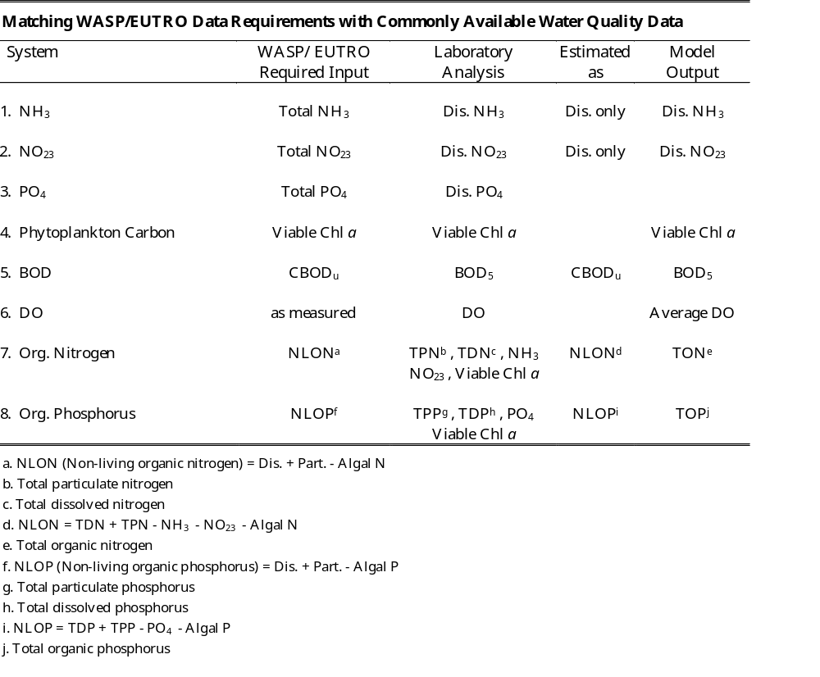

Slide 26
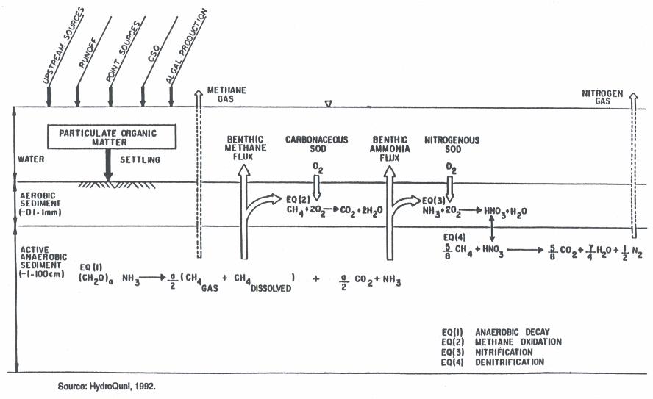
Diagenesis SOD and NH₄ flux

Slide 27
Building Up the Sediment
To Establish Initial Conditions in the Sediment for the Various Constituents Simulated (i.e., Organic Carbon, Organic Nitrogen, Organic and Inorganic Phosphorus), a Water Quality Model Including a Sediment Module Must Be “Spun Up” Until Equilibrium Levels Are Reached in the Sediment.
The Equilibrium Condition Values Can Be Utilized as Initial Concentrations in the Sediment for Model Simulation and Evaluation of Different Nutrient Loading Reduction Scenarios.

