Slide 1
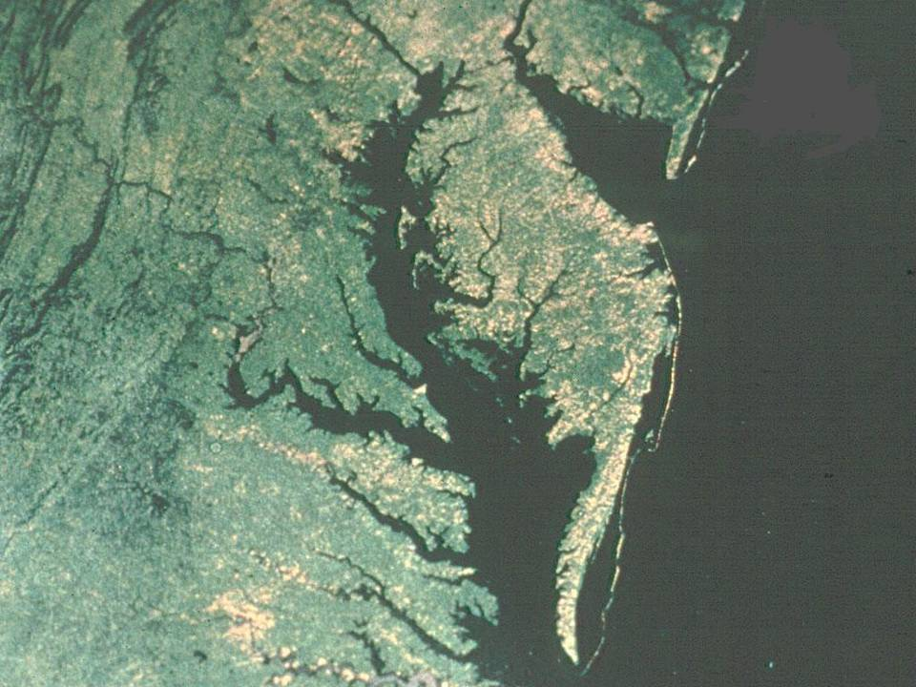
Fate and Transport Modeling of Ecosystems
Wu-Seng Lung
Department of Civil Engineering
University of Virginia
September 5, 2007

Slide 2
Pre-1970’s: To achieve ambient water quality standards
Impossible to administer
(translating ambient standards into
end-of-pipe effluent limits)
1972: Federal Water Pollution Control Act amended
NPDES permit program for municipal and
Industrial discharges (Technology-based control)
Substantial reduction in pollution
Allowing variances
1990’s: Clean Water Act reauthorization
2000: Total Maximum Daily Load
(TMDL)
1970: EPA
Established
1977: Clean Water Act passed
Water quality criteria for toxic substances
1982: Water quality-based control
Water quality-based toxics control
Superfund
1970
1980
1990
2000
1977: Toxics modeling
1972: Hydrothermal modeling
1970: Aquatic plants/nutrient
Eutrophication modeling
1990’s: Watershed Modeling
Mixing Zone Modeling
1982: Wasteload allocation modeling
Fate and transport modeling
Sediment modeling
Pre-1970’s: BOD/DO modeling
2000: Ecosystem Modeling

Slide 3
Manhattan College, NY
Donald J. O’Connor
Robert V. Thomann
Dominic M. Di Toro

Slide 4
Ask the Model Water Quality Management Questions
The Model Must be Well Calibrated and Verified with Field Data prior to asking questions.
Questions Raised by Model Projection Analysis (e.g., Why Nutrient Reductions are not Effective as Expected?)
Technical Issues to be Addressed Require Additional Model Runs (e.g., What are Other Key Factors Affecting Eutrophication Control?)
Questions Leading to Additional Data Collection Effort

Slide 5
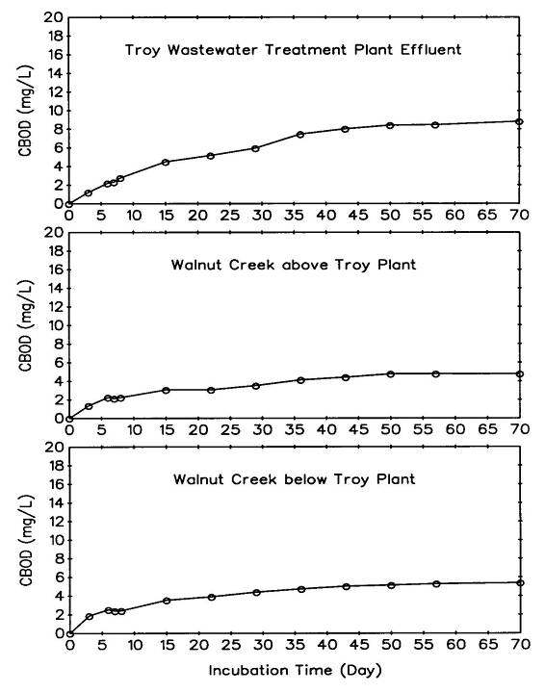

A Simple but Subtle Case: Quantifying In-Stream Biodegradation Rate Following Treatment Plant Discharge for Permitting
Based on Field Data:
k = 0.06 day⁻¹
Regulatory Agency:
k = 0.56 day⁻¹, Resulting in Extremely Stringent Effluent Limit

Slide 6
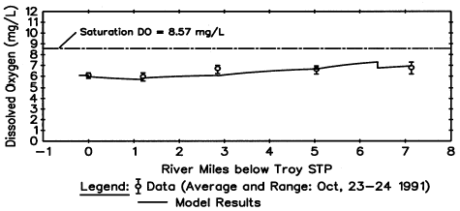
Assigning Key Coefficient Values
Using In-Stream Biodegradation Rate of 0.06 day⁻¹Model Calculated vs. Measured DO in Walnut Creek – Oct. 1991 Data

Slide 7
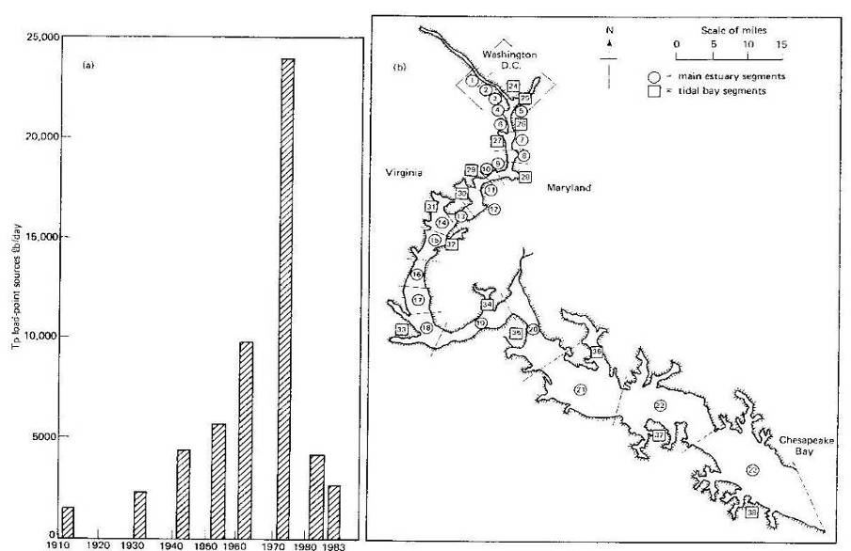
Reduction of Point Source Phosphorus Loads to Potomac Estuary
and Segmentation for Potomac Eutrophication Model

Slide 8
Specific Questions Raised by the Panel on Summer 1983 Blue-Green Bloom
Why Did the Potomac Estuary Exhibit a Bloom in 1983? Can It Be Simulated By the Model?
If There Were Excessive Nutrients in the Waters of the Upper Potomac Estuary, What Was Their Source?
Is There a Need to Increase the Wastewater Treatment Requirements Further?
Were Existing Mathematical Models Capable of Predicting the 1983 Bloom?

Slide 9
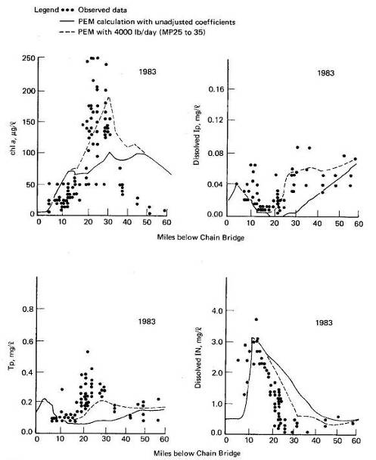
Using the Model to Quantify the Missing Phosphorus Loads
The Model Was Able to Track the Onset of the Bloom Up to About 100 μg/L Chl a by the End of July but Then Failed to Reproduce the Further Intensification of the Bloom – Out of Available Phosphorus
Model Sensitivity Runs Indicated About 4000-8000 lb/day Phosphorus Missing
Where Is the Source of Additional Phosphorus Load?

Slide 10
Source of Additional Phosphorus Loads
Enhanced Aerobic Sediment Phosphorus Release Brought About by High pH in the Overlying Water (Di Toro and Fitzpatrick, 1984) – the Most Likely Mechanism That Resulted in the Increased Phosphorus Input, Thereby Increasing the Bloom!
The Hidden Mechanism

Slide 11
Enhanced Aerobic Sediment Phosphorus Release Brought About by High pH in the Overlying Water
(Di Toro and Fitzpatrick, 1984)
Mechanisms Not Included in a Model Formulation Could Become Significant After Some Level of Treatment Had Been Installed – pH/Alkalinity/Photosynthesis Chemistry
It Is Critical to Review Model Performance After Treatment Levels Have Been Upgraded – Model Post-Audit
Some Mechanisms Are Exposed to View Only After Treatment Levels Have Been Upgraded
Any Modeling Framework May Still Be Subject to the Uncertainty of Some “Missed Mechanism.”

Slide 12
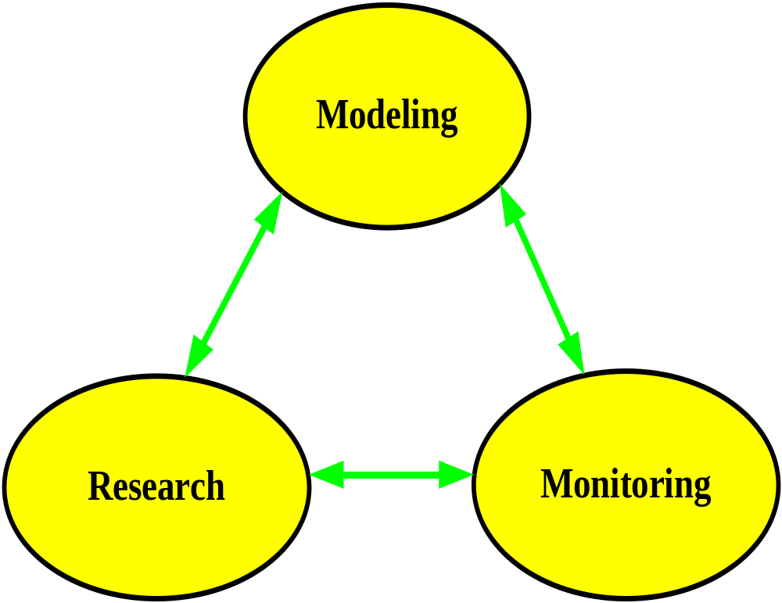
Research and Monitoring to Support Fate and Transport Modeling for Ecosystem Management

Slide 13
What is the Take-Home Message?
Field Data and
Science

