Slide 1

PlatinPie
GIT Training
Exercise 01
Notes:
1

Slide 2
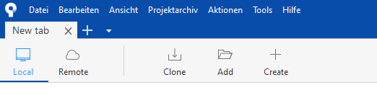
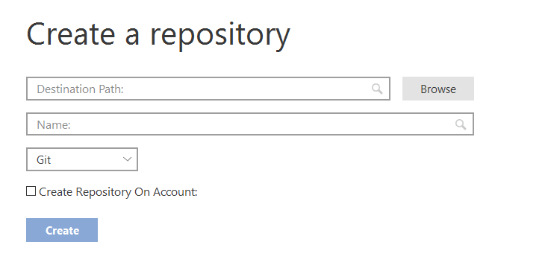

Make your own (local) Repository
Choose the path to your Repo
Give your Repo a Name
We choose GIT
Only needed if remote.
Leave blank for now
Click here to create
Notes:
2

Slide 3
Make your own (local) Repository
Remark:
Your destination path (and therefore the folder name) can be differently named than your repository Example: Destination path: „C:\hello_world“
Repository name: „HelloWorld“ Not recommended!
Notes:
3

Slide 4



Make your own (local) Repository
Alternatively via shell and git commands:
Change „path to repo“ to your destination path
Initializes a local git repository
Notes:
4

Slide 5
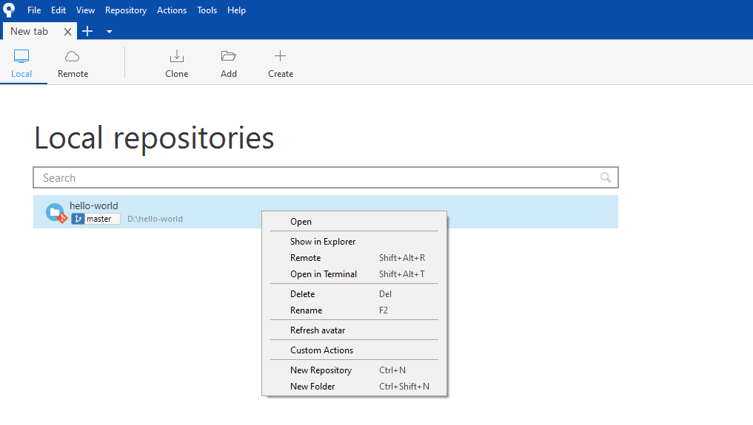
Delete a (local) Repository
Select Local To show all local Repositories
Right Click on the Repository you want to delete
Select delete
Notes:
5

Slide 6
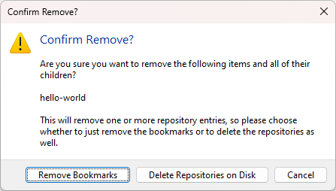
Delete a (local) Repository
Select Cancel if you don’t want to delete the repository
Will delete the folder on your local computer (therefore everything!)
Remove Bookmark will only remove it from sourcetree list
Notes:
6

