Slide 1

PlatinPie
GIT Training
Exercise 02
Notes:
1

Slide 2
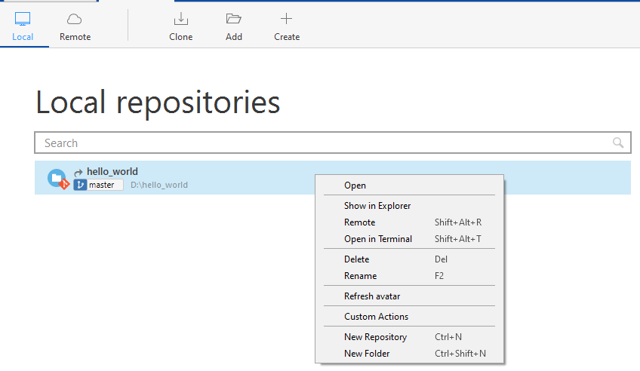

Make your first (local) commit
Create a new Repository according to Exercise 01
Go to your local repository or alternatively, you can open the folder via sourcetree
Right Click on the Repository you want to open / show in Explorer
Notes:
2

Slide 3
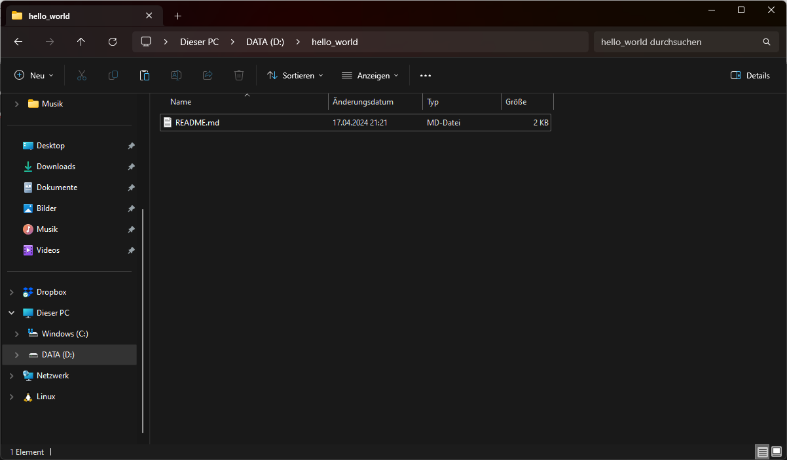
Make your first (local) commit
When the folder is opened in the explorer, create a new empty file named README.md
Your folder should look like this:
Notes:
3

Slide 4
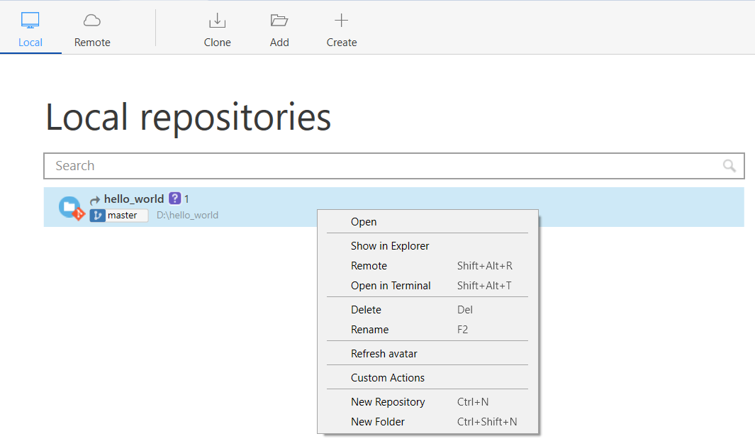
Make your first (local) commit
Switch back to sourcetree
You will notice a change, a question mark and a 1 has appeared
Right Click on the Repository and select open or double left click on Repo
Notes:
4

Slide 5
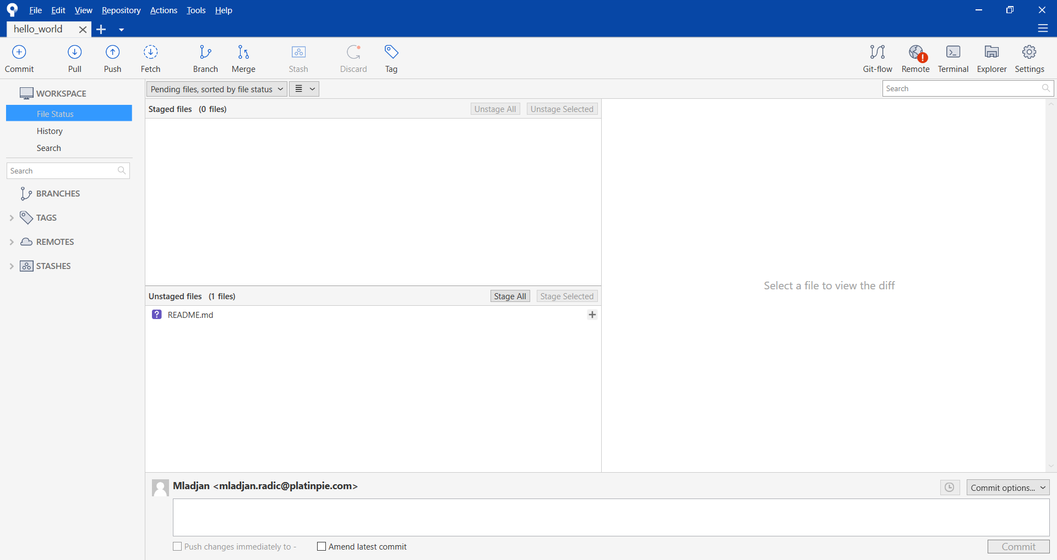
Make your first (local) commit
The following window will open:
Notes:
5

Slide 6
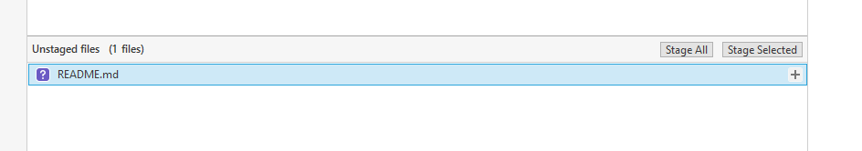
Make your first (local) commit
First, we have to stage the unstaged file
Click on the file you want to stage
Click on Stage Selected
Alternatively, you can also click on „Stage All“. This will stage all unstaged files!
Notes:
6

Slide 7
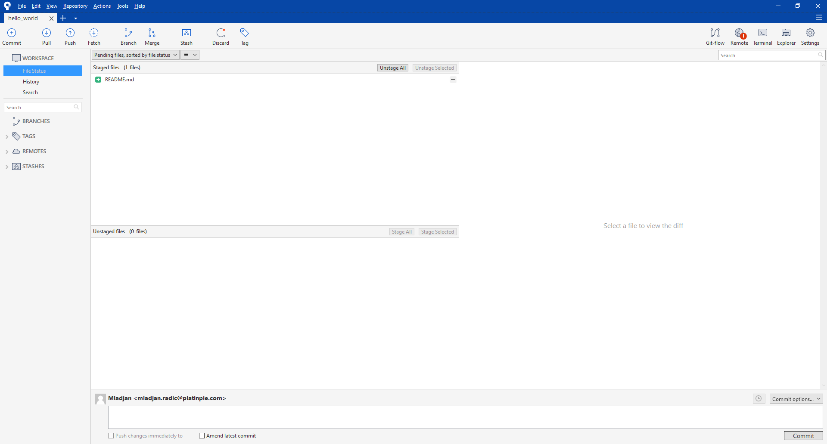
Make your first (local) commit
The file will go from unstaged to staged
Notes:
7

Slide 8
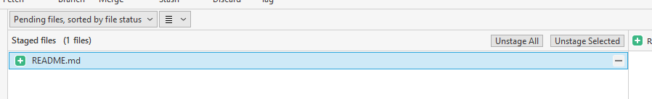
Make your first (local) commit
You can also unstage the file, if you select it or unstage all staged files
In this exercise, we want the README.md file to be staged!
Notes:
8

Slide 9
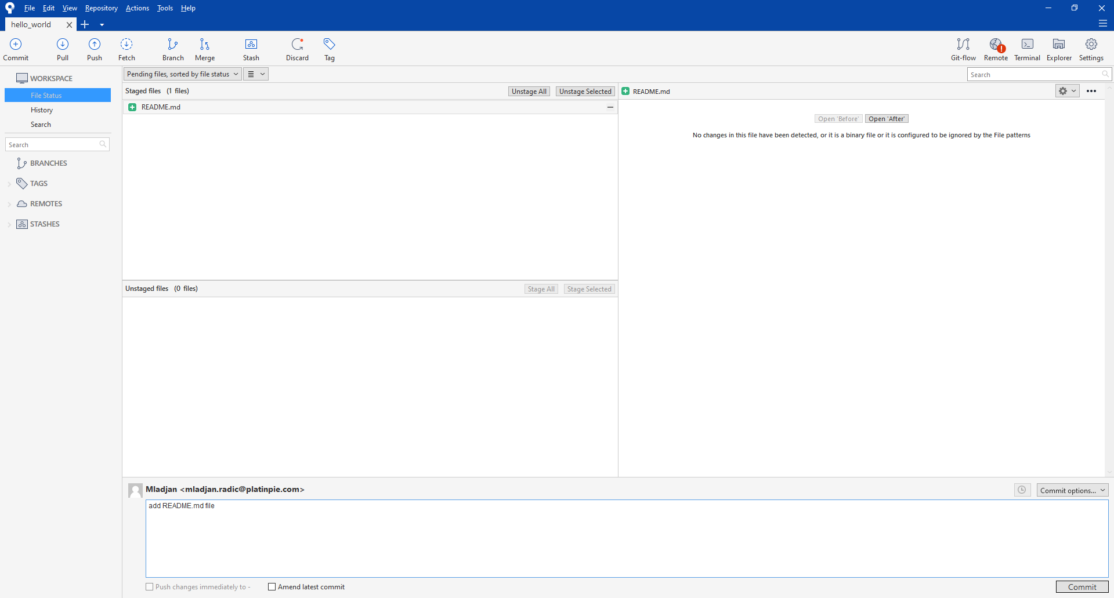
Make your first (local) commit
Now, set a meaningful, short commit message
Then select „Commit“
Notes:
9

Slide 10
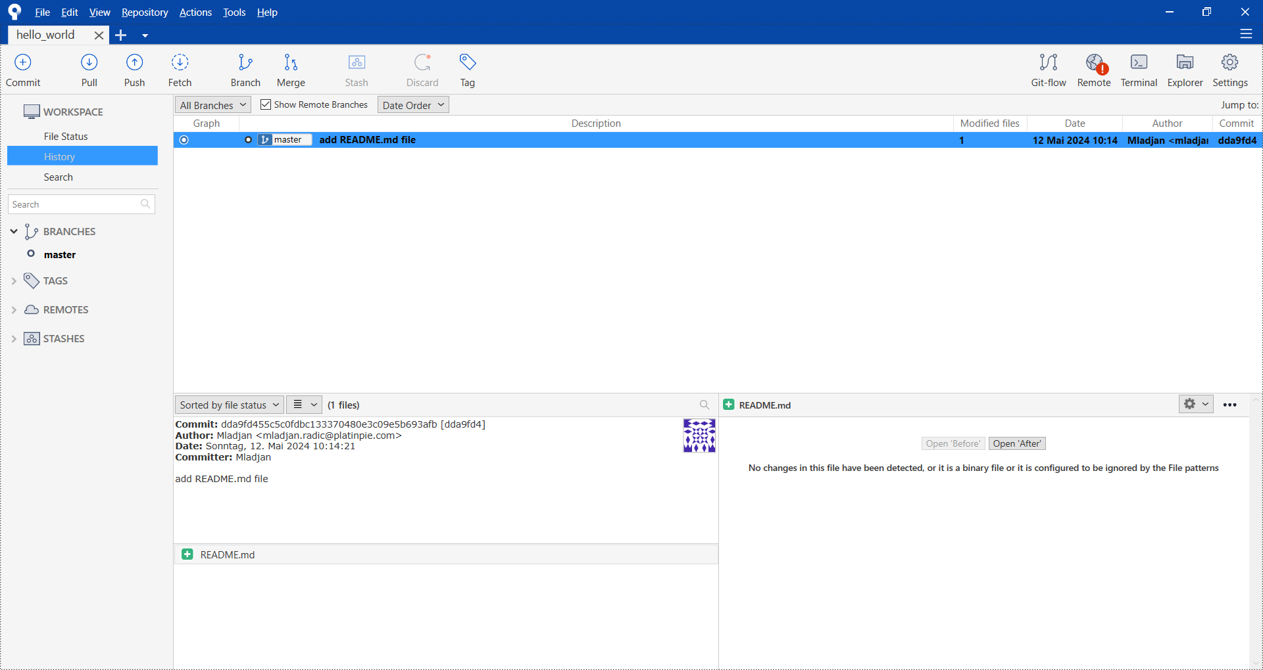
Make your first (local) commit
Congratulations! You made your first commit
Sourcetree will now change to „History“ and it will show you your first commit with your commit message
A new Branch called master will be created
Notes:
10

