Slide 1

PlatinPie
GIT Training
Exercise 03
Notes:
1

Slide 2
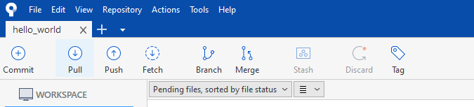
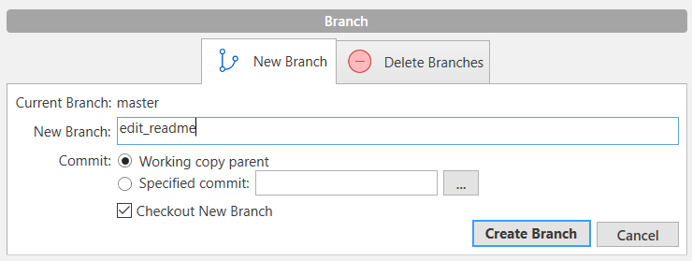
Make your first Branch
Click on Branch
Enter a meaningful name for the branch
Select „Create Branch“
Helpful! It does not only create the branch but also switch from master to the new branch
Notes:
2

Slide 3
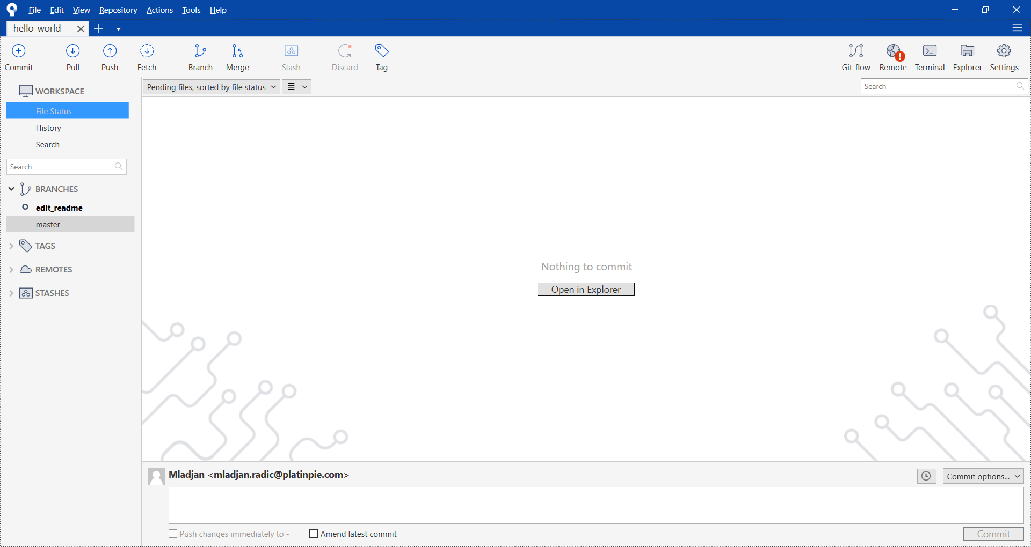
Make your first branch
Congratulations! You made your first Branch!
Sourcetree will now show the new Branch
Notes:
3

Slide 4
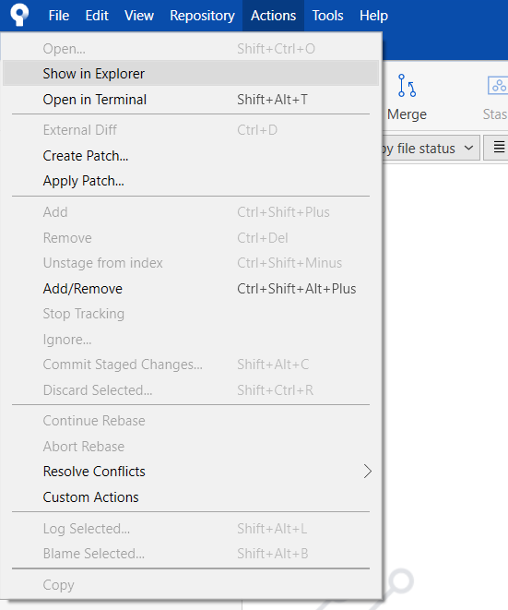
Make your first (local) commit
Open now the Repository in your File Explorer, e.g. via
Notes:
4

Slide 5
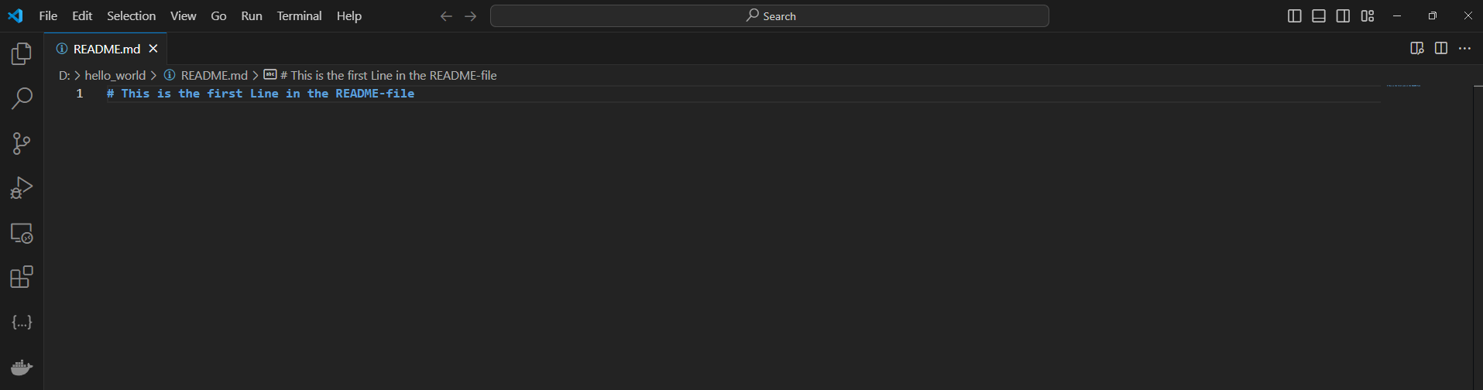
Make your first (local) commit
Open the README.md file and edit the file with the editor of your choice (e.g. Notepad++, VS Code, etc.)
Write something in the file.
You can be as creative as you want
Notes:
5

Slide 6
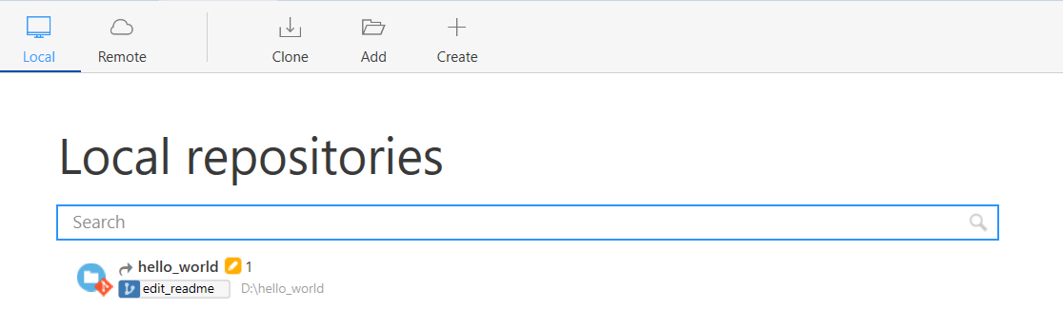
Make your first (local) commit
Sourcetree will show, that something has changed:
Notes:
6

Slide 7
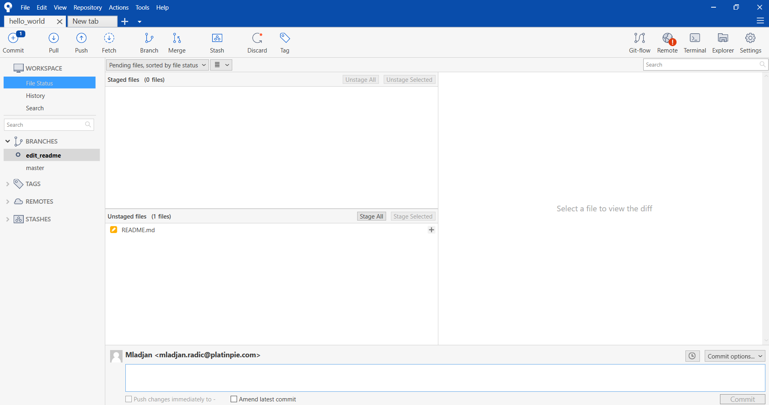
Make your first (local) commit
And also show, that there are unstaged files
Click on README.md
Notes:
7

Slide 8
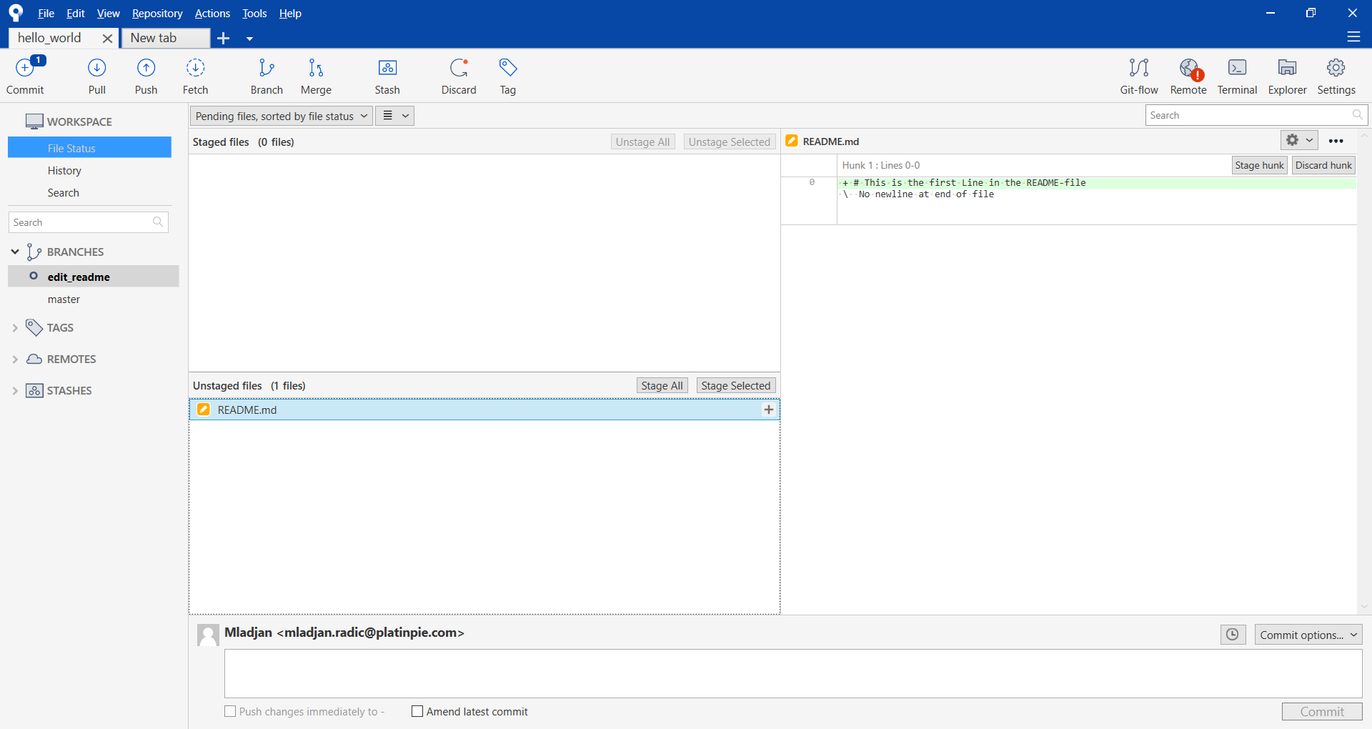
Make your first (local) commit
You will see the changes made in the file
Notes:
8

Slide 9
Make your first (local) commit
You will see the changes made in the file
Select „Stage Selected“
Notes:
9

Slide 10
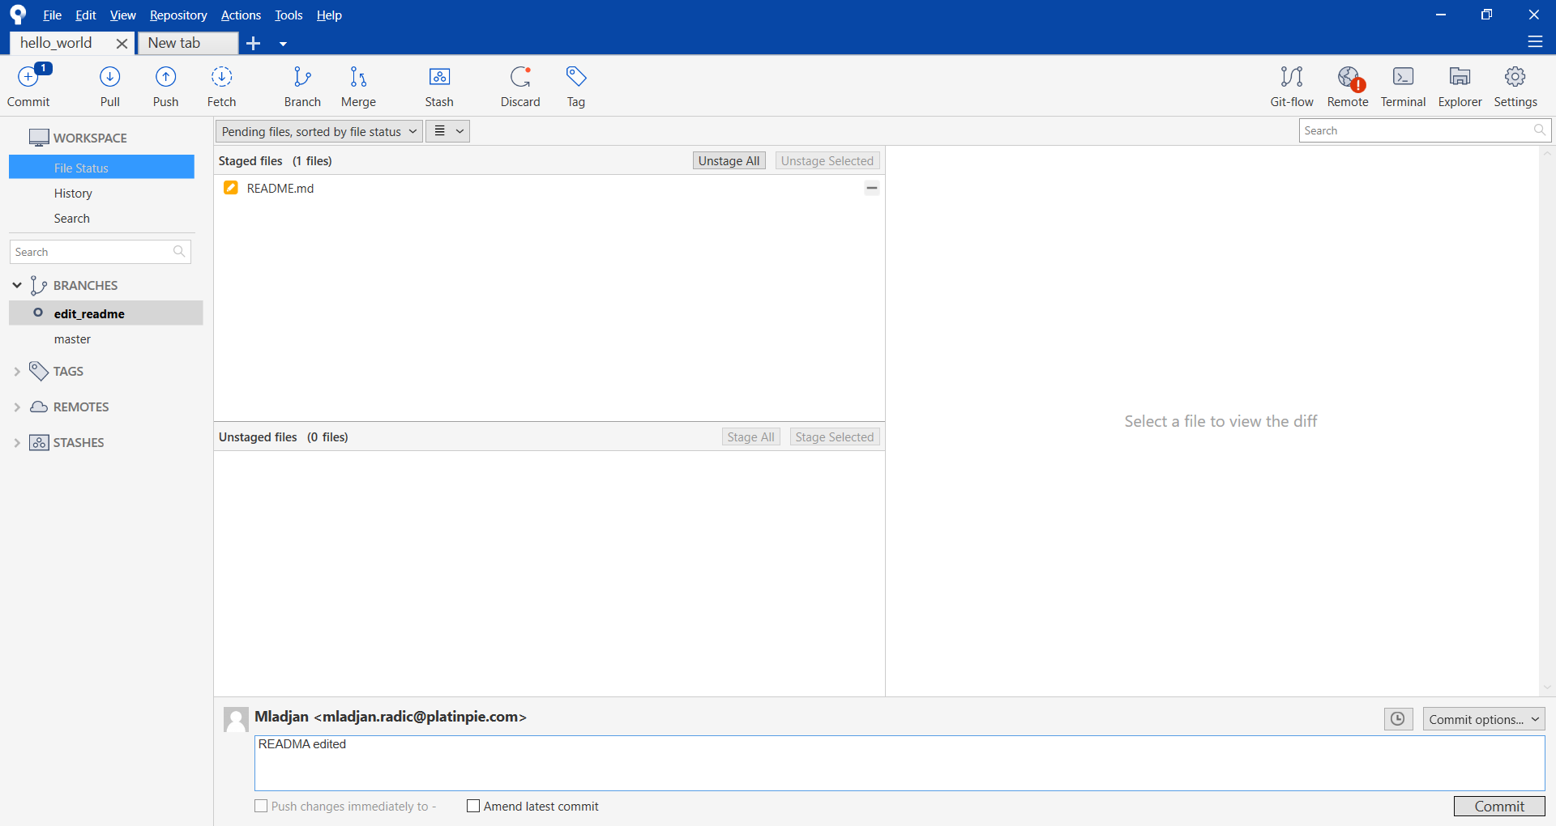
Make your first (local) commit
Edit a meaningful commit message and Select „Commit“
Notes:
10

Slide 11
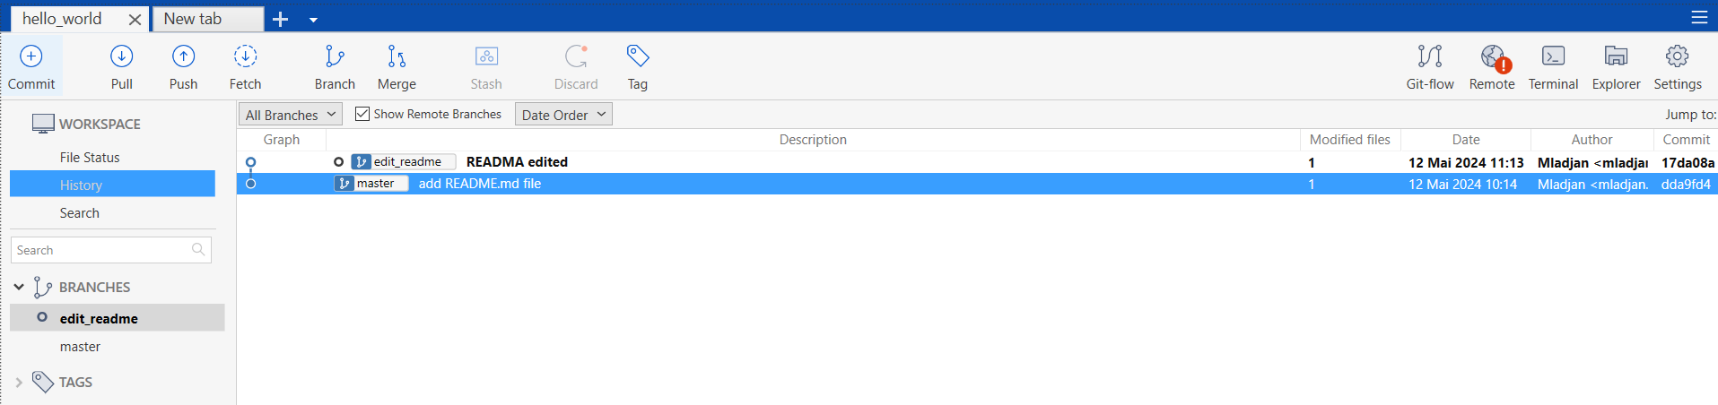
Make your first (local) commit
In the history, you will now receive a new commit with your commit message on your created branch
Your commit (message)
Your branch
Congratulation! You made your first (local) branch and your first commit on the new branch!
Notes:
11

