Slide 1

PlatinPie
GIT Training
Exercise 04
Notes:
1

Slide 2
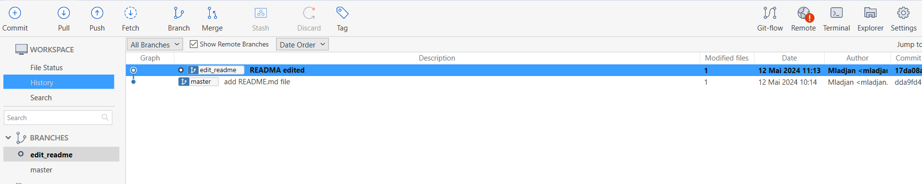

Make your first (local) Merge
We have now two branches, on commit each
Notes:
2

Slide 3
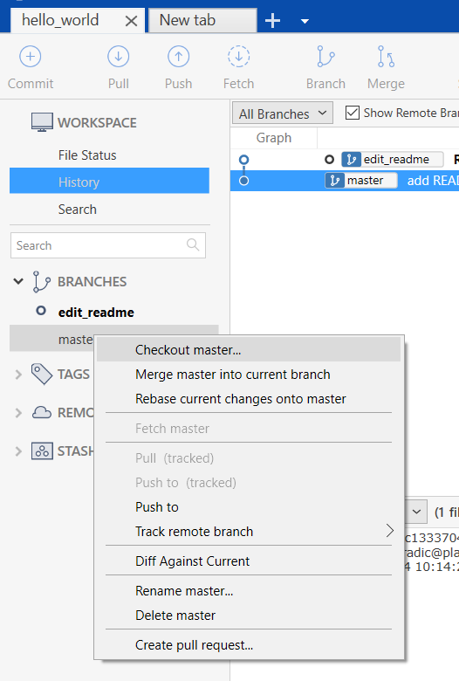
Make your first (local) Merge
Goal: We will merge the commit made on the „edit_readme“ branch back to the master branch First: checkout the master branch by right click on the master branch and then select „Checkout master“
Notes:
3

Slide 4
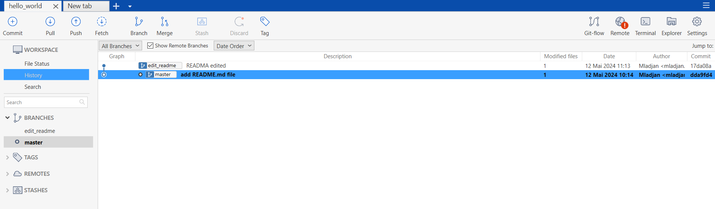
Make your first (local) Merge
Select „Merge“
Notes:
4

Slide 5
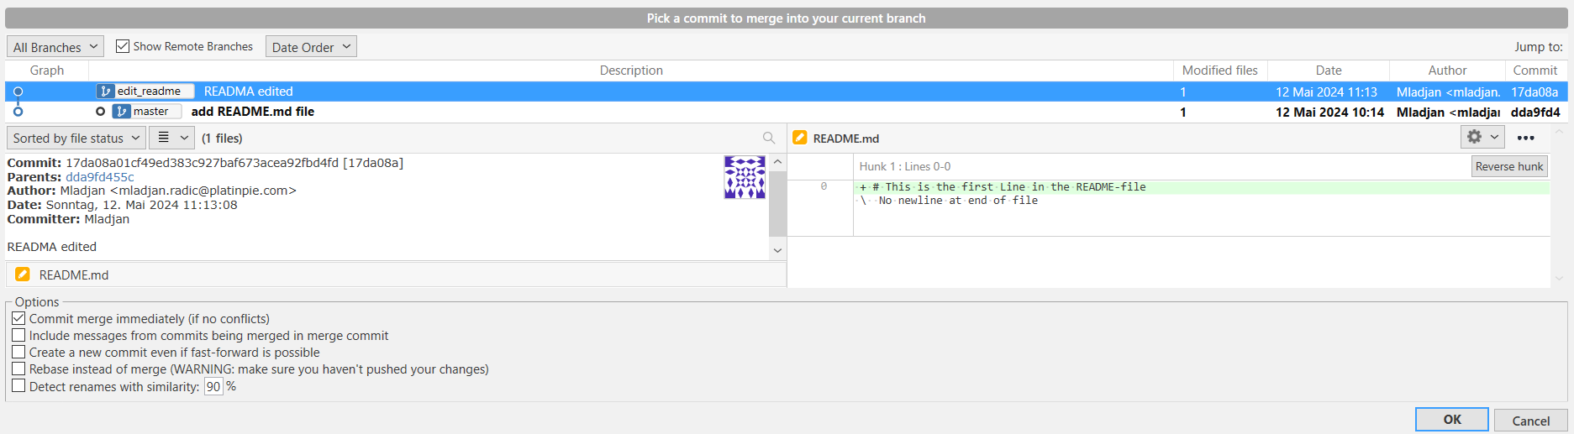
Make your first (local) Merge
A new window will appear and select the commit you want to merge back to master, then click „OK“
Notes:
5

Slide 6
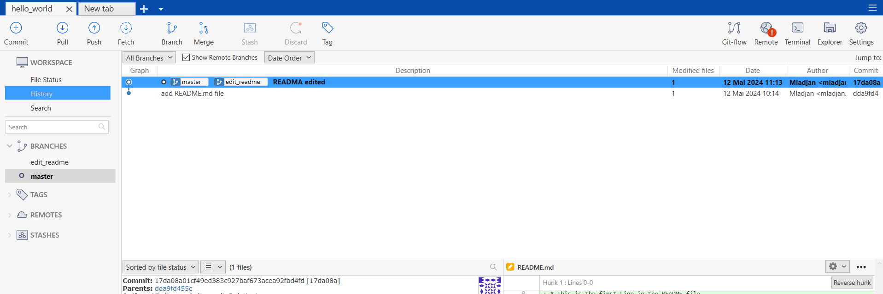
Make your first (local) Merge
Congratulation! You have done your first Merge!
Notes:
6

Slide 7
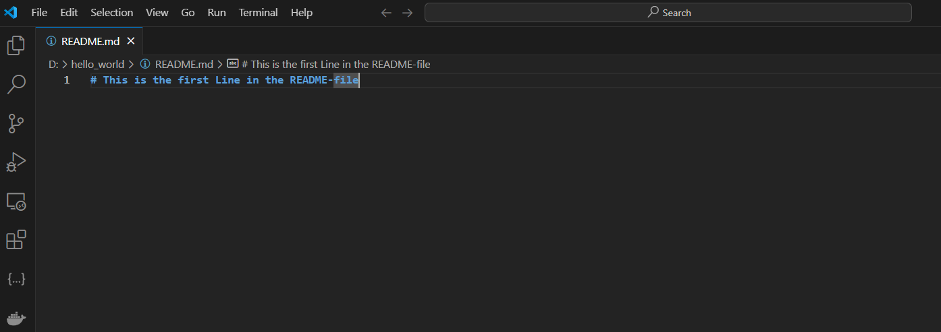
Make your first (local) Merge
Now, you can open your repository folder and the README.md file is now edited on your master branch
Notes:
7

