Slide 1

PlatinPie
GIT Training
Exercise 05
Notes:
1

Slide 2
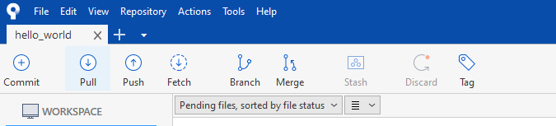
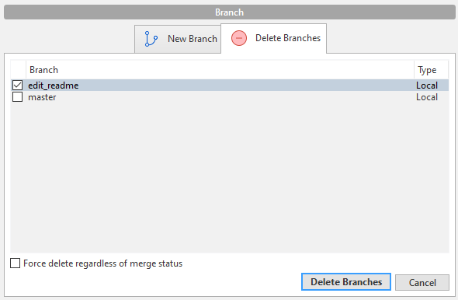
Delete (local) Branch
Click on Branch
Select the Tab „Delete Branches“
Select a Branch to Delete
Select „Delete Branches“
Notes:
2

Slide 3
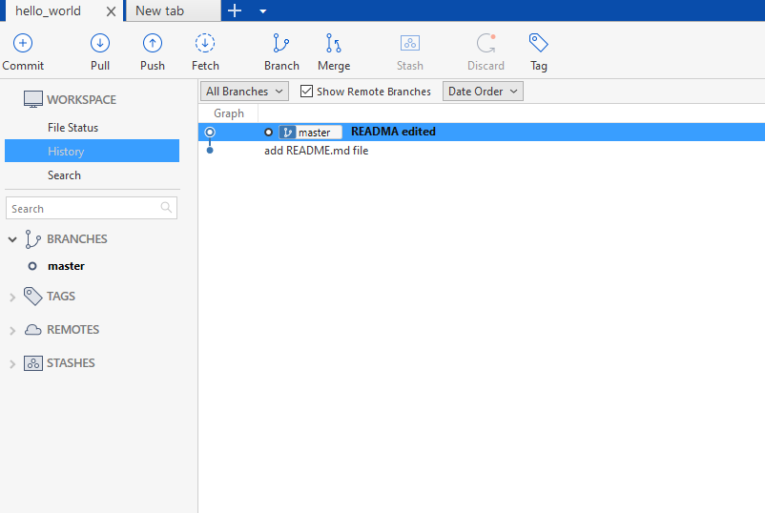
Delete (local) Branch
The selected Branch will now be deleted
The merge and the commit from Exercise 04 will persist
Notes:
3

