Slide 1

PlatinPie
GIT Training
Exercise 06
Notes:
1

Slide 2
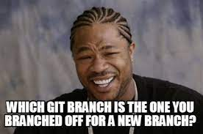

Now it is your turn to play along
Create a a branch b1
Checkout the branch
Create a new text-file with some content
Stage → Commit
Create a branch b2 branched from the new branch b1 (not from the master)
Checkout → modify → stage → commit
Merge the branch b2 back to b1 and afterwards b1 to master
Delete branch b1 and b2 after both is merged back
Make it your playground!
Notes:
2

