Slide 1
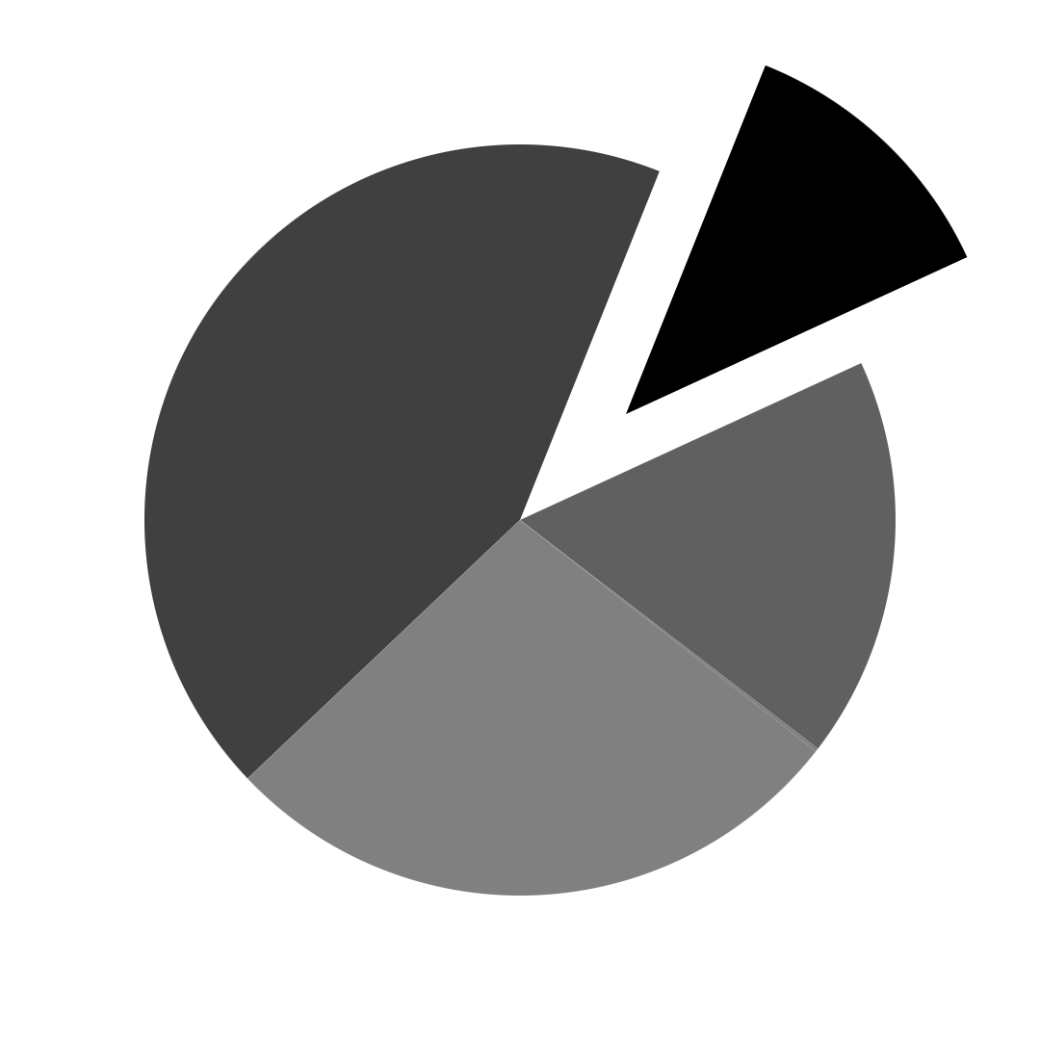
PlatinPie
GIT Training
Git Actions
Notes:
1

Slide 2
The Basics
When a particular Event in a Repository happens → Run a Sequence of (predefined) tasks
Examples of events:
A new commit is pushed (to a certain branch)
A pull request is made
A new release is made
A certain time (like 08:00 am) is reached
...
Examples of tasks:
Run unittests and/or regression tests
Check code coverage
Build the manual or executable
Check code formatting
Performance check
…
Dokumentation: https://docs.github.com/en/actions
Notes:
2

Slide 3
Why?
Automation
Save time
Saving resources
Simplify release process
Notes:
3

Slide 4
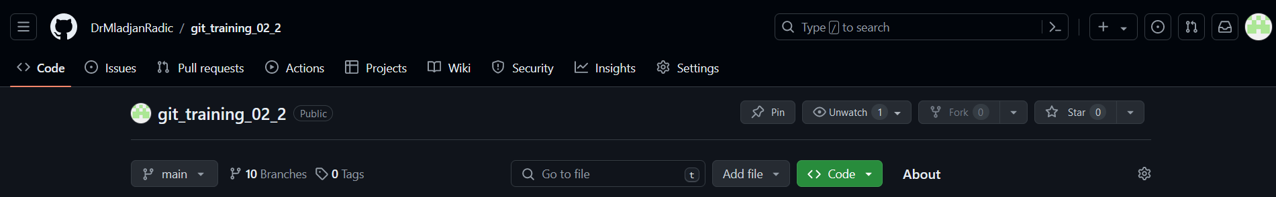
How?
It is „just“ a YAML-file stored in „.github/workflows/“
GitHub tracks and runs workflows
Thr results are shown in „Actions“ in GitHub
Notes:
4

Slide 5
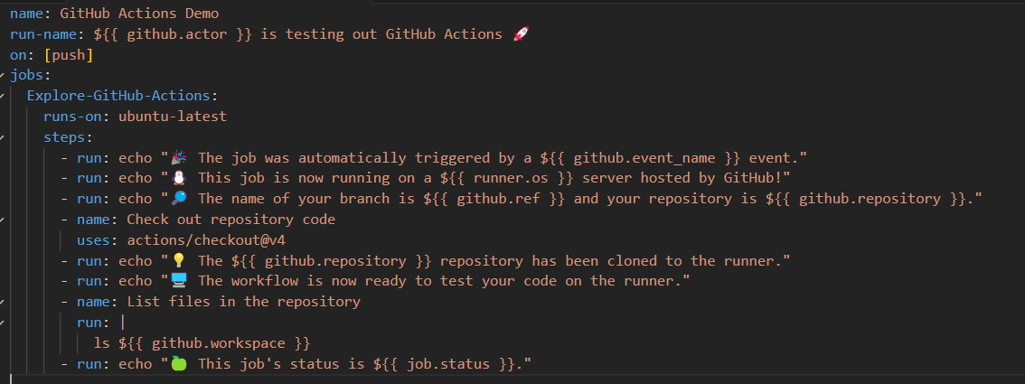
How does a workflow YAML-file look?
What event triggers the workflow?
Where does it run?
What?
Notes:
5

Slide 6
The Components
Workflows
Automated procedure triggered by an event defined in .yml-file in .github/workflows
Events
Specify what triggers the workflow: can be push, pull request, etc.
Jobs
Set of steps, executed on the same runner
Workflow with multiple jobs: run in parallel (by default) – can be configured to be run sequentially
Steps
Individual task, that can run commands in a job
Can bei an action or a shell command
Executed on the same runner allows data sharing
Actions
Standalone commands → Combined into steps → creates a job
Beside your own actions you can use actions created by the GitHub Community
Runners
Are Servers
You can specify or host your own „runners“
Listens, runs one job, reports the progress, logs and results back to GitHub
Notes:
6

