Slide 1

PlatinPie
GIT Training
Artifactory
Notes:
1

Slide 2





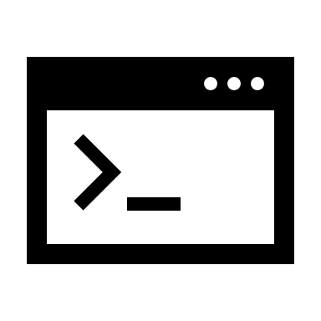

What is an artifact
Compiled code and/or the resources used to compile the code.
Examples:
- java: .jar, .war, …
- .NET: .dll
- docker: .tar
Dependencies
Artifact
Source Code
Build Tools / Compilation
Binary Code
Notes:
2

Slide 3
Source Code vs Binary
Source / Text | Binaries
Text | Blob
Differentiable | Not Differentiable
Versioned by Content | Versioned by name (not content!)
Stored by Override | Not stored by Override
Notes:
3

Slide 4
Artifact Repository
Centralized Storage, versionizing and managing multiple artifacts
Helps downloading and managing dependencies
Stores code, which is ready to deploy
Should provide Stability and reliability
Should provide security, access control and traceability
Manage binaries across different environments
Proxy for remote repositories
version 1
version 2
version 3
version 1
version 2
Notes:
5

Slide 5
Repository Types
Local
Physical, locally-managed
You deploy artifacts on this local repository
You consume artifacts produced by other teams
Remote
Proxy of another network repository
Caches foreign repository
Virtual
Collection of repositories under a URL
Simplification of client configuration
"Best Practice"
Notes:
5

Slide 6
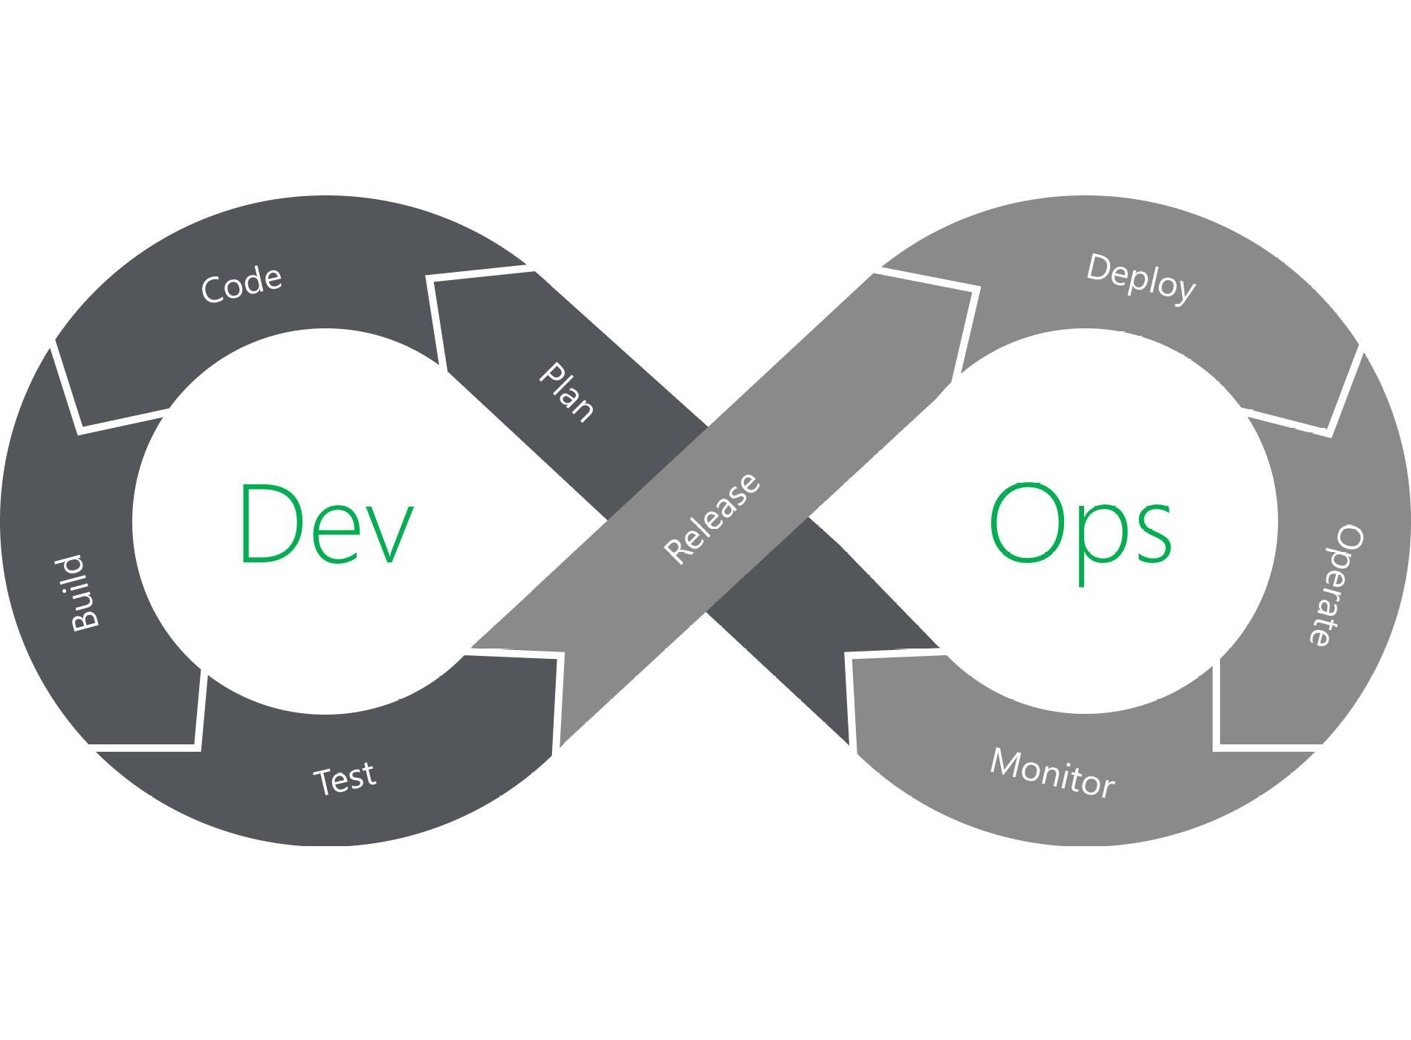
The "Dev-Ops-Vision"
Dev
Ops
Notes:
5

