Slide 1

PlatinPie
Git Training
Sourcetree

Slide 2
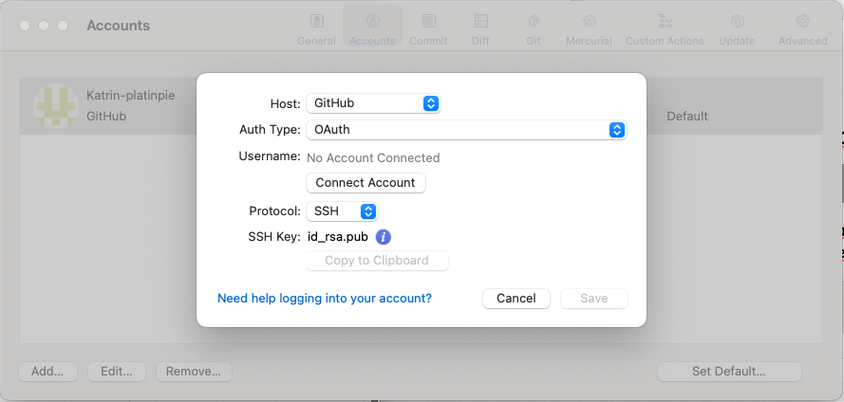

Create a remote account
Add new account
chose GitHub as Host
select OAuth as Auth Type
now click on Connect Account
A browser window will open where you have to sign in to your existing account on github. Then permit sourcetree to let it connect to github.

