Slide 1

PlatinPie
GIT Training
Git Aliases
Notes:
<Foliennummer>

Slide 2
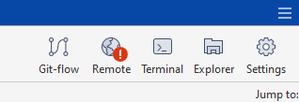
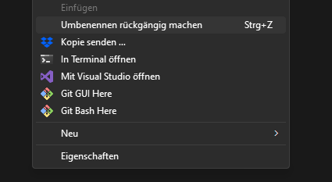
Git Aliases
Not available in sourcetree
Helpful to automate commands and shorten your „typing time“
Note recommended: If you get used to your shortcuts and you then change the system (or get a new PC or you have to work remotely) you have to reconfigure each of your aliases and remember them!
But if you want to configure aliases, open up a terminal via sourcetree:
Or right click in any folder:
Notes:
<Foliennummer>

Slide 3
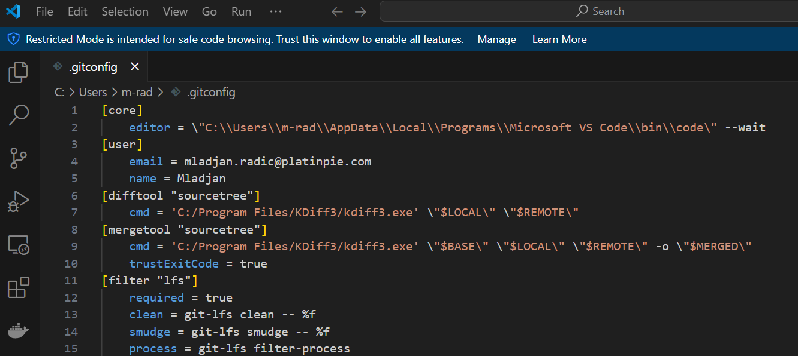
Git Aliases
To open the .gitconfig, type in:
And a text file will open, which looks like this:
Notes:
<Foliennummer>

Slide 4


Git Aliases
Adding our own commands or „aliases“, we simply add:
Which will create an alias for checkout.
Now instead of typing „git checkout main“, you can simply type: „git co main“ in your shell
Hint: Instead of editing the .gitconfig file, you may also type directly in the shell to construct an alias via:
$git config –global alias.co checkout
Some commonly used aliases are described here: https://git-scm.com/book/en/v2/Git-Basics-Git-Aliases
Notes:
<Foliennummer>

Slide 5
Git Aliases
Execute second command
Wait until the second command is finished
You can also define multiple commands, like:
Instead of typing:
$git stash
$git rebase origin/main
$git stash pop
You can simply type
$git up
And the above three commands will be fired up.
Execute third command
Wait until the first command is finished
Alias Name
„ignore the first git“ but execute git stash
Notes:
<Foliennummer>

Slide 6

Git Aliases
Aliases with multiple commands and parameters:
Now you can call the alias named test via „$git test feature/branch1“, which executes the following commands:
$echo checking out feature/branch1
$git checkout feature/branch1
$echo feature/branch1 is checked out
Hint: Of course you can pass many parameters, which you can access via $1, $2, $3, … or if you need all of them: $*
Notes:
<Foliennummer>

