Slide 1
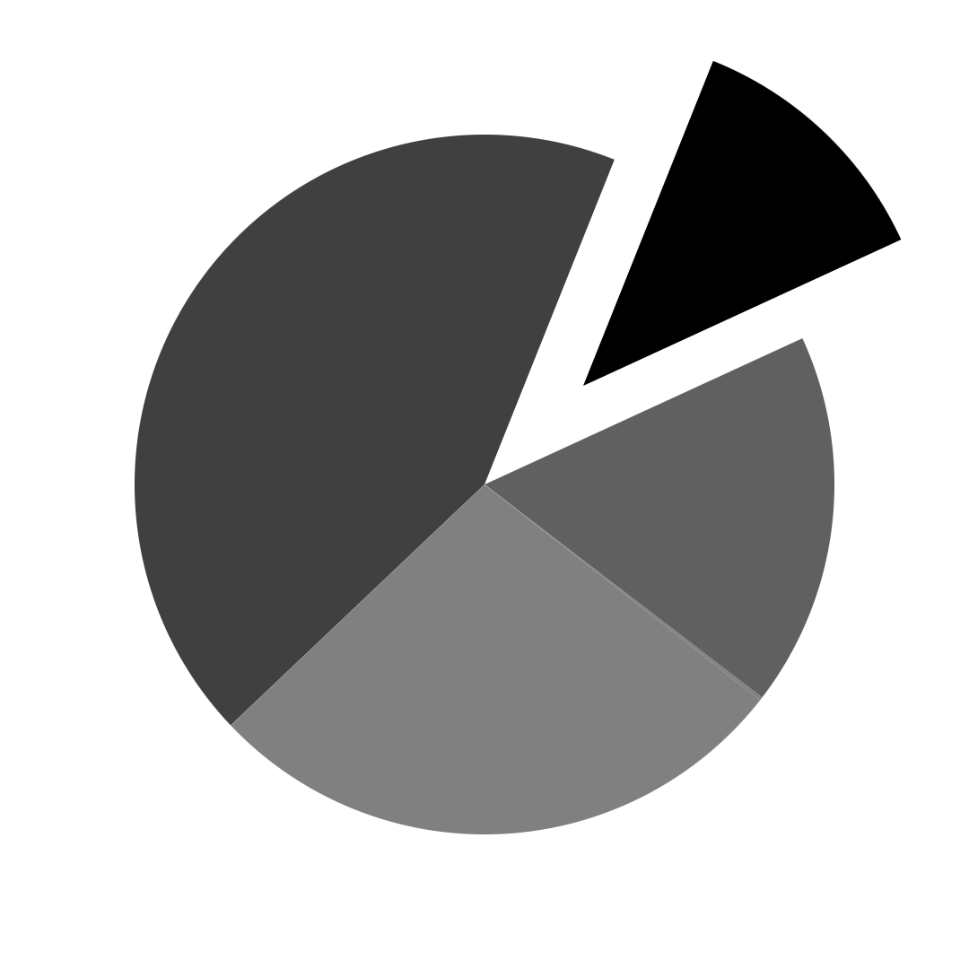
PlatinPie
GIT Training
Git Blame
Notes:
<Foliennummer>

Slide 2
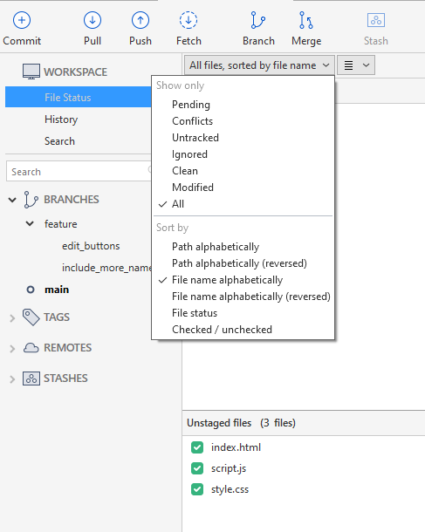
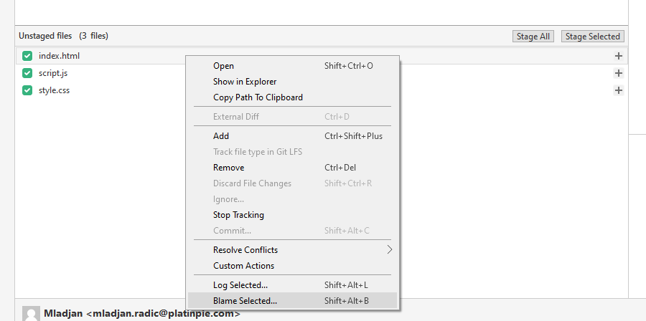
Git Blame
git-blame - Show what revision and author last modified each line of a file
Right click on any file and select „Blame Selected“
Notes:
<Foliennummer>

Slide 3
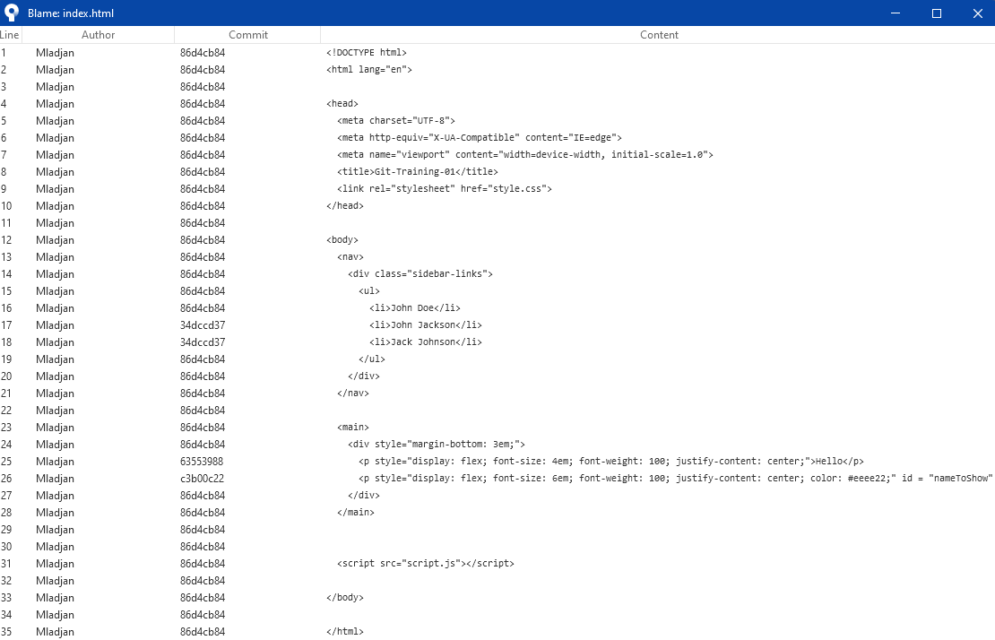
A window pops up, where you can see, which line (first column) was modified by which author (second column) and which was the last commit (third column)
Notes:
<Foliennummer>

Slide 4
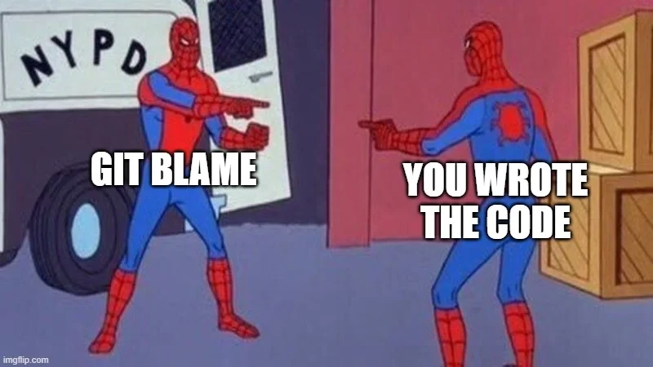
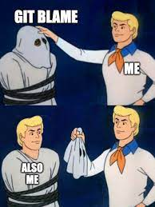
Important: Although the function is called „blame“ to actually not do, what the command says. Git Blame is used to understand the history of the code, to know how many developers worked on it and how old some code is and NOT TO BLAME or to „find the person responsible for“! Please keep that in mind.
More often than not, it happens suprisingly often, that people discover, that it is their own code „to blame“ ;-)
Notes:
<Foliennummer>

