Slide 1
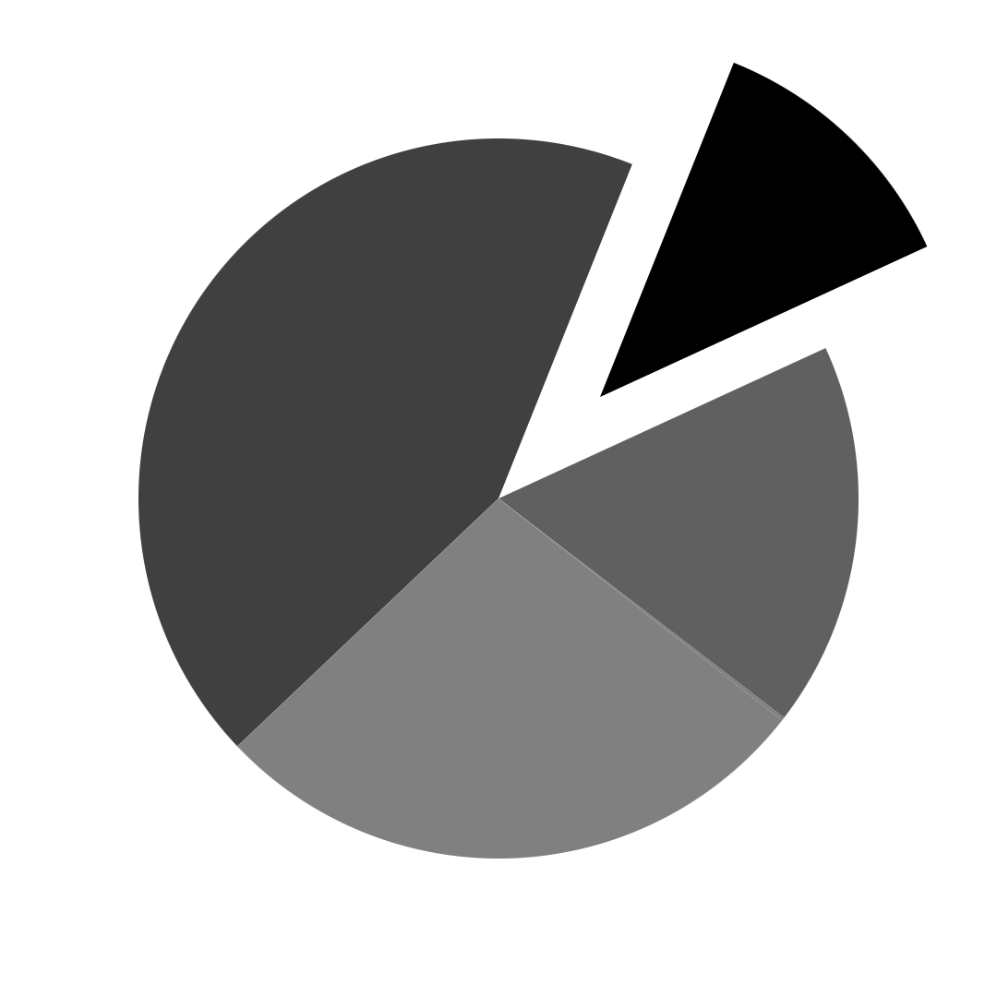
PlatinPie
GIT Training – Round 3
Exercise 04 – Merge Conflicts
Notes:
1

Slide 2
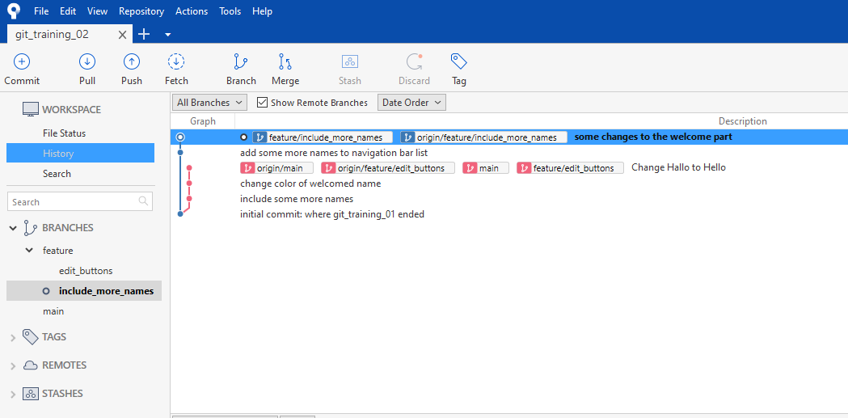
Merge Conflicts and How to Solve Them
Clone (or fork) the repository: https://github.com/DrMladjanRadic/git_training_02.git
You will receive:
Notes:
2

Slide 3
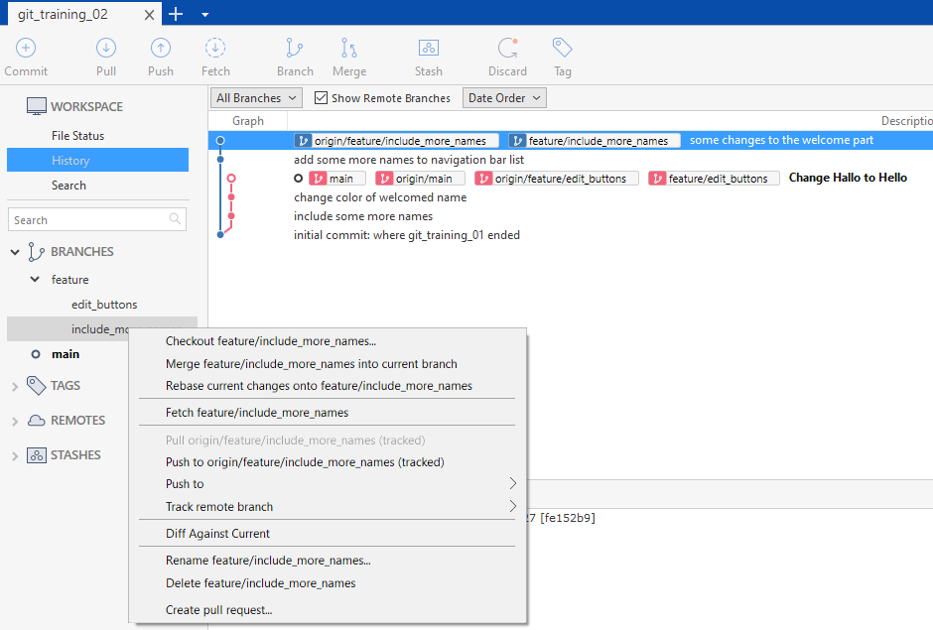
Merge Conflicts and How to Solve Them
Checkout the branch feature/include_more_names
We assume, that the current branch is „finished“ and it should now be merged back to the main branch
Notes:
3

Slide 4
Merge Conflicts and How to Solve Them
We see, that the main branch has more commits, than the current branch we are currently at
We have now 3 ways to deal with the current situation: 1) We merge directly back to main and solve the merge conflicts 2) We pull the main branch first in our current branch, solve the merge conflicts and merge then back main 3) We rebase on the main branch, solve the merge conflicts and then merge back to main
Notes:
4

Slide 5
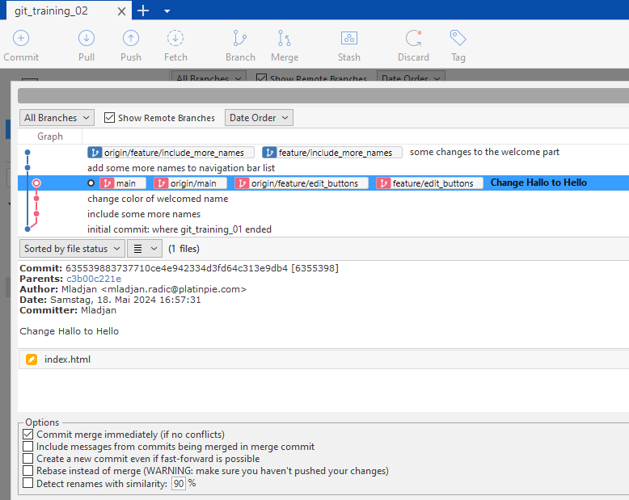
1) Merge Back to main
Checkout main
Merge the branch feature/include_more_names to main
Notes:
5

Slide 6
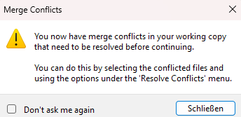
You will receive:
Close the dialog → we need to solve the merge conflicts
Notes:
6

Slide 7
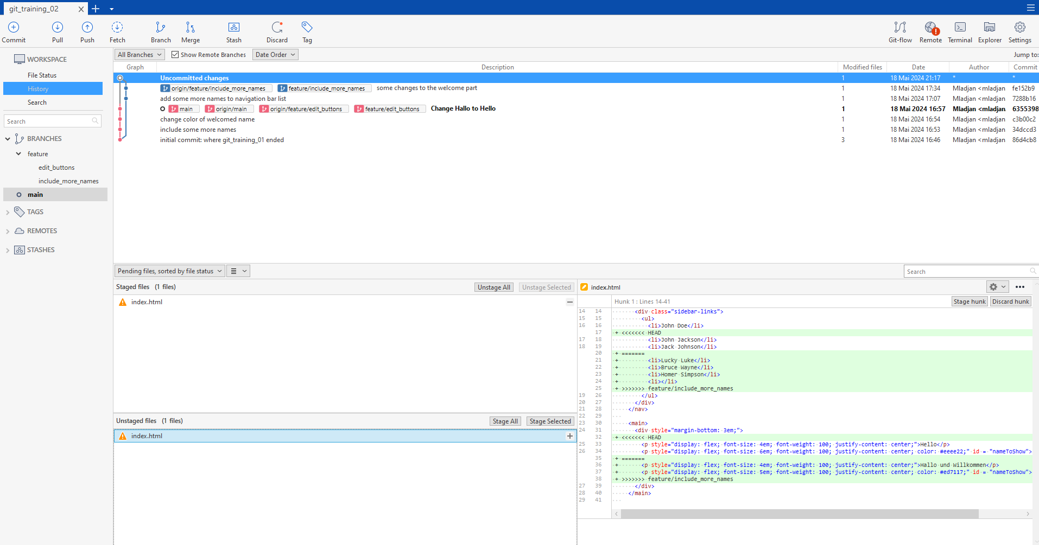
Notes:
7

Slide 8

Uncommitted changes indicating, that we have to resolve first all merge conflicts and the to stage them and commit them
Notes:
8

Slide 9
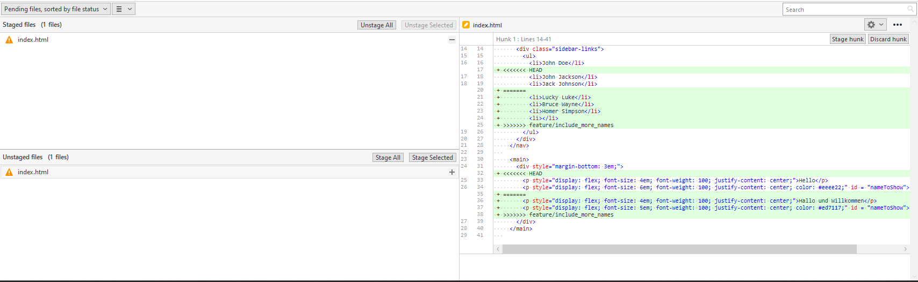
Click on any unstaged file (in our case there is only one)
You will see on the right hand side all the merge conflicts in the file
Notes:
9

Slide 10
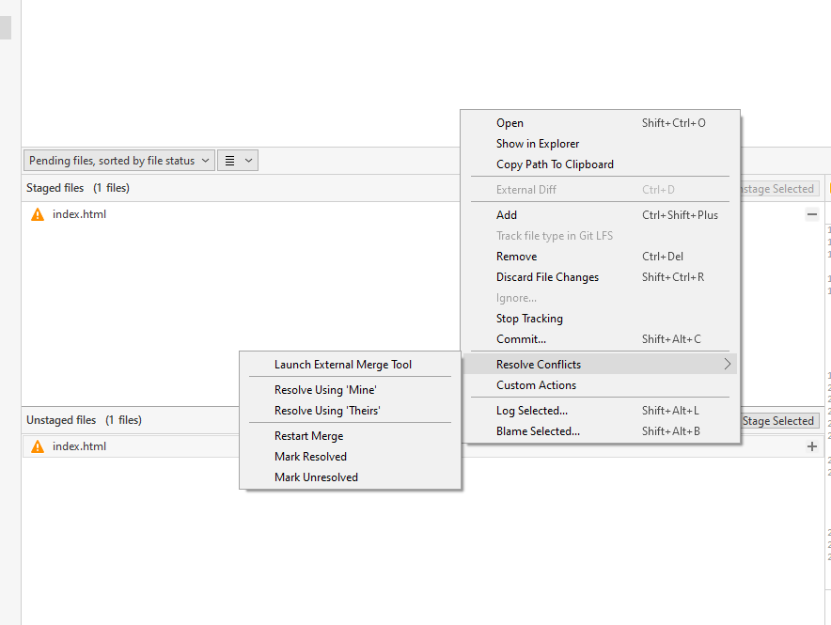
Right click on the unstaged file and select Resolve Conflicts
Select „Launch External Merge Tool“
You may also choose a „strategy“. Danger! (Not recommended!)
Notes:
10

Slide 11
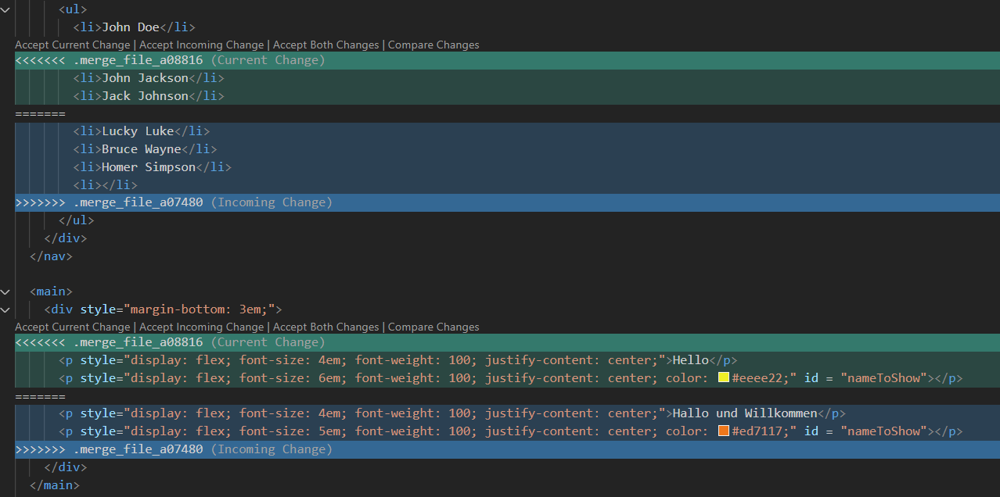
««««« indicates the changes of branch we are currently on (i.e.: main, since main is checked out!)
======= separates the changes
»»»»»»» indicates the changes of branch we are trying to merge (i.e.: feature/include_more_names)
Notes:
11

Slide 12
Since we want to keep all names, select “Accept Both Changes“
Notes:
12

Slide 13
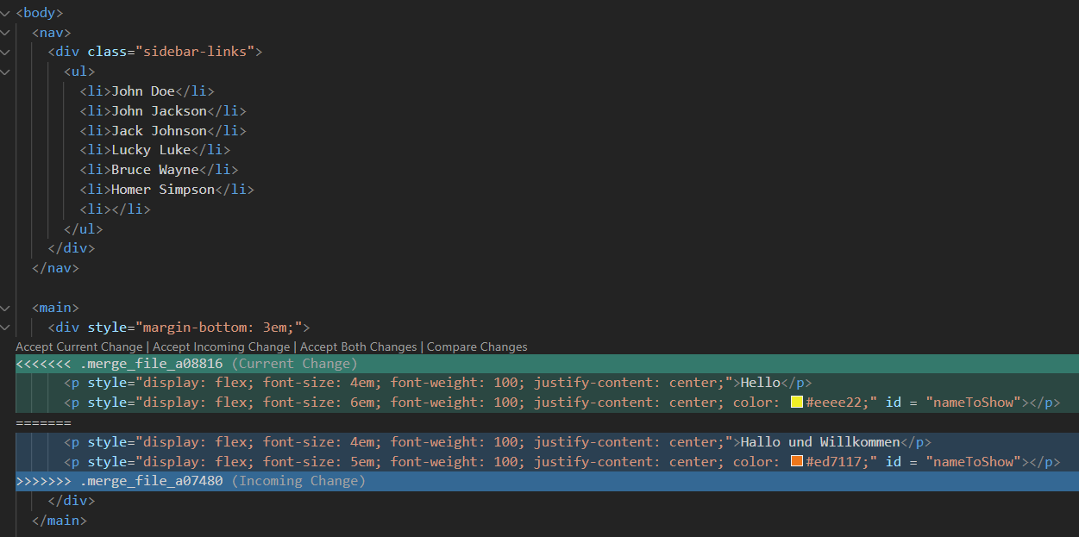
The first conflict is solved!
One more to go!
Notes:
13

Slide 14
Since we want to have everything in english, it makes sense to accept the „Current Change“
Notes:
14

Slide 15
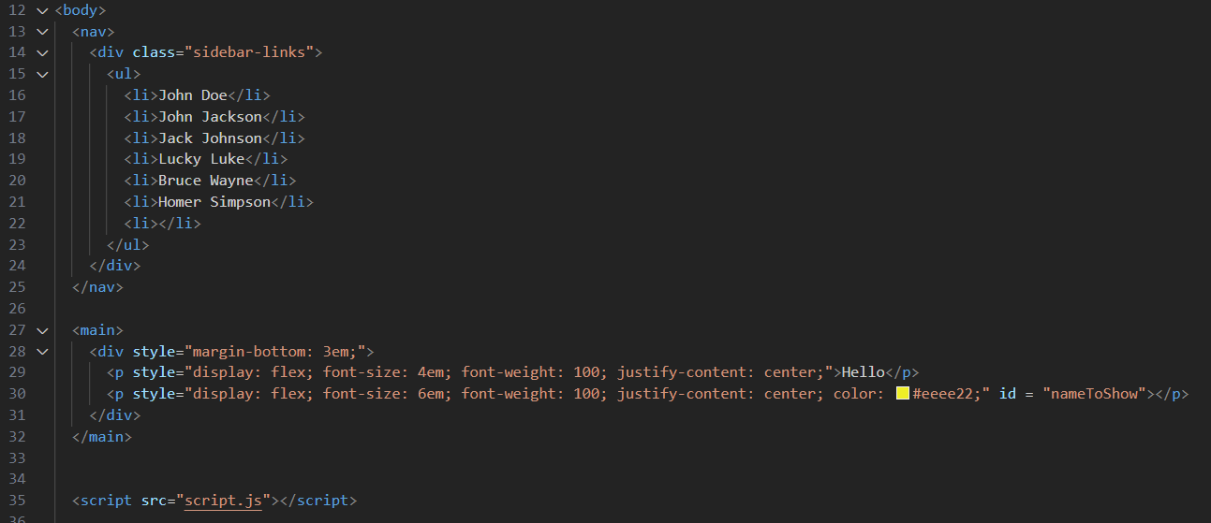
Second Merge Conflict is Solved!
Notes:
15

Slide 16
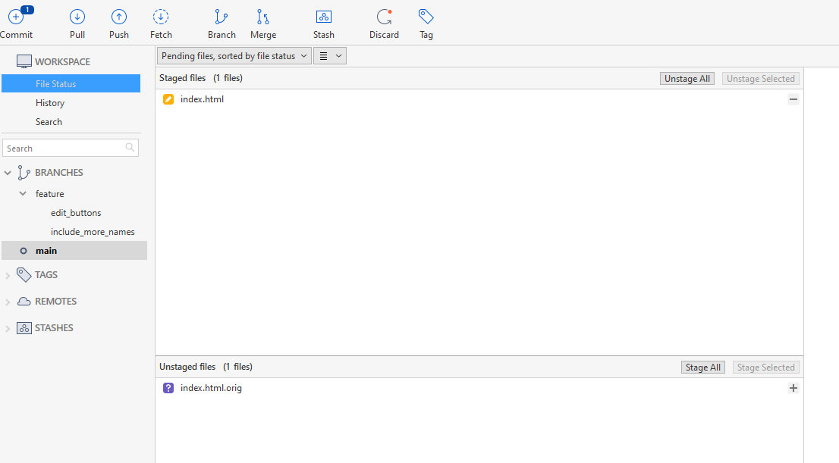
Close your Merge Tool after solving all of your merge conflicts
The file with the solved merge conflicts is then already staged
Commit it
Can be deleted (right click → delete)
Notes:
16

Slide 17
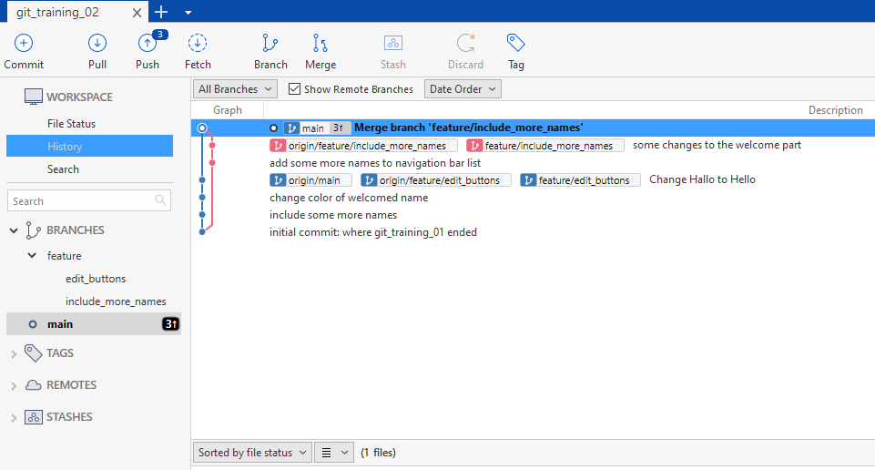
Congratulations! You have completed the Merge!
(Do not push!)
Notes:
17

Slide 18
Important Remarks
Solving Merge Conflicts require knowledge, which changes has to be accepted (both, current or incoming)
Sometimes, this is not clear, especially when working in large groups
Helpful:
Establish understanding / exchange between developers
Communication
Detailed and precise description of tasks
Keep in mind, that sometimes error may happen, i.e. the wrong change is chosen (current instead of incoming or vice versa or similar mistakes). It is therefor helpful to make regular code reviews!
Notes:
18

Slide 19
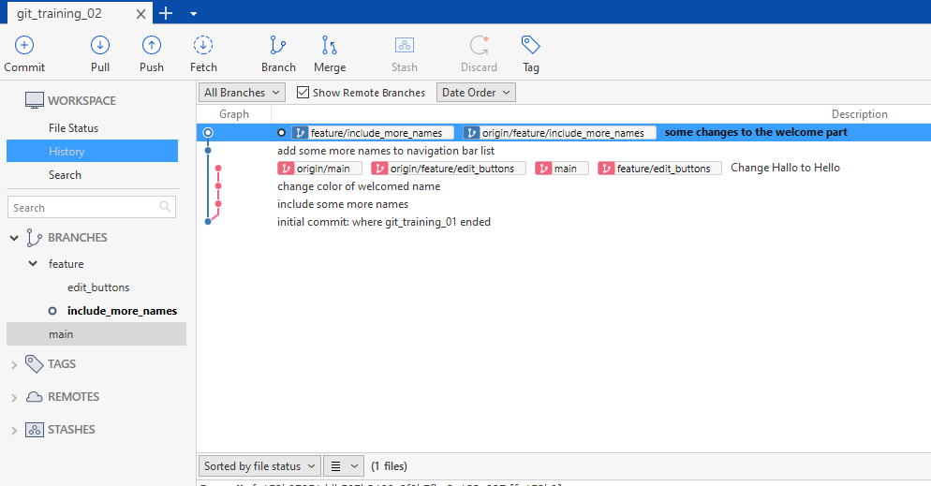
2) Pull main branch
Checkout the branch feature/include_more_names
Select Pull
Notes:
19

Slide 20
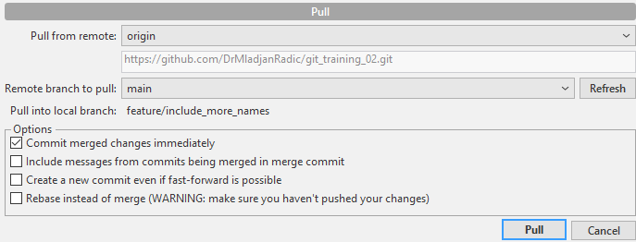
Checkout the branch feature/include_more_names
Select Pull
Select main
Notes:
20

Slide 21
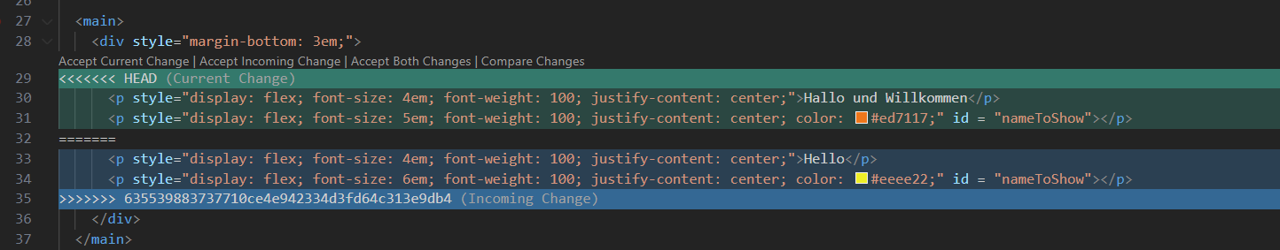
Solve again the merge conflicts
Keep in mind, that you have checked out feature/include_more_names and NOT main (as before!)
Notes:
21

Slide 22
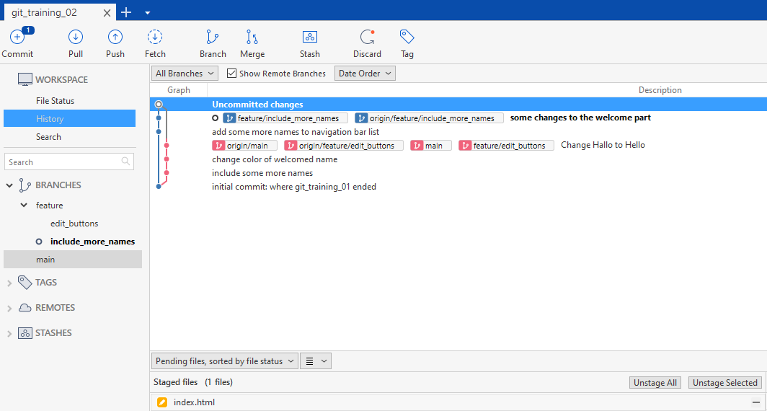
After solving all merge conflicts you receive:
And you can now commit
Notes:
22

Slide 23
Congratulations! You have now pulled the status from the main branch in yours!
You can now „safely“ merge your branch into the main branch without causing merge conflicts → try it out!
Notes:
23

Slide 24
3) Rebase to main branch
Similar to 2)
Again, checkout feature/include_more_names
Notes:
24

Slide 25
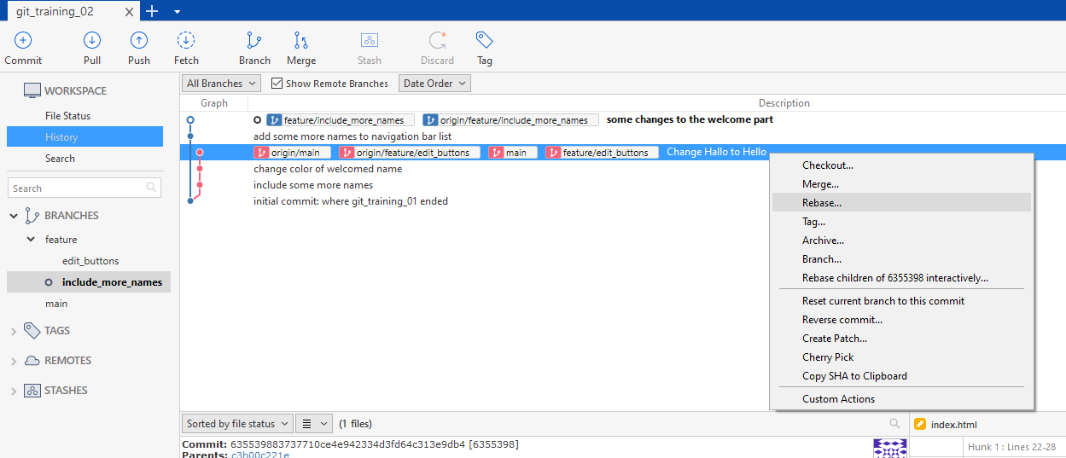
Right click on the main branch → Select Rebase
Notes:
25

Slide 26
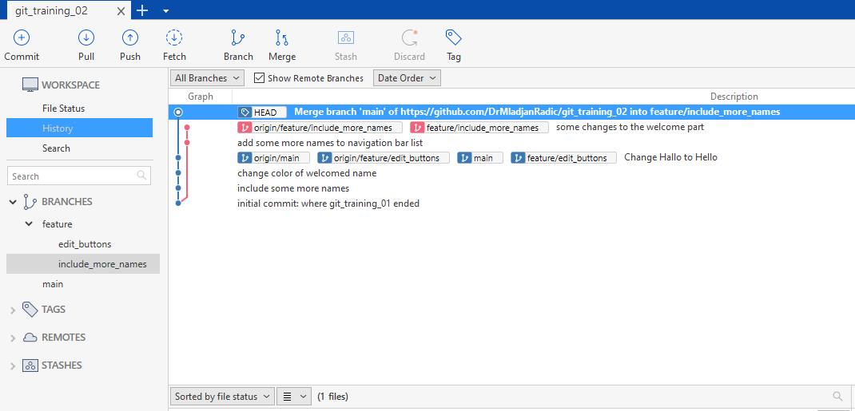
Solve all Merge Conflicts (as before!)
Commit (as before)
And you need to push (please only on forked repository, not a cloned one!!!)
Notes:
26

Slide 27
Congratulations! You have rebased your branch onto the main branch
You can now safely merge back to main → try it out!
Notes:
27

Slide 28
Now, we want to try it with another merge-tool: KDiff3.
We will only consider: We have checked out the main branch and try to merge the feature/include_more_names into the main-branch (not a rebase and not a pull from main to the feature/include_more_names-branch, since they are very similar!)
Notes:
28

Slide 29
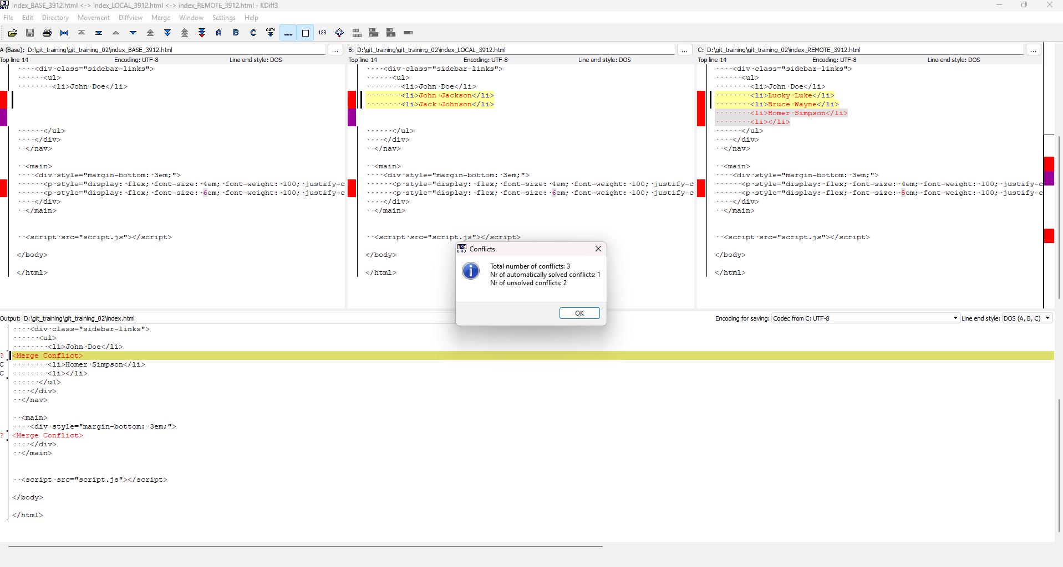
If you want to work with KDiff3 you will see this:
Notes:
29

Slide 30
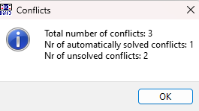
It will tell you how many conflicts awaits you
Press „OK“
Notes:
30

Slide 31
You get a window containing 4 versions of the same file:
Top left: “Base”. This is the original version of the file, the last shared version between what became later branch-A and branch-B.
Top Middle: “Local”. This is the target branch version of the file. It is called “Local”, because this is the currently selected branch (using the last git checkout command).
Top Right: “Remote”. This is the source branch version of the file. It is called “Remote”, as apposed to “Local”.
Bottom: “Output”. This is the merged version of the file. After successful completion of the merge, this will become the new version of the target branch. In this pane, you can edit the text, or you can right click on any merged part and select what version(s) of the original file you want to include in the output. In this case, I decide to include the changes done in both branch-A and branch-B.
Notes:
31

Slide 32
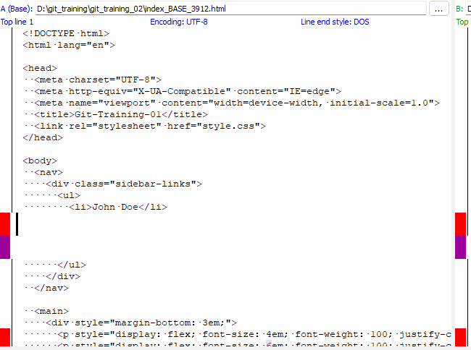
Top left: “Base”. This is the original version of the file, the last shared version between what became later branch-A and branch-B.
Notes:
32

Slide 33
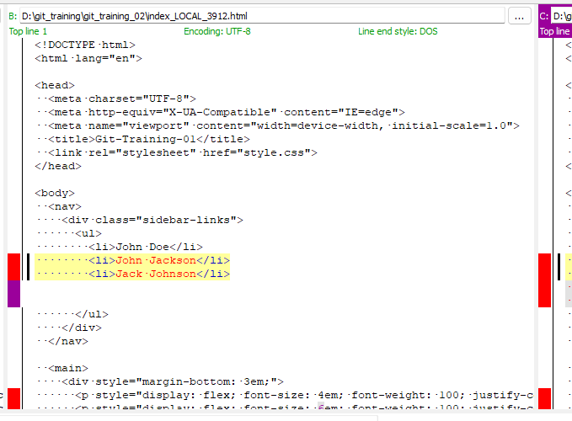
Top Middle: “Local”. This is the target branch version of the file. It is called “Local”, because this is the currently selected branch (using the last git checkout command).
Notes:
33

Slide 34
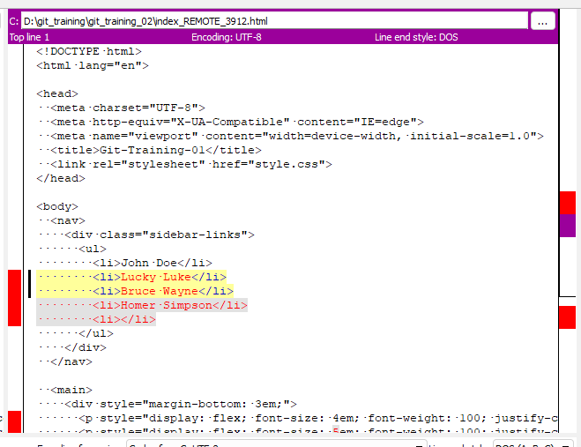
Top Right: “Remote”. This is the source branch version of the file. It is called “Remote”, as apposed to “Local”.
Notes:
34

Slide 35
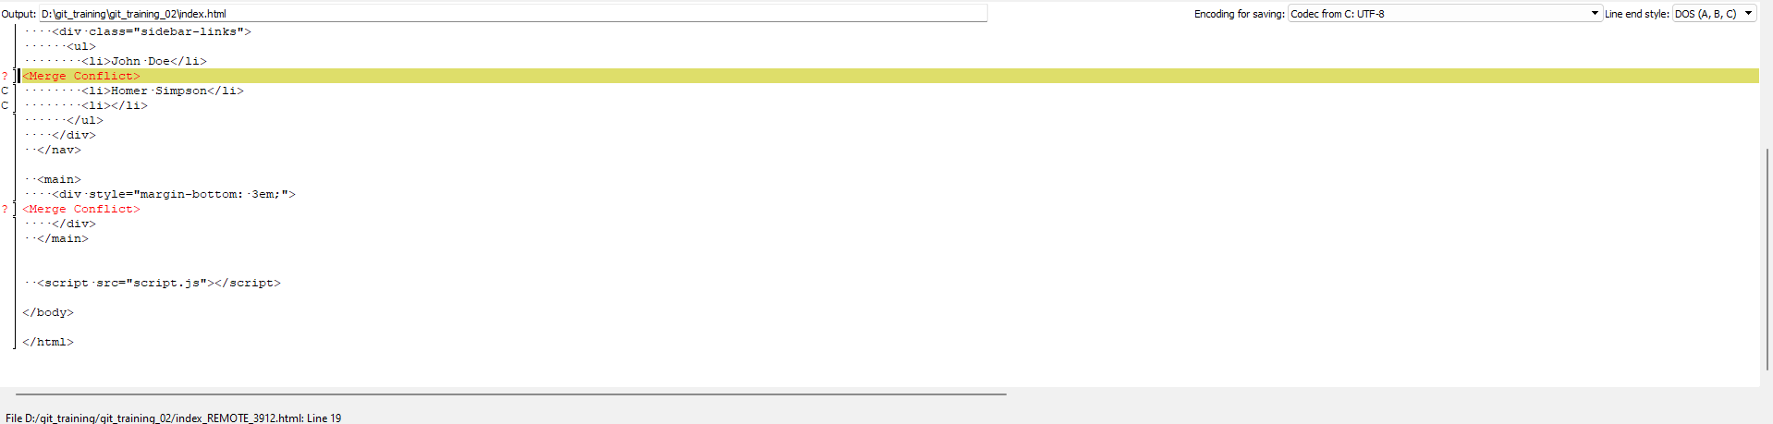
Bottom: “Output”. This is the merged version of the file. After successful completion of the merge, this will become the new version of the target branch. In this pane, you can edit the text, or you can right click on any merged part and select what version(s) of the original file you want to include in the output. In this case, I decide to include the changes done in both branch-A and branch-B.
Notes:
35

Slide 36
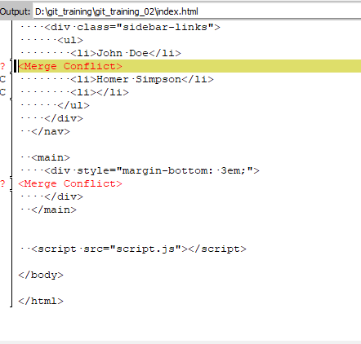
KDiff3 gives you more „overview“ but it needs a little bit practice to work with it.
You can now see in the output-window:
Notes:
36

Slide 37
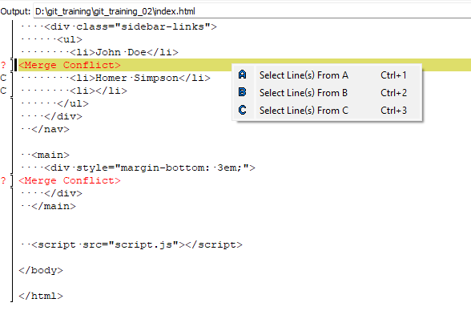
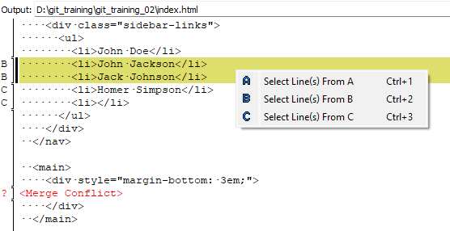
Right click on the merge conflict → you may now select if you want to select the Line(s) From A, B or C. Since we want to keep all names from the list we have to select „Select Line(s) From B“ Right click again → „Select Line(s) From C“
Notes:
37

Slide 38
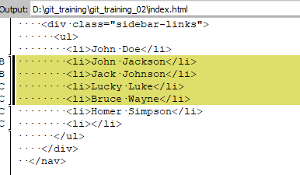
Now the output contains the lines from B and C:
Notes:
38

Slide 39
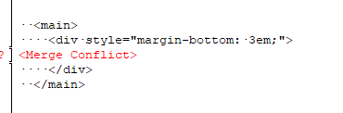
One more merge-conflict to go:
Notes:
39

Slide 40
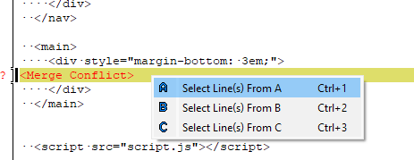
Since we want to have the „Hello“ and to take the changes, which are currently on the main-branch, we pick „Select Line(s) From B“
Notes:
40

Slide 41
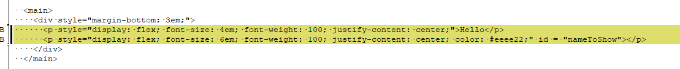
We receive:
Notes:
41

Slide 42
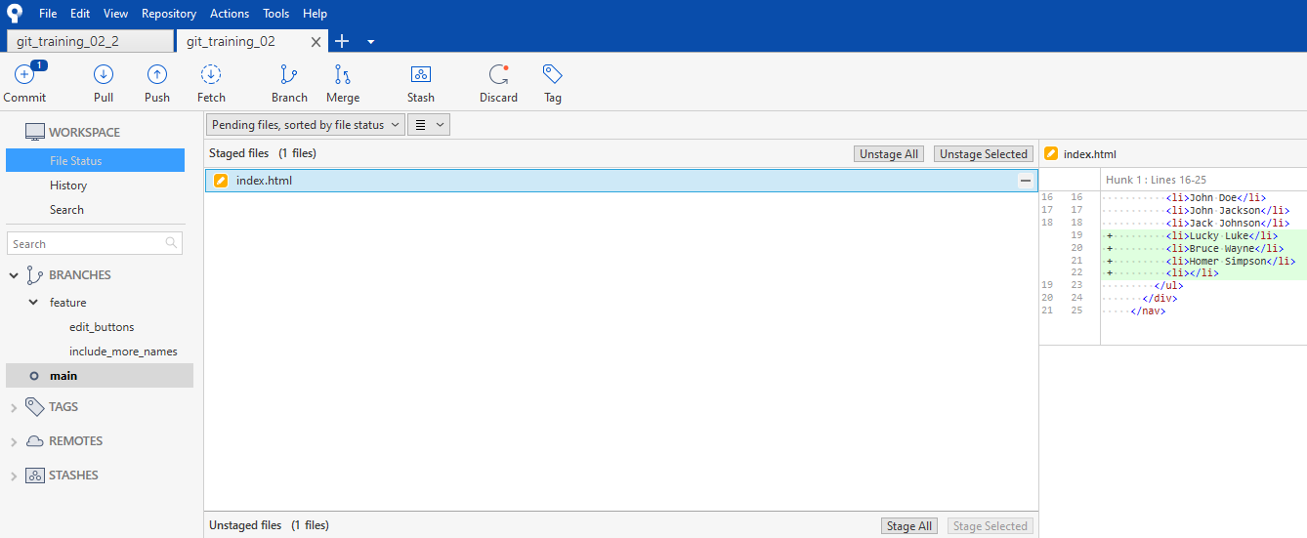
We have resolved every merge-conflict!
You can now close the KDiff software (the little x in the right top corner).
Got to sourcetree (or you will be automatically sent back to sourcetree) and you receive:
The resolved index.html file is already staged and you may now commit! Good job!
Notes:
42

Slide 43
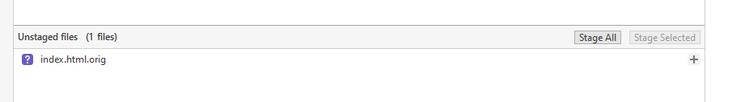
Remark:
It may happen, that sourcetree keeps the original file (even after merging), containing all merge-conflicts.
You do not need that file anymore. After comitting it should vanish, if not, you can remove it!
Notes:
43

