Slide 1

PlatinPie
GIT Training – Round 3
Exercise 05 – Merge Conflicts
Notes:
1

Slide 2
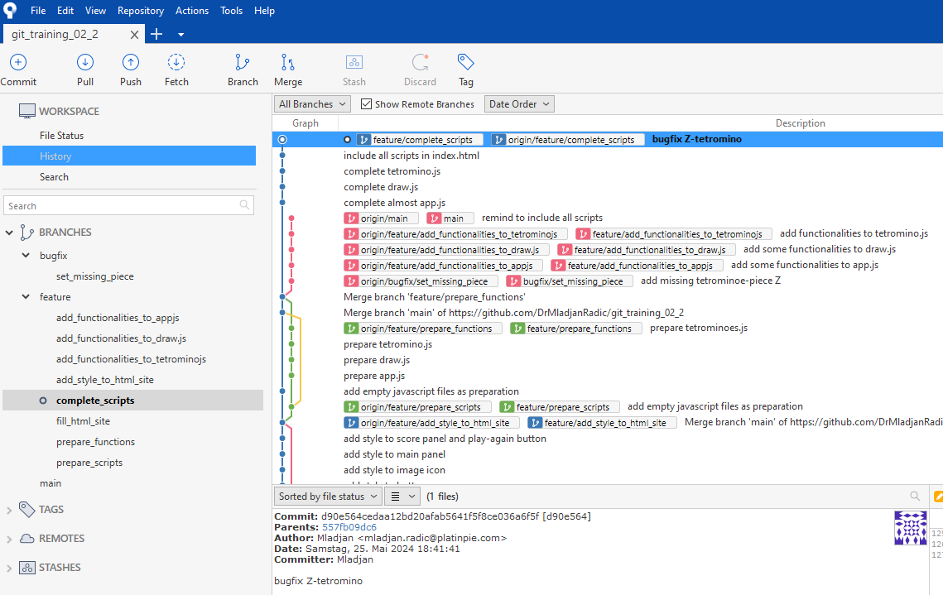
Merge Conflicts
Clone (or fork) the repository: https://github.com/DrMladjanRadic/git_training_02_2
Notes:
2

Slide 3
Merge Conflicts
Checkout the branch: feature/complete_scripts
We assume, that the current branch is „almost finished“ and it should now be merged back to the main branch
Unfortunately, the communication in this project was not good, since other team members have also worked on the same files, resulting in merge conflicts
Fortunately, you are able to solve them all!
Best of Luck!
If any merge conflict is unclear, ask your trainers!
Notes:
3

Slide 4
Merge Conflicts
If solved all merge conflicts, you can double click on „index.html“ and play a round ;-) If every merge conflict was solved correctly, everything should work just fine. You can use any of your preferred merge-tools.
Notes:
4

Slide 5
Further Discussion
Discuss with your team, why in this case a „Git Workflow“ would be appropriate and meaningful.
After having now a „stable“ version at the end, would you give it a „Tag“? Why, or why not? How would you Tag it?
Notes:
5

