Slide 1

PlatinPie
GIT Training – Round 4
Exercise 02 – squash commits
Notes:
1

Slide 2
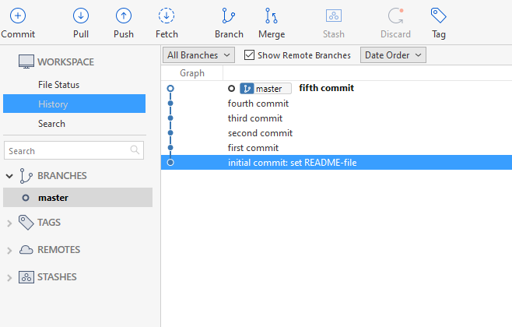
Squashing many commits
Sometimes, we keep working for a few days until a certain workload is finished.
On this way, many commits may be made, like in this case:
Notes:
2

Slide 3
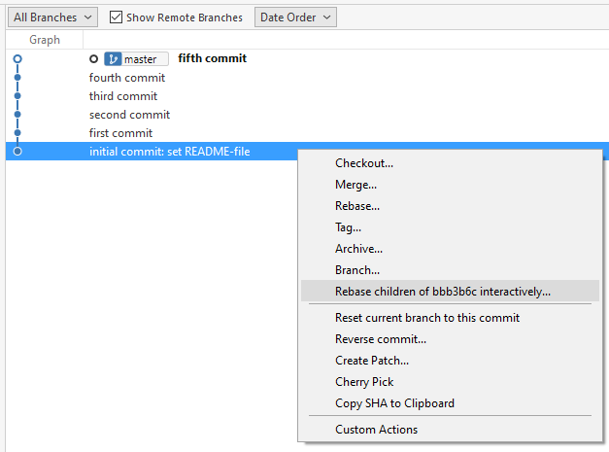
Maybe, we do not want to have 5 different commits
So we want to „squash“ all 5 commits into one
Right click on „first commit“
Select „Rebase children of … interactively“
Notes:
3

Slide 4
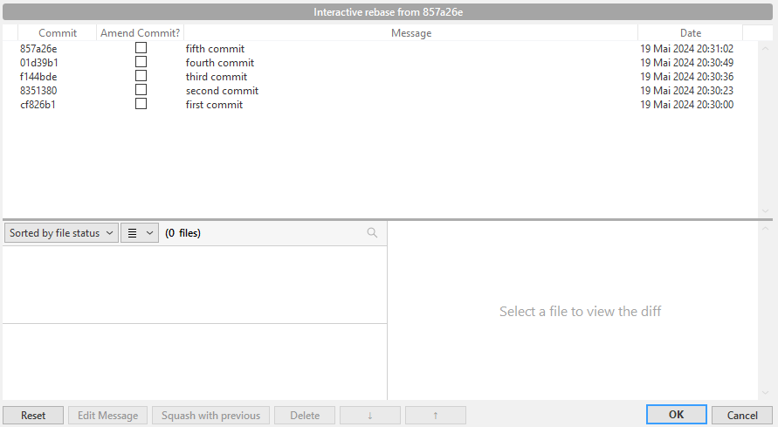
A new window will pop up
Notes:
4

Slide 5
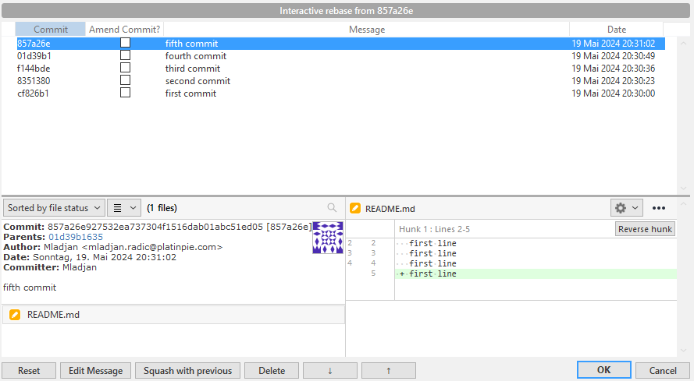
We select the fifth commit
We select „Squash with previous“ to squash the fifth commit with the fourth commit (previous one)
Press OK
Notes:
5

Slide 6
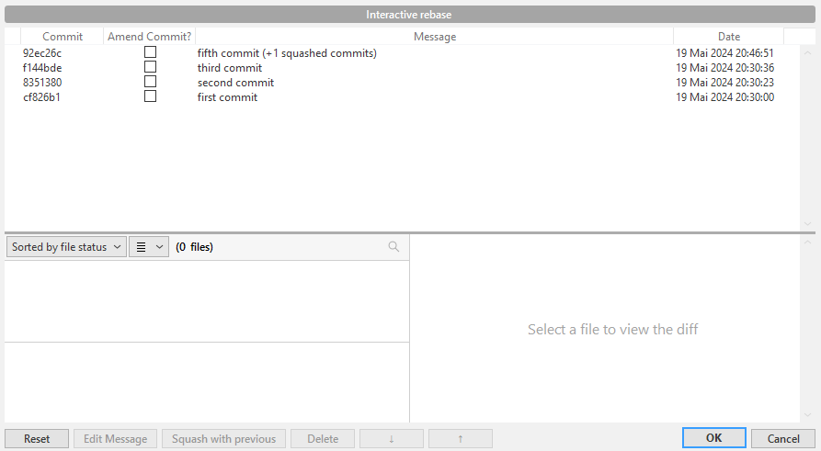
The fourth commit is vanished and is „squashed“ with the fifth commit
Notes:
6

Slide 7
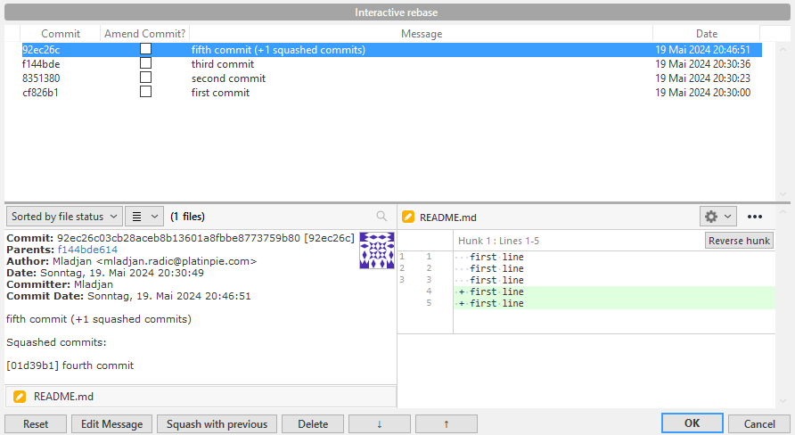
Repeat this process (if you want)
Notes:
7

Slide 8
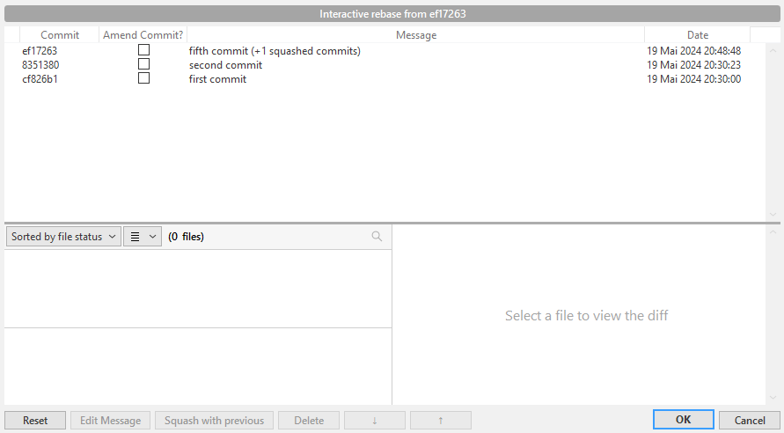
The third commit has vanished (squashed)
Repeat the process once again
Notes:
8

Slide 9
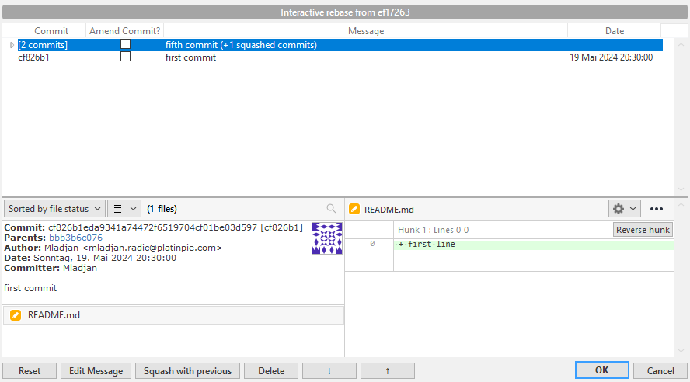
The second commit has vanished (squashed)
Repeat the process once again
Notes:
9

Slide 10
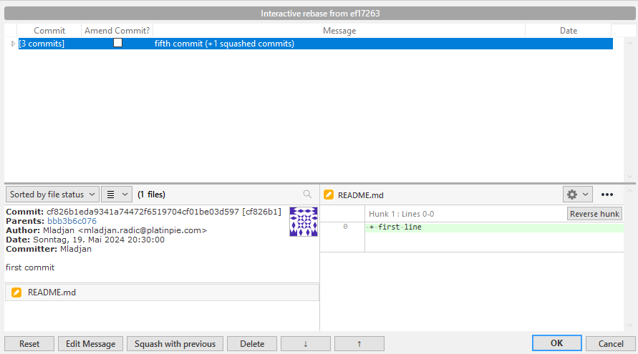
The first commit has vanished (squashed)
Recommended: We have to Edit the commit message, because „fifth commit“ has no valuable information
Select „Edit Message“
Notes:
10

Slide 11
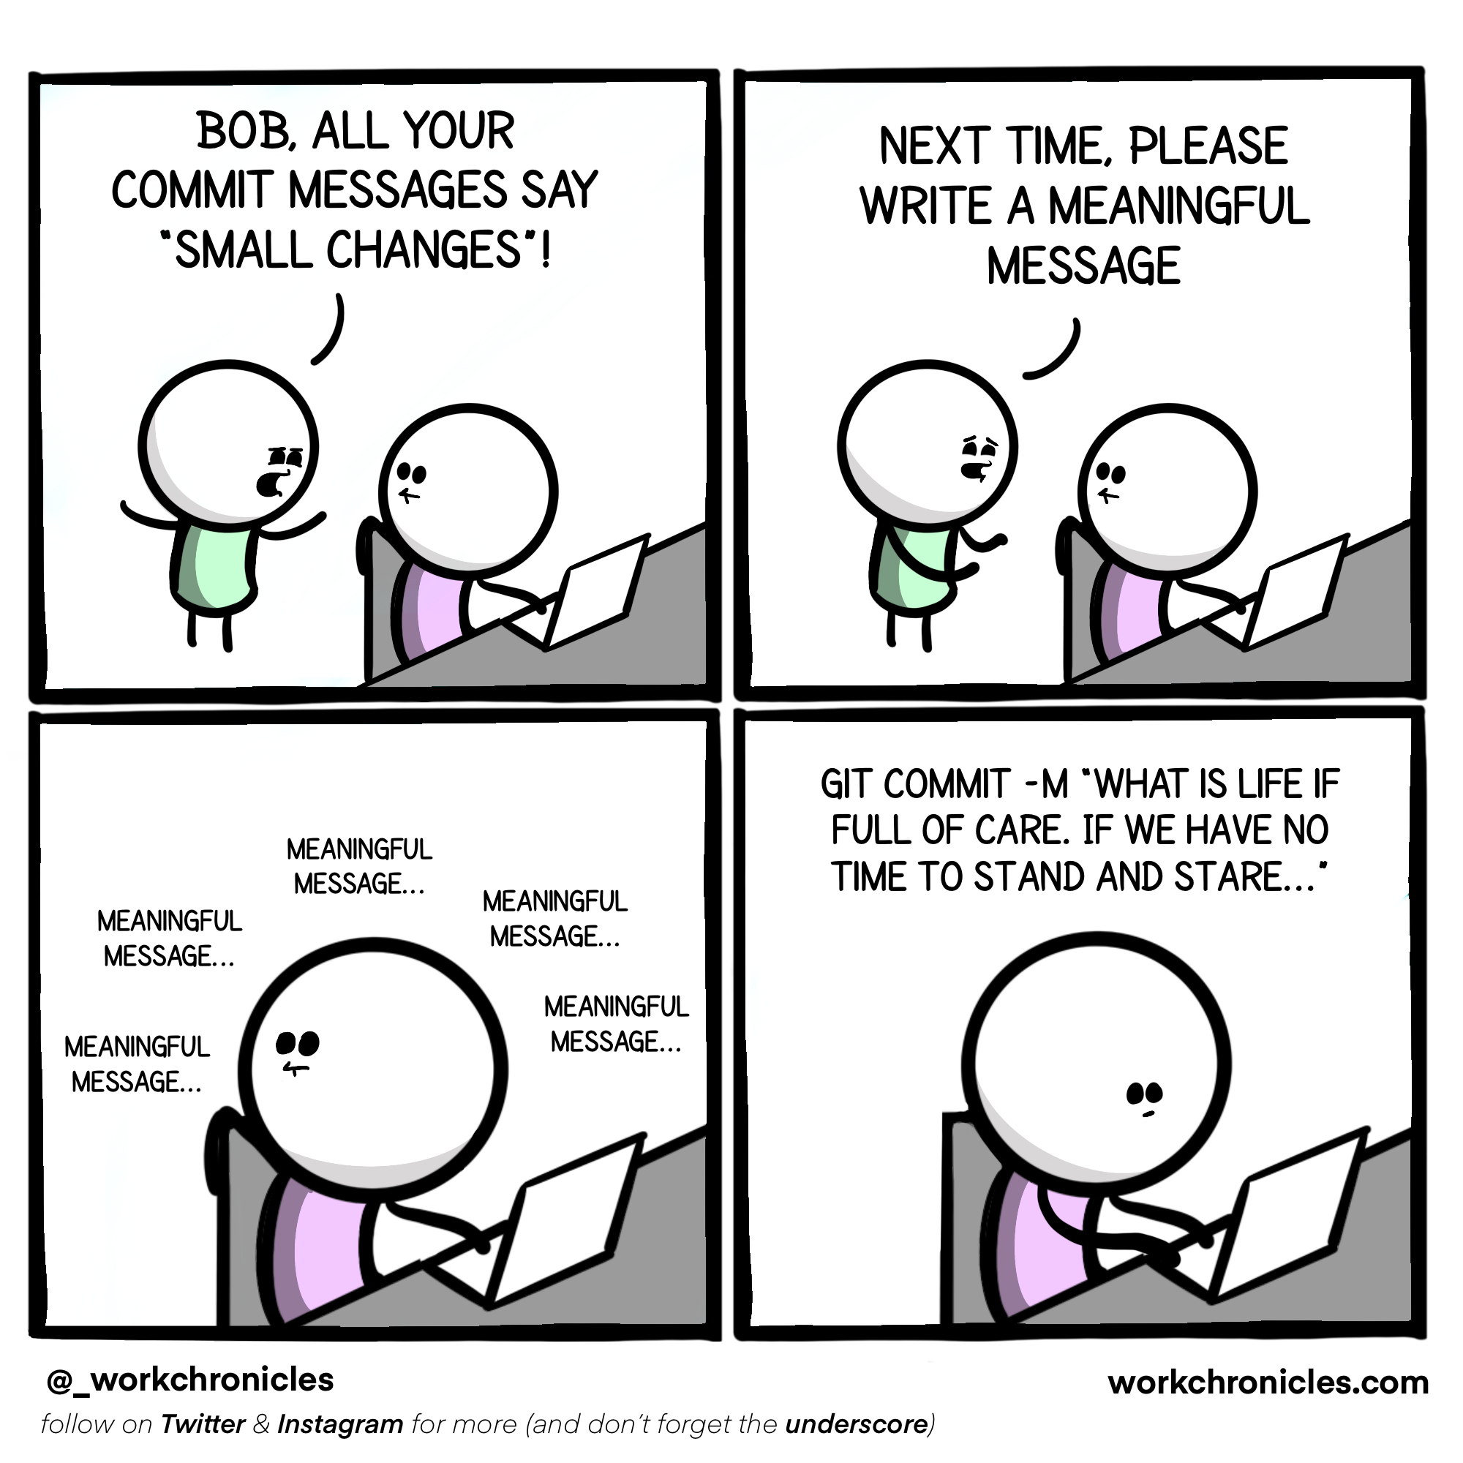
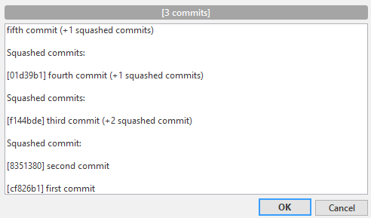
You can now Edit the message
Notes:
11

Slide 12

Give it a short and reasonable message
Select OK
Notes:
12

Slide 13
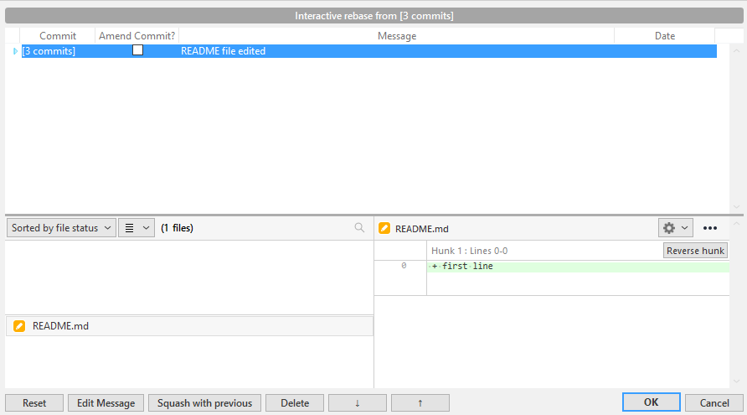
Your new Message will now be seen
Select again OK (if you are finished)
Notes:
13

Slide 14
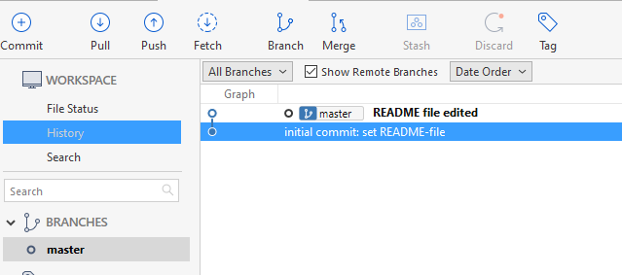
The history has changed
Five commits where squashed into one
The new message is now visualized
Notes:
14

Slide 15
You can also squash commits even though they are already pushed (on the remote repository)
Remarks
You can change the order by clicking here (arrow up or arrow down) You can therefore also squash with another commit and not only the previous one!
Notes:
15

