Slide 1

PlatinPie
GIT Training – Round 4
Exercise 03 – Amend Commit
Notes:
1

Slide 2
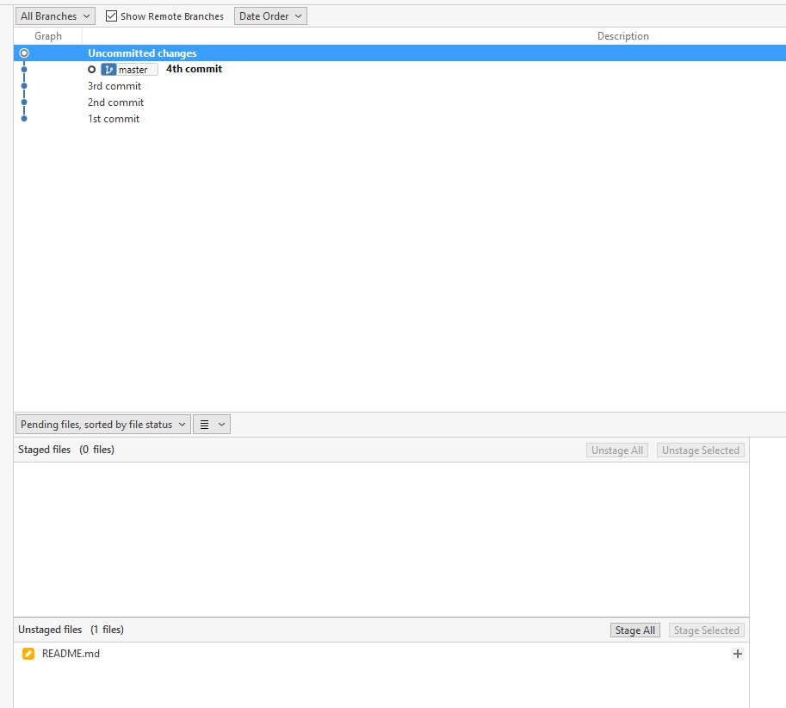
Consider having a Repository and you already made some commits. Now you made some changes and the changes made should be included in the latest commit
Notes:
2

Slide 3
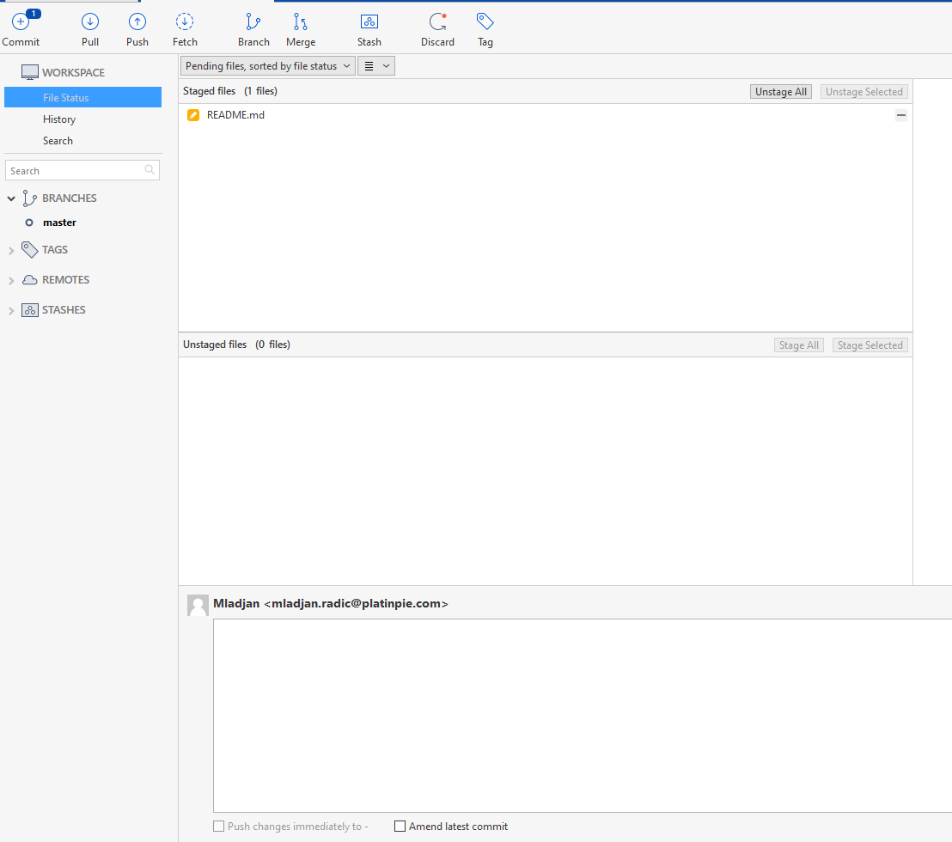
Stage your changes
Select „Amend latest commit“
Notes:
3

Slide 4
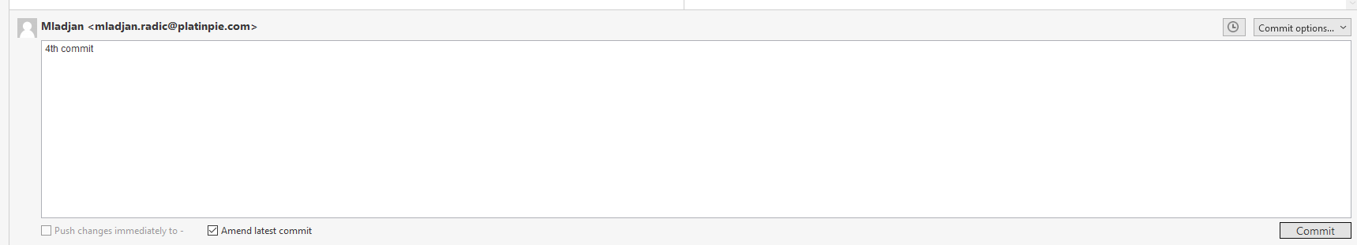
Select Commit
Notes:
4

Slide 5
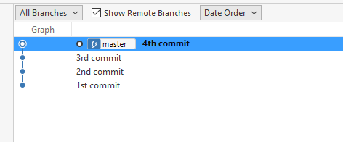
The changes are now amended to the latest commit (no „new commit“ is needed)
Notes:
5

