Slide 1

PlatinPie
GIT Training – Round 4
Exercise 04 – Divide Commit Messages
Notes:
1

Slide 2
Advanced Commiting
We all know the situation: we have made a lot of changes (e.g. in one file). But unfortunately, it would be better, to „divide“ some of the changes made in the file in several commits (and not to stage the whole file!). Keep in mind, that this makes the cherry-picking, the readability of the repository much more easier and helps a lot for the work with your team!
Notes:
2

Slide 3
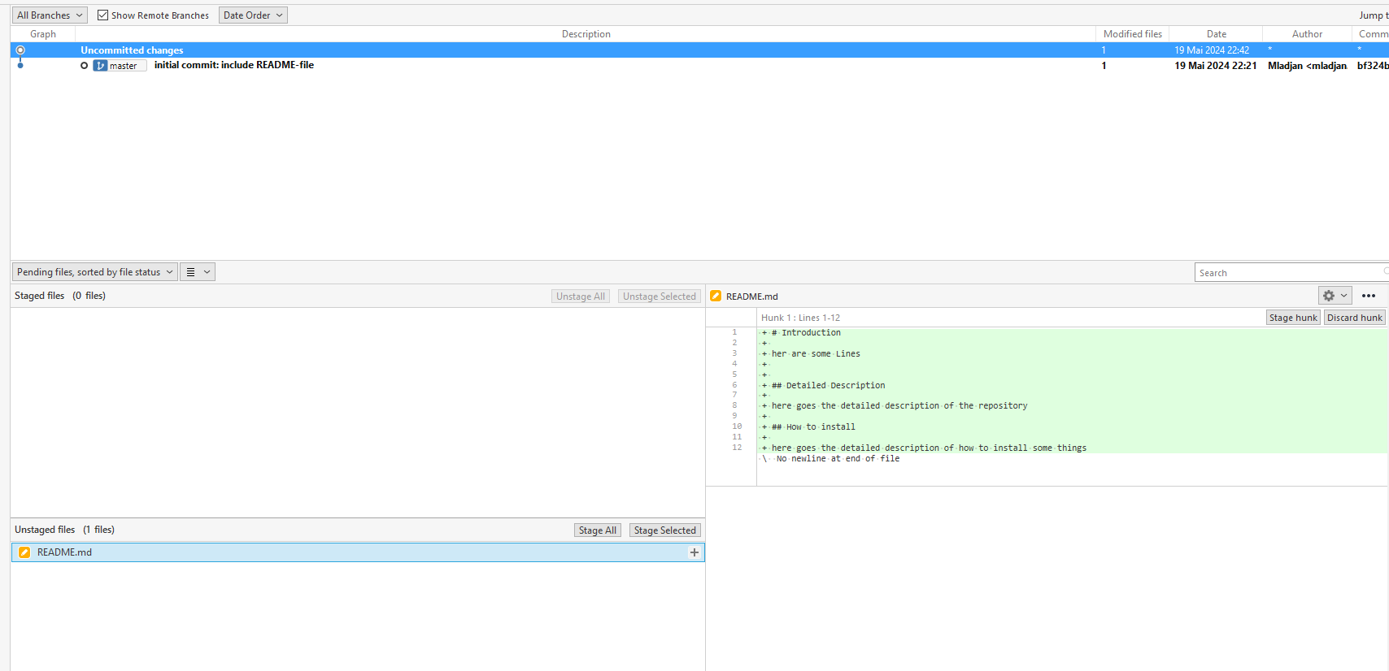
We do not want to commit the whole file and not all lines!
Notes:
3

Slide 4
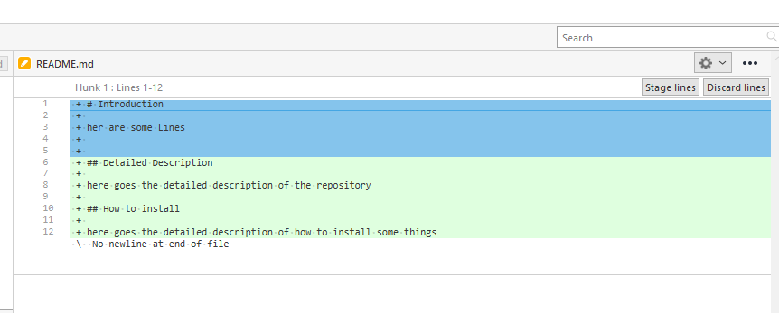
You can select only the lines (or hunk) you want to stage
Control + Right Mouse to select all lines you want to commit
Notes:
4

Slide 5
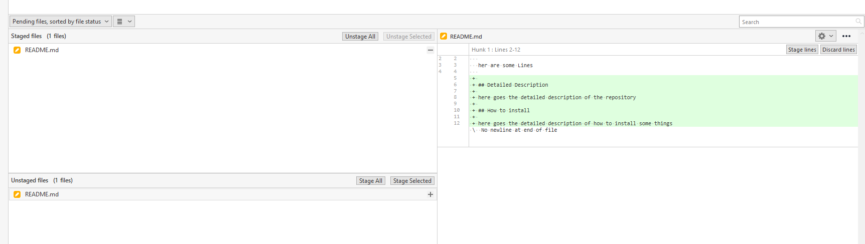
Now only the selected lines are staged and ready for commit Write a commit message and commit it
Proceed with the other lines as well
Notes:
5

Slide 6
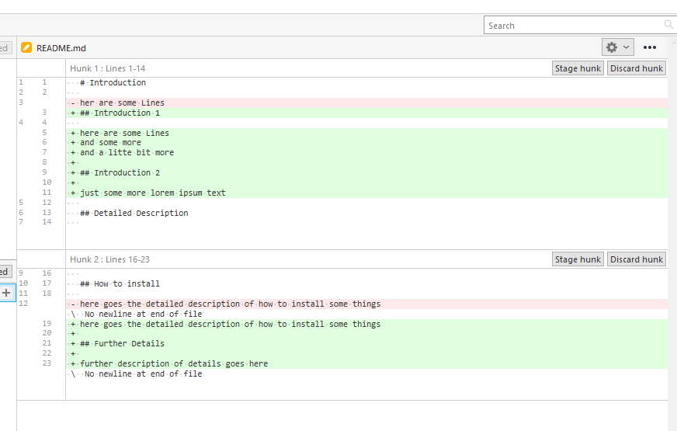
You can also Stage a whole hunk Easier than to select all lines by hand
Stage the other hunk (aftwerwards) to make a seperate commit
Notes:
6

Slide 7
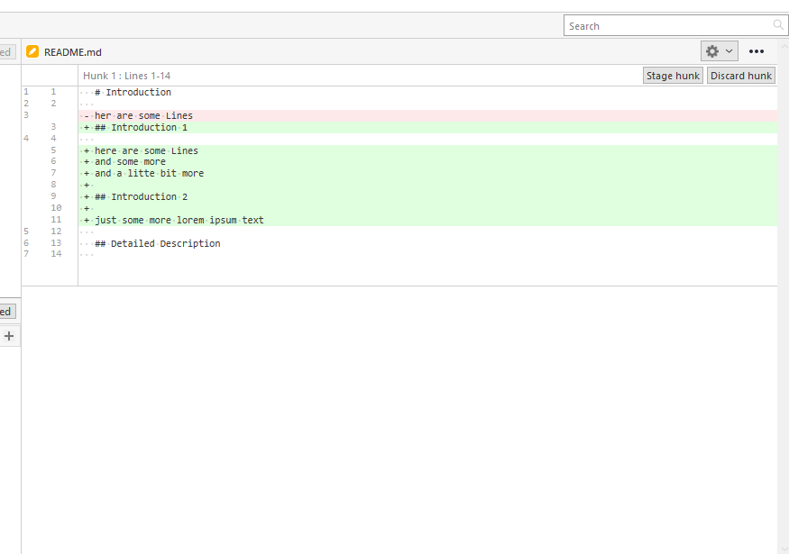
You can also discard the whole hunk (or lines if you select them)
Notes:
7

