Slide 1

PlatinPie
GIT Training – Round 4
Exercise 04 – Cherry Pick
Notes:
1

Slide 2
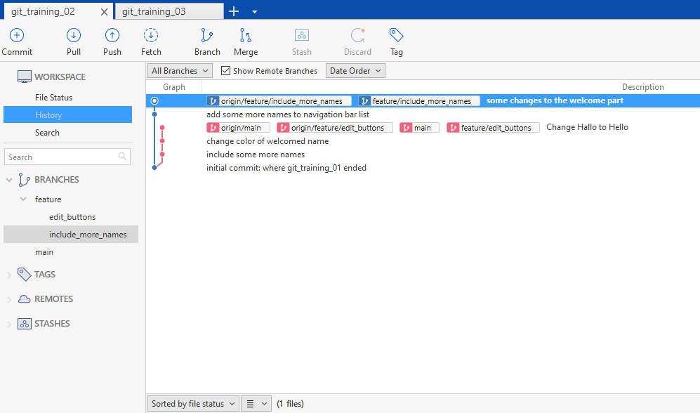
Cherry Picking
Consider having a Repository and several branches, in our case, two. Here, we consider the Repository:
https://github.com/DrMladjanRadic/git_training_02.git
Checkout this branch / commit
Notes:
2

Slide 3
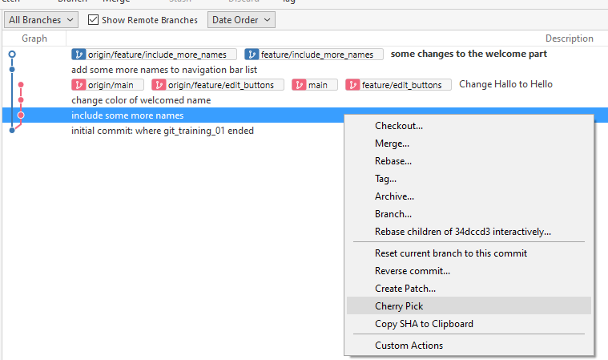
We want to only include one commit from the other branch (not the whole branch!)
Therefore called „cherry-picking“
Right click on the commit you want to pick Select „Cherry Pick“
Notes:
3

Slide 4
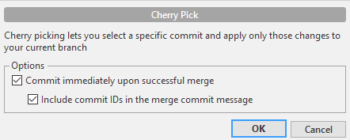
A new window will pop up
Select your options
Select „OK“
Unselect, if you do not want to commit it immediately or if you do not want to include the ID of the commit message
Notes:
4

Slide 5
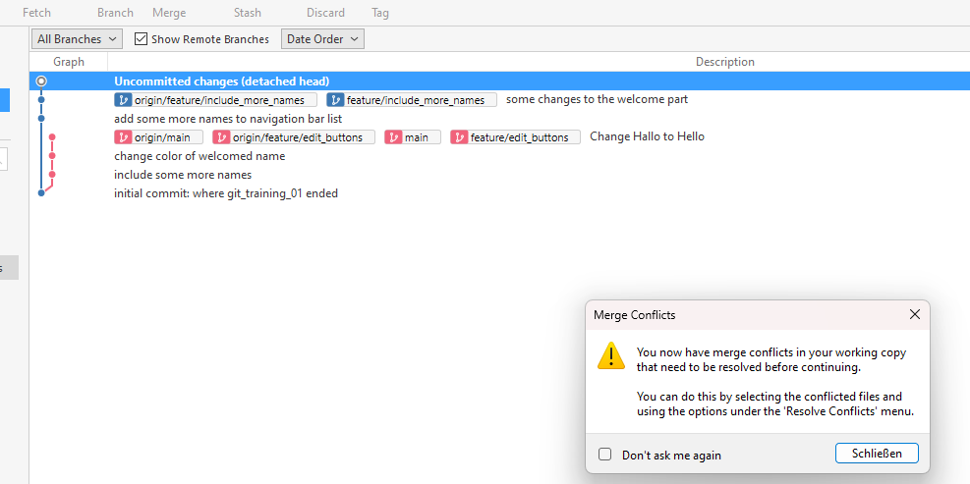
…, you know what to do ;-)
Notes:
5

Slide 6
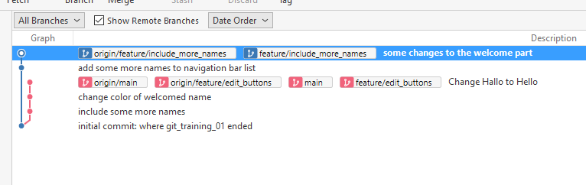
After you have solved the merge conflicts (if any) your commit has been included to your branch
Notes:
6

Slide 7
Important Remarks
You should design and make your commits always „cherry-pickable“ (easier said than done)
Commit Messages should indicate, what happens in the code → easing cherry-picking
Understanding of the code helpful (Consider regular code review etc.)
Merge Conflicts might happen
Notes:
7

