Slide 1

PlatinPie
GIT Training – Round 5
Exercise 01 – Large File Storage (LFS)
Notes:
1

Slide 2
LFS
Sometimes, we want to keep some binary files in our (local) repository, but pushing them would lead to issues (like storage, cloning the repo would lead to time-consuming issues etc)
Executable files like .exe ...
Binary files like .slx, .dat, .dll, .lib, .x3d, .stl ...
Image files like .png, .jpg, .pdf ...
Notes:
2

Slide 3
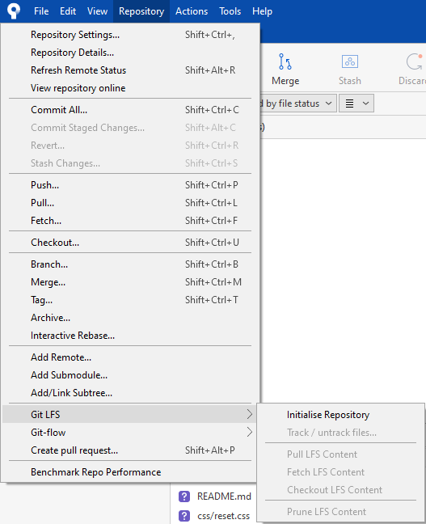
If you want to track certain files in LFS:
Select the tab Repository
Select „Git LFS“
„Initialise Repository“
Notes:
3

Slide 4
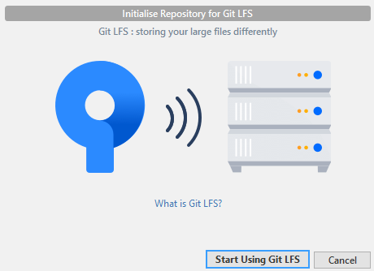
Select „Start Using Git LFS“
Hint: You can click on „What is Git LFS“ to inform yourself about Git LFS.
Notes:
4

Slide 5
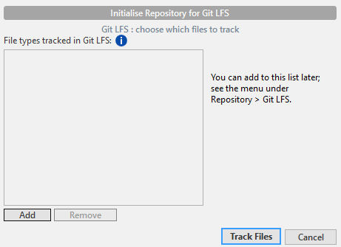
You can now Add Files to be tracked to
Notes:
5

Slide 6
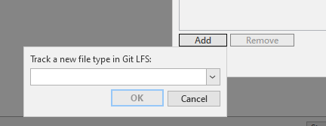
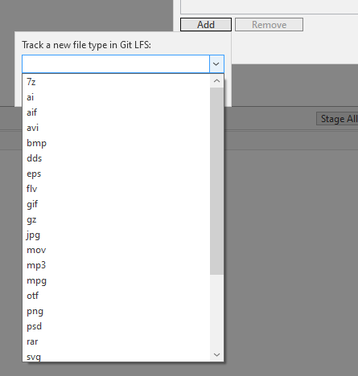
Select file type to be tracked for Git LFS from the selection list
Notes:
6

Slide 7
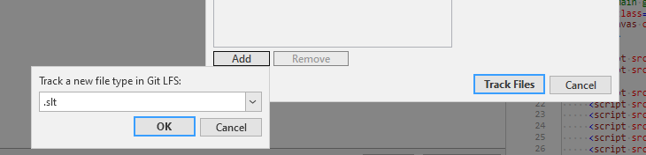
Or: type in the file type you want to track
Select OK
Select Track Files
Notes:
7

Slide 8
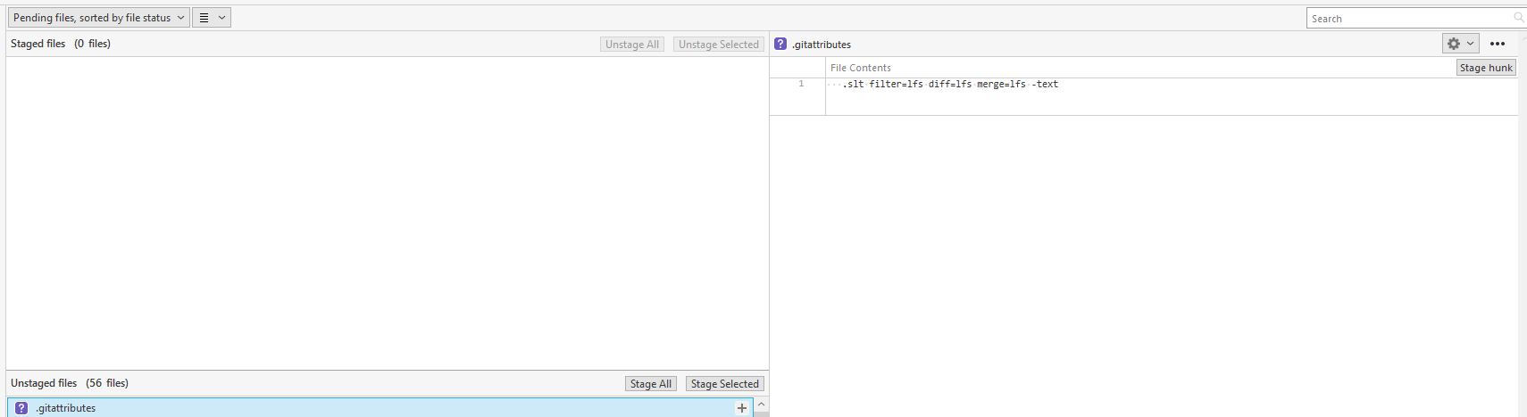
A new file will be generated, called „.gitattributes“
File content, indicating that „.slt“ will be tracked for LFS
Notes:
8

Slide 9
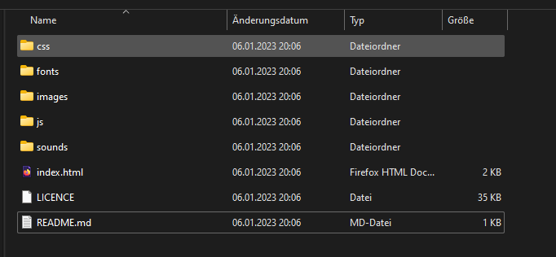
Let us get more concrete and let us do a concrete example!
Get the zip-file:
https://www.dropbox.com/scl/fi/0mg2lw78uoqj4e16z818g/git_training_04.zip?rlkey=wkcaqy106wox4zticyqzf6xw3&dl=0
Unzip it somewhere
Open the unzipped folder and you will see:
Double click on index.html and try to find out, what you received
Now your task is, to build a repository out of this folder, but:
You will need to explore, which type of binary files are included in the project (search in all subfolders!)
Try to track ALL binary files, such that they are tracked for Git LFS
Push it to the remote repository
Hint: Do NOT push before tracking binary files and including them into Git LFS!
Notes:
9

