Slide 1

PlatinPie
GIT Training – Round 5
Exercise 02 – LFS with Locking
Notes:
1

Slide 2
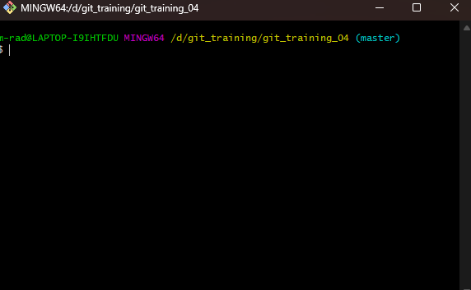
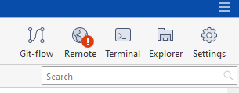
Locking
Unfortunately, sourcetree does not have the feature to lock files. Therefore, we switch to the console or terminal.
Select the terminal to open git bash
Notes:
2

Slide 3

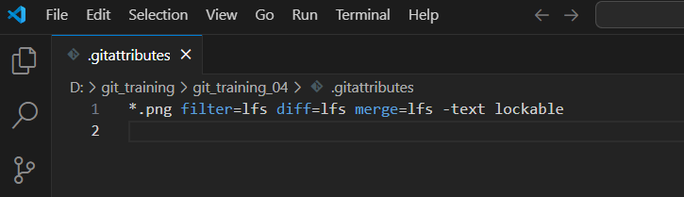
Locking
You can now first initialize (or install, if not already happened)
And now, exemplary, we may track and lock all .png-files via:
If not existing yet, a .gitattributes file will be created. The content will look like this:
Notes:
3

Slide 4
Locking
How to lock a file?
Replace „path_to_file.png“ with your actual path to your file, which you want to lock.
Notes:
4

Slide 5
Locking
How do I see which files are locked?
Notes:
5

Slide 6
Unlocking
How to lock a file?
Replace „path_to_file.png“ with your actual path to your file, which you want to unlock.
Notes:
6

Slide 7
Suggested Workflow in Projects
1) Lock the file
2) Edit the file
3) Commit your changes
4) Push the repository
5) Get your changes reviewed, approved and merged
6) Unlock the file
Notes:
7

Slide 8
Tasks
1) Get the repository from the previous Exercise
2) Track all .wav files (if not done already) and make them lockable
3) Lock at least one file
4) Unlock it
Make a discussion with your team, colleagues and trainers:
- What are the challenges hereby?
- What can go wrong?
- Are there any downsides of locking files?
Notes:
8

