Slide 1

PlatinPie
GIT Training – Round 3
Exercise 01 – Clone Remote Repo
Notes:
1

Slide 2
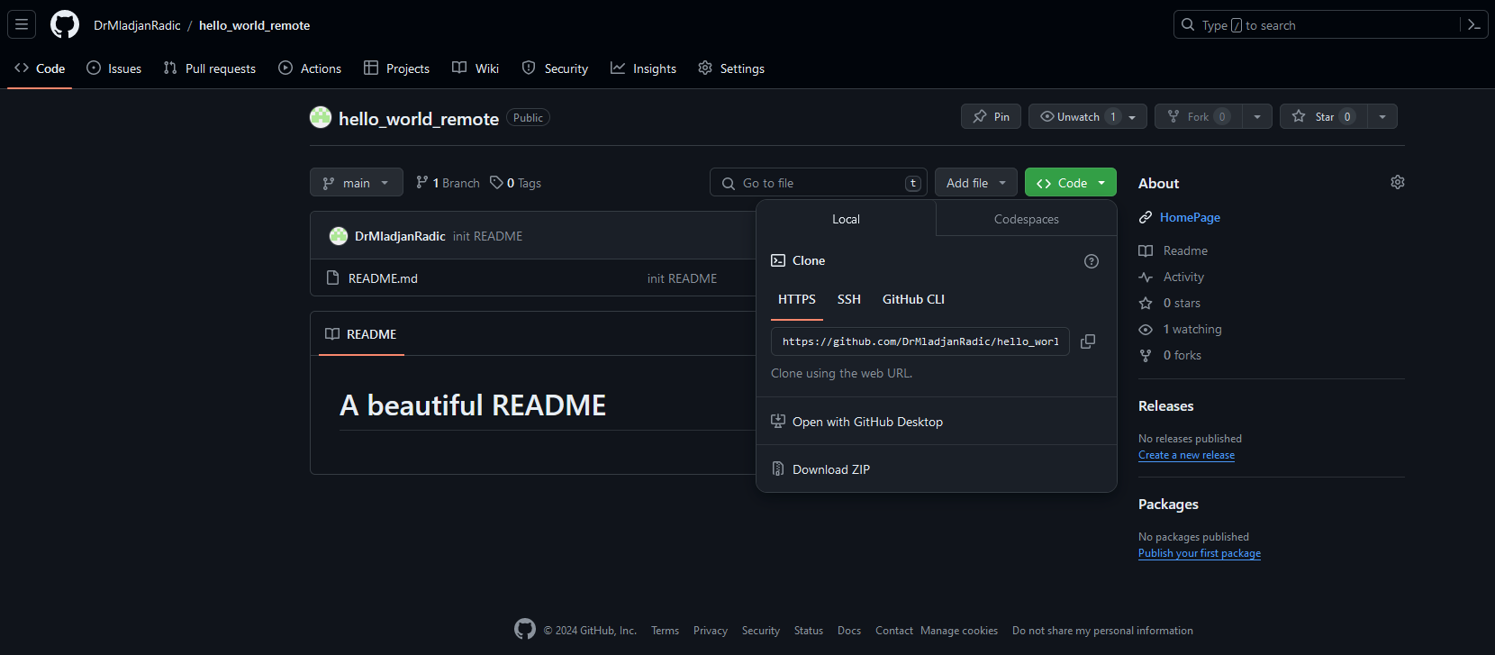
Clone Remote Repository
The link to a remote repository can be found on the remote homepage, in our case github.com
https://github.com/DrMladjanRadic/hello_world.git
Notes:
2

Slide 3
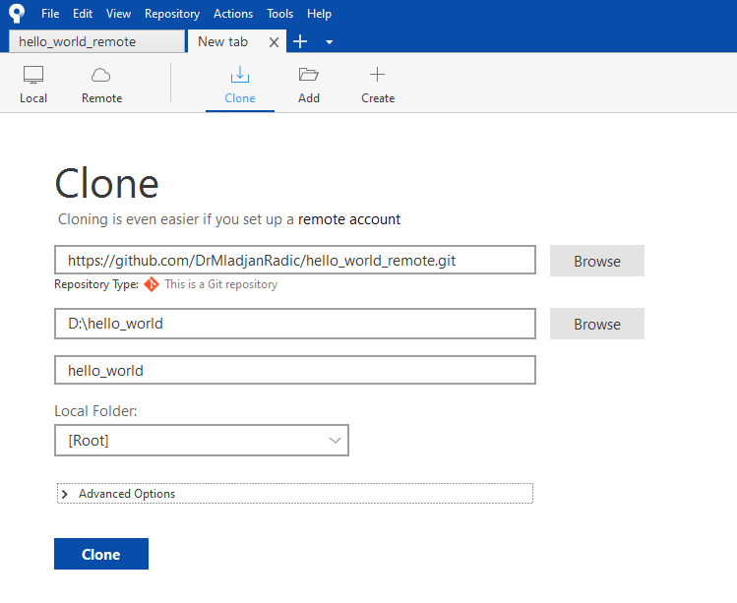
Clone Remote Repository
Copy the link and insert it into sourcetree after selecting „Clone“ Set a folder to store, give it a name and click „Clone“
Inser Link to Repo here
Select Folder where you want to store your Repo
You can give it a specific name
In the advanced options you can specify a certain branch to checkout and more (we do not need it here)
Notes:
3

Slide 4
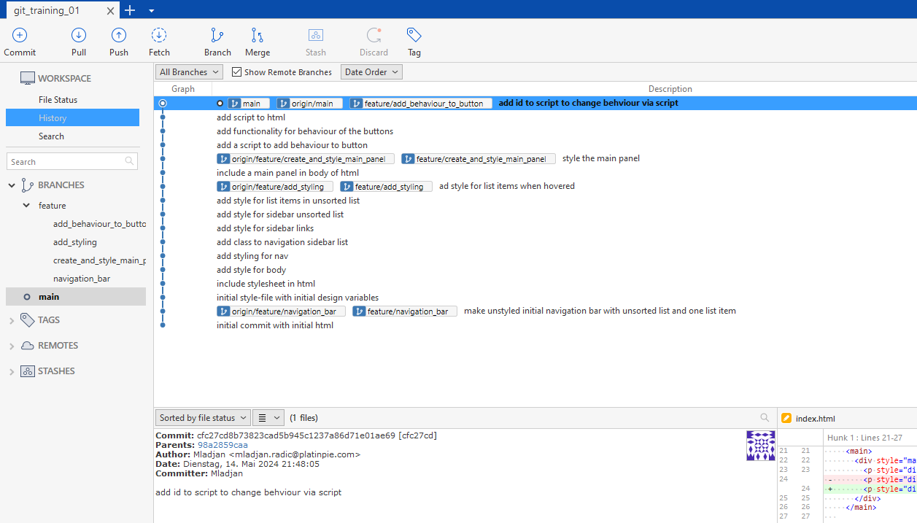
Clone Remote Repository
After Cloning the Repo, you will receive the full history and files
Notes:
4

Slide 5
Clone Remote Repository
Let’s make it interesting:
Clone the following Repository:
List all branches in the Repository
How many commits are already done in the Repository?
What files are in the Repository?
https://github.com/DrMladjanRadic/git_training_01.git
Notes:
5

Slide 6
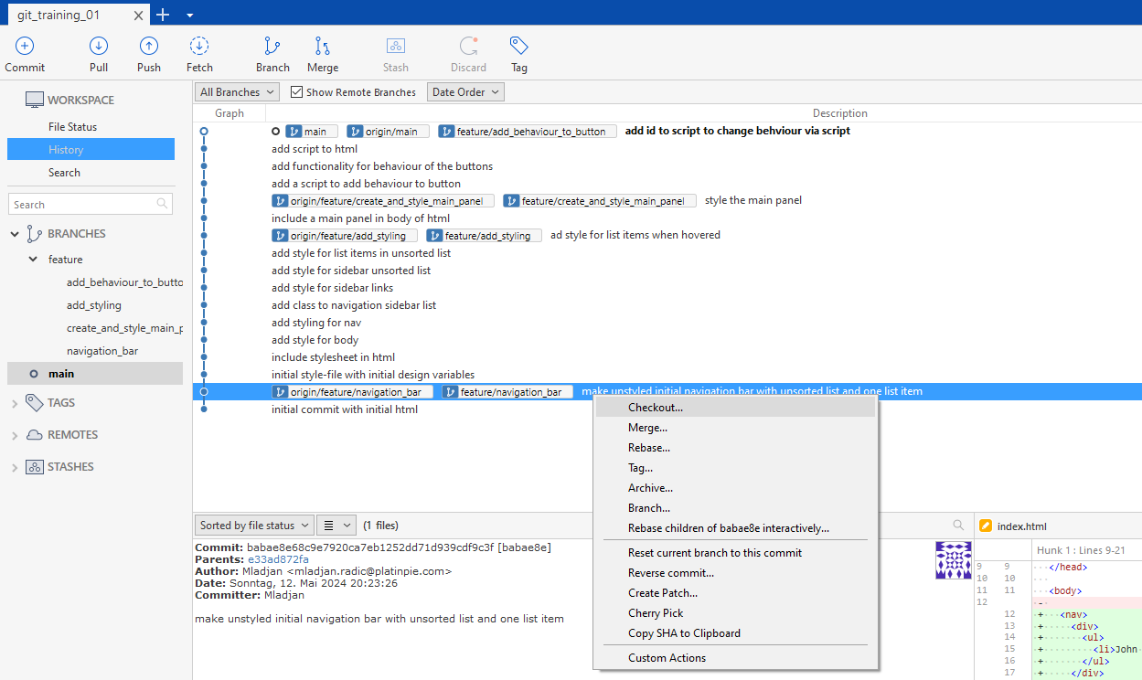
Checkout older Commits
Sometimes, it is helpful to checkout an older commit to understand the history of the code
Right Click on the commit you want to checkout, then select „Checkout“
Notes:
6

Slide 7
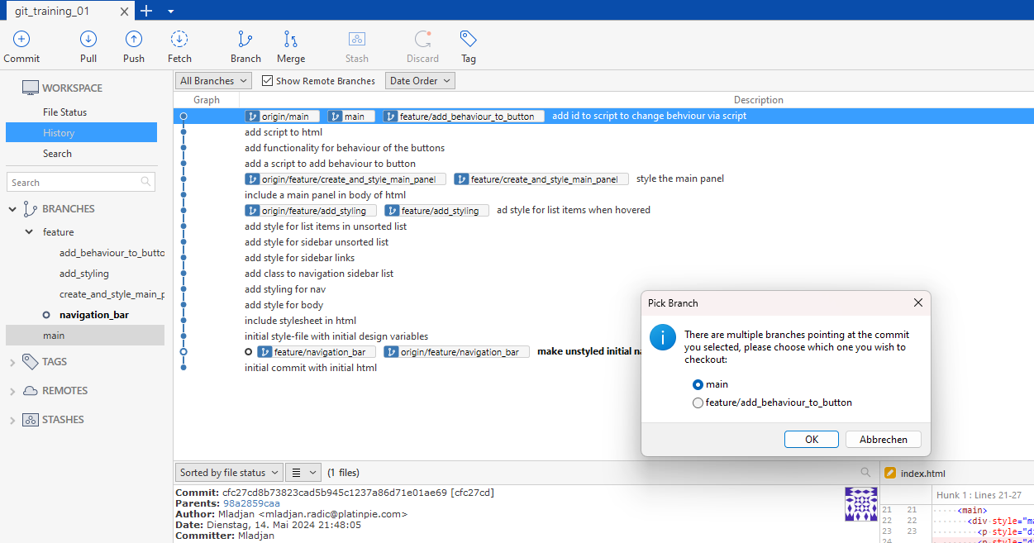
Checkout older Commits
If the commit is merged into another branch, which is then also pushed (to origin), you may need to checkout the right branch
Select the right branch
Notes:
7

Slide 8
Older Commits and History
Checkout (at least!) 3 older commits and try to understand the historical development of the code
Notes:
8

