Slide 1

PlatinPie
GIT Training – Round 3
Exercise 02 – Fetch and Pull
Notes:
1

Slide 2
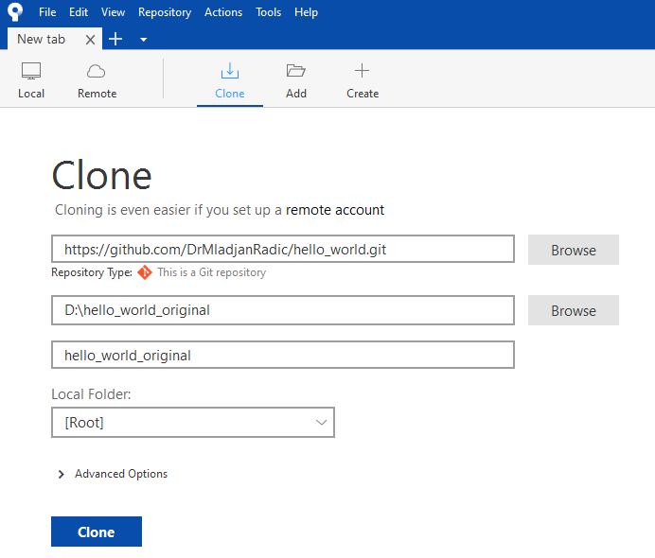
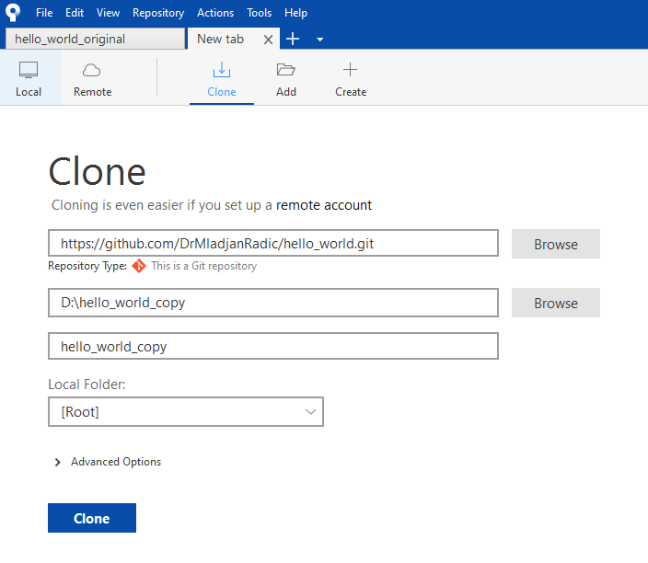

Fetch and Pull
Create your own remote repository, you may also use one of your existing ones
Clone it again (in another folder)
You have now two identical (remote!) repositories
Notes:
2

Slide 3
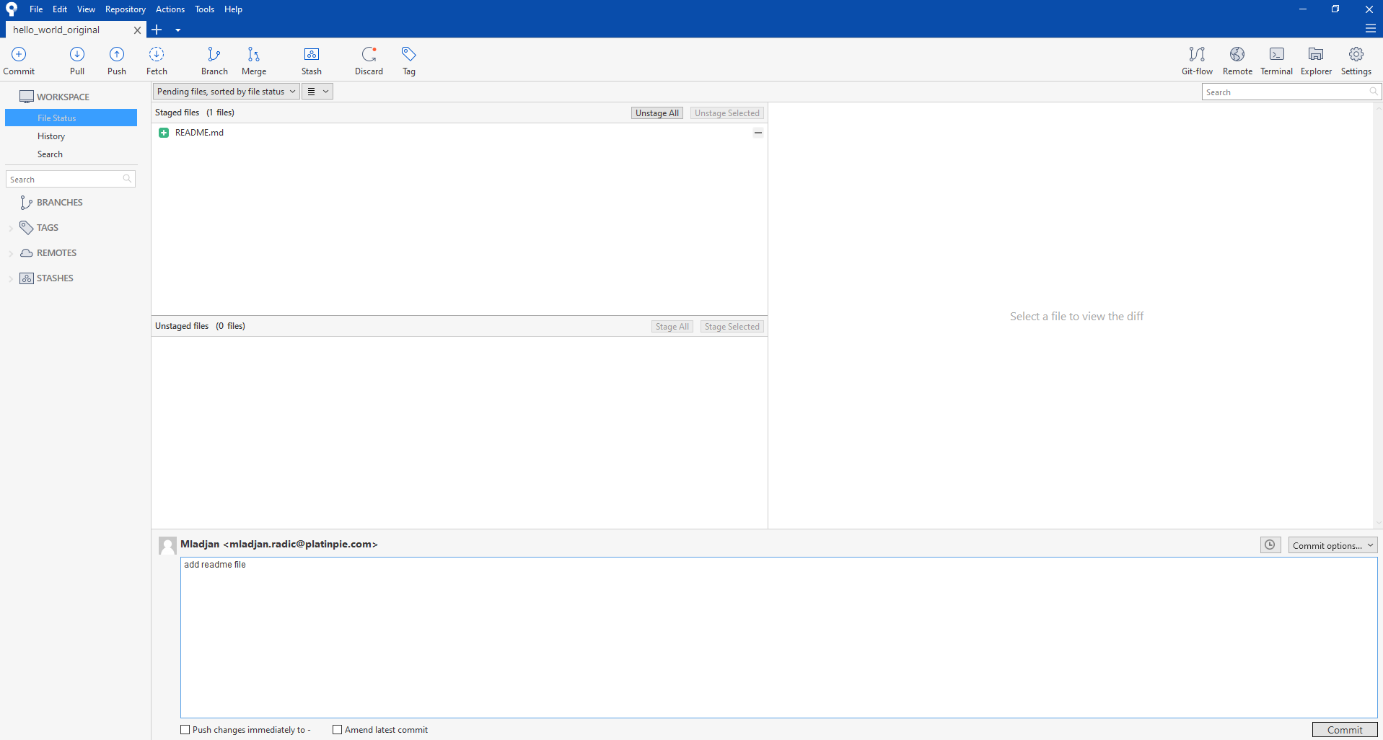
Fetch and Pull
Create a commit in of the remote repositories
Notes:
3

Slide 4
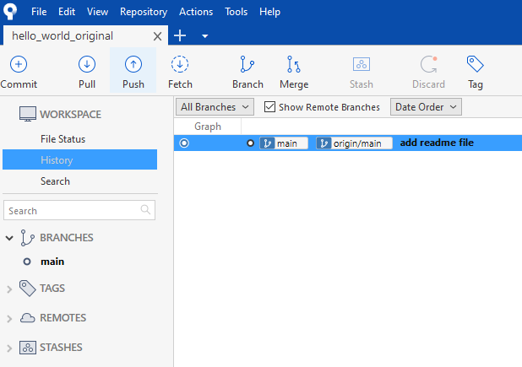
Fetch and Pull
Push it
The remote Repository has now a commit
Notes:
4

Slide 5
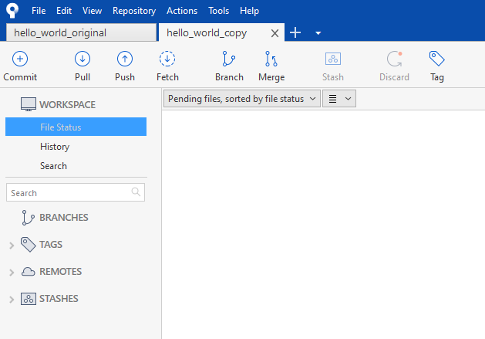
Fetch and Pull
Switch to your other Repository
You should see no commits, no changes or anything, just the repository as you left it
We now have to check if something on the repository happened
Select „Fetch“, to see if something on the remote Repo happened
Notes:
5

Slide 6
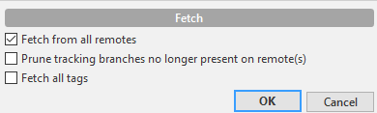
Fetch and Pull
Press OK
Notes:
6

Slide 7
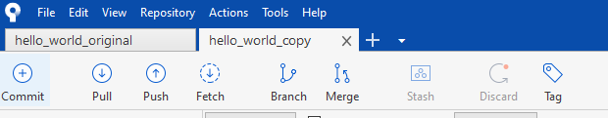
Fetch and Pull
Select Pull
What do you observe?
Notes:
7

Slide 8
Fetch and Pull
Now it is your turn:
Create more commits, or a branch with commits in one of both Repositories
Switch to the other Repository
Fetch
Pull
Play Around
Spice it up by Cloning the Repository of one of your colleagues
Make a commit, push it and let your partner fetch and pull it
Notes:
8

