Slide 1

PlatinPie
GIT Training – Round 3
Exercise 03 – Stash before Fetch and Pull
Notes:
1

Slide 2
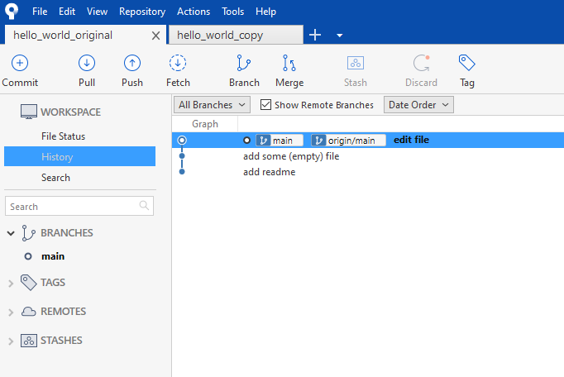
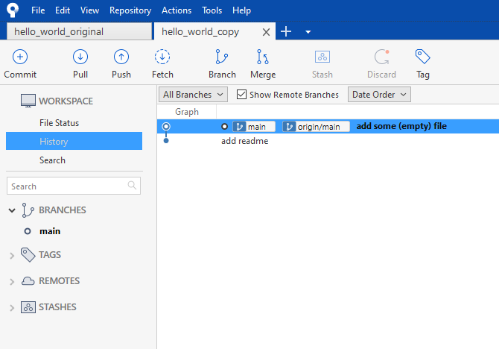

Stashing
Let us consider the following scenario:
You already made some changes on your local repository, but not on your other one, so one of your repositories is at least one commit behind
Notes:
2

Slide 3
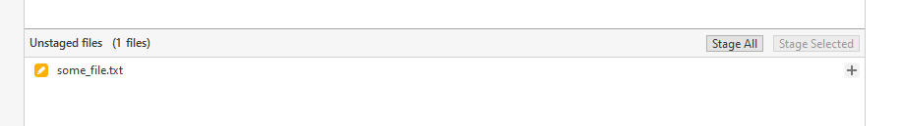
Stash, Fetch and Pull
On your other Repository, make some changes, e.g. edited one common file
Notes:
3

Slide 4
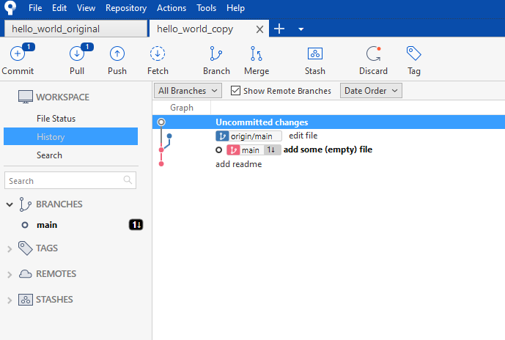
Stash, Fetch and Pull
We should pull one commit
Now, try to fetch, try to interpret the output
We have edited a file, but no commits
We are one commit behind
We are one commit behind
Notes:
4

Slide 5
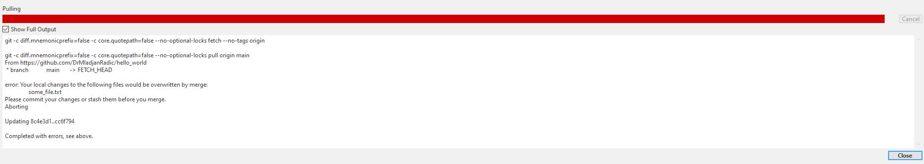
Stash, Fetch and Pull
We will receive an error message
Select „Close“
Commit or stash them! We will stash them
Notes:
5

Slide 6
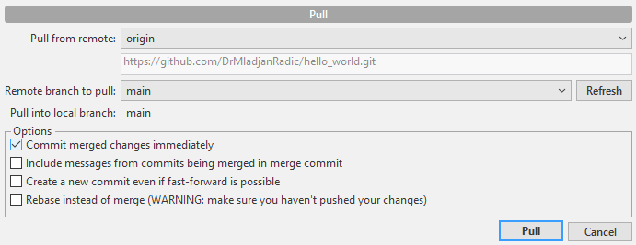
Stash, Fetch and Pull
You will be redirected
Select „Cancel“
Notes:
6

Slide 7
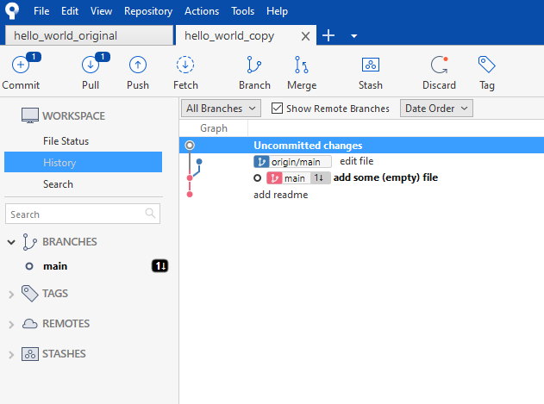
Stash, Fetch and Pull
Select „Stash“
Notes:
7

Slide 8
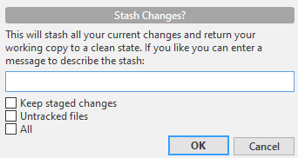
Stash, Fetch and Pull
A new window will appear
Select OK, after editing and selecting your options (I have left everything blank in this case)
Add a description if you want
Select any fitting option
Notes:
8

Slide 9
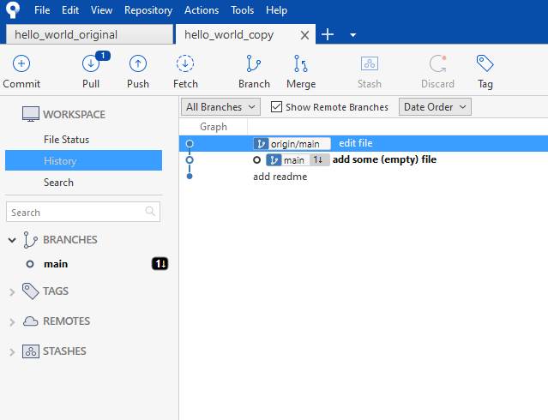
Stash, Fetch and Pull
You can now pull. There should be nothing to commit!
Notes:
9

Slide 10
Stash, Fetch and Pull
Click on „STASHES“
Notes:
10

Slide 11

Stash, Fetch and Pull
You should see something like
WIP, otherwise the name you gave!
Notes:
11

Slide 12
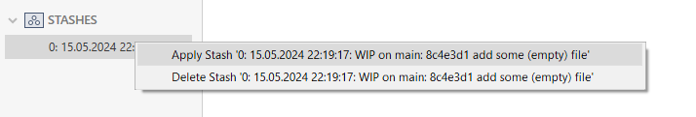
Stash, Fetch and Pull
You should see something like
WIP, otherwise the name you gave!
Right Click on the Stash and Select „Apply Stash“ or „Delete Stash“ to delete the Stash
Select Apply Stash
Notes:
12

Slide 13
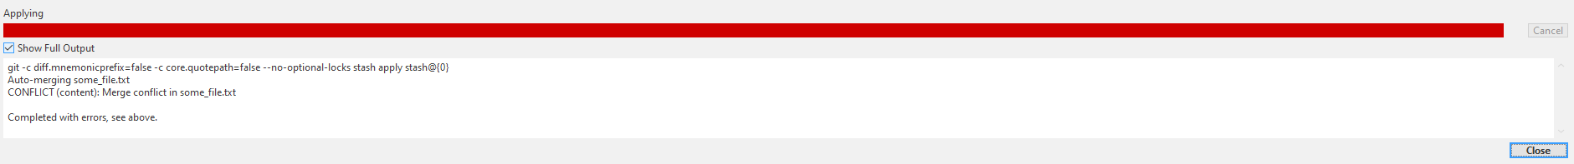
Stash, Fetch and Pull
Congratulations! You have encountered your first Merge conflict!
Now the real „fun“ of GIT really starts ;-)
How to deal with Merge Conflicts? This will be part of the next Exercise
Stay tuned!
Notes:
13

Slide 14
Some Remarks
You can stash whenever you want!
You can stash, change the branch and apply the stash → try it out!
Try to exercise to apply stashed and also to delete them
Notes:
14

