Slide 1

PlatinPie
GIT Training
Exercise 01 – Create Remote Repo
Notes:
1

Slide 2
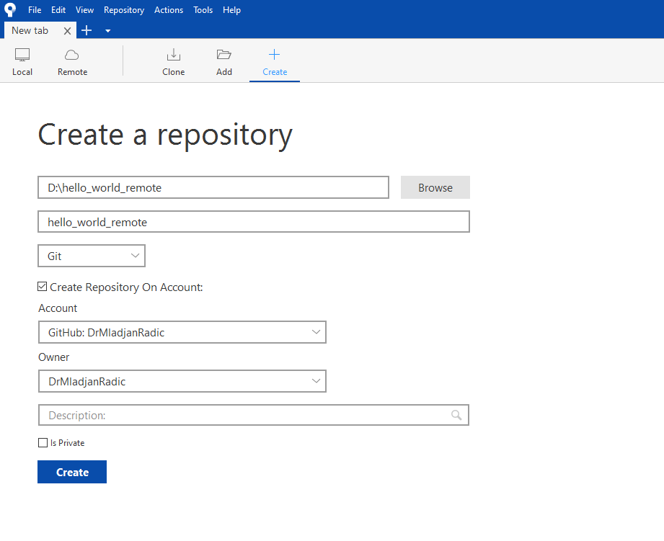

Make Remote Repository
Choose the path to your Repo
Give your Repo a Name
Now we check this Box
Choose the right Account
Set the Owner of the Repo
Recommended: Meaningful Description of Repo
If you want the Repo to be private
Click here to create
Notes:
2

Slide 3
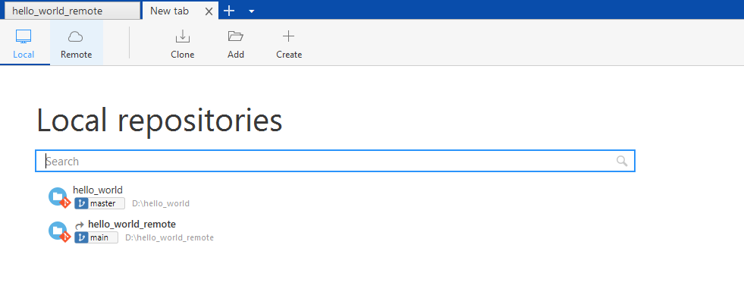
Make Remote Repository
Under Local you will receive a new Repository
Notes:
3

Slide 4
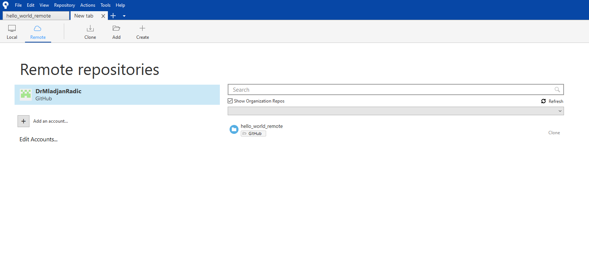
Make Remote Repository
Under Remote you will also receive a new Repository (Recommended: always click on Refresh first)
Notes:
4

Slide 5
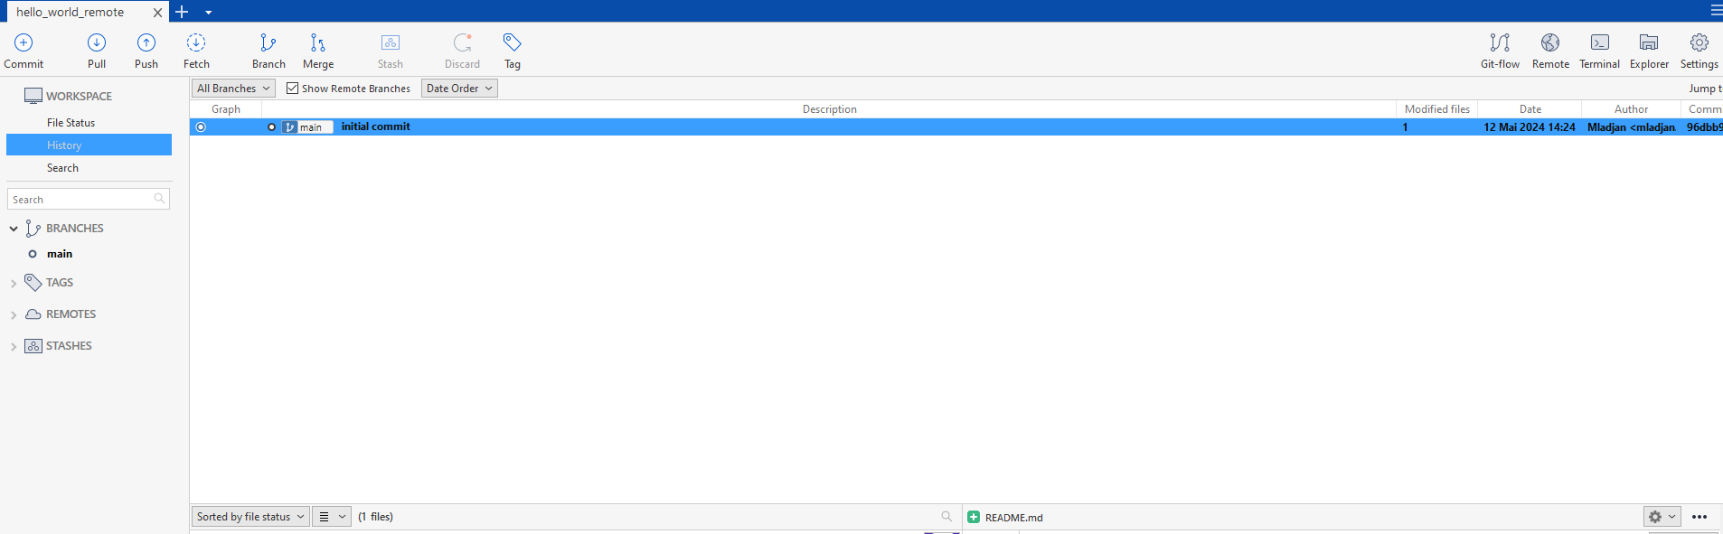
Make Remote Repository
The remote Repo can now be used totally analogously as the local repository
Create a new File in your Folder, e.g. README.md
Stage the new file
Commit
This is only local!
Commit message
main instead of master (github default)
Notes:
5

Slide 6
Make Remote Repository
How do we push the commit on the remote repository?
Notes:
6

Slide 7
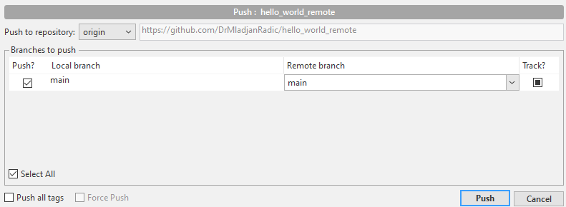
Make Remote Repository
Select the correct branch to push (if more are available)
A new window will appear
Notes:
7

Slide 8
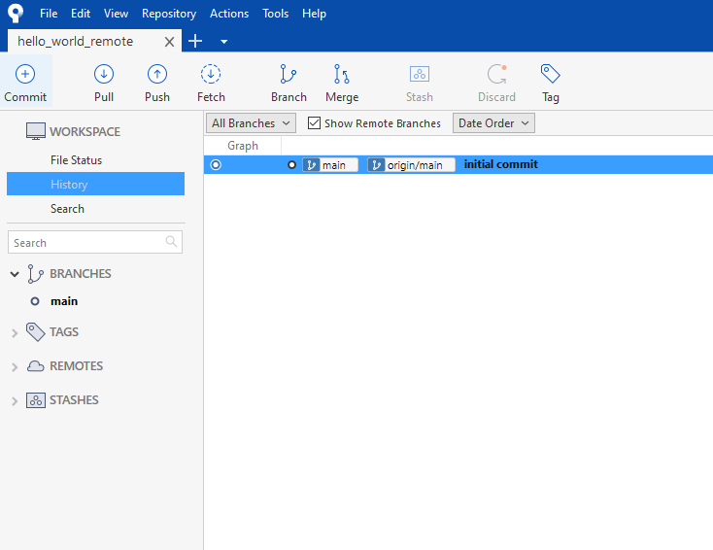
Make Remote Repository
Origin indicates, that the initial commit is also on the remote Repo (here: on github)
And therefore not only locally
Notes:
8

Slide 9
Short Recap
Create Repo → Do Some Changes → Stage → Commit → Push
Equal to a local Repo
Push the local commits / changes to the remote Repo
Notes:
9

Slide 10
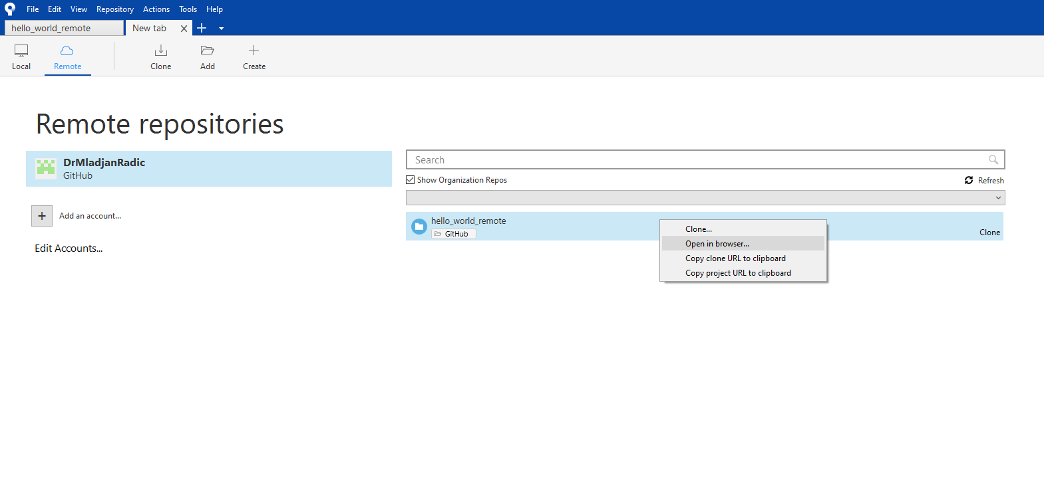
One more thing
Right click on the Repo and Select „Open in Browser“
(Don’t forget to click refresh)
Notes:
10

Slide 11
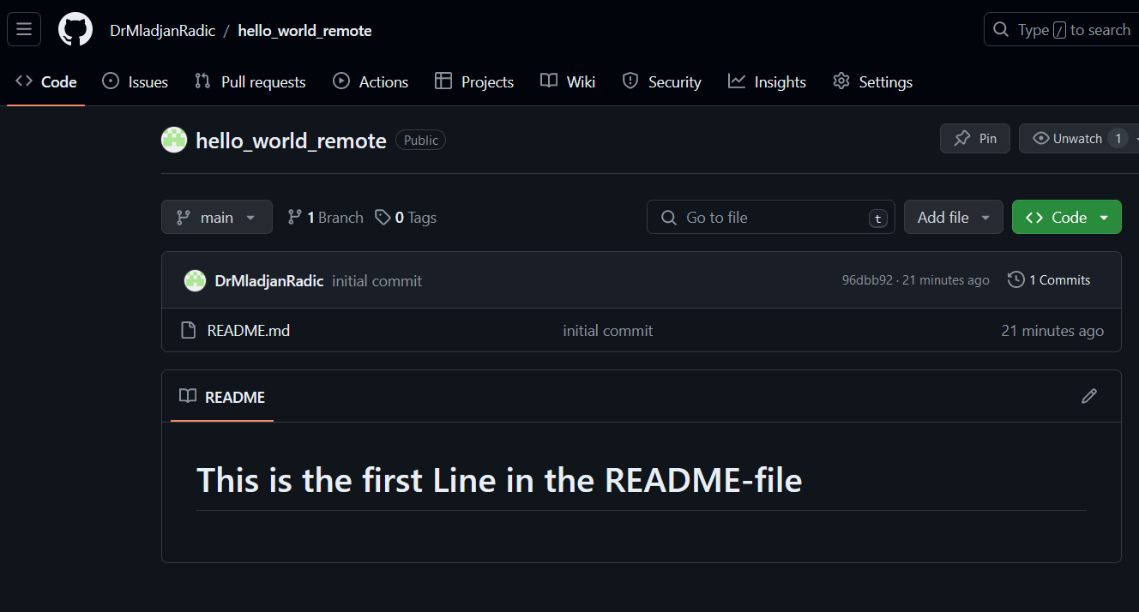
Now you can admire your Remote Repo und README - File :)
Notes:
11

