Slide 1

PlatinPie
GIT Training
Exercise 02 – Remote Repo Exercises
Notes:
1

Slide 2
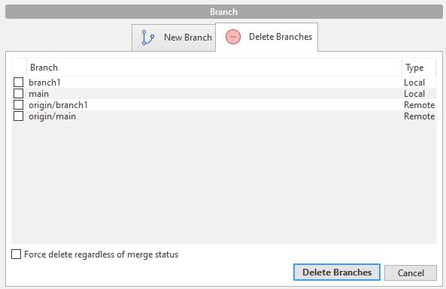
Play with the Remote Repository
Create a new Branch branch1
Checkout Branch branch1
Create a new file with some content
Stage
Commit
(Push if you want to)
Checkout main / master
Merge to main / master
Push
(Delete Branch, if needed)
You have the possibility to delete your branches locally and / or
remote, indicated by origin/...!
Notes:
2

Slide 3
Play with the Remote Repository
Create a multiple Branches, e.g. b1, b2, b3, ...
Create a new files or edit existing ones
Stage
Commit
(Merge, if needed)
(Push if you want to)
Merge to main / master
Push
Notes:
3

