Slide 1

PlatinPie
GIT Training
Git Hooks
Notes:
<Foliennummer>

Slide 2
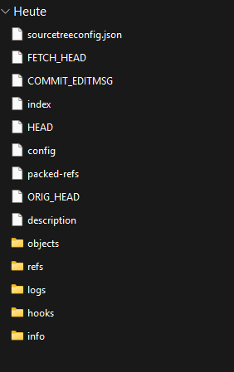
Git Hooks
Every Repo has a .git folder
This folder contains a hooks folder
Notes:
<Foliennummer>

Slide 3
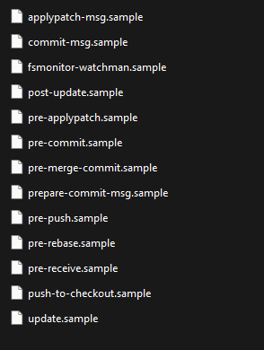
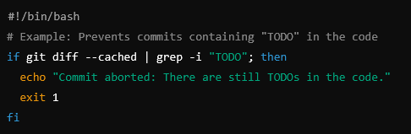

The hooks folder contains a lot of samples
If you want to activate a hook - just delete the .sample ending of the file, e.g. rename „pre-commit.sample“ to „pre-commit“
You can edit the pre-commit file, e.g.:
Don’t forget to make the script executable:
Which will check, if any file containts TODO and prevent the commit if so. You can also add pre-push commands etc (see list of samples).
Notes:
<Foliennummer>

Slide 4
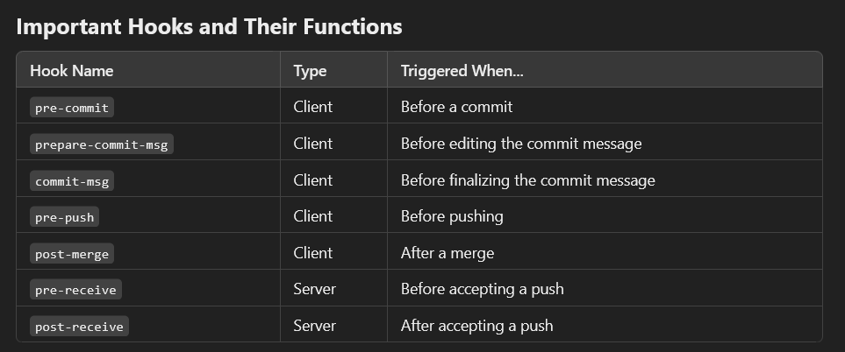

Slide 5
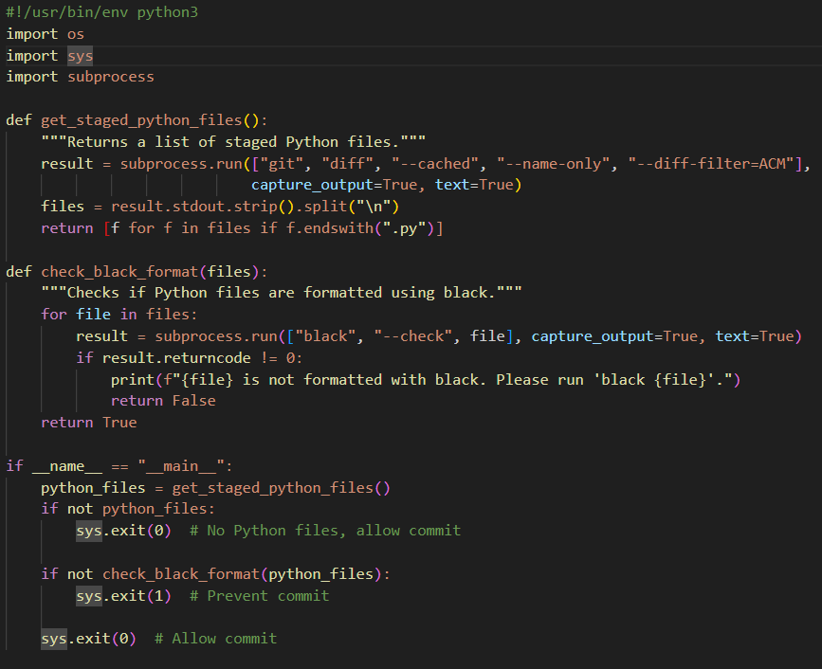

Git Hooks in other script languages
Git Hooks can also be written in any other script language, e.g. python:
This script does the following:
get_staged_python_files() retrieves all staged .py files.
check_black_format() runs black --check to verify formatting.
If any file isn’t formatted, the commit is prevented.
If all files are correctly formatted, the commit proceeds.
Never forget, to make the script executable:
Notes:
<Foliennummer>

