Slide 1

PlatinPie
GIT Training
Exercise 00
Notes:
1

Slide 2
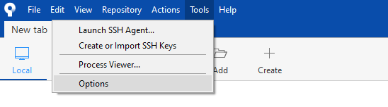
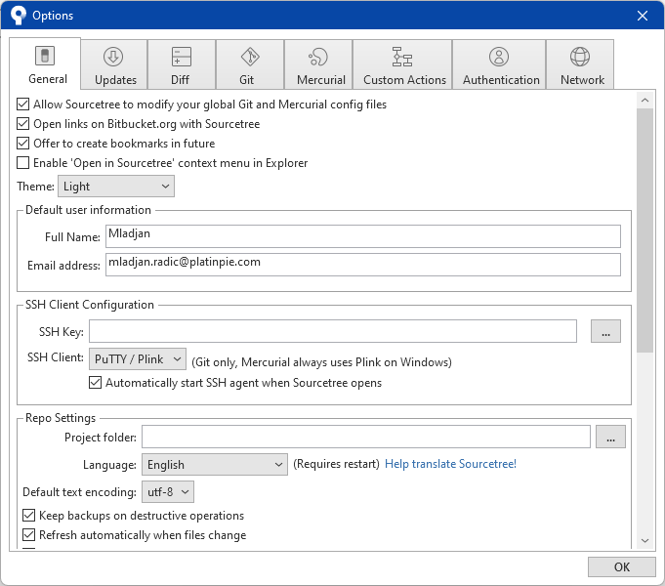
Preliminaries
Go to Tools and then click on Options
A new Window will pop up
Insert your Full Name
Insert your Email address
This is necessary to identify the commiter to the corresponding commits
You can make more changes to the design and appearence of sourcetree
Notes:
2

Slide 3
Preliminaries
Alternatively, you can also set these variables via git-shell or terminal:
Set your username: $ git config --global user.name "FIRST_NAME LAST_NAME"
Set your email address: $ git config --global user.email "MY_NAME@example.com"
Notes:
3

