Slide 1

PlatinPie
GIT Training – Round 6
Git submodules
Notes:
<Foliennummer>

Slide 2
Why submodules?
Imagine working on a large software project with multiple components (e.g a web application with a frontend, backend, and shared libraries).
Keeping everything organized, up-to-date, and version-controlled can become a nightmare.
This is where Git Submodules come to the rescue!
Git Submodules allow to include external repositories within the main repository while maintaining independent version control for each.
This means one can work on different parts of the project separately without disrupting the entire workflow.
By mastering Git Submodules, one gains more control over dependencies, enabling seamless collaboration and modular code management.
Notes:
<Foliennummer>

Slide 3
Example Use Case
Scenario: Managing a Shared Library Across Multiple Projects
Suppose a company has developed a custom authentication library used by multiple applications. Instead of duplicating the library code in every project (leading to maintenance headaches) -> create a dedicated Git repository for the library and add it as a submodule in each project.
Notes:
<Foliennummer>

Slide 4
Benefits
Benefits:
Keep the module(s) separate and reusable.
Update the module in one place and sync changes across all projects.
Avoid code duplication and ensure consistency.
By leveraging Git Submodules, one enhances code modularity, streamline collaboration, and maintain a cleaner, more scalable development process.
Notes:
<Foliennummer>

Slide 5

Consider a Repository
Notes:
<Foliennummer>

Slide 6
Include a submodule
We have cloned a repository
It contains an unstyled html-site
We want to add a .css-file, containing the style
Consider: We have several html-sites and we want to style them all the same. Hence, changes in the style should be tracked by ALL other repositories.
We want to use a submodule, containing a dedicated repository, having the stylesheet.
Notes:
<Foliennummer>

Slide 7
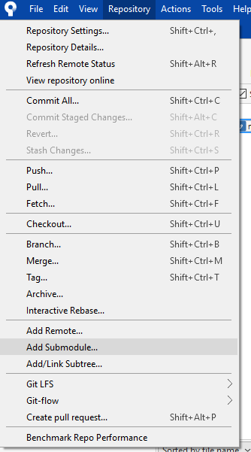
Choose adding a submodule
Notes:
<Foliennummer>

Slide 8
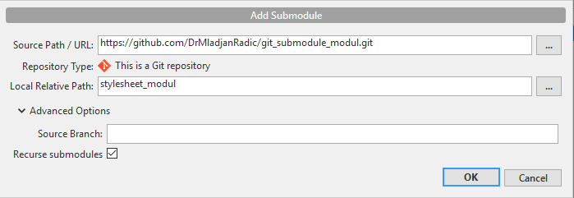
Choose the submodule repository
Name the subdirectory, where the submodule will be included
You can track a certain branch (besides the main-branch)
In the case of a submodule containing a submodule containing a submodule containing ...
Notes:
<Foliennummer>

Slide 9


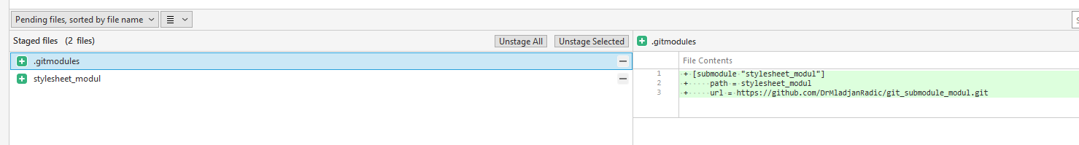

After selecting OK, sourcetree will create:
And your folder will contain a new folder:
Sourctree will recognize two new files:
New folder containing the submodule (repository)
New file
New file, containing the informations of the submodule
New file, containing the hash the the submodule commit
Notes:
<Foliennummer>

Slide 10
Both new files have to be commited
Note, that the submodule folder and its content is not tracked/versionized by your main repository! Only the two files .gitmodules and stylesheet_modul will be tracked and pushed to your main repository.
Notes:
<Foliennummer>

Slide 11
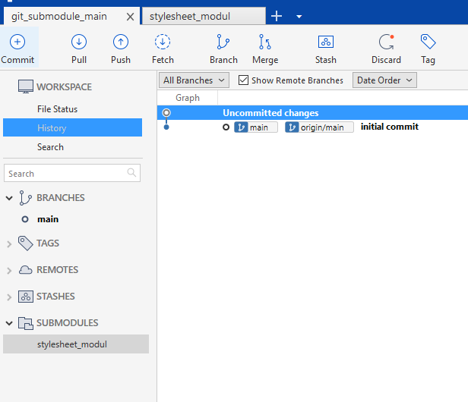
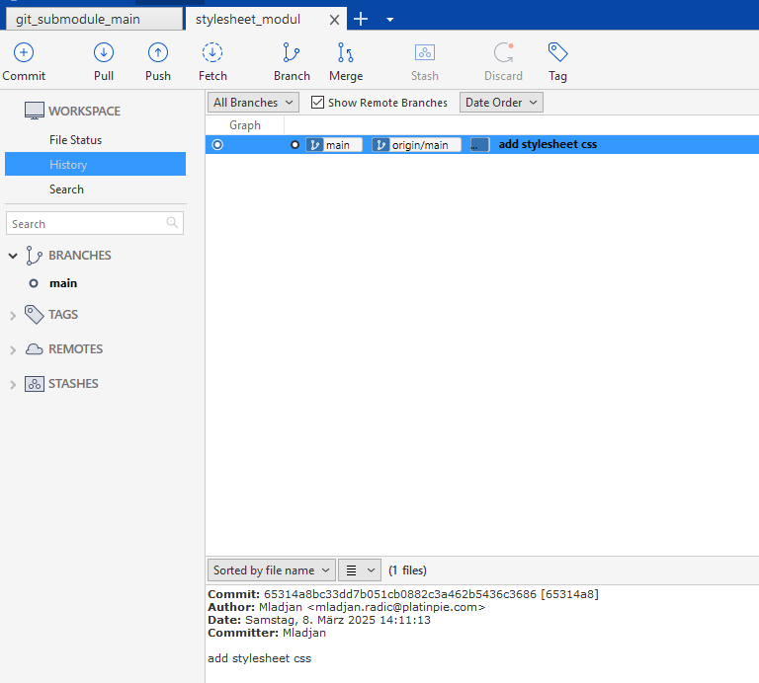
Double click on the submodule
Will open the stylesheet_modul and you can then inspect the repository and its history
This commit should be the one in the stylesheet_modul file!
Notes:
<Foliennummer>

Slide 12

You can checkout another commit in the submodule
Note, that the file „stylesheet_modul“ will change, since the commit-hash changes
Notes:
<Foliennummer>

Slide 13
Imporant commands
How to fetch all submodules?
How to update all submodules?
How to update all sumbodules recursively (if submodules also contains sumbodules)
Notes:
<Foliennummer>

Slide 14
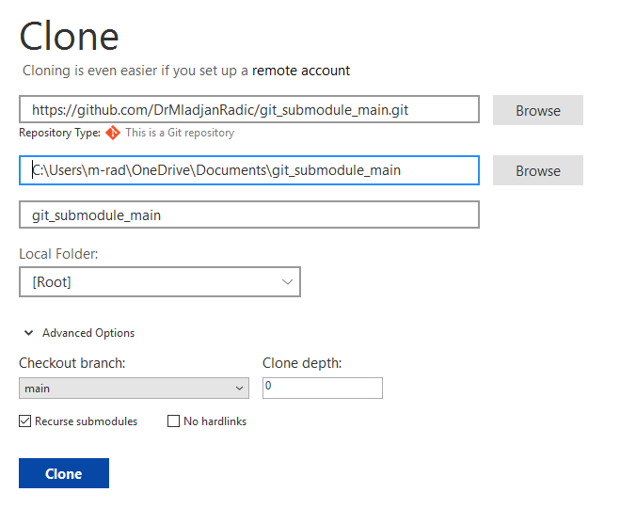
Clone a Repo with Submodules with Sourcetree
Should be checked, other submodules my not be checked out!
Notes:
<Foliennummer>

Slide 15
Clone a Repo with Submodules with Shell
Important, otherwise sobmodule folder will be empty!
Notes:
<Foliennummer>

Slide 16
Where to find more information
https://git-scm.com/book/en/v2/Git-Tools-Submodules
https://www.atlassian.com/git/tutorials/git-submodule
Notes:
<Foliennummer>

