Slide 1

PlatinPie
GIT Training – Round 6
Git Subtree
Notes:
<Foliennummer>

Slide 2
Submodules or Subtrees?
Differences
🔹 Git Submodules: Best when you want to treat an external repository as a separate entity while keeping full version control over it. The submodule remains an independent repository, meaning updates require explicit pulling and pushing. This is useful when different projects rely on a shared but independently evolving module.
🔹 Git Subtree: Best when you want to integrate an external repository directly into your project while still being able to sync changes. Unlike submodules, a subtree doesn’t require special commands to clone or check out—it’s just part of your main repository. This makes it easier to work with for teams unfamiliar with submodules.
Notes:
<Foliennummer>

Slide 3
Use Case Comparison
✅ Git Submodule Use Case:
A company-wide authentication library used across multiple projects. - The library is maintained separately, and each project uses a specific version of it. - Developers don’t need to worry about unnecessary updates; they can choose when to pull new changes. - Works well when the external module has its own independent lifecycle.
✅ Git Subtree Use Case:
A frontend project that integrates a UI component library from another team. - The UI library is actively developed within the main project and needs to be updated frequently. - The team wants a seamless workflow without extra commands to manage submodules. - Avoids the complexity of submodules while still allowing updates from the source repo when needed.
Notes:
<Foliennummer>

Slide 4
Key Differences
Feature | Submodule | Subtree
External repo remains independent | Yes | No (fully integrated)
Requires extra commands for updates | Yes | No
Easy for new contributors | No | Yes
Suitable for shared, versioned dependencies | Yes | No
Changes flow more easily between repos | No | Yes
Notes:
<Foliennummer>

Slide 5

Consider a Repository
Notes:
<Foliennummer>

Slide 6
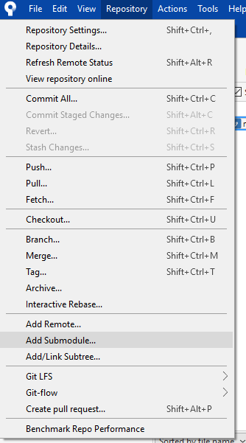
Include a subtree
Choose add/link subtree
Notes:
<Foliennummer>

Slide 7
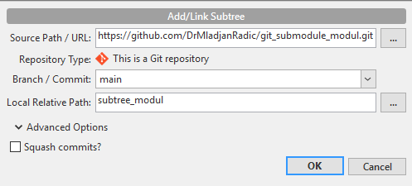
Choose a repository as a subtree
Choose a branch
Choose a subdirectory name
When not selected, the whole history of the repository will be included otherwise, the history will be squshed
Notes:
<Foliennummer>

Slide 8

Notes:
<Foliennummer>

Slide 9
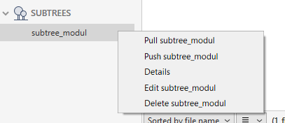
Pull and Push to the subtree-repository
Pull the latest changes
Push the latest changes
Here you can e.g. change the branch or make other changes

Slide 10
Remarks
Git Subtree is essentially like merging an entire repository into your main repository—but with some extra flexibility!
Unlike Git Submodules, which keep repositories separate, Git Subtree actually embeds the external repository’s content into your main repository while still maintaining a connection to its source.
When you add a repository as a subtree, you’re pulling in its entire commit history and placing it within a subdirectory of your main project. However, the key advantage is that you can still pull updates from the external repository and push changes back to it when needed.
Think of it as merging a repository but keeping the ability to sync with its source.

Slide 11
Key Features of Git Subtree
✅ No extra cloning needed – Unlike submodules, contributors don’t have to do special commands like git submodule update. Everything is inside the main repo.
✅ Self-contained history – The subtree’s commit history is included in the main repo, so there’s no dependency on an external repository.
✅ Bidirectional updates – You can pull updates from the original source repo and push changes back when necessary.
✅ Easier for new developers – No extra setup is needed; just clone the main repository, and everything is there!

Slide 12
More informations
https://www.atlassian.com/git/tutorials/git-subtree
https://www.geeksforgeeks.org/git-subtree/
https://medium.com/@v/git-subtrees-a-tutorial-6ff568381844

