Slide 1

PlatinPie
GIT Training
Best Practices
Notes:
1

Slide 2
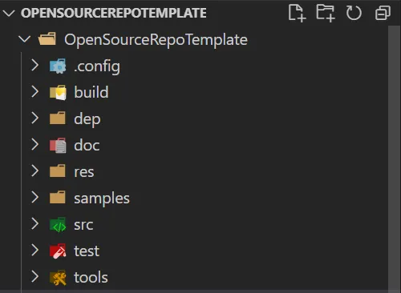
How to structure a Repository
src: Folder for the source code. (No Headers!)
test: Folder containing unit tests, integration tests, unittests, etc.
.config: Folder containing local configuration related to setup on local machine
.build: Folder containing scripts related to build process (e.g. Powershell, Docker compose, etc.)
dep: Folder containing all dependencies for the
doc: Folder containing the documentation
res: Folder containing all static resources in your project (e.g. images)
samples: Folder containing „Hello world“- Code supporting the documentation
tools: Folder containing scripts to automate tasks (e.g. rename scripts, etc.) You may also include folders like:
Lib: Folder for libraries, which should be rather stored in dep
Out: Folder for output produced by your code/software)
Notes:
2

Slide 3
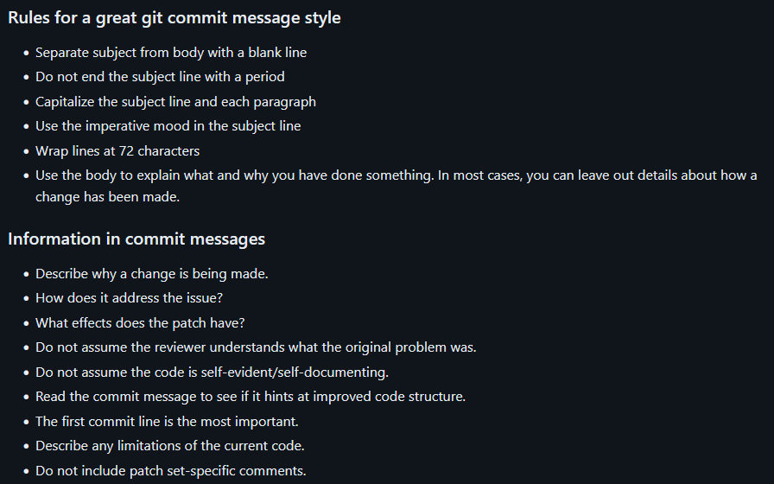
Commit Messages
Taken from: https://gist.github.com/robertpainsi/b632364184e70900af4ab688decf6f53
Notes:
3

Slide 4
Naming a Branch
You may consider fixing your most important branches (depending on your workflow)
main/master
develop
bugfix
hotfix
release
Etc. Use seperators, like „-“, „_“, „/“ (for readability, but please: be consistent!)
Example: optimize-data-analysis or optimize_data_analysis or optimize/data/analysis
Start Name with Category Word:
hotfix/optimize-data-analysis
bugfix/…
feature/…
test/…
wip/…
If you are working with ID’s, try to include them, like:
feature/458-optimize-data-analysis
Notes:
4

Slide 5
Some useful hints:
Avoid using only numbers
Avoid long branch names
Be Consistent (keep the same name conventions, seperators, etc.)
Include all relevant facts/tasks/etc
Notes:
5

Slide 6
Writing a README-file
The README-file is usually a markdown file.
For practicing markdown you can visit: https://www.markdowntutorial.com/ The README-file may/can contain:
Introduction (what does the Repo do?)
How to install
How to contribute
Ruleset
Authors
Licencing
There are a lot of wonderful Templates, like: https://gist.github.com/PurpleBooth/109311bb0361f32d87a2
https://gist.github.com/akashnimare/7b065c12d9750578de8e705fb4771d2f
https://github.com/matiassingers/awesome-readme
Notes:
6

