Slide 1

PlatinPie
GIT Training
Git Clients
Notes:
<Foliennummer>

Slide 2
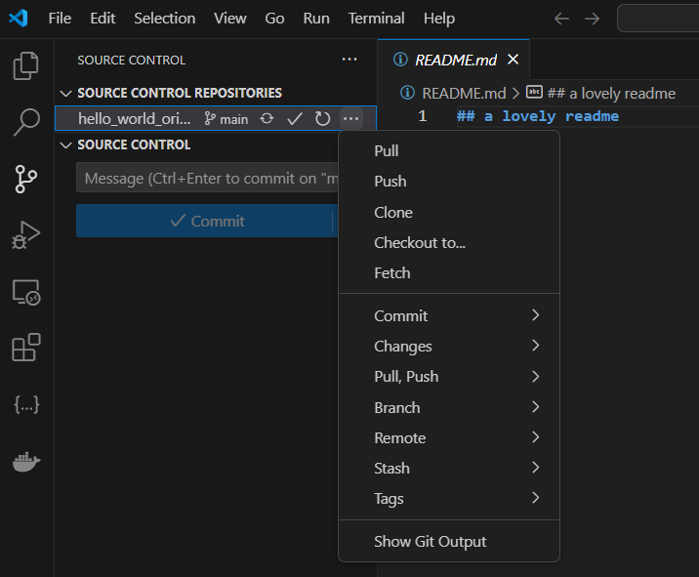
Git Clients
Git is very widely integrated in many IDEs, Editors.
There is also a lot of other UI-Editors for Git.
Let us start with Visual Studio Code:
Branch
Notes:
<Foliennummer>

Slide 3
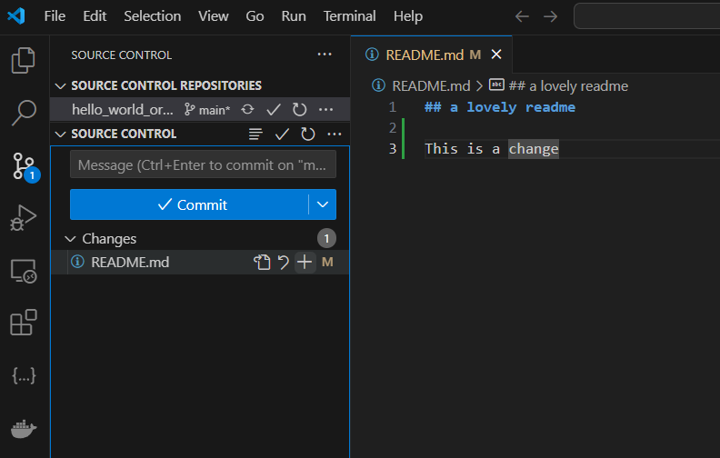
Git – VS Code
A change has been made
A change has been made
Set a commit message and commit it
Stage changes
Notes:
<Foliennummer>

Slide 4
Git – VS Code
A change has been made
A change has been made
Set a commit message and commit it
Stage changes
Notes:
<Foliennummer>

Slide 5
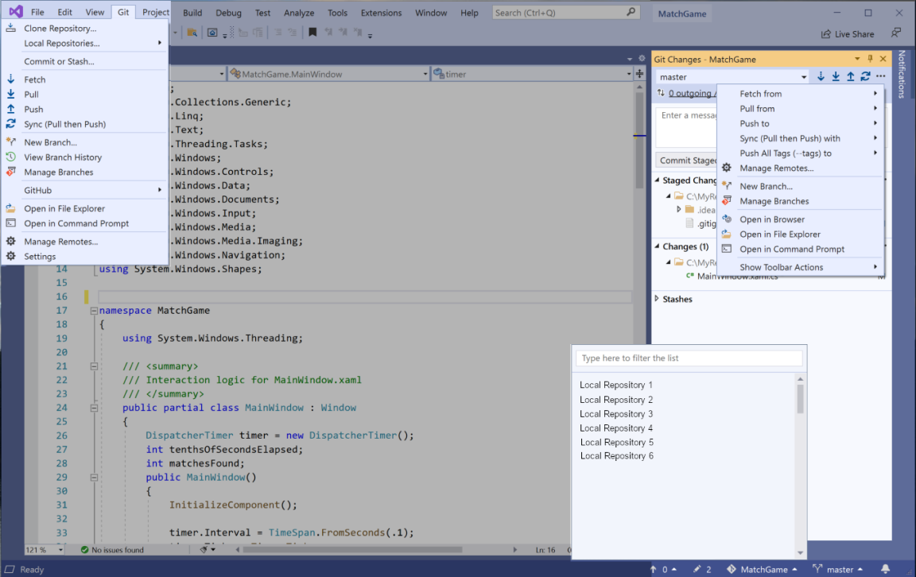
Git – Visual Studio
Taken from: https://learn.microsoft.com/de-de/visualstudio/version-control/git-with-visual-studio?view=vs-2022
Notes:
<Foliennummer>

Slide 6
Programs you might use having Git integrated
- PyCharm
- R Studio
- Eclipse
- etc
Notes:
<Foliennummer>

Slide 7
Git Clients – Alternatives to Sourcetree
SmartGit:
https://www.syntevo.com/smartgit/
GitKraken:
https://www.gitkraken.com/git-client
More Overview and a greater list:
https://git-scm.com/download/gui/windows
Notes:
<Foliennummer>

Slide 8
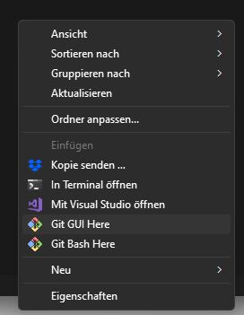
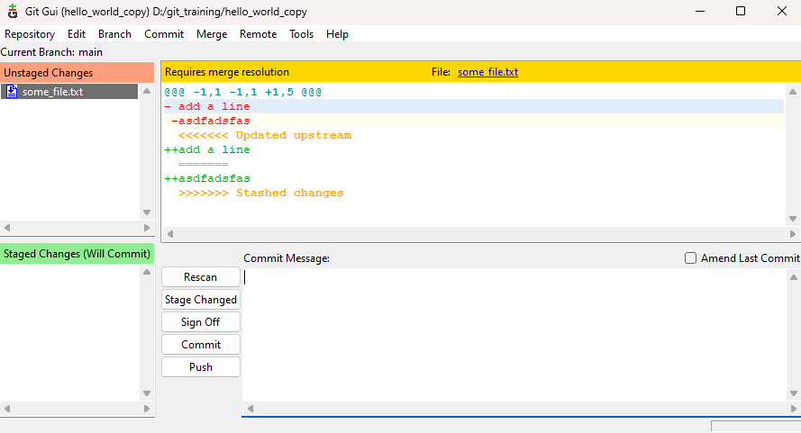
Git Clients – Alternatives to Sourcetree
In a repository folder, right click, you can also choose Git GUI (usually it comes preinstalled with Git, but maybe you need to install it). Similar Handling as sourcetree.
Notes:
<Foliennummer>

