Slide 1


Dynamics of Neural Systems Single Compartment Models
Martin A. Giese
Martin.giese@uni-tuebingen.de
Oct 28, 2024

Slide 2
Overview
Derivation of simplified circuit models
Behavior of simplified circuit model

Slide 3
Overview
Derivation of simplified circuit models
Behavior of simplified circuit model

Slide 4
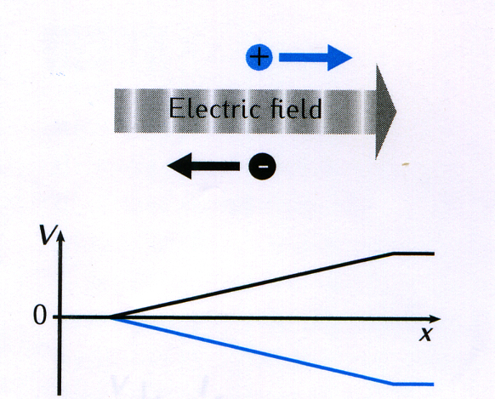

Physical basis of ion movements I
Ions move through channels in the cell membrane by electro-diffusion: a) Force induced by electrical field: F = q E q: charge E: strength of el. Field voltage: b) Diffusion along concentration gradient: [A]: concentration of ion type A Flux:
+
Fick‘s law:
Diffusion constant

Slide 5

Equivalent current density
Ion movement (flux) induces equivalent electric current.
Current density (current / area):
Total current density given by sum over all ion types that can cross the membrane, e.g.:
Faraday constant (charge of 1 mol electrons)
Signed valency of ion A
$$\left[\frac{\text{A}}{m^{2}}\right]$$

Slide 6
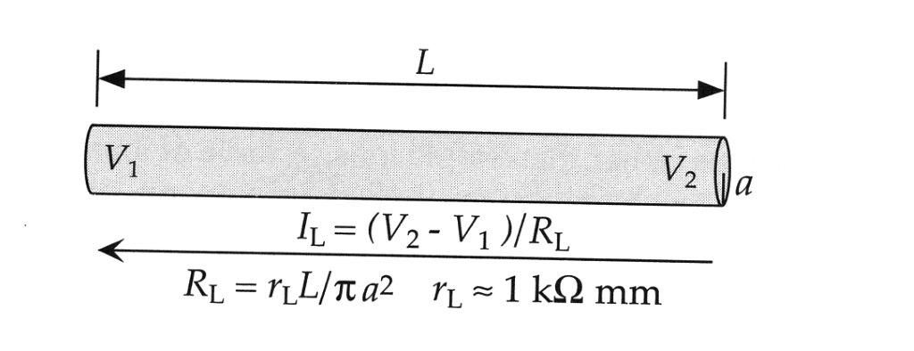
Longitudinal current
Current flowing along axon or cell compartment.
Assumption: constant concentration of ions along the compartment. ⇒ ; no diffusion current.
Homogeneous electrical field with strength E = (V₂− V₁) / L.
This implies the longitudinal current density:

Slide 7
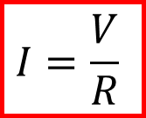
Longitudinal current
This implies the total current:
This is Ohm’s law; compartment behaves like a simple resistor.
Intracellular resistivity
Area
V₁
V₂
Remember: Ohm’s law:
V=V₂−V₁
$$I=\frac{V}{R}$$
V₁
R
V₂
I

Slide 8
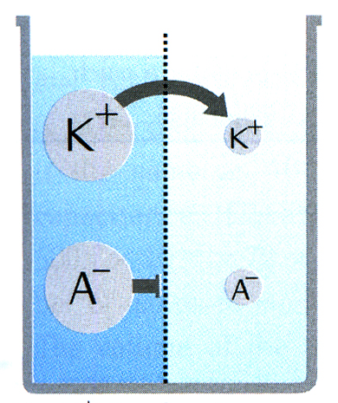
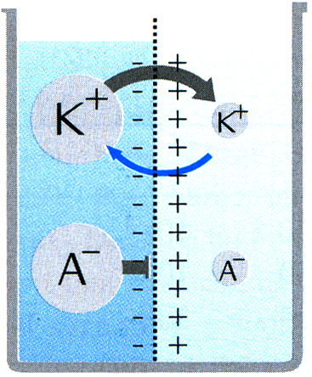
Resting membrane potential
Semipermeable membrane; K⁺ can pass; other ions A⁻ not.
K⁺ diffuses along concentration gradient.
This induces an electrical charge that creates a field that counteracts the diffusion.
Stationary equilibrium state without effective ion flow (diffusion movement = drift mov.) for Nernst (equilibrium) potential:
Nernst equation
E

Slide 9
Membrane capacity
Membrane is an insulator and thus behaves like a charged capacitor (ca. 1 μF /cm²).
Voltage changes induce current flow:

Slide 10
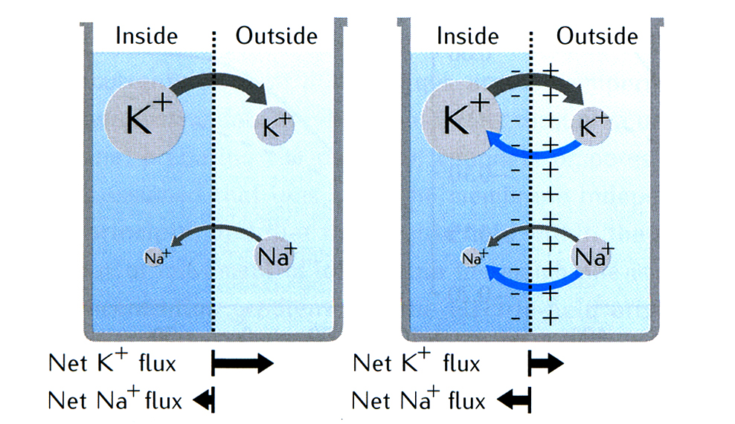
Permeability for multiple ion types
In equilibrium state net current through the membrane is zero.
In living cells ion pumps maintain continuous ion flow.
Equilibrium potentials for different ion types are coupled through the membrane potential.
Flux through membrane (for ion type A):
Membrane permeability (for ion type A)

Slide 11
Goldman-Hodgkin-Katz current equation
Assuming constant membrane potential V and independence of different ion types, one can derive for the current density (current per area): Goldman-Hodgkin-Katz (GHK) current equation
Permits computation of the current per ion type for a given membrane potential V.

Slide 12
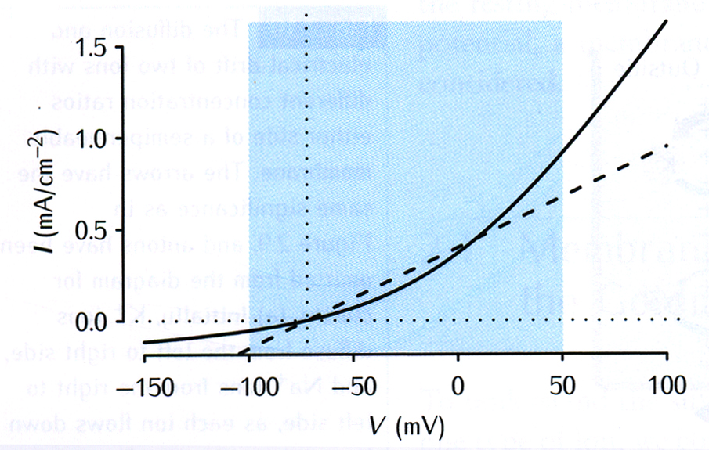
Simple approximations of the GHK current equation
The GHK current equation specifies a highly nonlinear (non-ohmic) current – voltage relationship.
Multiple approximations, dependent on ion type: a) Linear: I = g (V – V₀) (works well for potassium in normal working regime)
K⁺

Slide 13
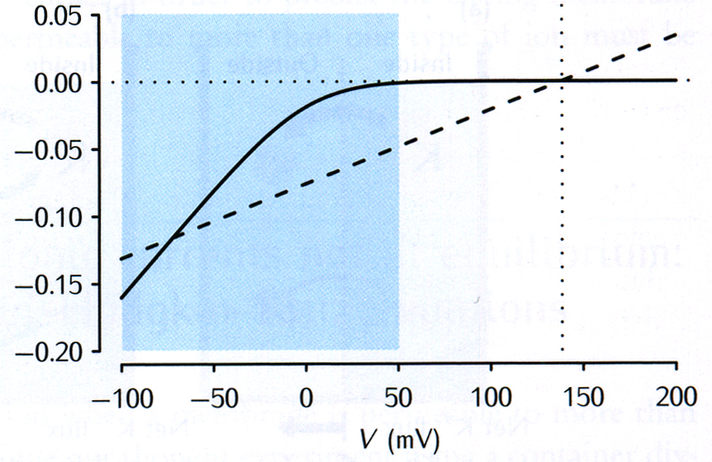
Simple approximations of the GHK current equation
The GHK current equation specifies a highly nonlinear (non-ohmic) current – voltage relationship.
Multiple approximations, dependent on ion type: a) Linear: I = g (V – V₀) (works well for potassium in normal working regime) b) Linear threshold (rectifying / ‘ReLU’ nonlinearity): I = − g [− (V - V₀)]₊ where [x]₊ = max (x, 0)
Ca²⁺
[x]₊
0
x

Slide 14
Goldman-Hodgkin-Katz voltage equation
Net membrane current is the sum of the currents of all ion types. (Here for example only 3 types.)
By setting net current to zero one can compute the equilibrium potential:
This equation holds for monovalent ions (z_{A} = ± 1).
Positive charges outside + neg. charges inside
Negative charges outside + pos. charges inside
Goldman-Hodgkin-Katz (GHK) voltage equation

Slide 15
Overview
Derivation of simplified circuit models
Behavior of simplified circuit model

Slide 16

Equivalent approximative electrical circuit for patch of membrane
Approximate linear relationship for ion type A:
The resulting equivalent electrical circuit for a piece of membrane is a linear ohmic network with parallel capacitor.
g_{A}
V
Current density
Conductance (per unit area)
Equilibrium potential for ion type
Intracellular
Remark: We use here a syste- matic convention from enginee-ring to define the direction of potential differences along voltage sources; in the literature sometimes this is inconsistent because some authors indicate the sign of E_{A} by the orientation of the voltage source / battery symbol.
g_{A}
1
V
C
$$E_{A}$$
2
Extracellular

Slide 17
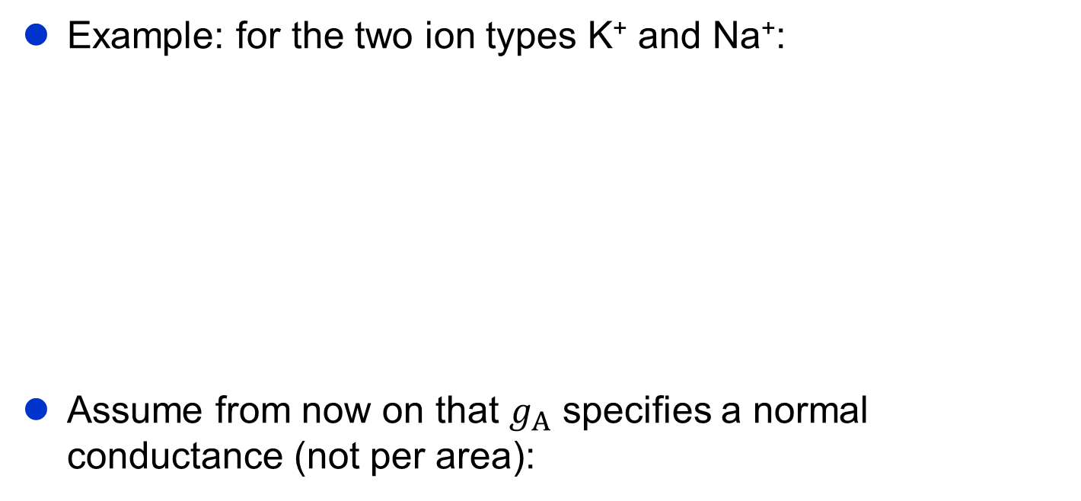

Equivalent approximative electrical circuit for patch of membrane
Example: for the two ion types K⁺ and Na⁺:
Assume from now on that $g_{A}$ specifies a normal conductance (not per area):
Intracellular
V
C
Extracellular
$$I_{A}=g_{A}⋅\left(V−E_{A}\right)$$

Slide 18
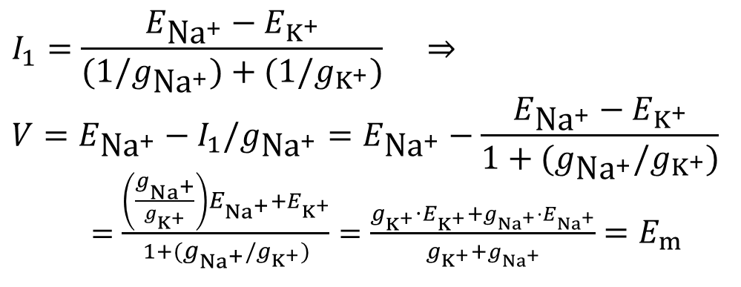
Behavior of the basic circuit I
Analysis of simplified circuit: stationary state (d/dt = 0): Capacitor irrelevant:
$$I_{1}=\frac{E_{\text{N}{\text{a}}^{+}}−E_{K^{+}}}{(1/g_{\text{N}{\text{a}}^{+}})+(1/g_{K^{+}})} ⇒ \\ V=E_{\text{N}{\text{a}}^{+}}−I_{1}/g_{\text{N}{\text{a}}^{+}}=E_{\text{N}{\text{a}}^{+}}−\frac{E_{\text{N}{\text{a}}^{+}}−E_{K^{+}}}{1+(g_{\text{N}{\text{a}}^{+}}/g_{K^{+}})}$$ $=\frac{\left(\frac{g_{{Na}^{+}}}{g_{K^{+}}}\right)E_{{Na}^{+}}+E_{K^{+}}}{1+(g_{{Na}^{+}}/g_{K^{+}})}=\frac{g_{K^{+}}⋅E_{K^{+}}+g_{{Na}^{+}}⋅E_{{Na}^{+}}}{g_{K^{+}}+g_{{Na}^{+}}}$ $=E_{m}$
Auxiliary current:
Intracellular
Equivalent eqilibrium voltage
I₁
V= E_{m}
C
Extracellular

Slide 19
Behavior of the basic circuit II
Analysis of simplified circuit (ctd.):
Shortcut current:
Equivalent membrane resistance
Equivalent simplified circuit (Thévenin theorem)
Intracellular
Intracellular
I_{s}
I_{s}
V
C
Extracellular
Extracellular

Slide 20
Behavior of the basic circuit III
Total circuit: Linear ohmic network with capacitor (here e.g. 2 ion types.)
Equilibrium potential (assume: output current = 0).
The effective output resistance is: (Trick: Shortcut ideal voltage sources.)
Linearity implies that we can replace the non-capacitive parts of the circuit by a single voltage source and a resistor (Thévenin theorem).
Intracellular
V
C
Extracellular

Slide 21
Behavior of the basic circuit IV
To investigate dynamic behavior we assume external input current I_{e}(t); for example step function:
I_{e}(t)
Circuit with external current
t
V
C

Slide 22



Behavior of the basic circuit IV
To investigate dynamic behavior we assume external input current I_{e}(t); for example step function:
Derive corresponding differential equation using Kirchoff’s 1st law:
I_{e}(t)
Circuit with external current
t
$$I_{1}(t)$$
$$I_{C}(t)$$
V
C
$$I_{e}\left(t\right)=I_{C}\left(t\right)+I_{1}\left(t\right)$$
$$I_{e}\left(t\right)=C\frac{dV}{dt}+\frac{V(t)−E_{m}}{R_{m}}$$

Slide 23
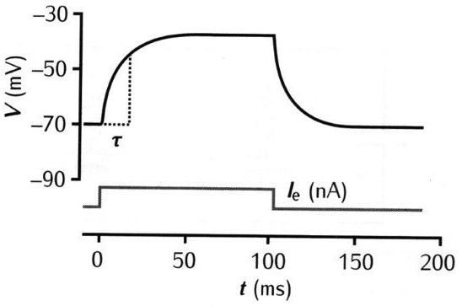
Behavior of the basic circuit IV
Solution for initial condition V(0) = E_{m}
Circuit with external current
V
C
τ: Time constant
Response to rectang. current pulse
V(t)
V(∞)
0
t
E_{m}

Slide 24
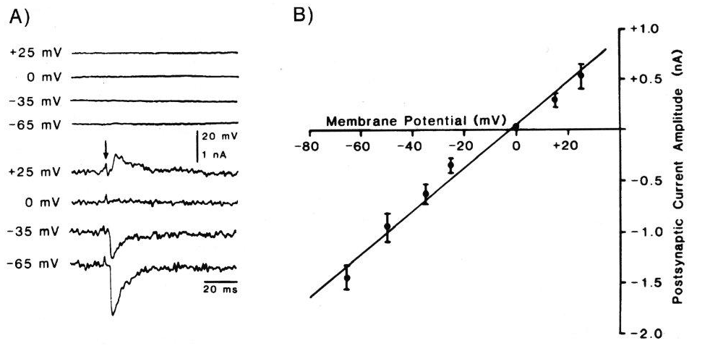
Effect of synaptic input
Activation of chemical synapse leads to short postsynaptic voltage pulse (EPSP, IPSP).
Measurement of induc- ed dynamic postsyn- aptic currents by Voltage clamp: mem- brane voltage kept constant through feedback loop.
Peak amplitude of postsynaptic current is a linear function of the membrane potential V.
Model: Voltage source with time-dependent conductance.
Source voltage E_{syn} typically small, e.g. -5 mV.
Postsynaptic voltage and current
Postsynaptic pulse
Transmitter blocked
pharmacologically
Membrane voltage
(Brown & Johnston,1983)

Slide 25
Equivalent circuit with synaptic input
Model for the postsynaptic current:
The time course of g_{syn}(t) can be modeled, e.g. by an alpha function:
Equivalent circuit described by the differential equation:
Same circuit can be replicated if different types of synaptic channels have to be considered.
V
C

Slide 26
Saturation and effective time constant
Substituting V’(t) = V(t) - E_{m} follows:
Transformation into standard form:
τ’
g_{syn}R_{eff} ⁻¹

Slide 27
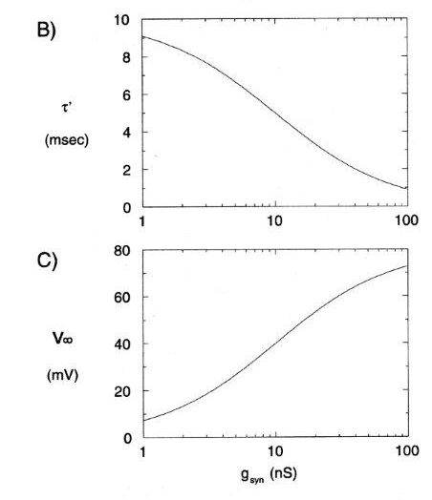
Saturation and effective time constant
Effective time constant:
⇒ Time constant decreases for larger input signal.
Assuming very slow change of g_{syn}, this implies for the stationary activity: ⇒ Saturation for large values of g_{syn}.
Time constant without synapse
g_{syn}R_{eff} ⁻¹

Slide 28
Things to remember
Physical principles of electrodiffusion → 4)
Equilibrium potential → 4)
GHK equations → 4)
Linearized equivalent RC circuits → 4)
Modeling of the effect of synaptic input → 2)
(Numbers relate to literature on next page.)

Slide 29
Literature (for this lecture)
1) Dayan P. & Abbott, L.F. (2001 / 2005) Theoretical Neuroscience: Computational and Mathematical Modeling of Neural Systems. MIT Press, Cambridge MA, USA. Chapter 5.
2) Gerstner, W. & Kistler, W. (2002) Spiking Neuron Models - Single Neurons, Populations, Plasticity. Cambridge University Press, UK. Chapter 2.
3) Koch, C. (1999) Biophysics of Computation. Oxford University Press, UK. Chapters 2 and 3.
4) Sterratt, D., Graham, B, Gillies, A., Willshaw, D. (2011) Principles of Computational Modelling in Neuroscience. Cambridge University Press, UK. Chapters 2 and 4.

