Slide 1
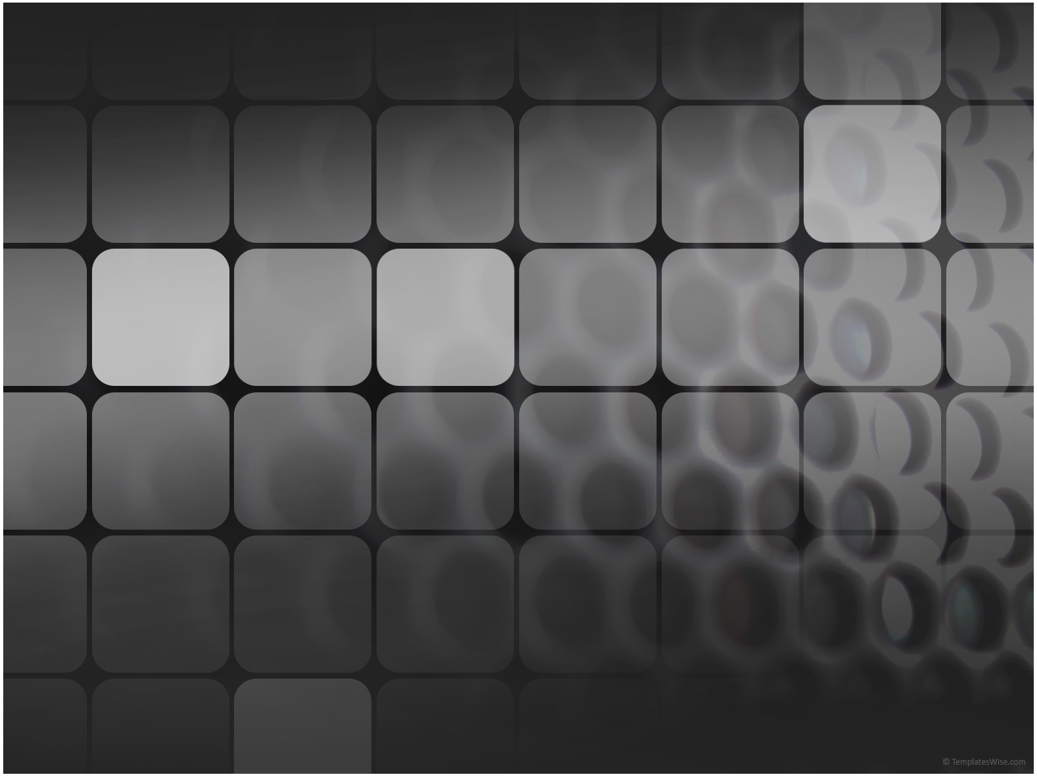
The Stability-Plasticity Dilemma:
A Demonstration of an Imbalance in Layered Learning
Sean Mondesire
College of Engineering & Computer Science
University of Central Florida

Slide 2

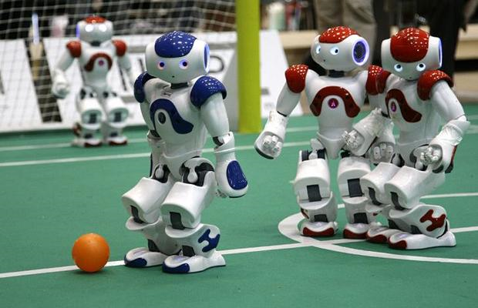
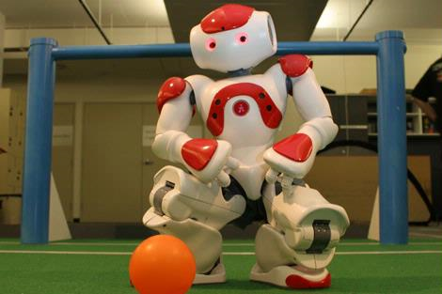
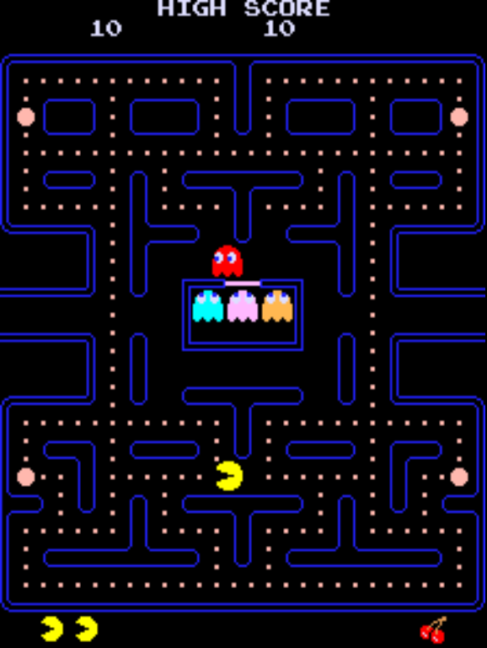
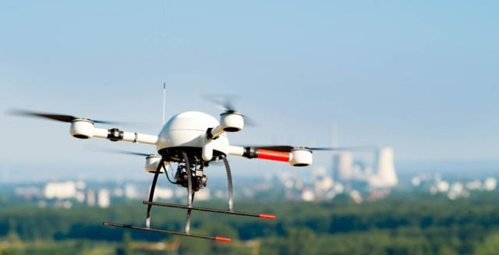
Layered Learning
Notes:
LL uses in real/sim robots to teach them complex tasks
Walking, variations of soccer, solve logic problems, train NPCs in videogames
Robocup accomplishments
http://www.smh.com.au/news/technology/robo-pups-ready-for-battle/2007/05/11/1178390515090.html
http://heraldk.ca/2007/02/14/robocup-soccer/
http://www.telegraph.co.uk/technology/picture-galleries/5734786/Robots-warm-up-for-the-Robocup-Football-World-Cup-2009.html
http://www.omgubuntu.co.uk/2011/01/lca2011-robots-running-on-linux-compete-in-robocup/
http://kn2c.ir/blog/

Slide 3
Goal & Contributions
Goals
Demonstrate Imbalance
Analyze negative effects
Identify causes
Contributions
First study of forgetting
Bring attention to Practioners
Awareness to similar approaches

Slide 4
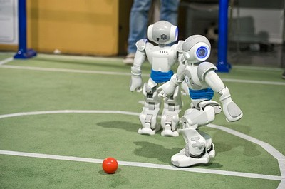
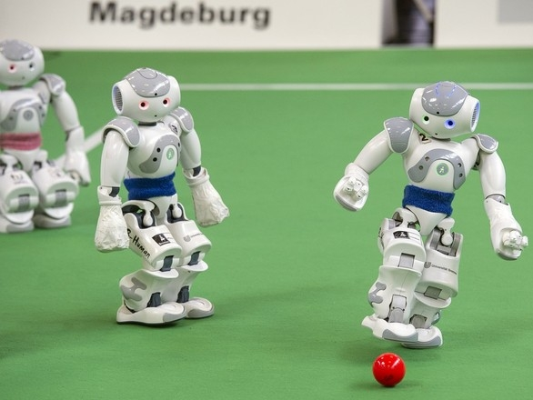
Complex Task:
Shoot
Policy
States
Actions
Move
To
Ball
State1
State2
State3
State4
…
StateN
Action1
Action2
Action3
Action4
…
ActionN
Wind up
Kick
The
Ball

Slide 5
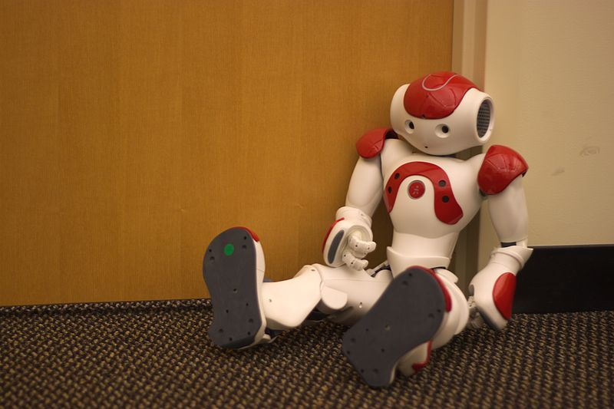
Forgetting
Negative Forgetting
Catastrophic Forgetting
Stability-Plasticity
Imbalance

Slide 6
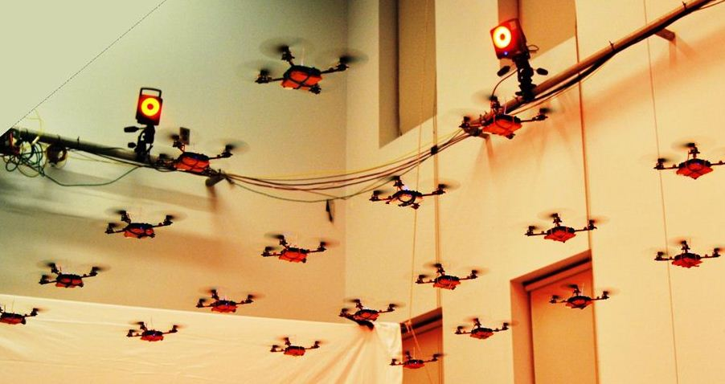
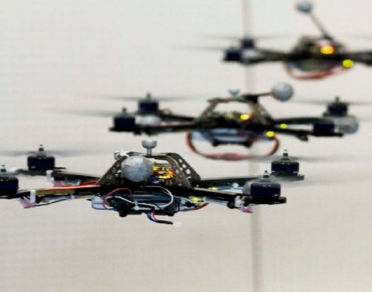
Methodology: Imbalance Demonstration
Multi-agent System Experiments
Evolutionary Algorithm and Q-learning
Subtask Performance Changes are caused by Policy Changes
Task Performance Suffers

Slide 7

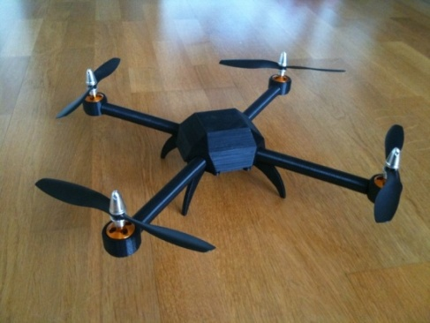
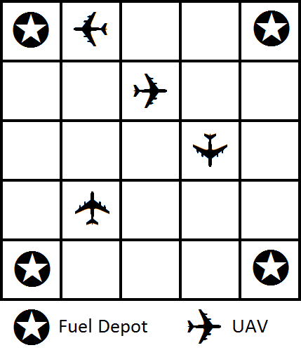
UAV Surveying Problem
4 Quadcopters (UAVs)
Navigate to all cells (50x50)
2,000 Time-steps
Limited Fuel
Takeoff, Move, Land, Refuel
Transmit Visited Cells
Refuel, Takeoff & Survey, UAV Surveying Problem

Slide 8
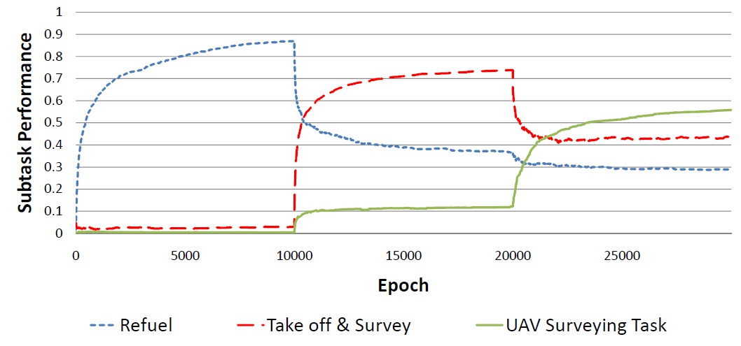
Performance Changes

Slide 9
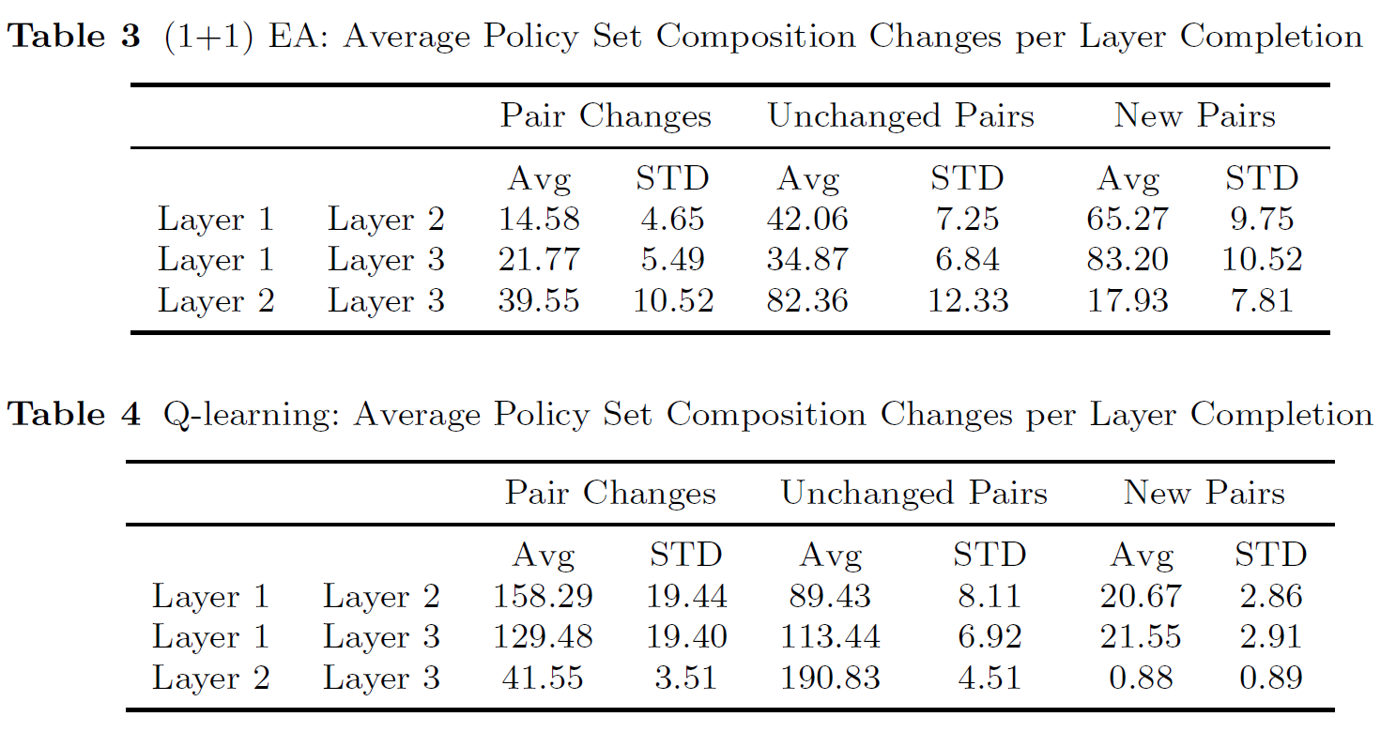
Policy Changes

Slide 10
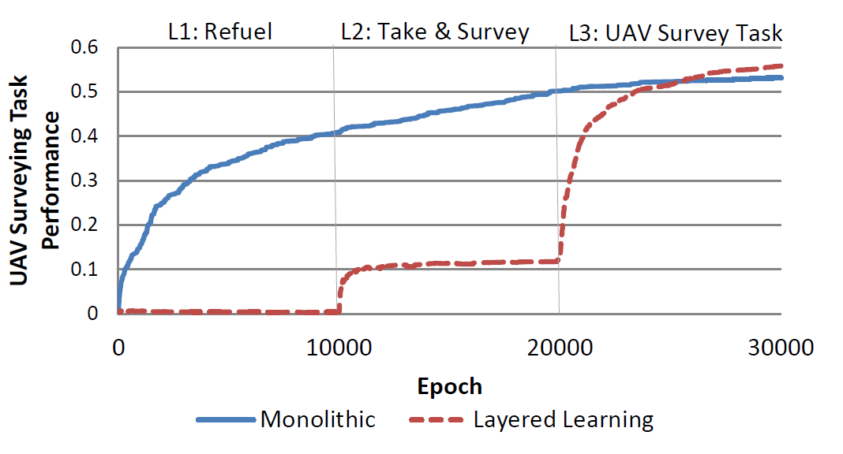
Layered vs. Monolithic Learning

Slide 11
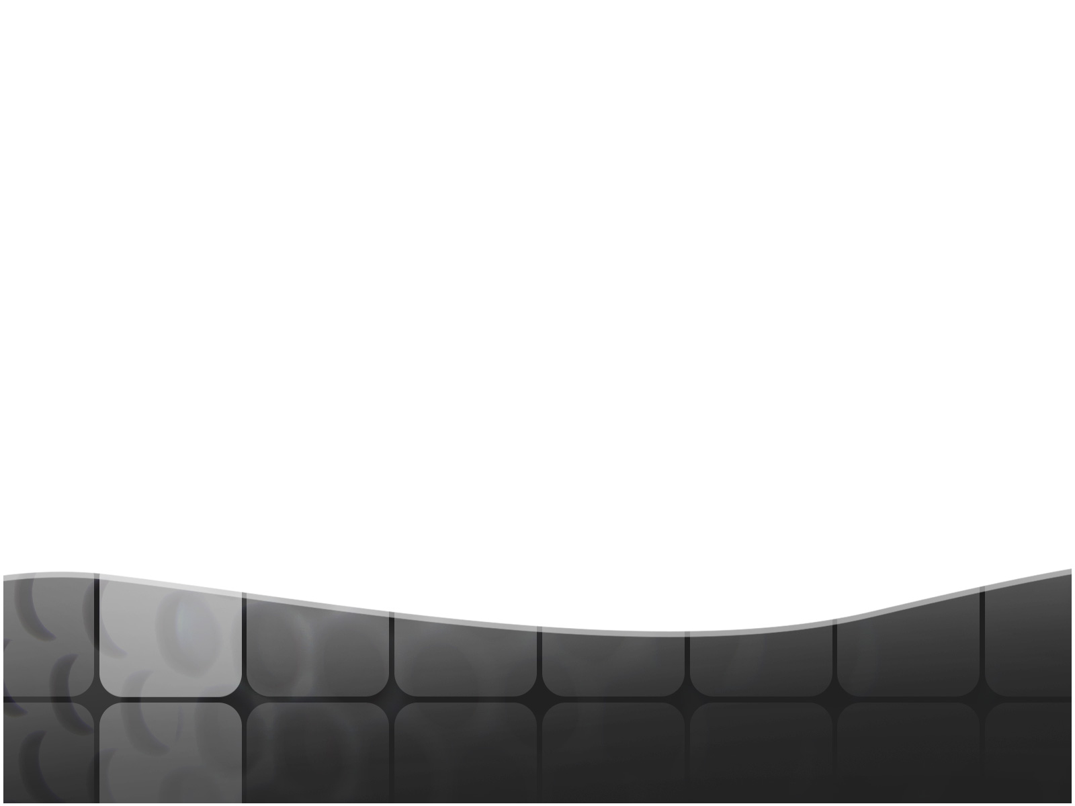
Causes of Imbalance
Layer Transitions
Performance Criteria Change
Greedy Algorithms
No retention incentive
Conflicting Subtasks
Knowledge driven out
Local Optima
Refuel
Take-off and Survey
UAV Survey
(S, A)

Slide 12
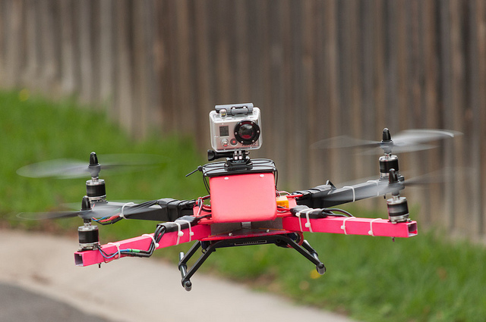
Conclusion
Demonstrated there is a problem
Preference for Plasticity
Identified negative affects
Negative Forgetting
Performance Drops
Unnecessary Re-Learning Time
Pinpointed causes
Layer Transitions

Slide 13
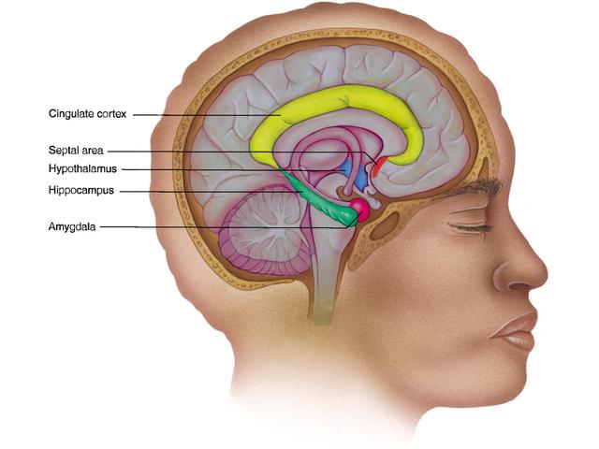
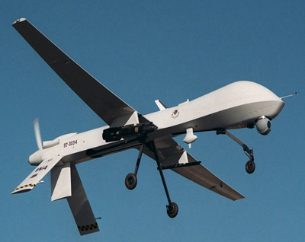
Future Research
Rehearsal Techniques
Layer Repetition
Concurrent Layered Learning
Learning 2+ Subtasks at once
Complementary Learning System
Short/Long-term Memory
25% Improvement

