Slide 1
STRATEGIC BLUEPRINT | BOEHRINGER INGELHEIM KOREA
Korea MASLD / MASH
Ecosystem Blueprint
Systems Analysis, Gap Identification, and Strategic Framework
Dr. Kyungmoon Kim, M.D., MPH · Medical Affairs
Apr 2026 | Johns Hopkins Bloomberg School of Public Health · MPH Practicum

Slide 2
EXECUTIVE SUMMARY
2
Current clinical gap in MASH/MASLD
13 M
95 %
4
Koreans estimated to have MASLD
(~30% of adults 20+)
of at-risk patients never reach
a fibrosis diagnosis
reinforcing feedback loops
sustain the diagnostic gap
Three-Point Thesis
Korea has the clinical evidence, the screening infrastructure, and the imaging density required to identify MASLD/MASH at a population scale. Yet <5% of the at-risk population is actually staged for fibrosis.
This gap is not a clinical competence problem; it is a systems problem. Four interlocking reinforcing loops lock the current state in place.
public awareness, screening system loss, primary/secondary care inertia, and tertiary hepatology bias
Closing the gap therefore requires ecosystem-level intervention, not a single partner or a single product launch. This blueprint defines that ecosystem and maps where each loop can be broken.
Korea MASLD/MASH Ecosystem Blueprint | Johns Hopkins Bloomberg SPH · MPH Practicum
Medical Affairs, Boehringer Ingelheim Korea | Apr 2026

Slide 3

PROBLEM FRAMING · 1
3
Korea's MASLD/MASH diagnostic funnel
Korean Adults (age 20+)
~42M
Estimated MASLD (30% prevalence)
~13M
Estimated MASH (20% of MASLD)
~2.5M
≥F2 MASH (20~40% of MASH)
~500K–1M
Diagnosed MASH
5%
<130K
~95% of MASH patients in Korea remain undiagnosed due to structural NIT barriers
Nah, E. H., et al. (2021). Prevalence of liver fibrosis in the Korean general population. BMJ Open, 11(1), e046529. Kim, H. Y., et al. (2024). Prevalence of clinically significant liver fibrosis: A meta-analysis. Clin Mol Hepatol, 30(S), S199-S213. HIRA. (2022). Statistics on disease subgroups (K758, K760). Healthcare Bigdata Hub. Ye Q, et al. Lancet Gastroenterol Hepatol. 2020;5:739-52. Younossi ZM, et al. (2023). Hepatology, 77(4):1335-1347. (MASH ~20% of MASLD)
Korea MASLD/MASH Ecosystem Blueprint | Johns Hopkins Bloomberg SPH · MPH Practicum
Medical Affairs, Boehringer Ingelheim Korea | Apr 2026

Slide 4
PROBLEM FRAMING · 2
4
Why this is a systems problem, not a clinical one
Every component needed to identify MASLD/MASH at a population scale already exists in Korea.
The gap is not a missing tool. It is the absence of alignment across sectors.
Tools exist
Infrastructure exists
Professional bodies exist
FIB-4, HSI, FLI scoring inputs are present in routine labs
Liver USG and 2D-SWE devices are broadly distributed
Validated non-invasive tests (NIT) recommended by EASL, WFUMB, KASL
KMI operates 30+ health-screening centers
~70% annual adult screening participation (NHIS 2024)
~3.5 M abdominal USG claims per year, 52% at primary care
35,446 USG devices nationwide (KHIDI 2021)
KASL publishes NIT guidelines (2024)
KSoM has Clinical Obesity Guidelines (2022)
KDA has Diabetes Guidelines (2025) referencing liver health
Yet cross-society, MASLD-specific action is limited
Tools and infrastructure are not missing. Alignment across sectors is missing. Systems analysis identifies where that alignment fails.
Sources: NHIS 2024 Health Screening Yearbook · KHIDI 2021 · Jeon SK et al. Clin Ultrasound 2020;5(2):59-64 · KASL 2024 NIT Guidelines · KSoM 2022 · KDA 2025 · EASL-EASD-EASO Clinical Practice Guidelines (J Hepatol 2024)
Korea MASLD/MASH Ecosystem Blueprint | Johns Hopkins Bloomberg SPH · MPH Practicum
Medical Affairs, Boehringer Ingelheim Korea | Apr 2026

Slide 5
PROBLEM FRAMING · 3
5
Stakeholder network — current state
Systems Thinking Tool #1: Stakeholder Network Analysis
Public & Media
(low MASLD awareness)
Interpretation
Primary / Secondary HCPs
(passive)
Health Screening Operators
(KMI, NHIS)
• 8 actors · 1 patient group at center
• Current flows are bilateral and fragmented — no shared operational spine
• Screening operators do not feed hepatologists; hepatologists do not pull from primary care
• Industry invests in tertiary, not primary
• Policymakers wait for clinical demand signals that never arrive
• The Blueprint re-wires these edges around the patient
Policymakers
(MOHW, NHIS, HIRA)
Patients with Obesity
~13 M Koreans with MASLD
Device Manufacturers
(Philips, GE, Samsung)
Academic Societies
(KASL, KSoM, KDA)
Pharmaceutical Industry
(BI, GLP-1 peers)
Tertiary Hepatologists
(HBV/HCV legacy focus)
Korea MASLD/MASH Ecosystem Blueprint | Johns Hopkins Bloomberg SPH · MPH Practicum
Medical Affairs, Boehringer Ingelheim Korea | Apr 2026

Slide 6
SYSTEMS ANALYSIS · OVERVIEW
6
Four reinforcing failure loops
Systems Thinking Tool #2: Causal Loop Diagram (detail in slides 7–11)
R1
Public Awareness Trap
R2
Screening System Loss
Low MASLD awareness in the general public → no patient-initiated screening → no HCP demand for education
→ no investment in awareness
→ awareness stays low.
National & private screening do not surface MASLD (platelet exclusion, HSI/FLI not computed, USG under-used) → no detection signal → no incentive to update panels.
R3
1° / 2° Care Inertia
R4
Tertiary Hepatology Bias
No intervention available at primary/secondary care
→ HCPs do not actively assess
→ no referrals
→ no industry investment in primary-care tools
→ intervention absent.
Hepatology organised around HBV/HCV legacy
→ low therapeutic engagement with MASLD
→ passive referral handling
→ 1°/2° see no value in referring
→ HBV/HCV focus persists.
Korea MASLD/MASH Ecosystem Blueprint | Johns Hopkins Bloomberg SPH · MPH Practicum
Medical Affairs, Boehringer Ingelheim Korea | Apr 2026

Slide 7
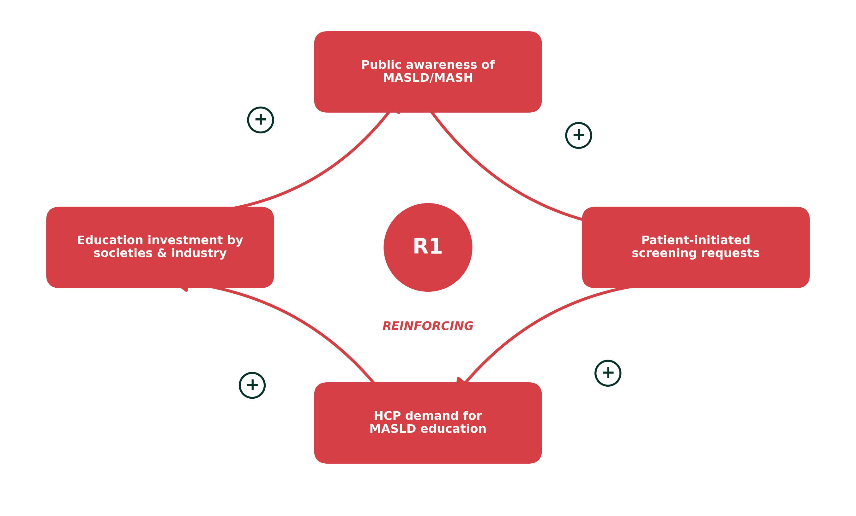
SYSTEMS ANALYSIS · R1
7
Loop R1 — Public Awareness Trap
Reinforcing Loop R1
Narrative
Korea treats obesity primarily as a cosmetic or metabolic-risk issue. Liver health rarely enters public discourse, so patients do not request liver-focused screening. Without patient demand, primary-care HCPs see no need for MASLD training, and professional societies & industry see no audience to educate. The loop stabilises at low awareness.
Leverage Point
Partner with a trusted public-health brand (365MC, Jibang-i) to seed a liver-health narrative directly into the obesity conversation.
Korea MASLD/MASH Ecosystem Blueprint | Johns Hopkins Bloomberg SPH · MPH Practicum
Medical Affairs, Boehringer Ingelheim Korea | Apr 2026

Slide 8
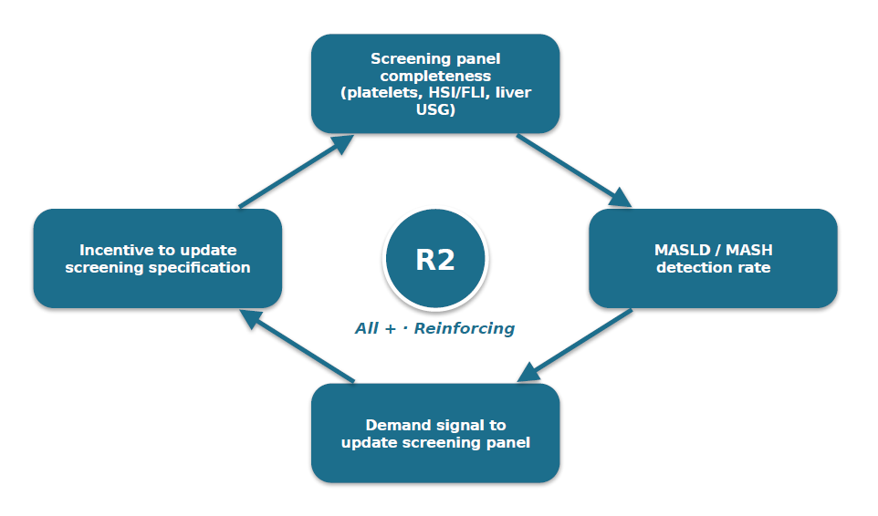
SYSTEMS ANALYSIS · R2
8
Loop R2 — Screening System Loss
Reinforcing Loop R2
Narrative
Korea's screening infrastructure is world-leading in coverage (NHIS 2024: 70%+ adult participation) but structurally blind to MASLD. Platelet counts are excluded from the national panel, blocking FIB-4 calculation. HSI and FLI scoring inputs are recorded but not computed or surfaced. Liver USG is available yet not deployed for systematic MASLD screening. No detection = no demand signal = no panel update.
Leverage Point
Activate KMI as the first large-scale health-screening network to compute FIB-4, HSI, and FLI from existing screening data, and add targeted liver USG at high-risk patients.
Korea MASLD/MASH Ecosystem Blueprint | Johns Hopkins Bloomberg SPH · MPH Practicum
Medical Affairs, Boehringer Ingelheim Korea | Apr 2026

Slide 9
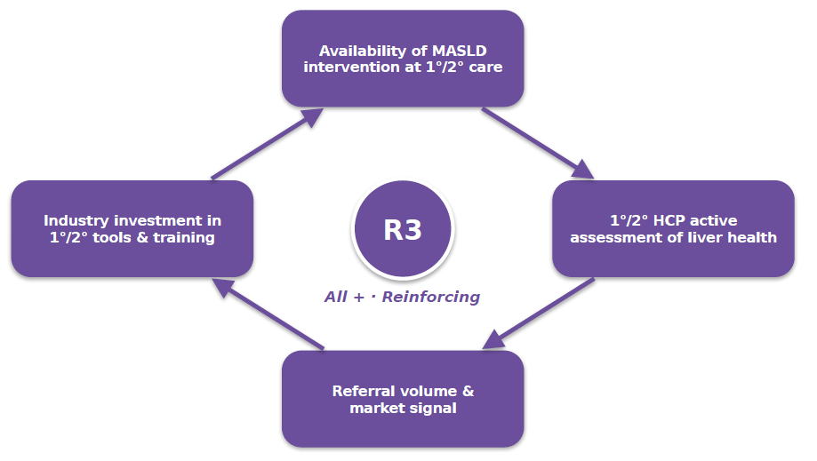
SYSTEMS ANALYSIS · R3
9
Loop R3 — Primary and Secondary Care Inertia
Reinforcing Loop R3
Narrative
With no approved MASLD/MASH therapeutic available in Korea, 1°/2° HCPs have no operational reason to actively assess liver fibrosis. Without active assessment, referral volume to hepatology is low. Low referral volume weakens the market signal back to device makers, pharma, and professional societies. The primary-care segment stays untrained and unequipped.
Leverage Point
Deploy Philips 2D-SWE (Auto ElastQ) + HCP Masterclass to create a bedside, single-visit MASLD assessment pathway that works even before therapeutic approval.
Korea MASLD/MASH Ecosystem Blueprint | Johns Hopkins Bloomberg SPH · MPH Practicum
Medical Affairs, Boehringer Ingelheim Korea | Apr 2026

Slide 10
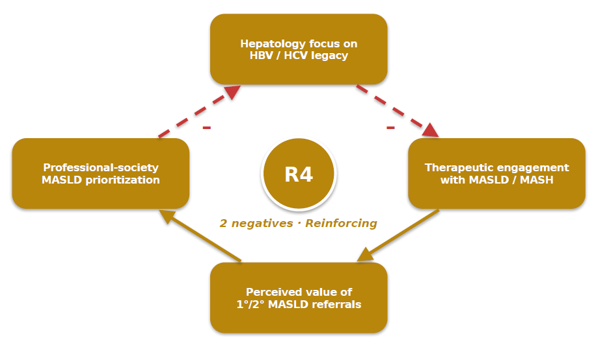
SYSTEMS ANALYSIS · R4
10
Loop R4 — Tertiary Hepatology Bias
Reinforcing Loop R4
Narrative
Korean hepatology is historically organised around HBV and HCV — decades of operational focus, reimbursement, and training. MASLD/MASH falls outside this legacy. When 1°/2° referrals arrive, they are often passively managed rather than aggressively treated. 1°/2° HCPs perceive low value in referring, so the referral channel weakens. The loop reinforces tertiary focus on antivirals.
Leverage Point
Engage academic societies (KASL, KSoM) and digital-health platforms to build a MASLD-specific care pathway at the tertiary level — partnership still to be secured (see Pillar 4). Archetype view: Shifting the Burden — see slide 11.
Korea MASLD/MASH Ecosystem Blueprint | Johns Hopkins Bloomberg SPH · MPH Practicum
Medical Affairs, Boehringer Ingelheim Korea | Apr 2026

Slide 11
SYSTEMS ANALYSIS · COMPOSITE
11
The four loops are interlocked
Composite Causal Loop Diagram — single integrated systems view
Demand signal for
panel update
Patient-initiated
screening requests
Awareness Trap
Screening panel
completeness
Screening Loss
R1
Society / industry
education investment
R2
MASLD detection
at screening
HCP demand for
MASLD education
Panel update
incentive
Public awareness
of MASLD
Referral volume
(1°/2°→ tertiary)
1°/2° HCP
active assessment
Hepatology MASLD
engagement
1°/2° Inertia
Industry investment
in 1°/2° tools
HBV/HCV
legacy focus
Tertiary Bias
R3
R4
Intervention
availability
Society MASLD
prioritization
R1 Awareness Trap
R2 Screening Loss
R3 1°/2° Inertia
R4 Tertiary Bias
Shared variable
Negative (dashed)
Korea MASLD/MASH Ecosystem Blueprint | Johns Hopkins Bloomberg SPH · MPH Practicum
Medical Affairs, Boehringer Ingelheim Korea | Apr 2026

Slide 12
INTERVENTION · LEVERAGE
12
Where each loop can be broken
Loop
Structural lock-in
Leverage point
Delivery sector
R1
Public awareness absent → no patient pull
Brand-anchored liver narrative at scale
365MC (obesity clinic + media brand)
R2
Screening panels do not detect MASLD
Compute FIB-4/HSI/FLI from existing screening data; add liver USG
KMI + national screening operators
R3
No intervention d/t no active assessment
Bedside 2D-SWE + HCP Masterclass create pre-launch pathway
Philips + HCP education
R4
HBV/HCV legacy blocks MASLD engagement
MASLD-specific tertiary pathway via society + digital health
KASL(KSSG), KSSO, digital health partner (potential)
Korea MASLD/MASH Ecosystem Blueprint | Johns Hopkins Bloomberg SPH · MPH Practicum
Medical Affairs, Boehringer Ingelheim Korea | Apr 2026

Slide 13
STRATEGIC FRAMEWORK
13
Four-pillar ecosystem structure
PILLAR 1
Public Awareness
PILLAR 2
Screening Activation
PILLAR 3
Diagnostic & HCP Enablement
PILLAR 4
Tertiary & Society Engagement
365MC partnership
"See Obesity, Think Liver"
Jibang-i character
KMI integration of FIB-4,
HSI / FLI, liver USG
into screening panels
Philips 2D-SWE +
HCP Masterclass
(Auto ElastQ)
(Potential) Digital health partners,
academic societies
(KASL, KSSSo)
Breaks R1 · Assists R3
Breaks R2 · Assists R3
Breaks R3 · Assists R2
Addresses R4
Each pillar is operationalised by one signed or targeted partnership.
Detail for Pillars 1–3 is in Deliverable 2 (KMI, 365MC, Philips MOUs).
Pillar 4 is a potential partnership area which is not yet contracted.
Korea MASLD/MASH Ecosystem Blueprint | Johns Hopkins Bloomberg SPH · MPH Practicum
Medical Affairs, Boehringer Ingelheim Korea | Apr 2026

Slide 14
EXECUTION
14
Phased roadmap and governance
Implementation roadmap
2026 H1–H2 · Foundation
2027 · Expansion
2028+ · National Scale-up
MOU execution · Research collaboration (CDM, Kakao Healthcare) · FIB-4/HSI/FLI pilot at KMI · Jibang-i omni-channel campaign pilot
National FIB-4/HSI/FLI rollout across KMI
· HCP Masterclass scale-up
· 365MC content series
· Pillar 4 partner selection
Policy advocacy (platelet inclusion)
· Integrate into KASL CME program
· Digital-health integration
· Intl. reference model
Governance structure
Representative KPIs
• Cross-stakeholder steering committee (BI, KMI, 365MC, Philips, KASL observer)
• Quarterly Medical Affairs governance review
• RACI defined at the partnership-agreement level in each MOU
• Pillar 1: Campaign reach (Jibang-i asset views, target audience recall)
• Pillar 2: MASLD detection rate at KMI screenees (FIB-4 ≥ 1.3)
• Pillar 3: 2D-SWE adoption, HCP Masterclass graduates
• Pillar 4: Society CME participation, policy engagement milestones
Korea MASLD/MASH Ecosystem Blueprint | Johns Hopkins Bloomberg SPH · MPH Practicum
Medical Affairs, Boehringer Ingelheim Korea | Apr 2026

Slide 15
CLOSING · BRIDGE TO DELIVERABLE 2
15
How the blueprint is operationalised
KMI Strategic Partnership
365MC Public Advocacy Campaign
Philips HCP USG Hands on
Pillars 1 & 2
Health-screening-driven MASLD/MASH ecosystem
Pillar 1
"See Obesity, Think Liver"
Jibang-i communication
Pillar 3
2D-SWE + HCP education for primary-care MASLD assessment
Version: March 2026
Version: Feb 2026
Version: March 2026
Key References
· Nah EH et al. Prevalence of liver fibrosis in the Korean general population. BMJ Open. 2021;11:e046529.
· Kim HY et al. Prevalence of clinically significant liver fibrosis: A systematic review and meta-analysis. Clin Mol Hepatol. 2024;30(S):S199-S213.
· Younossi ZM et al. Hepatology. 2023;77(4):1335-47. HIRA Statistics K758/K760, 2022. KOSIS 2024.
· EASL-EASD-EASO. Clinical Practice Guidelines on the management of MASLD. J Hepatol. 2024. · KASL. 2024 Clinical Practice Guidelines for NIT.
· Ferraioli G et al. WFUMB Liver Ultrasound Elastography Guidelines Update. 2018. · Rinella ME et al. AASLD Practice Guidance on NAFLD. Hepatology. 2023;77(5):1797-1835.
· Indre MG et al. Diagnostic accuracy of 2D-SWE for liver fibrosis in MASLD: meta-analysis. Hepatology. 2025;82(2):454-469.
· Jeon SK et al. Clin Ultrasound. 2020;5(2):59-64. · KHIDI 2021 Equipment Statistics. · OECD Health at a Glance 2025 (Korea). · NHIS 2024 Health Screening Yearbook.
· Senge PM. The Fifth Discipline. 1990. · Meadows DH. Thinking in Systems. 2008. (Systems-archetype framework).
Korea MASLD/MASH Ecosystem Blueprint | Johns Hopkins Bloomberg SPH · MPH Practicum
Medical Affairs, Boehringer Ingelheim Korea | Apr 2026

