Slide 1
Exploring Controllable Text Generation Techniques
SEQUENTIAL INPUT
Assoc. Prof. Murat Karakaya
Cansen Çağlayan

Slide 2
Controllable text generation
Controllable text generation is the task of generating natural sentences whose attributes can be controlled.
Stylistic such politeness, sentiment, formality, personality.
Content such as information, topic,keywords, entities, etc.;
Applications : such as dialogue response generation task, story generation

Slide 3
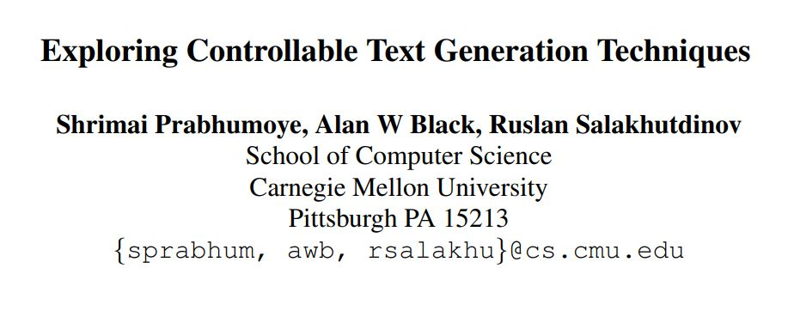
Purpose of the paper : Outline a new schema which connects prior work and provides an insight into various aspects of controllable text generation.

Slide 4
Questions :
Where can we potentially add the control attribute ?
In this generation process what can be modified to include the control attributes ?

Slide 5
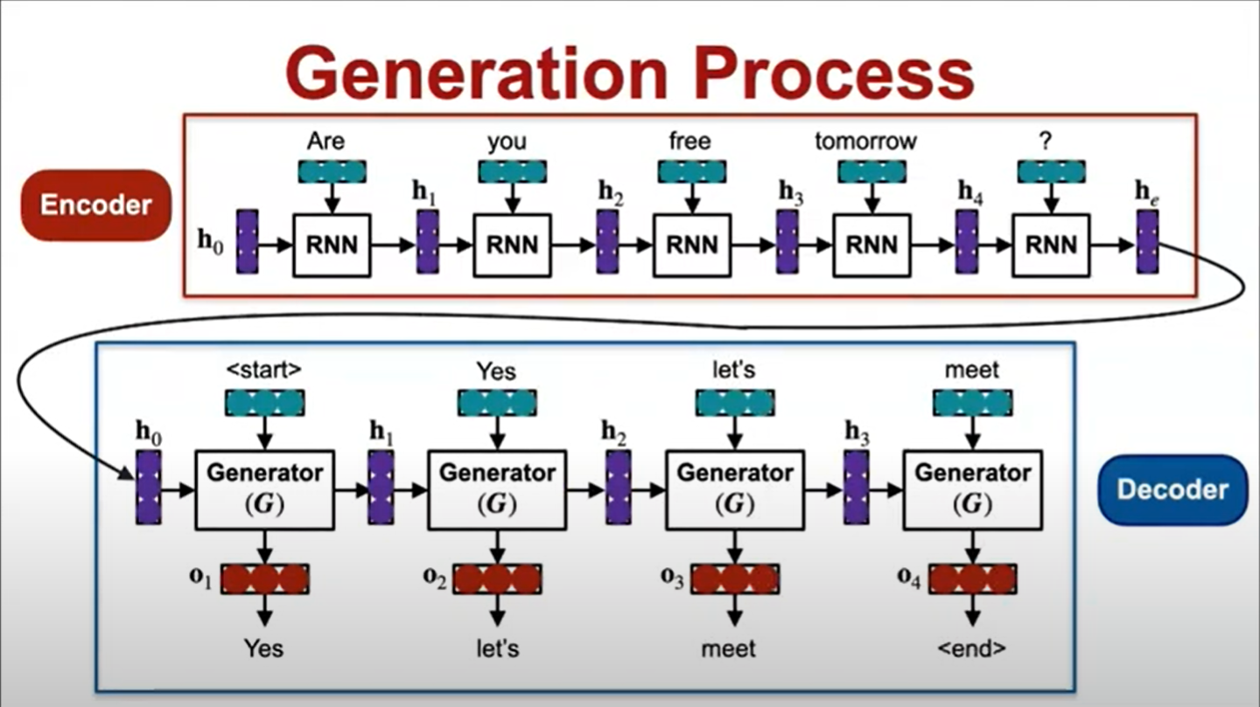

Slide 6
We can modifiy :
1. External Input (h0)
2. Sequential Input (Xt)
3. Generator (G)
4. Output (Ot)
5. Training Objective (L)

Slide 7
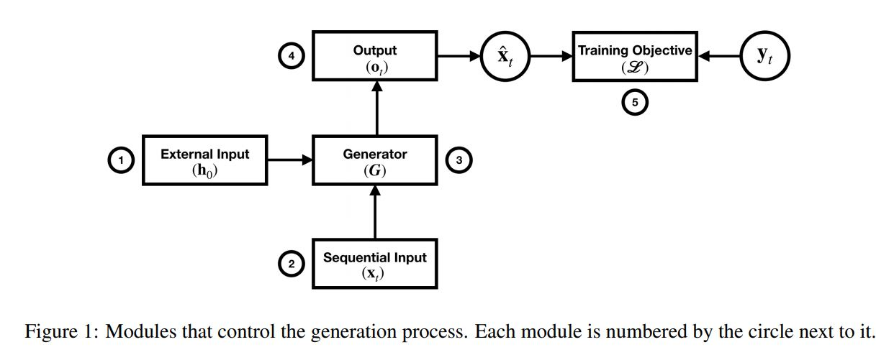

Slide 8
(1) External Input module is responsible for the initialization h0, of the generation process.
(2) Sequential Input module is the input Xt at each time step of the generation.
(3) Generator Operations module performs consistent operations or calculations on all the input at each time step.
(4) Output module is the output Ot which is further projected on to the vocabulary space to predict the token at each time step.
(5) Training Objective module takes care of the loss functions used for training the generator.
Notes:
In this section we discuss the different techniques which can be used to manipulate the sequential input Xt to the decoder at each time step.

Slide 9
SEQUENTIAL INPUT
We can change the input (Xt) by concatenating the information at each time step with some additional control vector (s).
Notes:
Xt here is used to denote the word embedding of the token at time step t.

Slide 10
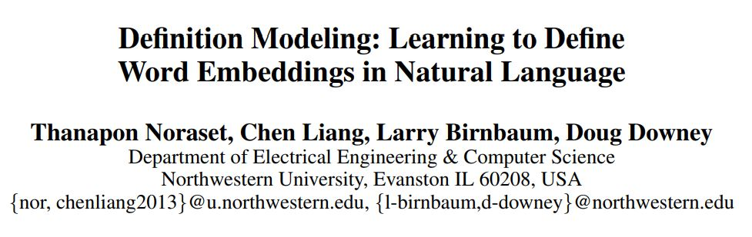
ARTICLE 1
They concatenate word embedding vector s of the word to be defined at each time step of the definition generation process.
Notes:
2017
They introduce definition modeling: the task of estimating the probability of a textual definition, given a word being defined and its embedding. Specifically, for a given set of word embeddings, a definition model is trained on a corpus of word and definition pairs.

Slide 11
ARTICLE 1
Model :
Recurrent Neural Network language model (RNNLM)
Dataset :
using various dictionaries to create a new dictionary corpus
Notes:
the probability of generating definition text depends on both the previous words and the word being defined
Note that in our expression, the word being defined w∗ is present at all time steps as an additional conditioning variable.

Slide 12
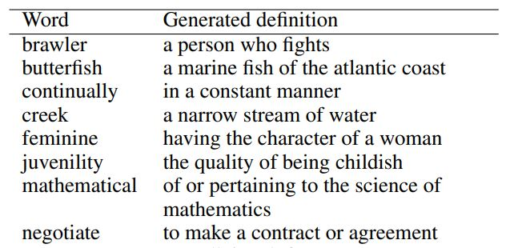
ARTICLE 1 sample

Slide 13
ARTICLE 1
The word being defined «s» is present at all time steps as an additional conditioning variable.
«s» is likewise the embedding of the word being defined.
«s» as a constant input at each time step.

Slide 14
Usıng external source (document)
In this section we will see articles that use an external source to control text generation.

Slide 15
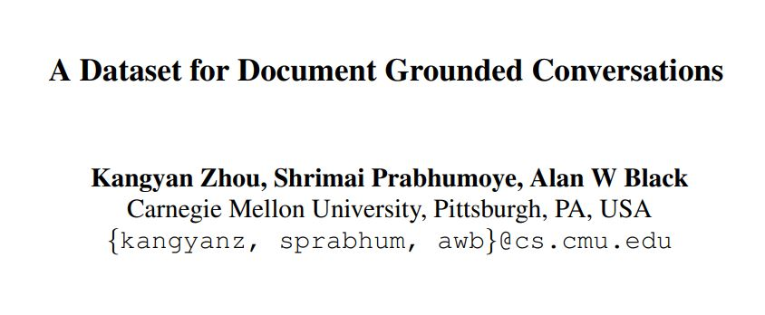
ARTICLE 2 (content)
They concatenate the hidden representation of the external source of information (s) to each time step of dialogue response generation.
Notes:
2018

Slide 16
ARTICLE 2
Dataset :
A set of documents (Wikipedia articles about 30 popular movies)
Two people chatting about the content of the document for more than 12 turns.
Model :
They use the sequence-tosequence model
Added control (s) vector to X at each time step in Encoder.

Slide 17
ARTICLE 2
Control :
four sections {s1, s2, s3, s4} corresponding to basic information and three key scenes of the movie.
s1 contains data such as year, genre, director. It also includes a short introduction about the movie, ratings from major review websites, and some critical responses.
Each of the key scene sections {s2, s3, s4} contains one short paragraph from the plot of the movie

Slide 18
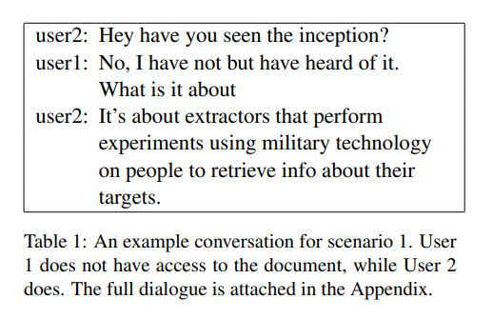
ARTICLE 2 Sample

Slide 19
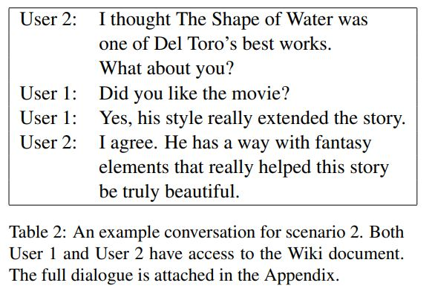
ARTICLE 2 sample

Slide 20
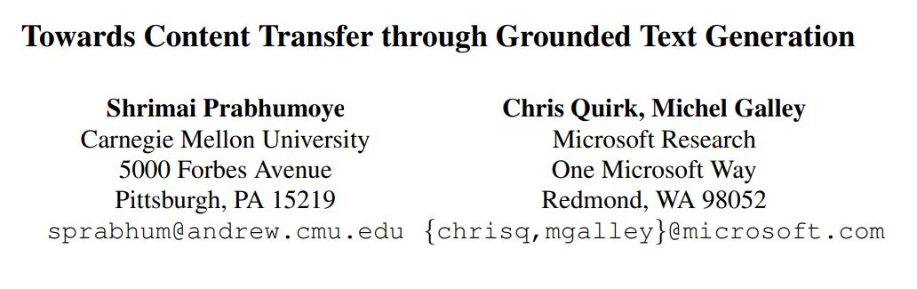
ARTICLE 3 (content)
They concatenate the hidden representation of the external source of information s to each time step of Wikipedia update generation process.
Notes:
2019

Slide 21
ARTICLE 3 (content)
Dataset :
Wikipedia articles
Control:
Citation files as control documents
Model :
sequence-to-sequence encoder-decoder model
Added control (s) vector to X at each time step in Encoder.

Slide 22
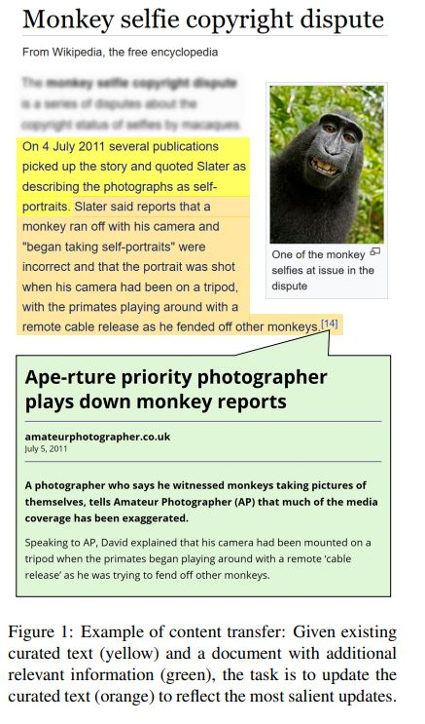
Notes:
The task is to generate a next sentence in a document that both fits its context and is grounded in a content-rich external textual source such as a news story.
They ensured that the generated text had a certain content.

Slide 23
ARTICLE 3 (content)
They tried many methods to extract information from external sources.
They basically tried to summarize the document and include the sentences containing the most important information.

Slide 24
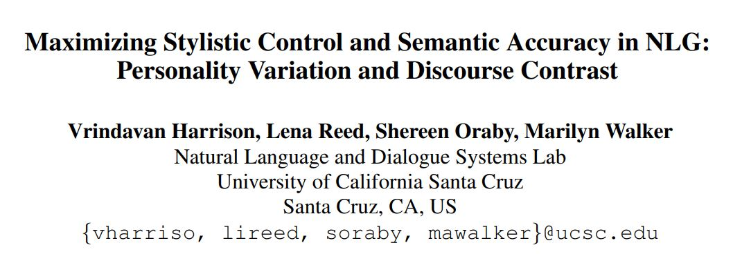
ARTICLES 4 (style and personality)
They concatenated a side constraint s which represents style and personality into the generation process.
Notes:
2019
experiment with two stylistic benchmark tasks, generating language that exhibits variation in personality, and generating discourse contrast.

Slide 25
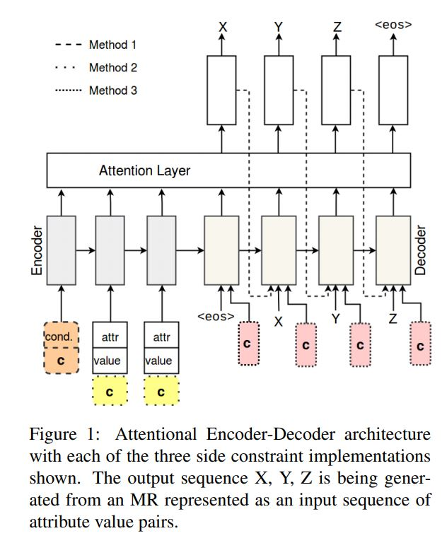
ARTICLES 4 (style and personality)
Notes:
The first method involves adding slot-value pairs to the input
the second involves extending the slot-value encoding through a concatenation operation.
In the third method, side constraints are incorporated into the model by modifying the decoder inputs.
incorporating style information into the decoder performs best.
a LSTM decoder takes two inputs.

Slide 26
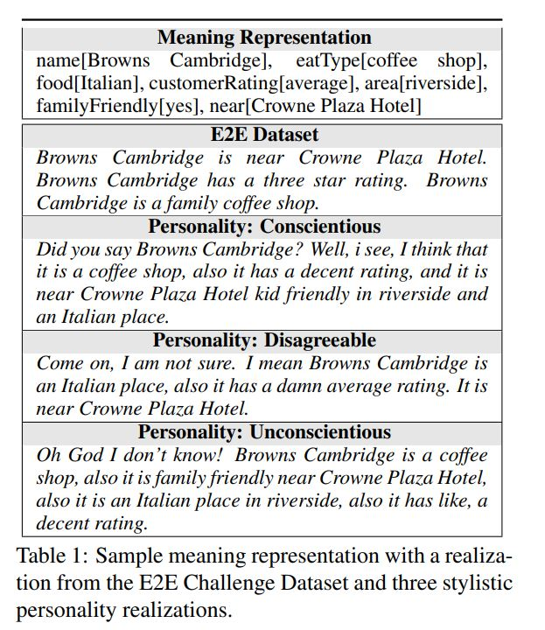
ARTICLES 4 (style and personality)

Slide 27
ARTICLES 5 (personality)
Chandu et al. (2019) also concatenate the personality representation P at each time step of the story generation process.
This is used to control the personality of the visual stories.
In addition to concatenation, this work proposes to modify the sequential input as ˜xt = xt − S + P (here S denotes the average representation of the story and P denotes the representation of the personality).
Notes:
”My Way of Telling a Story”: Persona based Grounded Story Generation
Many model but added to the decoder.

Slide 28
Sentıment control text generatıon
Different models :
LSTM
Encoder-Decoder
Transformer based
Ways to Obtain Sentiment Information
To label sequences (input) positive or negative
Using Sentiment Classifier
Using Pretrained Sentiment Classifier (BERT)

Slide 29
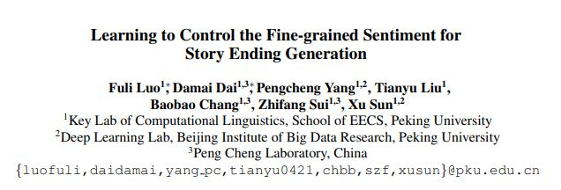
ARTICLE 6 (sentiment)
This paper focuses on generating a story ending which meets the given fine-grained sentiment intensity.

Slide 30
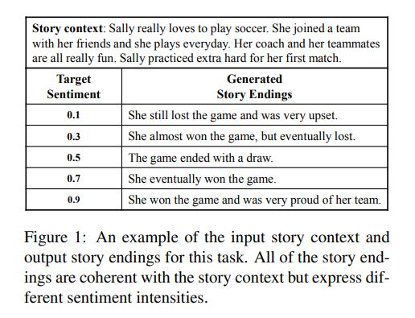
ARTICLE 6 (sample)
Notes:
Dataset : ROCStories corpus which consists of 100k five-sentence stories

Slide 31
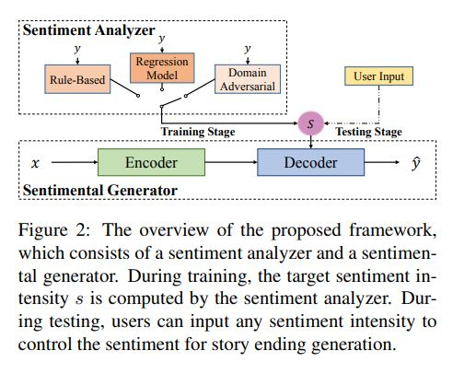
ARTICLE 6 (model)
Notes:
The sentimental generator introduces the sentiment intensity into decoder via a Gaussian Kernel Layer to control the sentiment of the output.

Slide 32
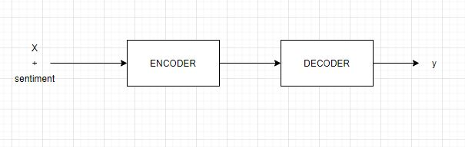
Encoder Decoder Model with sentiment Control

Slide 33
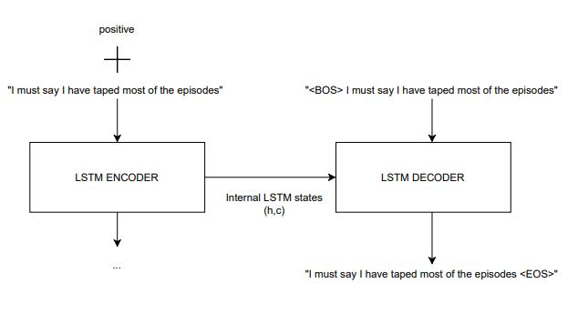
Encoder Decoder Model with sentiment Control

Slide 34
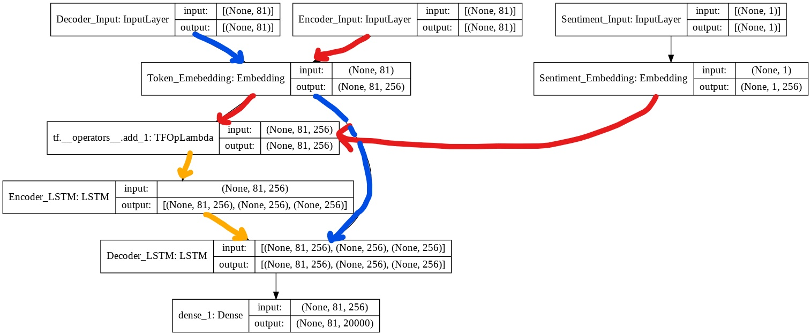
Encoder Decoder Model with sentiment Control

Slide 35
REFERENCES
https://www.youtube.com/watch?v=khTYgGHLDqE&t=363s
Exploring Controllable Text Generation Techniques (Shrimai Prabhumoye, Alan W Black, Ruslan Salakhutdinov)
Definition Modeling: Learning to Define Word Embeddings in Natural Language (Thanapon Noraset, Chen Liang, Larry Birnbaum, Doug Downey)
A Dataset for Document Grounded Conversations (Kangyan Zhou, Shrimai Prabhumoye, Alan W Black)
Towards Content Transfer through Grounded Text Generation (Shrimai Prabhumoye,Chris Quirk, Michel Galley)
Maximizing Stylistic Control and Semantic Accuracy in NLG: Personality Variation and Discourse Contrast (Vrindavan Harrison, Lena Reed, Shereen Oraby, Marilyn Walker)
“My Way of Telling a Story”: Persona based Grounded Story Generation (Khyathi Raghavi Chandu, Shrimai Prabhumoye, Ruslan Salakhutdinov, Alan W Black)
Learning to Control the Fine-grained Sentiment for Story Ending Generation (Fuli Luo , Damai Dai1, , Pengcheng Yang, Tianyu Liu, Baobao Chang, Zhifang Sui1, Xu Sun)

