Slide 1

PROJECT – 4 DRUG SIDE EFFECTS AND MEDICAL CONDITION
UNIFIED MENTOR INTERNSHIP | August – October 2024
Presented By: Dr. Nandini Arvind
Data Analytics & Business Intelligence | Data Science

Slide 2
OBJECTIVE
The goal is to analyze the relationships between drugs, their side effects, and the
medical conditions they treat, as well as to explore the ratings and reviews
associated with these drugs.
TOOLS REQUIRED:
Python: The primary programming language for data analysis.
Pandas: For data manipulation and analysis.
Matplotlib/Seaborn: For data visualization.
Jupyter Notebook: To write and run Python code.

Slide 3
PROJECT WORKFLOW
Data Preparation: Imported the employee dataset (CSV) into Jupyter Notebook. Cleaned and prepped the data using Python (Pandas, NumPy), addressing duplicates and missing values.
Data preprocessing:
Selection
Dropped irrelevant attributes such as 'csa,' 'drug_link,' and 'medical_condition_url.‘
Filled empty spaces in binary attributes for easier analysis.
Data Cleaning
Tokenized 'medical_condition_description' using the NLTK module.
Processed and cleaned textual data in the 'side_effects' column.
Transformed and standardized the dataset for effective analysis.
3. Exploratory Data Analysis (EDA): Performed univariate, bivariate, and multivariate analyses. Used Matplotlib and Seaborn to plot pair plots, correlation heatmaps, and bivariate graphs, uncovering key attrition factors.
4. Insights Generation: Identified key drivers of attrition, such as low job satisfaction and inadequate compensation, through visualizations and analysis.
5. Results and Recommendations: Highlighted actionable insights to help reduce attrition, focusing on high-risk groups and departments.

Slide 4

COMPREHENSIVE ANALYSIS OF DRUG SIDE EFFECTS AND MEDICAL CONDITIONS
The dataset has 2931 rows and 17 columns.
Analyzed unique drugs and medical conditions.
Explored attributes (imputed) such as 'rx_otc,' 'pregnancy_category,' 'alcohol,' and more.
Utilized bar graphs, pie charts, line plots, scatter plots, and more to visualize data.
Applied correlation matrices and Apriori algorithm to find related drugs.
Used decision tree classification and clustering for data analysis.

Slide 5
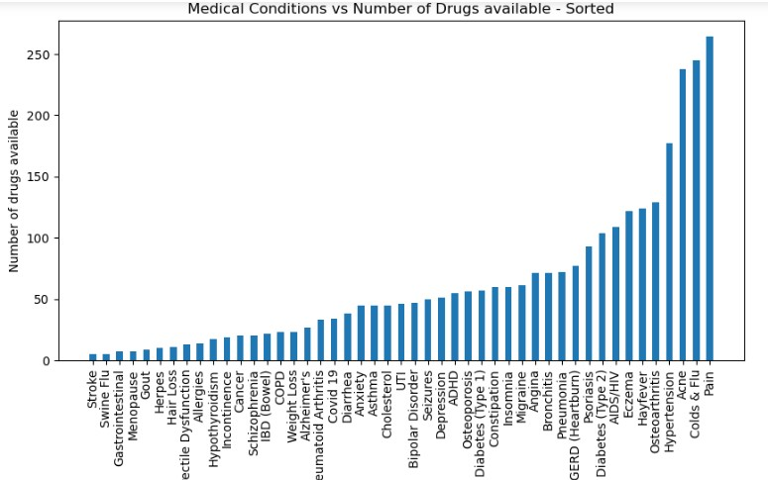
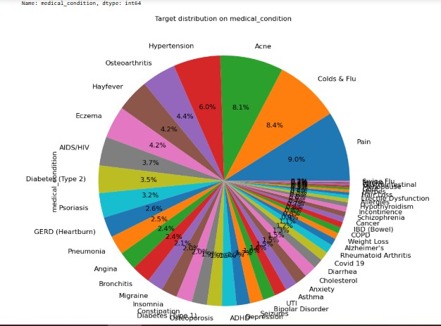
ANALYSIS OF DRUGS VS ACTIVITY(%), MEDICAL CONDITIONS VS DRUG AVAILABILITY (SIDE EFFECTS & CONDITIONS)
Top 10 diseases with most medicines available:
Pain 264 ,Colds & Flu 245 , Acne 238 , Hypertension 177, Osteoarthritis 129, Hay fever 124, Eczema 122 , AIDS/HIV 109 ,Diabetes (Type 2) 104 , Psoriasis 93
Least number of drugs are available for strokes, swine flu, gastrointestinal problems, menopause and gout.
Omeprazole, metformin, loperamide, etc in order of decreasing priority are the most active drugs, i.e, they are in most demand from the consumer side.
It can be noticed that the top 10 in-demand drugs are of same importance in the consumer market.

Slide 6
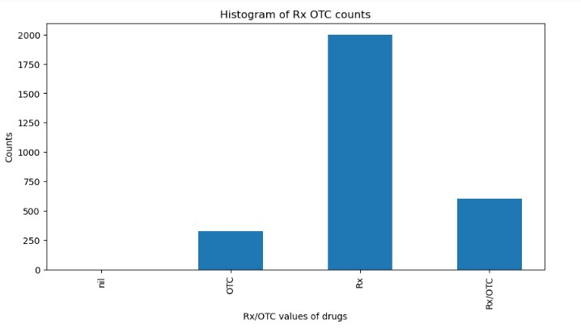
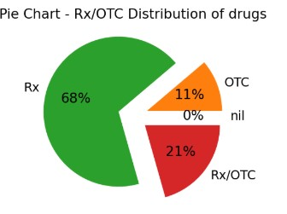
DISTRIBUTION OF RX/OTC DRUG TYPES: COUNT ANALYSIS
Most of the drugs have Rx, i.e, most of the drugs require prescription to be used. (Around 1900 from the available 2900+ drugs).
The remaining 1000 drugs are not that dangerous and can be prescribed or not prescribed.
It can be observed that 68% of the drugs are of type 'Rx', meaning that they can only be used if prescribed by a doctor
21% of the drugs can either be prescribed or not prescribed by a doctor
11% of the drugs need not be prescribed by a doctor

Slide 7
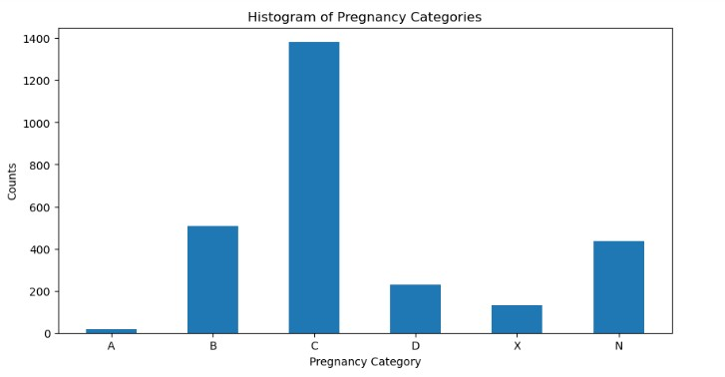
PREGNANCY RISK CATEGORIES: DISTRIBUTION OF DRUGS ACROSS FDA CLASSIFICATIONS
Key Observations From The Bar Chart :
High: Category 'C', where most of the drugs show an adverse effect on the fetus and there are no adequate and well-controlled studies in humans, but potential benefits may warrant use in pregnant women despite potential risks.
Least: Category A, representing drugs that pose no risk to the fetus based on adequate and well-controlled studies, has the lowest count, with fewer than 50 drugs.
Category B ranks second, with over 500 drugs, meaning animal studies have not demonstrated a risk to the fetus, but adequate human studies are lacking.
Drugs classified as Category N, where the FDA has not yet classified the drug, also total around 500.
Category X, which includes drugs where the risks clearly outweigh any potential benefits, has less than 100 drugs.

Slide 8
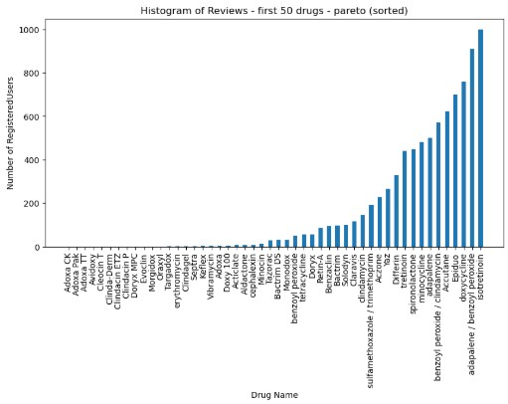
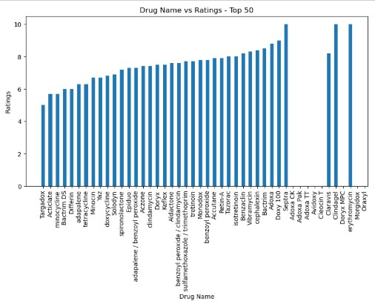
TOP 50 DRUGS BY USER REVIEWS:USAGE,RATINGS INSIGHTS
Drugs 'isotreonoin', 'adapalene', 'doxycycline', etc in sequential orders are reviewed the most by users, indicating that they are the most used drugs in the first 50 mentioned drugs
Erythromycin, clindagel, septra, etc are the top rated drugs in the first 50 drugs
It can be noticed from this that the drugs with the most number of reviews are not in the top rated drugs, i.E, number of reviews is not an apt parameter to judge the usefulness of a drug

Slide 9
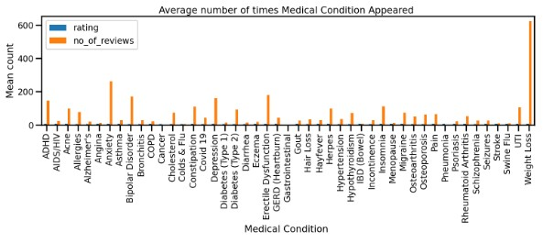
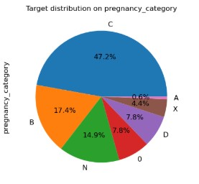
PREGNANCY RISK CATEGORIES: DISTRIBUTION OF DRUGS ACROSS FDA CLASSIFICATIONS
It can be noticed that weight loss drugs have most number of reviews, showing that it is a popular concern among drug-consumers.
ADHD, Anxiety, Bipolar Disorder, Depression, Erectile Dysfunction are the next most used drugs.
Just like the bar graph, it is clear that most drugs are of pregnancy category type C, meaning that animal reproduction studies have shown an adverse effect on the fetus and there are no adequate and well-controlled studies in humans, but potential benefits may warrant use in pregnant women despite potential risks.

Slide 10
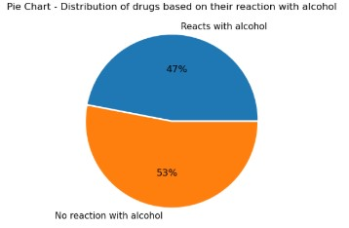
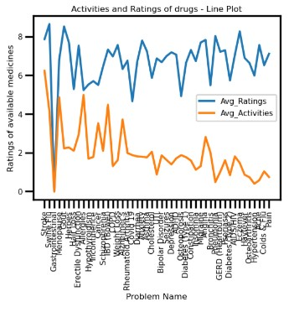
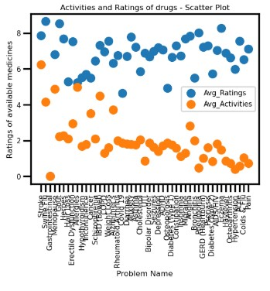
KEY INSIGHTS ON DRUG RATINGS, ALCOHOL REACTIONS, AND SALES ACTIVITY
About 47% of the drugs have a reaction with alcohol, implying that alcoholic patients should have alternatives incase they have problems that can be solved only with these drugs.
It can clearly be noticed from here that except for a few anomalies, the ratings and activities of a drug are almost similar.
A drug with a good rating has more activity in sales and a drug with less rating has less activity in sales.
While not much can be concluded from this scatter, we can at least say that the two parameters, ratings and activities are linearly separable.

Slide 11
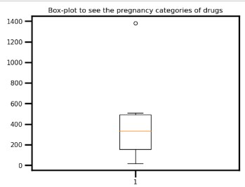
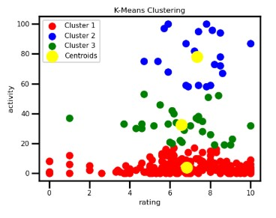
CLASSIFICATION AND CLUSTERING INSIGHTS FROM KEY DRUG ATTRIBUTES
Pregnancy Category boxplot: Not skewed ,no outliers, a good attribute to be used to classify drugs.
Kmeans Clustering: It can be observed that 'activity' and 'rating' can be used as parameters to form clusters and differentiate between drugs.

Slide 12
FINAL INSIGHTS:
Top Drug Categories: Most drugs belong to Pregnancy Category C, indicating potential adverse effects on fetuses, with limited human studies but potential benefits for pregnant women. Category A drugs (safest) are the least common.
Drug Reviews vs Ratings: Highly reviewed drugs are not always the top-rated, suggesting that review count isn’t a reliable indicator of drug effectiveness.
Consumer Trends: Weight-loss drugs are the most reviewed, followed by medications for ADHD, Anxiety, Depression, and Erectile Dysfunction.
Rx vs OTC Drugs: 68% of drugs require a prescription, while only 11% are completely over-the-counter (OTC).
Drug Interactions: 47% of drugs interact negatively with alcohol, highlighting the need for alternatives for alcoholic patients.
Clustering Analysis: Ratings and activity levels are linearly separable and effective parameters for clustering and classification.
Demand Patterns: Drugs like omeprazole and metformin are in high demand, and the top 10 drugs hold similar importance in the consumer market.
Key Visualization Insights: Decision trees and K-means clustering help uncover relationships between activity, rating, and drug classification.

Slide 13
RECOMMENDATIONS
Address gaps in medication availability, focusing on conditions with the least number of drugs, such as strokes, menopause, and gastrointestinal issues.
Develop safer alternatives for drugs in Pregnancy Category C and those interacting with alcohol to better cater to patient needs.
Prioritize marketing and distribution efforts on high-demand drugs like omeprazole and metformin to meet consumer demand effectively.
CONCLUSION
This project involved comprehensive data preprocessing and analysis of a pharmaceutical dataset, ensuring accuracy through cleaning, tokenization, and standardization.
Using descriptive statistics, data visualization, association rule mining, decision tree classification, and K-means clustering, the analysis provided critical insights into the relationships between drugs, medical conditions, and user ratings.
These findings equip pharmaceutical companies to:
Optimize drug offerings.
Enhance safety measures.
Tailor strategies to align with consumer preferences, fostering improved healthcare outcomes.

