Slide 1

EMPLOYEE ATTRITION ANALYSIS
UNIFIED MENTOR INTERNSHIP | August – October 2024
Presented By: Dr. Nandini Arvind
Data Analytics & Business Intelligence | Data Science

Slide 2
OBJECTIVE
XYZ company which was established a few years back is facing around a 15% attrition rate for a couple of years.
And it's majorly affecting the company in many aspects.
In order to understand why employees are leaving the company and reduce the attrition rate XYZ company has approached an HR analytics consultancy for analyzing the data they have.
You are playing the HR analyst role in this project and building a dashboard which can help the organization in making data-driven decisions.
Identify Key Factors Driving Attrition.
Develop Predictive Insights for Retention.
Provide actionable recommendations to improve company policies, ultimately reducing the attrition rate and fostering a more stable workforce.

Slide 3
PROJECT WORKFLOW
Data Preparation: Imported the employee dataset (CSV) into Jupyter Notebook. Cleaned and prepped the data using Python (Pandas, NumPy), addressing duplicates and missing values.
Exploratory Data Analysis (EDA): Performed univariate, bivariate, and multivariate analyses. Used Matplotlib and Seaborn to plot pair plots, correlation heatmaps, and bivariate graphs, uncovering key attrition factors.
Insights Generation: Identified key drivers of attrition, such as low job satisfaction and inadequate compensation, through visualizations and analysis.
Dashboard Creation: Built an interactive Power BI dashboard with visualizations (bar charts, pie charts, trend lines) and filters to display metrics like attrition rate and tenure.
Results and Recommendations: Highlighted actionable insights to help reduce attrition, focusing on high-risk groups and departments.

Slide 4
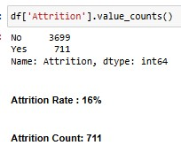

KEY PERFORMANCE INDICATOR (KPI)
Overall Employees: The total number of employees in the company at a given time.
Attrition: The number of employees who have left the company over a specified period.
Attrition Rate: The percentage of employees who have left the company compared to the total number of employees.
Active Employees: The number of employees currently working in the company.
Average Years at Company : The average number of years an employee works in the company.

Slide 5
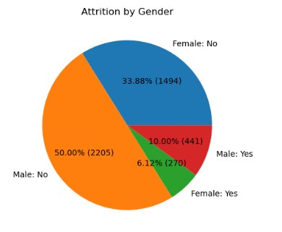
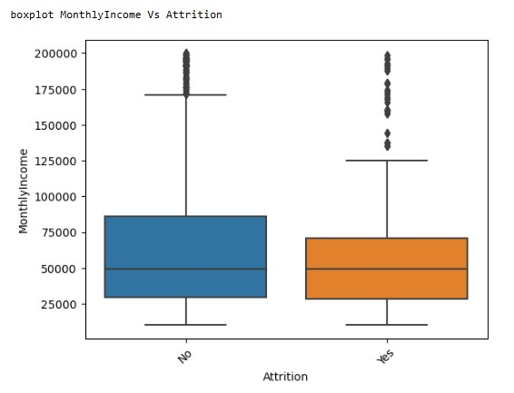
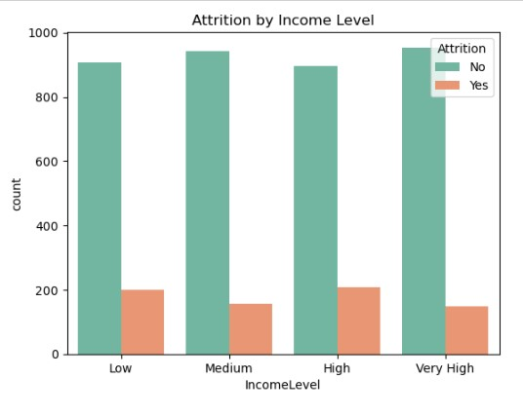
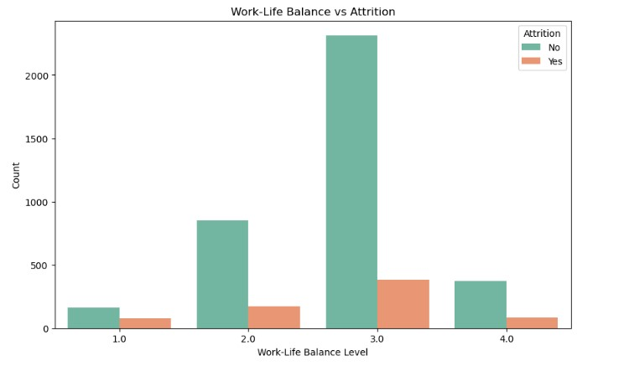
ATTRITION ANALYSIS: THE IMPACT OF GENDER, INCOME LEVELS, AND WORK-LIFE BALANCE
The attrition rate is 10% for male employees and 6.12% for female employees in the company.
Income May Not Be the Sole Factor: There is a slight increase in attrition rates among employees in the higher salary brackets. This suggests that factors beyond income, such as career growth opportunities or work-life balance, may play a more significant role in employee turnover
Work-Life Balance Challenges: The highest attrition levels are observed among Level 3.0 group. Employees in the 3.0 group likely experience moderate work-life balance, which may not meet their expectations or needs. This dissatisfaction could be a significant driver of turnover.

Slide 6
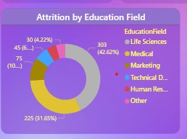
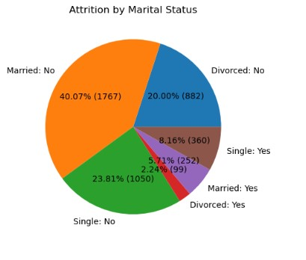
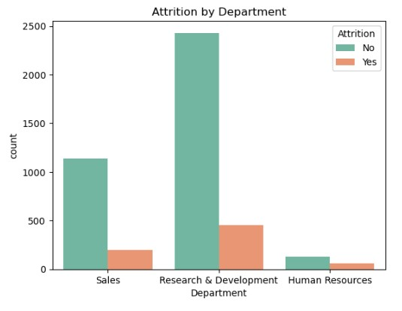
KEY DRIVERS: LIFE SCIENCES, R&D, AND MARITAL STATUS
High Attrition in Life Sciences and Medical Fields: Employees from life sciences (42%) and medical (31%) backgrounds exhibit the highest attrition rates, suggesting potential dissatisfaction or challenges in these roles.
Lower Attrition in HR and Technical Fields: HR and technical education fields experience significantly lower attrition, possibly reflecting better alignment of job roles with employee expectations or more stable career paths in these areas.
The high attrition in the R&D department could indicate challenges such as high work pressure, lack of innovation support, or limited career progression opportunities.
Marital Status: Highest Attrition among single employees at 8%, compared to married employees at 5%.
High Attrition in R&D: The high attrition in the R&D department could indicate challenges such as high work pressure, lack of innovation support, or limited career progression opportunities.

Slide 7
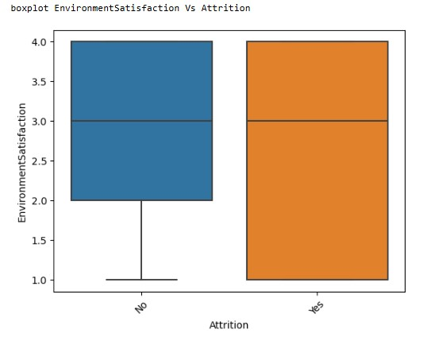
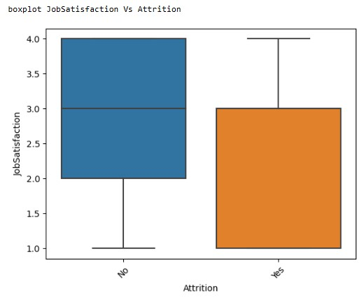
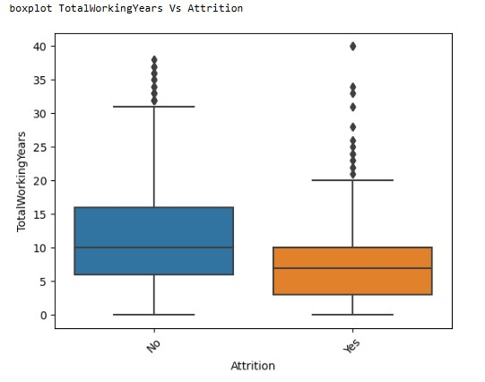
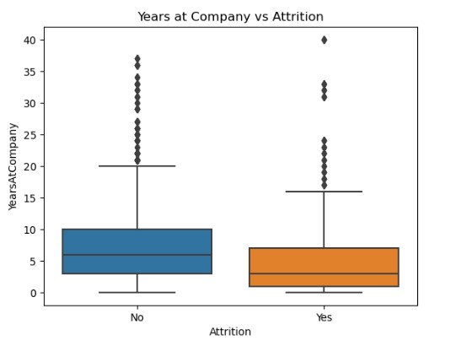
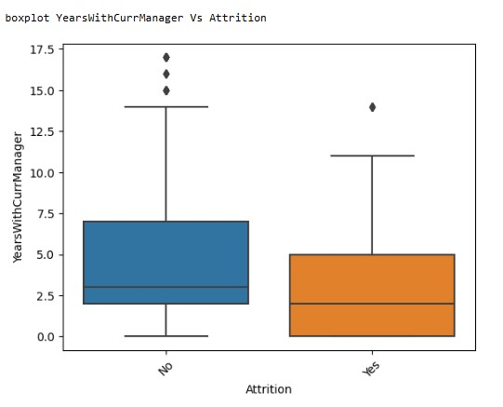
ATTRITION TRENDS: LONG TENURE, MANAGERIAL STAGNATION, AND ENVIRONMENTAL FACTORS
Minimal Impact of Environment Satisfaction Factors on Attrition: no significant difference between employees who have left the organization and those who have stayed.
Employees with an average tenure of 7 years at the company exhibit a higher likelihood of attrition.
Employees with an average of 2 years working under the same manager show a higher likelihood of attrition.

Slide 8
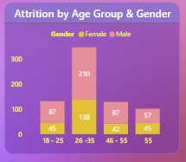
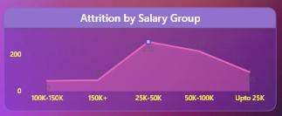
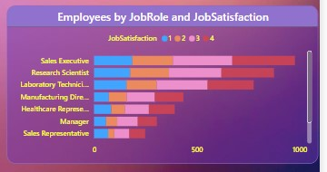
ATTRITION TRENDS: AGE 26-35, SALARY ₹25,000-₹50,000, AND JOB SATISFACTION
The 26-35 age group experiences the highest attrition, with approximately 138 females and over 200 males leaving the organization.
Employees in the salary group of ₹25,000-₹50,000 exhibit the highest attrition rate.
Each job role has an equal distribution across all four job satisfaction levels. This suggests that job satisfaction is not specific to any particular role and is likely influenced by external factors such as company-wide policies, workplace environment, or individual preferences.

Slide 9
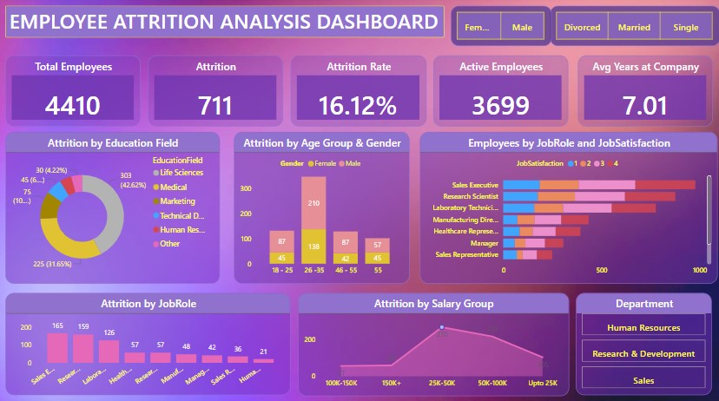

Slide 10
FINAL INSIGHTS:
Male attrition (10%) is higher than female (6.12%).
Higher salary groups, especially of ₹25,000-₹50,000, show slightly higher attrition, indicating factors beyond income.
The 26-35 age group has the highest attrition, with more than 200 males and 138 females leaving the organization.
Work-Life Balance: Highest attrition is in the Level 3.0 group, suggesting moderate dissatisfaction.
Employees from life sciences (42%) and medical (31%) educational backgrounds show the highest attrition rates.
R&D Department Challenges: High attrition due to work pressure and limited career growth.
Lower Attrition in HR and Technical Fields: HR and technical fields experience lower attrition, indicating more stable career paths.
Marital Status : Single employees have higher attrition (8%) than married (5%).
Employees with an average tenure of 7 years are more likely to leave, suggesting potential stagnation or lack of growth. This could suggest a plateau in career growth, lack of new challenges, or limited advancement opportunities over time.
Employees with an average of 2 years working under the same manager show higher attrition, indicating limited career development opportunities.

Slide 11
RECOMMENDATIONS / ACTIONABLE INSIGHTS FOR MANAGING EMPLOYEE ATTRITION
Gender-Specific Strategies: Address higher male attrition with tailored retention programs.
Compensation Review: Ensure salary isn't the sole factor; focus on career growth and job satisfaction.
Work-Life Balance: Improve work-life balance, especially for Level 3.0 employees, to reduce dissatisfaction.
Career Growth in Life Sciences & Medical: Offer more development opportunities to reduce high attrition.
Support R&D Employees: Reduce work pressure and enhance career progression in R&D.
Strengthen HR & Technical Paths: Maintain low attrition by developing stable career paths in HR and technical roles.
Engage Single Employees: Provide benefits catering to the needs of single employees.
Focus on Tenured Employees: Address causes of attrition among employees with 7+ years of tenure by offering growth opportunities.
Managerial Support: Invest in managerial development to support long-term employees.
Age-Specific Programs: Create programs targeting the 26-35 age group to improve retention.
Addressing compensation and offering growth incentives : could help reduce attrition in of ₹25,000-₹50,000 group.

Slide 12
CONCLUSION
Attrition is influenced by factors like gender, age, salary, work-life balance, and career development.
Focus on targeted strategies for high attrition groups, such as R&D, life sciences, and medical fields.
Enhancing work-life balance, career growth, and managerial support will help reduce turnover.

