Slide 1

PROJECT – 1 SUPPLY CHAIN MANAGEMENT ANALYSIS
UNIFIED MENTOR INTERNSHIP | August – October 2024
Presented By: Dr. Nandini Arvind
Data Analytics & Business Intelligence | Data Science

Slide 2
OBJECTIVE
Analyze key metrics such as lead times, order quantities, shipping costs, defect rates, and supplier performance to identify bottlenecks and areas for improvement.
Track performance over time, compare supplier efficiency, and assess the impact of transportation modes and carriers on costs.
Provide insights into customer demographics to boost sales.
By gaining these insights, we can make informed decisions to optimize logistics, reduce delays, lower costs, and improve overall supply chain reliability and responsiveness to customer demands. Ultimately, this enables better resource allocation and more strategic planning, ensuring smooth operations and increased profitability.

Slide 3
ANALYSIS FOCUS AREAS
Which Product Type generates the highest revenue?
Are there any significant correlations between Lead times and Order quantities?
How do Shipping costs vary by Shipping carrier and Location?
Which suppliers have the most efficient manufacturing processes?
What demographic group contributes the most to sales?

Slide 4
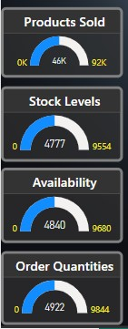

PRODUCT PERFORMANCE DASHBOARD OVERVIEW
Provides key metrics: sales, revenue, Average Shipping Costs, Average Defect Rates, Average Lead Times.
Products Sold, Stock levels, Availability and Order Quantities.
Helps businesses evaluate product performance.
Enables data-driven decisions to optimize strategies and improve overall performance.

Slide 5
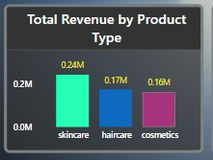
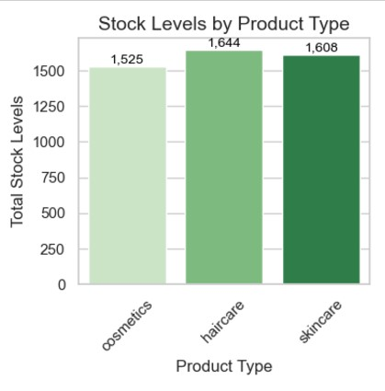
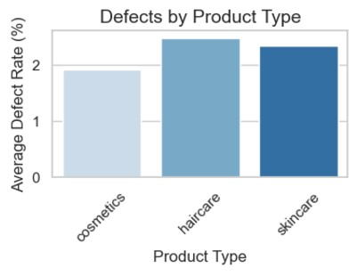
ANALYSIS FOCUS AREA
Which Product Type Generates The Highest Revenue?
Skincare generates the highest revenue (0.24M), indicating strong market demand.
Highlights the effectiveness of current strategies.
Insights can guide future investments and focus to capitalize on this success.

Slide 6
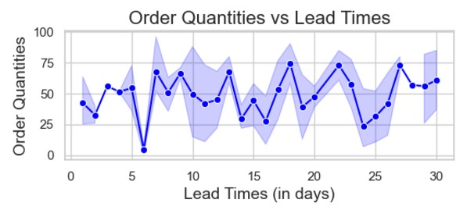
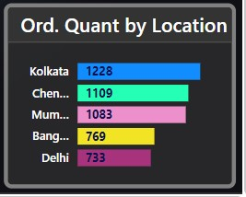
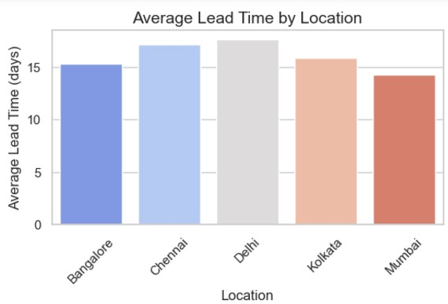
ANALYSIS FOCUS AREA
Are there any significant correlations between Lead times and Order quantities?
Supplier | Lead Times | Order Quantities
Supplier 1 | 453 | 1458
Supplier 2 | 357 | 1022
Supplier 3 | 215 | 632
Supplier 4 | 306 | 342
Supplier 5 | 265 | 968
After visualizing scattered graph of lead times and order quantities result shows there is no effective correlations between them.
When order quantities are less than 40, the lead times are shorter; otherwise, the lead times are longer.

Slide 7
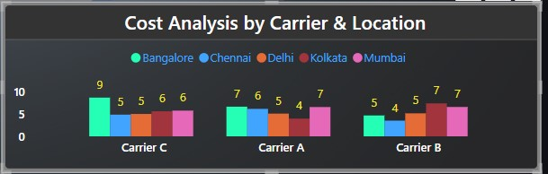
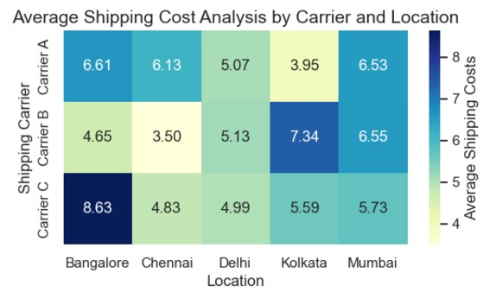
ANALYSIS FOCUS AREA
How Do Shipping Costs Vary By Shipping Carrier And Location?
Key Observations From The Bar Graph:
Carrier C has the highest shipping costs, particularly in Location Bangalore(9) .
Carrier A and B offers lower costs but shows some variability based on location.
Bangalore incurs higher shipping costs across all carriers, possibly due to its geographic distance from major hubs.
Lowest seen among Chennai(4-6) and Kolkata(4-7).
Business Implications :
Higher costs for Carrier C in certain regions may require negotiation or a switch to alternative carriers.
We need to factor in location-based shipping costs when planning deliveries to optimize our shipping expenses.

Slide 8
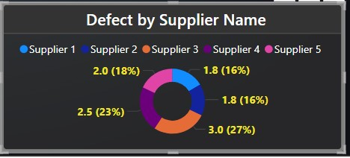
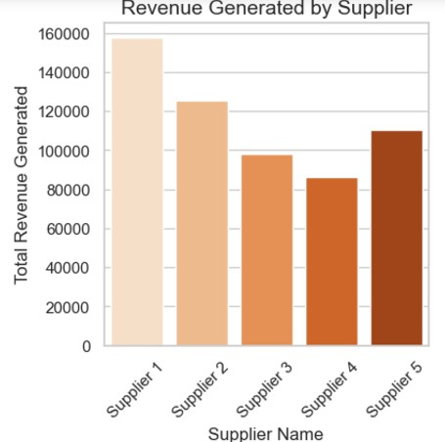
ANALYSIS FOCUS AREA
Which Suppliers Have The Most Efficient Manufacturing Processes?
Key Observations From The Donut Chart : Depicting The Defect Rates Of The Suppliers:
Supplier 1 (with 16% avg. defect rate) and supplier 2(with 16% avg. defect rate) are considered to have the most efficient manufacturing processes as compared to other suppliers. They both have a lower defect rates which suggest better manufacturing quality and efficiency.
Worst Defect Rate observed for Supplier 4 with 23% avg. defect rate.
Business Implications :
Suppliers with higher defect rates, such as Supplier 4, may require a review of their manufacturing processes to identify and address inefficiencies or quality issues.
Collaboration with efficient suppliers like Supplier 1 and 2 can help maintain product quality and reduce customer complaints.

Slide 9
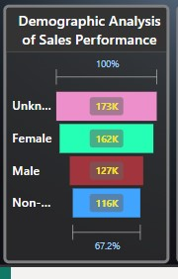
CUSTOMER DEMOGRAPHICS DASHBOARD OVERVIEW-
Key Observations :
The Female demographic is the highest contributor to sales, generating 162K in revenue.
The Non-Binary group contributes the least to sales, with revenue totaling 116K.
Business Implications:
Focused marketing campaigns targeting the Female demographic can further boost revenue by leveraging their existing purchasing power.
Explore strategies to engage and increase sales from the Non-Binary group, such as personalized offers, tailored product recommendations, or inclusive branding initiatives.
Tailors marketing strategies to improve targeting and customer engagement.

Slide 10
ANALYSIS FOCUS AREA
Which Demographic Group Places the Highest Number of Orders?
Key Observations from Clustered Bar Chart:
Kolkata contributes the highest order quantities, approximately 1,228, followed by Chennai with 1,109.
Delhi records the lowest order quantities, with a count of 733, comparatively lower than the other regions
Business Implications:
Enhance marketing in Kolkata and Chennai to sustain high order volumes.
Target Delhi with localized campaigns to address sales gaps.
Launch region-specific promotions to boost engagement and orders.

Slide 11
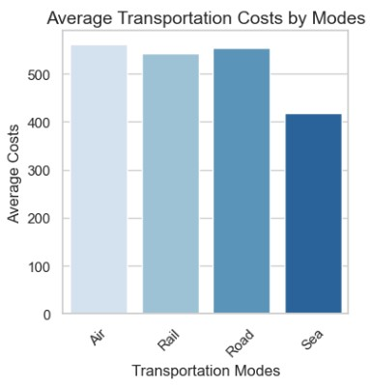
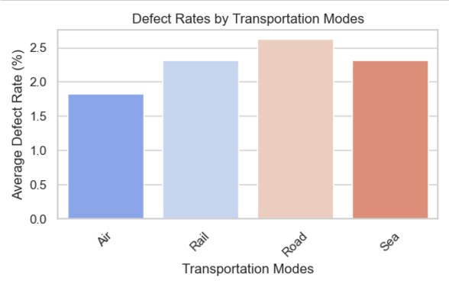
ANALYSIS FOCUS AREA
Which Transport Group costs the Highest Price?
Key Observations from Bar Chart:
Air and Roadways contributes the highest average costs.
Sea Ways records the lowest costs.
Defect Rates are higher in road mode and vey less in air mode.
Business Implications:
Air and Roadways are the Most Expensive: Consider optimizing or negotiating better rates to reduce costs.
Sea Transport is the Cheapest: Increase reliance on sea transport for long-distance, non-time-sensitive shipments.
Higher Defect Rates in Road Transport: Investigate packaging and handling to reduce defects, while maintaining air transport for sensitive goods.

Slide 12
FINAL RECOMMENDATIONS:
Invest further in the skincare category due to its strong revenue generation.
Reassess lead-time strategies, as they show minimal impact on order quantities.
Negotiate lower rates with Carrier C or explore alternative carriers to reduce costs, especially in Bangalore.
Optimize location-based shipping costs, focusing on Chennai and Kolkata for more efficient logistics.
Collaborate with Suppliers 1 and 2 to maintain product quality and reduce defect rates.
Address inefficiencies in Supplier 4’s processes to improve overall product quality.
Target Female customers with tailored campaigns to leverage their strong purchasing power.
Develop personalized offers and strategies to engage and boost sales among Non-Binary customers.
Strengthen marketing efforts in Kolkata and Chennai to sustain high order volumes.
Launch localized campaigns in Delhi to address sales gaps and boost order quantities.

