Slide 1

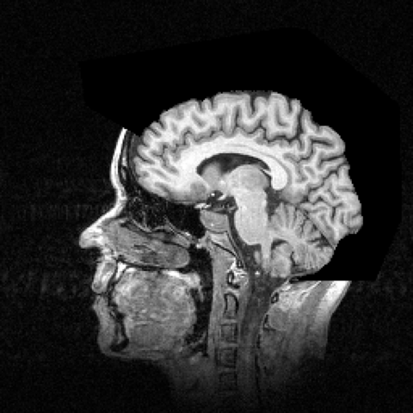
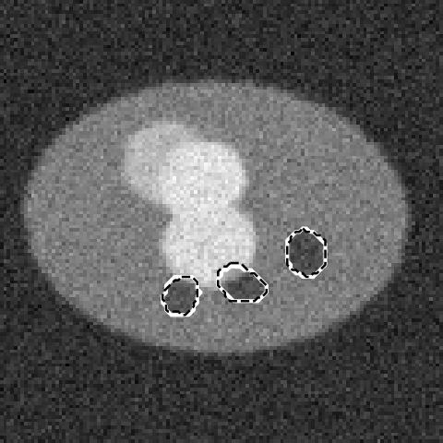
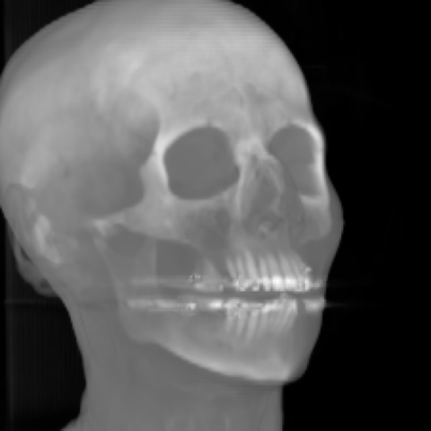
GPU-Accelerated Medical Image Analysis
CT reconstruction
MRI
Case study: processing CT and MRI scans with CUDA on an NVIDIA GeForce RTX 5060
Parallel & Distributed Systems | Case Study Presentation
Presented by: [Your Name] · [Roll No.] · October 2026
U-Net segmentation
3D volume rendering
Notes:
Good morning. This case study shows how GPU computing speeds up the processing of CT and MRI scans. Everything in this deck was built and measured by us: a five-stage pipeline written for both CPU and GPU, including hand-written CUDA kernels, benchmarked on an RTX 5060. The four images on the right are real outputs of our pipeline.

Slide 2



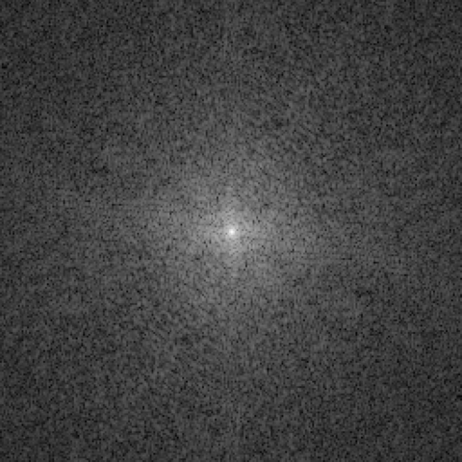
CT and MRI produce 3D volumes, not single pictures
Computed Tomography (CT)
Magnetic Resonance (MRI)
X-ray source rotates around the patient
Detector records projections from hundreds of angles
Raw data = sinogram, image is rebuilt by reconstruction
Fast (seconds): trauma, lungs, bone, stroke
Strong magnet + radio-frequency pulses, no radiation
Scanner samples spatial frequencies line by line
Raw data = k-space, image = inverse 2D/3D FFT
Slow (20–60 min): brain, soft tissue, joints
Raw CT data: sinogram
Raw MRI data: k-space
Output: stack of 2D slices = 3D voxel volume
Output: stack of 2D slices = 3D voxel volume
Notes:
Both scanners don't capture a photo. CT measures X-ray projections from many angles, stored as a sinogram. MRI measures spatial frequencies, called k-space. In both cases a computer has to rebuild the image, and the output is a 3D volume of voxels. That reconstruction step is the first place GPUs help.

Slide 3
Medical imaging data is huge and keeps growing
524 MB
~10 GB
134 M
3–4 s
one 512 × 512 × 1,000-slice CT at 16 bits per voxel
a 4D cardiac CT with 20 time phases
voxels in one 512³ volume, every stage touches each one
time per image a radiologist has to keep up with workload (McDonald et al., 2015)
Work grows with N³: doubling resolution means 8× more voxels to process
In our tests a single CPU took 11.8 s just to reconstruct one 128-slice CT, before any denoising, AI or rendering.
512³
256³
128³
2.1 M voxels
16.8 M voxels
134 M voxels
Notes:
Scale is the issue. A single high-resolution CT is half a gigabyte, 4D studies reach 10 GB, and radiologists are already overloaded. Because volumes are 3D, work grows with the cube of resolution. Our own CPU baseline needed 11.8 s just for reconstruction.

Slide 4



Problem statement and objectives
Time-critical care
THE PROBLEM
1.9 million neurons are lost every minute an ischaemic stroke goes untreated (Saver, 2006)
Can GPU parallelism bring CT/MRI processing from seconds or minutes down to interactive speed, without losing any accuracy?
Heavier algorithms
Iterative reconstruction and deep learning need 10–100× the compute of classic methods
Clinical workflow
Results must be ready while the patient is still on the table
Objectives
O1
O2
O3
O4
Build a 5-stage CT/MRI pipeline in both CPU and GPU versions
Write our own CUDA kernels (FBP, naive and tiled 3D convolution)
Measure speedup, scaling with size, and data-transfer cost
Prove outputs are identical: max error, PSNR, Dice
Notes:
Our problem statement: can GPU parallelism make CT and MRI processing interactive without changing the answer? Speed matters clinically, for example in stroke. We set four concrete objectives, and the rest of the deck answers each one with measurements.

Slide 5

CPU vs GPU: latency vs throughput
CPU · latency-optimised
GPU · throughput-optimised
Control
Core
Core
Core
Core
Core
Core
Large cache
AMD Ryzen 5 7600 6-Core Processor
12 hardware threads
NVIDIA GeForce RTX 5060 · 30 SMs · 3,840 CUDA cores · 8 GB GDDR7
Why it fits medical imaging: the same operation runs on millions of independent pixels or voxels. That is data parallelism, which the GPU's SIMT model is built for.
Notes:
A CPU has a few powerful cores, 6 cores and 12 threads on our machine, with big caches to make one thread fast. The GPU has 30 streaming multiprocessors and about 3840 simple cores that run the same instruction on many data items. Each small square here stands for a group of cores. Medical images are a perfect match because every voxel can be processed independently.

Slide 6
GPU architecture and the memory hierarchy
GeForce RTX 5060 (Blackwell)
Memory | Size | Speed | How we used it
Registers | per thread | fastest | Running sums in every kernel
Shared memory | up to 128 KB / SM | ~20–30 cycles | 12³ halo tile in tiled 3D convolution
Constant memory | 64 KB, cached | fast when all threads read the same value | cos/sin tables (FBP), filter weights
Global (GDDR7) | 8 GB | ~400–600 cycles | CT/MRI volumes, network weights
PCIe to host | system RAM | 11.8 GB/s measured | Upload scans, download results
SM 0
SM 1
… SM 29
128 CUDA cores
128 CUDA cores
128 CUDA cores
Tensor Cores
Tensor Cores
Tensor Cores
Registers
Registers
Registers
Shared mem / L1
Shared mem / L1
Shared mem / L1
L2 cache (shared by all SMs)
Rule of thumb: keep data on the GPU and reuse it from fast on-chip memory. Every trip to global memory or across PCIe costs time.
Global memory: 8 GB GDDR7
PCIe link
Host: CPU + system RAM
Notes:
The GPU is organised into streaming multiprocessors. Each SM has CUDA cores, Tensor Cores for matrix maths, registers and fast shared memory. Below that are the L2 cache and the 8 GB global memory, and the PCIe link to the CPU. We measured that link at about 11.8 GB/s. The table shows where each part of our project lives. Performance comes down to using the fast memories well.

Slide 7



CUDA model: one thread per pixel or voxel
Grid → Blocks → Threads
Our launch configurations
Kernel | Block | Grid | Threads
FBP back-projection | 16 × 16 | 16 × 16 × 128 | 8.4 M
3D convolution | 8 × 8 × 8 | 32 × 32 × 32 | 16.8 M
(0,0)
(1,0)
(2,0)
(0,1)
(1,1)
(2,1)
1 thread = 1 output voxel
(0,2)
(1,2)
(2,2)
no communication between threads is needed
One block: threads share fast memory; 32 threads = 1 warp (light row)
Blocks share on-chip memory
Grid of thread blocks
used to share the 3D convolution tile
int col = blockIdx.x*blockDim.x + threadIdx.x;
int row = blockIdx.y*blockDim.y + threadIdx.y;
int s = blockIdx.z; // slice
img[s][row][col] = backproject(...);
Millions of threads in flight
the GPU hides memory latency by switching warps
Notes:
In CUDA we launch a grid of blocks, and each block holds threads. We give every output pixel or voxel its own thread. For CT reconstruction that means 8.4 million threads, one per pixel of every slice. Threads in a block can share fast memory, which our tiled convolution uses. Warps of 32 threads execute together.

Slide 8
Experimental setup
Component | Specification
GPU | NVIDIA GeForce RTX 5060, 30 SMs, 3,840 CUDA cores
GPU memory | 8 GB GDDR7, compute capability 12.0
CPU | AMD Ryzen 5 7600 6-Core Processor
CPU threads | 12 hardware threads; PyTorch CPU baselines use 6 (one per core)
OS / Python | Windows 11 Pro · Python 3.12
CUDA | CUDA 13.4 toolkit (nvcc + MSVC 2022, -arch=sm_120); PyTorch built on CUDA 13.0
Libraries | PyTorch 2.14.1+cu130, NumPy, SciPy, scikit-image
Project structure
pds_present/
├─ src/
│ ├─ kernels/fbp.cu CUDA FBP
│ ├─ kernels/conv3d.cu naive + tiled
│ ├─ ct_recon.py stage 1
│ ├─ mri_recon.py stage 2
│ ├─ filtering.py stage 3
│ ├─ segmentation.py stage 4
│ ├─ visualize.py stage 5
│ └─ benchmark.py run all
├─ data/ CThead, MRbrain
├─ results/results.json all metrics
├─ results/figures/ images
└─ presentation/ this deck
Notes:
All numbers come from this one machine. CPU baselines use NumPy and SciPy, and where PyTorch is used on the CPU it uses all hardware threads, so the comparison is fair. The code is organised by stage, and one script reruns everything and writes every metric to results.json, which this deck is generated from.

Slide 9

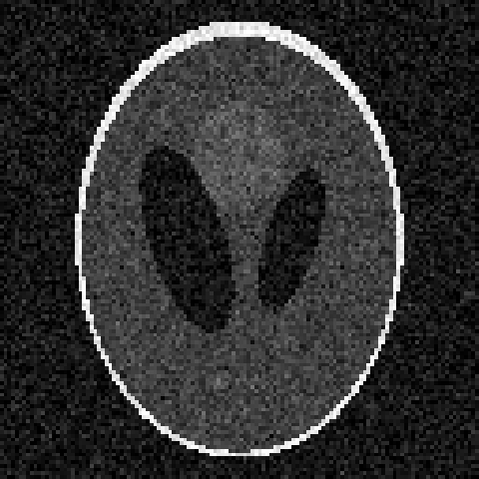
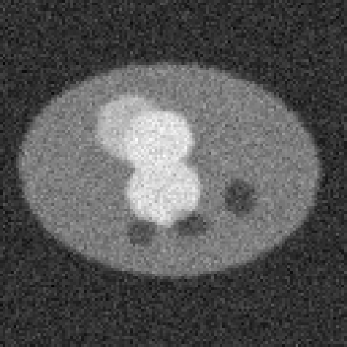
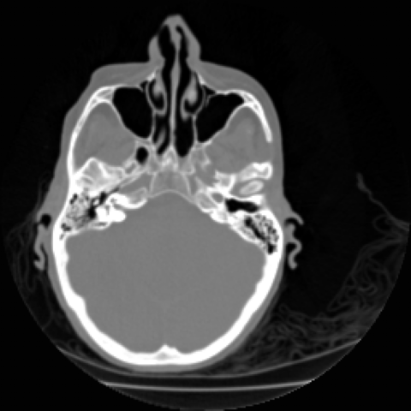
Datasets and images used
SIMULATED
REAL
SIMULATED
SIMULATED
REAL
Shepp-Logan
Brain MRI
Noisy CT volume
Lesion CT slices
Head CT
Standard CT test object. 2D 128–512 px, 3D 128 × 256². Exact ground truth.
Stanford MRbrain: 109 sagittal T1 slices, 256², 16-bit. 10 used.
3D phantom 64³–256³ + Gaussian noise (σ = 0.08), like low dose.
2,000 train + 200 test slices (128²), 1–3 lesions, exact masks.
Stanford CThead: 113 axial slices, 256², 16-bit, 2 mm spacing.
Stage 1 · CT recon
Stage 2 · MRI recon
Stage 3 · Denoising
Stage 4 · U-Net
Stage 5 · 3D render
Notes:
We used five data sources: two real scans and three simulated sets. The real MRI and real CT come from the Stanford Volume Data Archive. Simulated data is used where we need an exact ground truth: the Shepp-Logan phantom is the standard CT reconstruction benchmark, and our lesion slices have exact masks so Dice can be measured precisely. Large labelled public sets such as the Medical Segmentation Decathlon would be the next step.

Slide 10
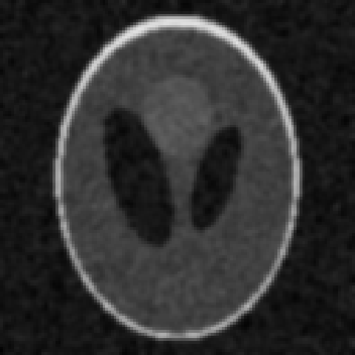
Our five-stage processing pipeline
1
2
3
4
5
CT reconstruction
MRI reconstruction
3D denoising
Segmentation
3D visualisation
Filtered back projection
k-space → image, iterative CS
5×5×5 Gaussian convolution
2D U-Net, lesion masks
MIP + volume ray casting
Custom CUDA kernel
cuFFT (PyTorch)
Custom CUDA, shared memory
cuDNN + Tensor Cores (FP16)
PyTorch grid_sample
Notes:
Here is the pipeline end to end, with real outputs from each stage. Each stage has a CPU version and a GPU version, and the bottom row shows which GPU technique it demonstrates: our own kernels, NVIDIA libraries like cuFFT and cuDNN, mixed precision on Tensor Cores, and parallel ray casting.

Slide 11




How we measured: a fair, verified benchmark
Warm-up
Time
Repeat
Verify
Untimed first run: CUDA context, cuFFT plans, kernel loading
cudaEvent timers inside kernels; perf_counter + synchronize in Python
3–10 repetitions, reported as the mean
Compare GPU output with CPU output and ground truth
Correctness check: GPU results match the CPU
Stage | Max |CPU − GPU| | Quality vs ground truth
1 CT reconstruction (128 slices) | 2.5e-3 | PSNR 29.5 dB
2 MRI iterative recon | 4.1e-6 | PSNR 25.6 dB (zero-filled 22.8 dB)
3 3D denoising 256³ | 7.2e-7 | PSNR 21.9 → 25.3 dB
4 U-Net segmentation | same weights | Dice 0.909 on 200 test slices
5 Volume rendering | 1.9e-3 | visually identical
Notes:
We followed a strict protocol: warm up, time with CUDA events or with explicit synchronisation, repeat and average. Most importantly we checked that the GPU computes the same answer. Differences are at the level of floating-point rounding, so every speedup we report comes with the same accuracy.

Slide 12
Stage 1 · CT reconstruction with filtered back projection
Ramp filter
FFT · multiply · IFFT
(cuFFT)
Back-projection
CUDA kernel
1 thread / pixel
Core of our CUDA kernel (fbp.cu)
__global__ void backproject(const float* sino,
float* img, int A, int D, int N) {
int col = blockIdx.x*blockDim.x + threadIdx.x;
int row = blockIdx.y*blockDim.y + threadIdx.y;
int s = blockIdx.z; // slice
float acc = 0.f;
for (int a = 0; a < A; ++a) { // all angles
float t = y*c_cos[a] - x*c_sin[a] + centre;
int i = floorf(t); float w = t - i;
acc += (1-w)*__ldg(p+i) + w*__ldg(p+i+1);
}
img[...] = acc * PI / (2*A);
}
Sinogram
256 angles × 256 detectors
Reconstructed
slice
Why it parallelises perfectly
Each pixel = sum over all angles of the filtered projection value where it lands
Pixels never depend on each other, so no synchronisation is needed
Volume: 128 slices × 256² px × 256 angles = 2.1 billion interpolations
8.4 M
6.8 ms
GPU threads, one per pixel of every slice
kernel time for all 128 slices
Notes:
FBP has two steps. First each projection is sharpened with a ramp filter, which we do with cuFFT. Then every pixel sums the filtered values from all angles. In our kernel one thread does one pixel. The cos and sin tables sit in constant memory, and __ldg reads the sinogram through the read-only cache. The whole volume is 2.1 billion interpolations, all independent.

Slide 13
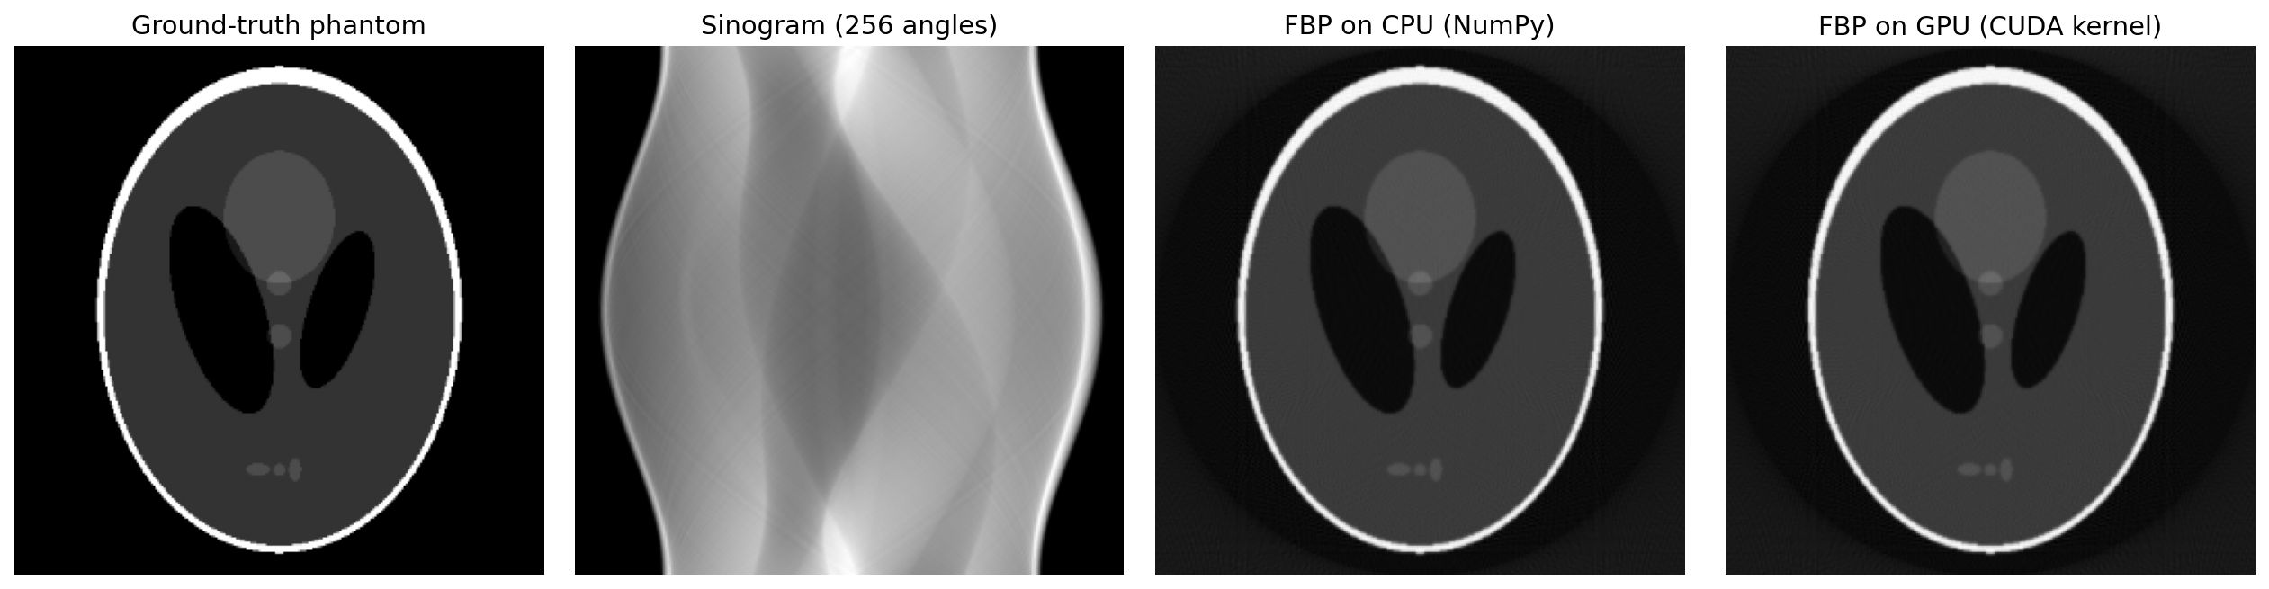
Stage 1 results · 265× faster CT reconstruction
265×
full 128-slice volume: 11.8 s → 45 ms (incl. transfers)
906×
single 512² slice: 1.3 s → 1.4 ms
29.5 dB
PSNR, same as CPU; max difference 2.5e-3
Notes:
Results: the GPU images are identical to the CPU ones. For a full 128-slice volume the CPU took 11.8 s, the GPU 45 ms including all transfers. That is 265×. The kernel alone runs in 6.8 ms. The chart shows the gap widens as images get larger, because a bigger problem keeps more GPU cores busy. At 128 px the GPU is less impressive because the work is too small to fill the GPU.

Slide 14
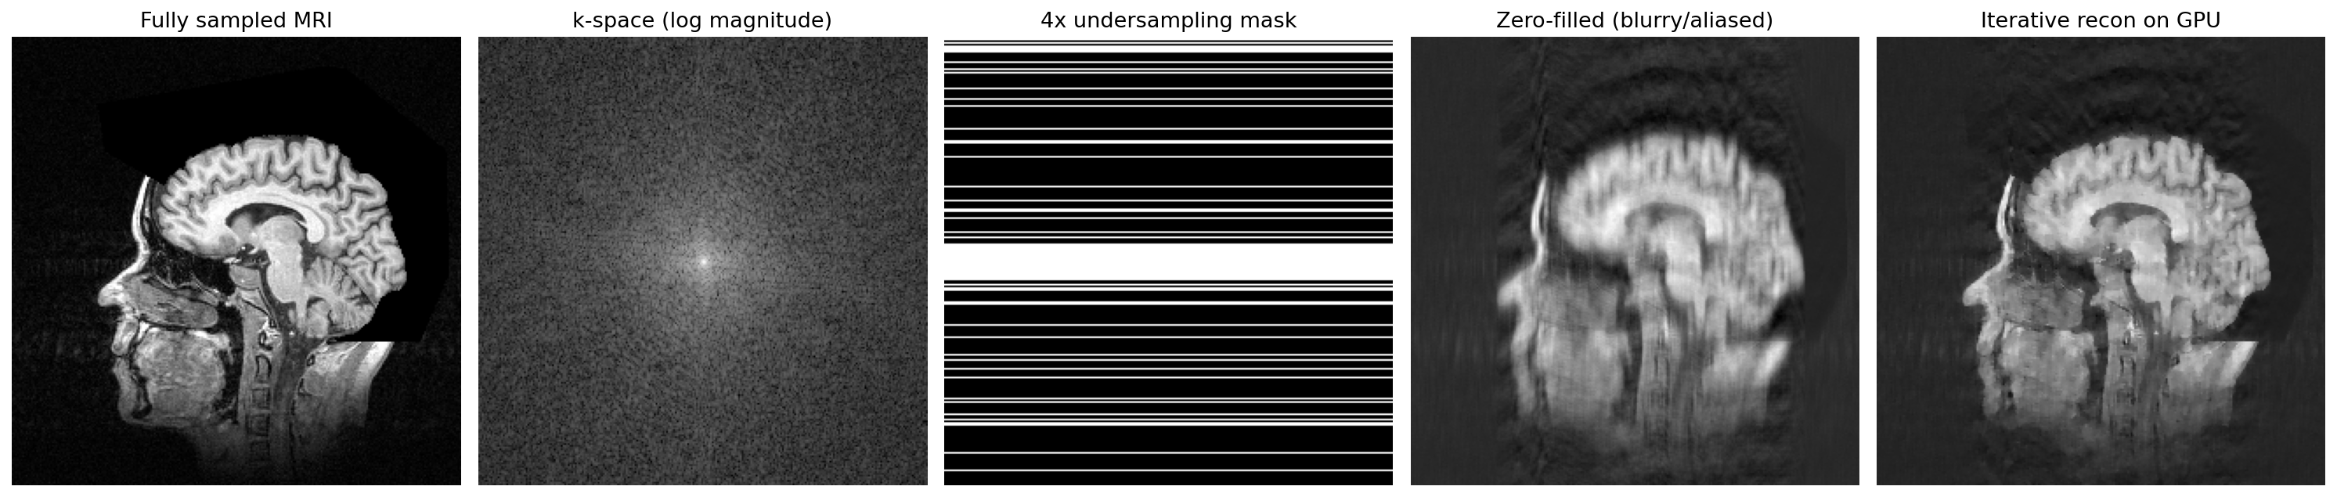
Stage 2 · MRI: 4× less data, better image, 7.0× faster
4×
+2.8 dB
7.0×
12×
fewer k-space lines measured, so a 4× shorter scan
PSNR gain: 22.8 → 25.6 dB (zero-filled vs our GPU recon)
iterative recon, 10 slices × 400 FFTs: 670 ms → 96 ms vs 6-thread CPU
cuFFT on a 512³ 3D FFT: 238 ms → 19 ms vs 6-thread CPU
Notes:
We took a real brain MRI, converted it to k-space and kept only a quarter of the lines, like a four-times-faster scan. Simply inverting gives a blurry, aliased image at 22.8 dB. Our iterative compressed-sensing method recovers 25.6 dB. It needs 400 FFTs per slice, which is why it is normally too slow. On the GPU it runs 7.0× faster than on all CPU threads. FFT scaling: on a 512-cubed volume cuFFT takes 19 ms. Against single-thread NumPy that looks like 329×, but the fair comparison is an optimised multi-threaded CPU FFT: 12×.

Slide 15
Stage 3 · 3D denoising: 503× over CPU, 1.75× from tiling
Naive kernel
Tiled kernel (shared memory)
Each thread reads its 125 neighbours directly from slow global memory.
Each 8×8×8 block first copies a 12×12×12 tile (with halo) into shared memory, then reads neighbours from there.
125 global reads per voxel · 4.2 ms
3.4 global reads per voxel · 2.4 ms
GLOBAL
SHARED
Notes:
Denoising is a 5 by 5 by 5 convolution: 125 multiply-adds per voxel. The naive kernel reads all 125 neighbours from global memory. The tiled kernel has each block load a 12-cubed tile into shared memory once, so global reads fall from 125 to about 3.4 per voxel. Result on a 256-cubed volume: CPU 1.2 s, tiled kernel 2.4 ms, which is 503× faster and 1.75 times faster than naive, about 7.0 billion voxels per second. It also beats cuDNN by 4.3 times, because cuDNN is tuned for many-channel deep-learning layers. Reality check: PCIe copies take 85% of GPU time, so with transfers the speedup is 78×. Image quality improves from 21.9 to 25.3 dB PSNR.

Slide 16
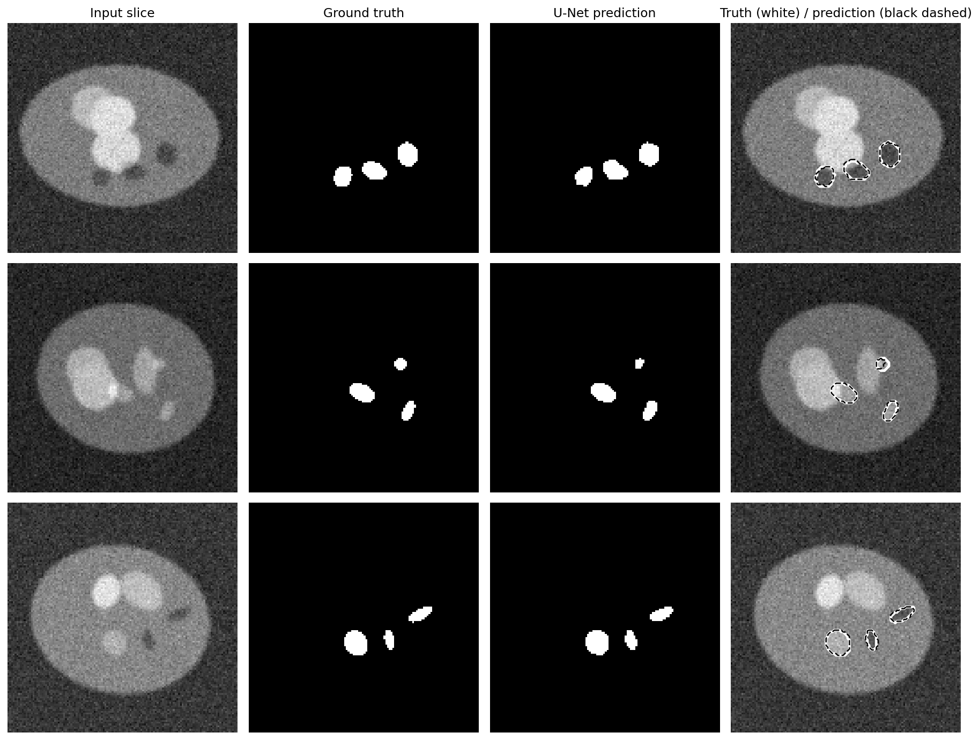
Stage 4 · U-Net segmentation: Dice 0.91, 46× faster
0.909
8.7×
0.38 ms
Dice on 200 unseen test slices
faster training: 107.3 s → 12.4 s per epoch
per slice on GPU (CPU: 17 ms)
Notes:
Stage four is deep learning: a 7.8 million parameter U-Net, an encoder-decoder with skip connections, trained to outline lesions. It reaches Dice 0.909 on 200 test slices it never saw. White is the truth, black dashed is the prediction. Training: one epoch takes 107.3 s on the CPU and 12.4 s on the GPU with FP16 mixed precision; all 25 epochs took 310 s on the GPU versus roughly 45 minutes on the CPU. Inference: 2608 slices per second on Tensor Cores versus 57 on the CPU, so a 500-slice CT is segmented in well under a second.

Slide 17
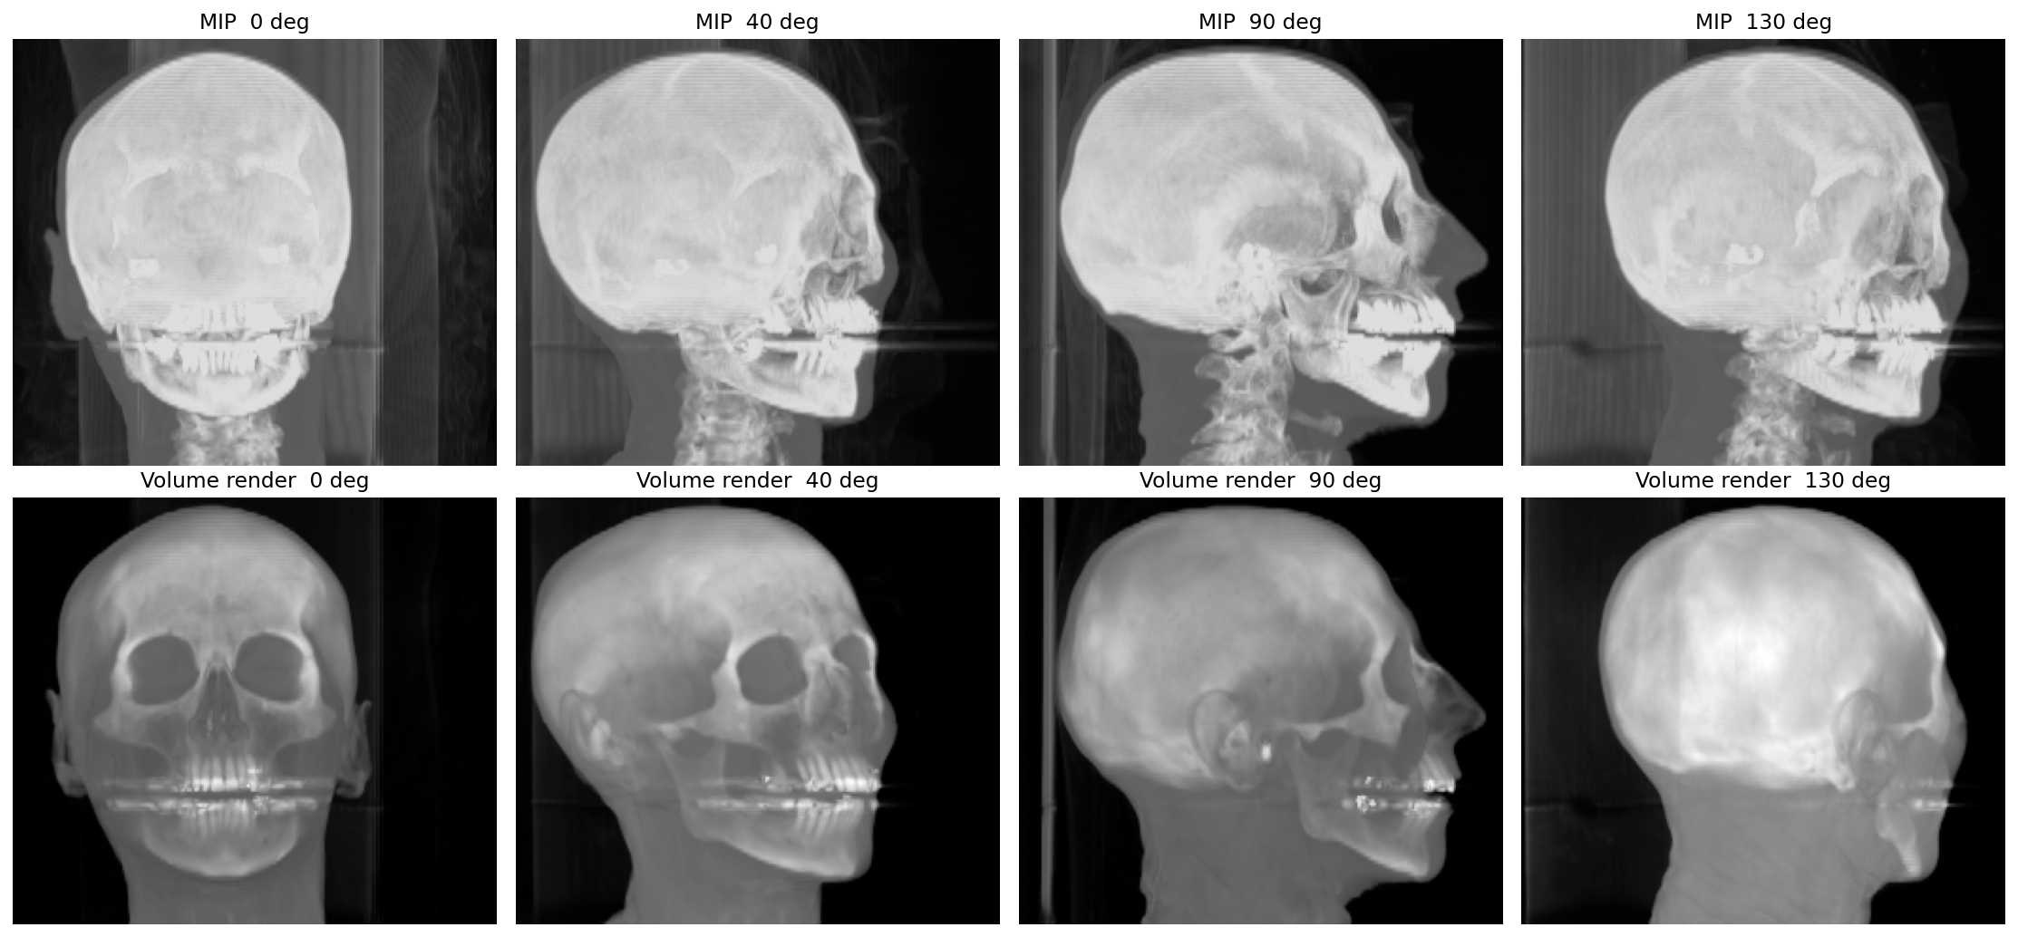
Stage 5 · Interactive 3D visualisation
69 fps
volume rendering on GPU (CPU: 2.2 fps)
31×
faster rendering; MIP 38×
Each view: rotate volume (trilinear resampling), then cast one ray per pixel
36 views of a real head CT (resampled to 256 × 226 × 256)
Every ray is independent, so it runs in parallel
Notes:
The last stage is visualisation, on a real head CT from the Stanford archive. For each view we rotate the volume and cast a ray through every pixel. Maximum intensity projection keeps the brightest voxel; volume rendering blends colour and opacity along the ray. The GPU renders 69 frames per second, fast enough to rotate the scan smoothly. The CPU manages 2.2.

Slide 18
End-to-end: the whole pipeline is 44× faster
Stage | CPU | GPU | Speedup
CT reconstruction (128 × 256², FBP) | 11.8 s | 45 ms | 265×
MRI CS recon (10 × 256², 200 iters) | 670 ms | 96 ms | 7.0×
3D denoise (256³, 5³ Gaussian) | 1.2 s | 16 ms | 78×
U-Net inference (128 slices) | 2.2 s | 49 ms | 46×
3D rendering (36 DVR views) | 16.2 s | 523 ms | 31×
Total pipeline | 32.2 s | 728 ms | 44×
32.2 s → 728 ms
for one study through all five stages
From waiting time to interactive
Where GPU time goes (ms)
Data transfer is 85% of the denoise stage. Keeping data on the GPU between stages is the next big win (Amdahl's law).
GPU times include host↔device transfers. Stage 4 = inference on 128 slices.
Notes:
Putting it together, one study takes 32.2 s on the CPU and 728 ms on the GPU: 44× overall. The bottom bar shows where GPU time goes. For simple stages like denoising, copying data over PCIe costs more than the computation itself. That's Amdahl's law: once compute is fast, the serial transfer part dominates. In production you keep the data on the GPU across the whole pipeline.

Slide 19






Challenges, limitations and future scope
PCIe transfer bottleneck
GPU memory limits
Precision and validation
11.8 GB/s measured. Fix: pinned memory, CUDA streams to overlap copy and compute, GPU-resident pipeline
8 GB VRAM: a 512³ complex FFT already needs 1 GB. Fix: tiling, streaming, multi-GPU
FP16 needs careful checking; clinical use needs bit-level reproducibility and validation
Privacy and regulation
Scaling out
Already in industry
Patient data rules (HIPAA/GDPR), FDA/CE approval. Fix: federated learning, on-premise GPUs
Multi-GPU (NVLink), GPU clusters and cloud for population-scale studies
GPU deep-learning recon in GE, Siemens and Canon scanners; NVIDIA Clara and MONAI in hospitals
Notes:
Our results also show the limits. Transfers are the biggest bottleneck, GPU memory caps the volume size, and reduced precision must be validated for clinical use. Privacy and regulation shape where GPUs can run. The good news: industry already does this. Major scanner vendors ship GPU-based deep-learning reconstruction, and NVIDIA Clara and MONAI are used in hospitals.

Slide 20
Conclusion
44× faster end to end
References
CT recon 265×, denoising 78×, U-Net 46×
Kak & Slaney, Principles of Computerized Tomographic Imaging, IEEE Press, 1988.
Shepp & Logan, “The Fourier reconstruction of a head section,” IEEE Trans. Nucl. Sci., 1974.
Lustig, Donoho & Pauly, “Sparse MRI,” Magn. Reson. Med., 2007.
Ronneberger, Fischer & Brox, “U-Net,” MICCAI, 2015.
Eklund et al., “Medical image processing on the GPU: past, present and future,” Med. Image Anal., 2013.
Cardoso et al., “MONAI: an open-source framework for deep learning in healthcare,” arXiv, 2022.
Saver, “Time is brain, quantified,” Stroke, 2006.
McDonald et al., radiologist workload study, Academic Radiology, 2015.
NVIDIA, CUDA C++ Programming Guide and cuFFT documentation, 2026.
Stanford Volume Data Archive (CThead, MRbrain), graphics.stanford.edu/data/voldata.
Same answers
GPU and CPU agree to floating-point rounding
Memory is the key
Shared-memory tiling 1.75×; PCIe transfers dominate simple stages
Clinical impact
Faster scans, real-time 3D views, AI results while the patient is still in the scanner
Notes:
To conclude: GPUs made our complete CT and MRI pipeline about 44× faster with identical results. The biggest lessons were about memory: use shared memory, and avoid moving data back and forth. This is what makes real-time medical imaging possible. Thank you; happy to take questions.

