Slide 1

FINAL REVIEW | PROJECT WORK
UW-TIG: Uncertainty-Weighted Temporal Information Gain for Closed-Loop Defect Inspection
PSG College of Technology, Department of Computer Science and Engineering, Coimbatore
Guide
Team
Ms. L. Karthika
Akhil Ramalingam
23Z207
Anbuchandiran K
23Z209
Co-Guide
Dr. N. Gopika Rani
Neelesh Padmanabh
23Z241
Saumiyaa Sri V L
23Z261
Sowndarya Elangi S
23Z269
Therdhana J P
23Z273

Slide 2
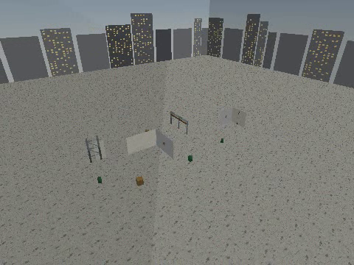
Problem and objective
The problem
Cracks, corrosion and leaks on buildings, towers and pipelines need repeated inspection
Routes are usually fixed: what the camera sees never changes where it goes next
Nothing carries over between flights, so a defect found last month is not tracked
A low-confidence detection is trusted like a confident one
Objective
Pick each next viewpoint from detections, detector uncertainty and defect memory
Find out which parts of that planner actually help
The simulated yard (PyBullet)
2

Slide 3
Contributions
1
UW-TIG, a planner
One score: coverage phase, uncertainty, growth, staleness, lookahead
2
A reproducible testbed
Real defect photos as textures, 9-wall and 31-wall yards, separate dev and test seeds
3
An evaluation that reports what did not work
Seven planners, six ablations, ten seeds, an oracle test; negative results included
3

Slide 4
How UW-TIG picks the next view
Utility(v) = 1.0 InfoGain + 1.5 Uncertainty + 2.0 Growth + 1.0 Staleness − 0.4 Cost
54 candidate views re-scored after every move; coverage phase first
Part | What it does | Effect of removing it (9 walls)
Coverage phase | See every wall once before anything else | F1 0.963 → 0.679
Detector uncertainty | Look again at detections the model is unsure about | no change
Growth from memory | Track a defect's size across missions | no change
Staleness | Revisit areas not seen for a while | 36% less flight, F1 0.973
Two-step lookahead | Score a view together with the best view after it | 34% less flight, F1 0.973
Ten seeds, original detector. Staleness and lookahead come from Alamdari et al. and Bircher et al.
4

Slide 5
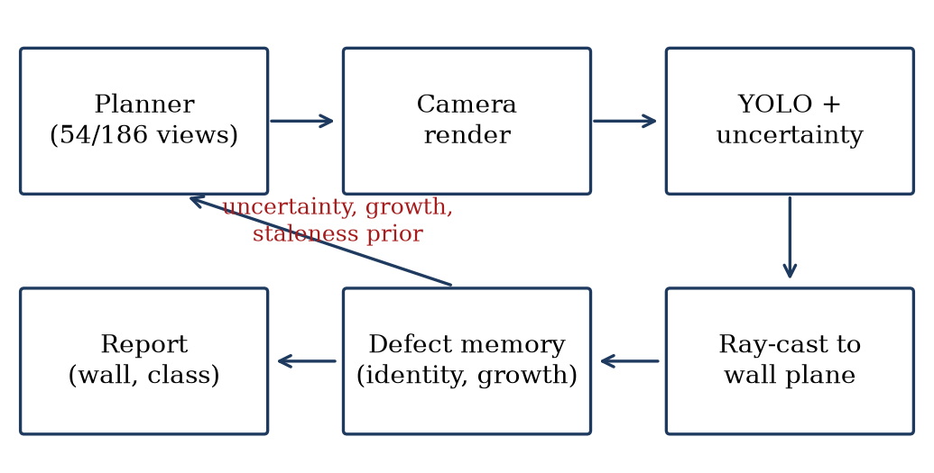
System overview
The planner scores the candidate views after every move
YOLOv8s with five-view test-time augmentation gives a detection and an uncertainty
Each detection is ray-cast onto the wall and matched to known defects (Postgres and Neo4j)
Defect memory feeds growth and staleness back to the planner
A defect is reported after three looks, or one look at confidence 0.45 or more
The same loop runs across missions, so memory persists between flights.
5

Slide 6
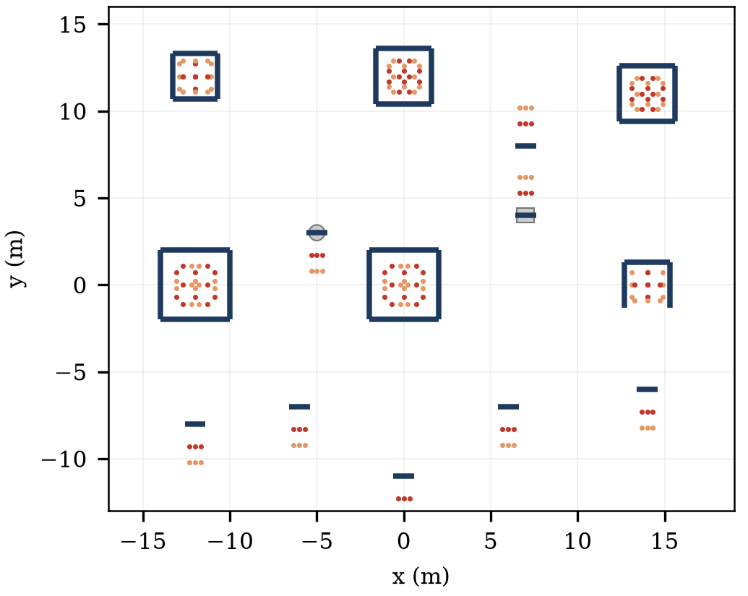
Test environment
Small yard: 9 walls, 54 viewpoints, budget of 16 views
Large yard: 31 walls, 186 viewpoints, budget of 50 views
Scenarios: static, uncertain, multi-defect, growing
Textures: real MBDD2025 defect photographs on the walls
Seeds: development 100 to 102, test 0 to 9
Metrics: confirmed F1 and flight distance
31-wall yard: walls in blue, candidate viewpoints in orange and red
6

Slide 7
Data and detector training
Data
Preprocessing and training
MBDD2025: 14,471 UAV photos, five classes (crack, leakage, abscission, corrosion, bulge)
Also tried: dacl10k bridge photos, Roboflow corrosion, concrete-crack crops
Test split: 1,448 held-out MBDD2025 images
Photos cropped to each wall's true shape at 1536 px
320x240 camera frames resampled to square pixels
Bulge class oversampled about 4x
Detections outside the wall are rejected, removing 51 to 75% of false positives
YOLOv8s, 640 px, 100 epochs on an NVIDIA L4
7

Slide 8
Detector results
YOLOv8s on the held-out test split (mAP50 0.884)
Fair size comparison, identical settings
Class | Precision | Recall | F1
Crack | 0.84 | 0.75 | 0.79
Leakage | 0.90 | 0.92 | 0.91
Abscission | 0.87 | 0.78 | 0.82
Corrosion | 0.83 | 0.79 | 0.81
Bulge | 0.95 | 0.96 | 0.95
Mean | 0.87 | 0.84 | 0.86
Model | Params | mAP50 | Recall
v8n | 3.0 M | 0.743 | 0.681
v8s (used) | 11.1 M | 0.793 | 0.740
v8m | 25.8 M | 0.796 | 0.744
4,000-image subset, 640 px, 30 epochs, one run each. YOLOv8l was not trained (8 GB GPU).
v8m adds only 0.003 mAP50 over v8s for 2.3x the parameters
Extra training data did not improve the closed loop, so the original detector stays the default
Confidence is poorly calibrated (ECE 0.29 to 0.33), so uncertainty only ranks views
8

Slide 9
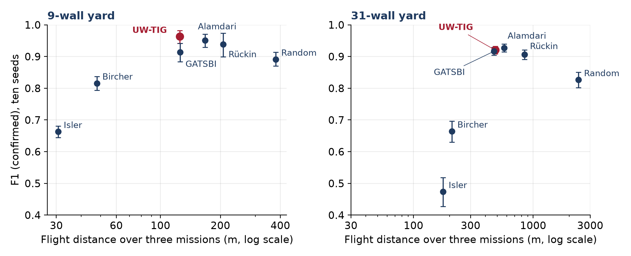
UW-TIG against published planners
Level with the best published planners on both yards, and it flies less than most of them
9 walls: ahead of Alamdari by 0.012 (CI 0.001 to 0.022), borderline
31 walls: Alamdari ahead by 0.007, within the noise
9

Slide 10
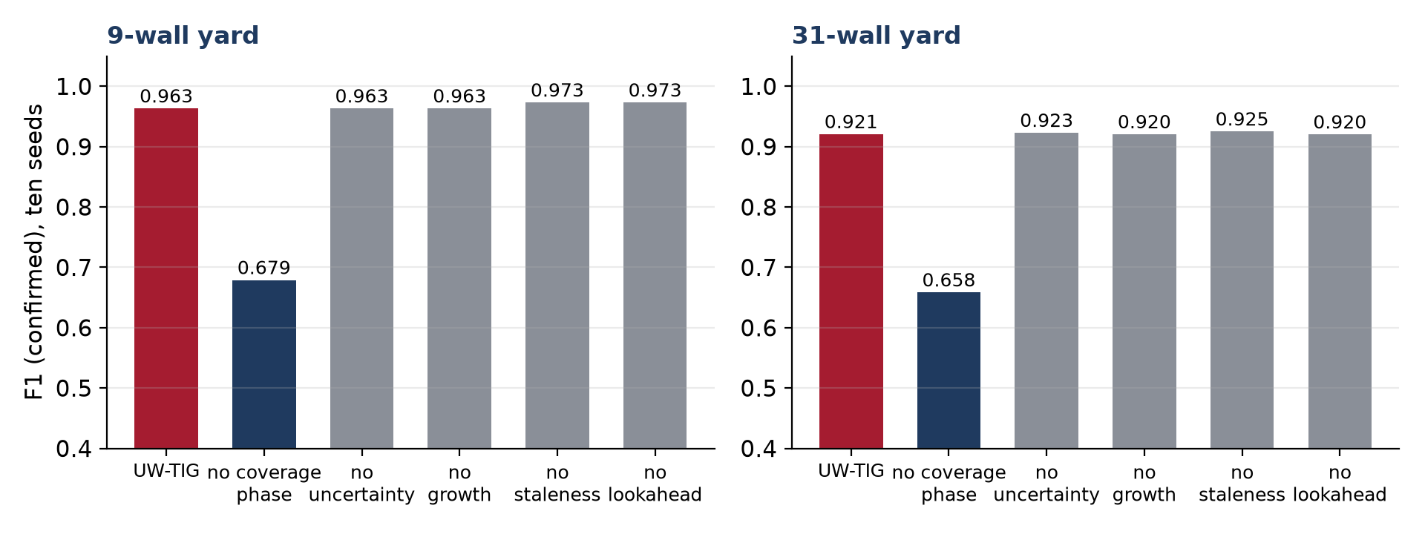
What carries the result
Without the coverage phase, F1 falls to 0.679 and 0.658
Removing uncertainty or growth changes F1 by 0.002 at most, also with a perfect (oracle) detector and weights up to 20
Staleness and lookahead cost extra flight but no F1
10

Slide 11
Live demo
Run it
set UWTIG_MEMORY=inmem
python demo_uwtig_flight.py --planner uwtig --gui --missions 1
A 3-D window shows the flight; the terminal prints each wall chosen and the detections
No Postgres or Docker needed with the in-memory store
Swap the planner for isler_nbv or random to compare on the same scene and seed
Recorded flights, if the live run is slow
output/comparison_inspection_uwtig_vs_isler_nbv_vs_random.mp4 (three planners side by side)
output/comparison_flythrough_uwtig_vs_isler_nbv_vs_random.mp4 (3-D chase view)
11

Slide 12
Conclusion and future work
Conclusion
Future work
A working closed loop: detect, judge uncertainty, remember, replan
F1 0.963 on 9 walls and 0.921 on 31 walls over ten seeds
Level with the best published planners, usually with less flight
The coverage phase and cost-aware routing carry the result
The uncertainty and growth terms show no measurable effect
Find a setting where uncertainty and growth matter, with real growth data
A better-calibrated uncertainty than test-time augmentation
Re-implement the rival planners as full systems
Raise precision in the uncertain scenario above 0.90
12

Slide 13
Backup: ten-seed results
Seeds 0 to 9, original detector, confirmed F1; CI is a 95% bootstrap over seeds.
Planner | F1 (9 walls) | 95% CI | Flight (m) | F1 (31 walls) | 95% CI | Flight (m)
UW-TIG | 0.963 | 0.941 to 0.982 | 125 | 0.921 | 0.908 to 0.933 | 481
Alamdari 2014 | 0.951 | 0.930 to 0.971 | 168 | 0.928 | 0.914 to 0.940 | 570
GATSBI | 0.914 | 0.884 to 0.942 | 125 | 0.917 | 0.904 to 0.929 | 471
Rückin 2023 | 0.938 | 0.899 to 0.974 | 206 | 0.906 | 0.891 to 0.921 | 846
Random | 0.891 | 0.870 to 0.914 | 379 | 0.827 | 0.802 to 0.851 | 2396
Bircher 2016 | 0.816 | 0.793 to 0.838 | 48 | 0.664 | 0.630 to 0.697 | 209
Isler NBV | 0.663 | 0.645 to 0.681 | 31 | 0.474 | 0.428 to 0.518 | 177
13

