Slide 1

Vaathi AI Empowering Learning Through AI Conversations
Nikhil V
Praveen Kumar S

Slide 2
Contents
01 The Problem
02 The Proposed Solution
03 Potential Impact
04 Testing and Accessibility

Slide 3
The Problem Enhancing Educational Experiences through AI Chatbot Innovation
Key Focus Areas
Personalized Learning
Homework Assistance
Collaborative Learning
General Educational Assistance

Slide 4
Goals
Enhance Learning Outcomes: Improve students' understanding of concepts and their ability to apply knowledge through personalized and interactive support.
Increase Engagement: Encourage active participation in both individual and collaborative learning activities.
Streamline Administrative Tasks: Reduce the administrative burden on educators and provide timely information to students.
Support Well-being: Offer mental health support and create a safe space for students to discuss their concerns.

Slide 5
The Proposed Solution
Vaathi AI is an advanced AI chatbot designed to transform the educational experience by providing personalized learning, real-time homework assistance, collaborative learning support, and comprehensive educational guidance. Utilizing cutting-edge AI technology, Vaathi AI aims to enhance student engagement, improve learning outcomes, and streamline administrative processes for educators.
Vaathi AI's modular architecture enables seamless integration into various educational settings. Its adaptive capabilities and continuous improvement ensure relevance and effectiveness across different learning environments.

Slide 6

Potential Impact
Increased Student Confidence
Greater Retention Rates
Efficient Resource Utilization
Improved Mental Health Support
Enhanced Collaboration Skills
Scalability for Diverse Educational Contexts

Slide 7
Tech Stack
Streamlit
A Python library used for building interactive web applications with Python scripts.
Python
The programming language used for implementing the application.
Development Environment
Developed in a Jupyter Notebook using Visual Studio Code (VS Code)

Slide 8
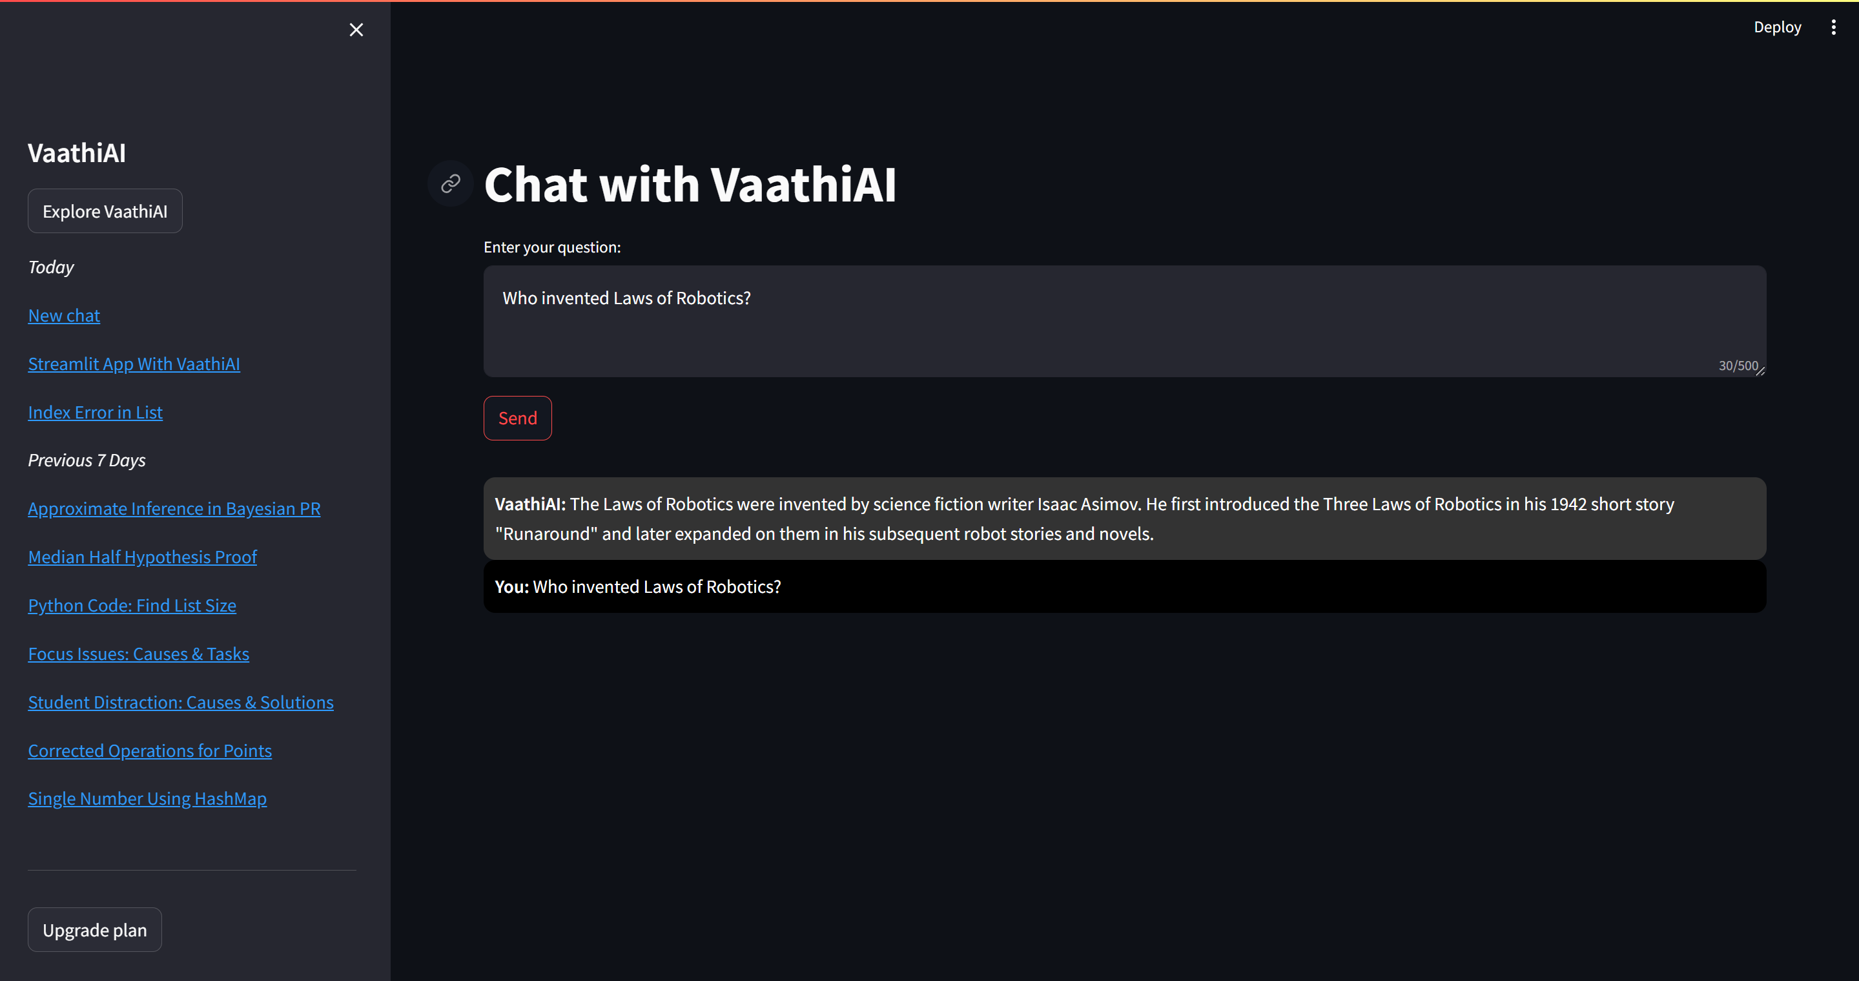
Demo
The model demo can be viewed via this video or accessed through Github.

Slide 9

Thank you

